Slide 1
id_div_jubilee_controls cl_div_jubilee_controls
i_container_id m_container_id
cl_overlay_image_text_div_el width= 0.7 height= 0.8
position= absolute left= 0.2 top= 0.2 zIndex = 5
cl_overlay_image_div_el width= 99& height= 69% zIndex = 10
cl_overlay_text_div_el width= 99& height= 22% zIndex = 10

Slide 5
GuestbookData
All data set by the user g_guestbook_data
onClickForwardThreeButton
saveNewRecordAlsoToJazzGuestsXml
saveNewGuestbookUploadedRecord
backupJazzGuestsXml
appendSetSaveGuestbookUploadData
g_guests_uploaded_xml
backupJazzGuestsUploadedXml
saveJazzGuestsUploadedXmlOnServer
JazzGuestsUploaded.xml
copyImageFromUploadToGuestbookDir
sendNewRecordNotificationEmailToAdmin
appendSetSaveGuestbookData
g_guests_xml
GuestStorage.setGuestbookData
saveJazzGuestsXmlOnServer
JazzGuests.xml

Slide 6
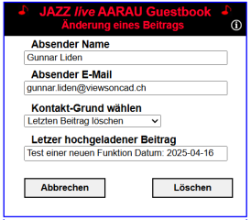
Class DeleteLastUploadedRecord
start
Do nothing if no local storage or record is missing in XML
UtilLock.lock
reloadJazzGuestsObject
reloadJazzGuestXmlObject
reloadJazzGuestsUploadedObject
reloadJazzGuestUploadedXmlObject
backupJazzGuestsUploaded
UtilServer.copyFileCallback
backupJazzGuestsXml
UtilServer.copyFileCallback
moveImageFromUploadedToBackupDir
getDeleteRecordNumber for object JazzGuestsUploaded.xml
JazzGuestsXml.getGuestFileName
GuestbookServer.getUploadedXmlDirUrl, getBackupDirUrl
UtilServer.moveFileCallback
moveImageFromJazzGuestDirToBackupDir
getDeleteRecordNumber for object JazzGuests.xml
JazzGuestsXml.getGuestFileName
GuestbookServer.getUploadedXmlDirUrl, getBackupDirUrl
UtilServer.moveFileCallback
deleteRecordSaveJazzGuestsUploadedXml
UtilServer.saveFileCallback
deleteRecordSaveJazzGuestsXml
UtilServer.saveFileCallback
unlockFiles
sendNoticationEmail
finish
executeContactRequest

Slide 7
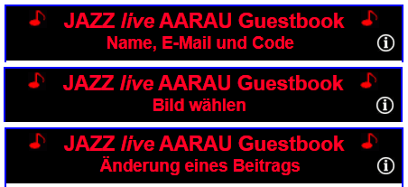
UploadWindow
Sets the title for the active upload window
Member variables
m_el_div_window_title
Container <div> element for the window title
m_active_window_index
Active window index
m_windows_title_array= GuestStr.getUploadWindowTitleArray()
Array with titles for the upload windows
m_n_forward_max= arraylength - 2
Maximum index number for function forward
m_n_forward_min = 1
Minimum index number for function backward
m_contact_active_window_index = arraylength - 2
Active index for window contact (change of record)
Member functions
init
Initialization
setTitle
Sets the title defined by m_active_window_index
forward
Sets the title for the next window
backward
Sets the title for the previous window
toContact
Sets the title for the page contact
toUploadImage
Sets the title for the page upload window
cancelContact
Sets title for back from contact (page 1)
getInfoUrl
Returns the URL to the page information HTML file

Slide 8
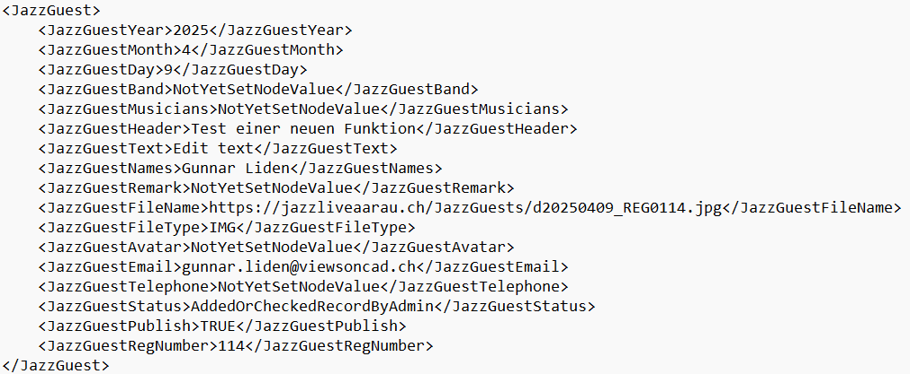
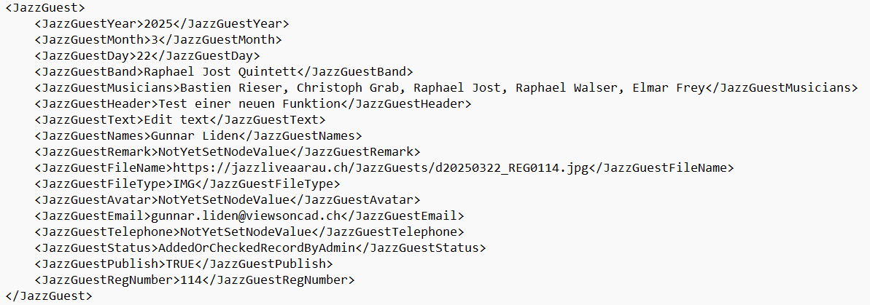
JazzGuests.xml

Slide 9
GuestbookData
Holds all data for a guest record
GuestStorage
Functions to get and set local storage strings
Member variables
m_names
m_email
m_title
m_remark
m_band
m_musicians
m_year
m_month
m_day
m_image_file
m_file_name
m_reg_number
m_append_both_callback
m_uploaded_xml_new_record_number
m_xml_new_register_number
m_xml_new_register_image_file_name
m_user_opened_record_for_edit
Generated upload code
Input upload code from the user
Member set and get functions for all members
Member functions
getGuestbookData
Returns object GuestbookData
setGuestbookData(i_guestbook_data)
Sets storage data from object GuestbookData
getNames, getEmail, getTitle, …
setNames, setEmail, setTitle, …
getKeyNames, getKeyEmail, getKeyTitle, ….

Slide 10
www
JazzGuests
JazzGuests.xml
Images
LockUnlock
LockUnlock.txt
Uploaded
JazzGuestsUploaded.xml
Images

Slide 11
Server Ordner
www
Guestbook
Version_1
Version_x
Info
GuestbookUpload.htm
Icons
jQuery
Php
Scripts
Styles
GuestbookAdmin.htm
favicon.ico
Computer (GitHub) Ordner
WwwGuestbook
GuestbookUpload.htm
Icons
jQuery
Php
Scripts
Styles
GuestbookAdmin.htm
Description
Info
XmlTestData
favicon.ico

Slide 12
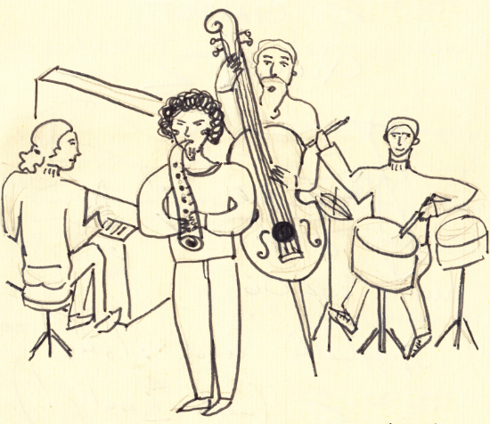
id_div_upload_container_part_two clear both
id_div_upload_input_file_image clear both Container for JazzUploadImage
id_div_guestbook_fileupload
Bild wählen
id_guestbook_fileupload
id_div_guestbook_file_name clear both
Name des ausgewählte Bildes
id_div_image_container clear both
id_div_upload_button_back_forward_part_two clear both
id_upload_button_back_two float left
id_upload_button_forward_two float right
Zurück
Weiter

Slide 13

id_div_upload_texts clear both
id_div_upload_texts_concert clear both
Gästebuch-Bild hochladen
id_div_upload_texts_title clear both
id_div_upload_texts_title clear both
Konzert wählen (optional)
Titel
id_div_upload_texts_text clear both
Kurzer Bildtext
Text (optional)
id_div_upload_texts_remark clear both
Freier Text
Bemerkung (optional)
id_div_upload_button_back_forward_part_three clear both
Freier Text
id_upload_button_back_three float left
id_upload_button_forward_three float right
Zurück
Speichern
Zurück
Senden

