Slide 1
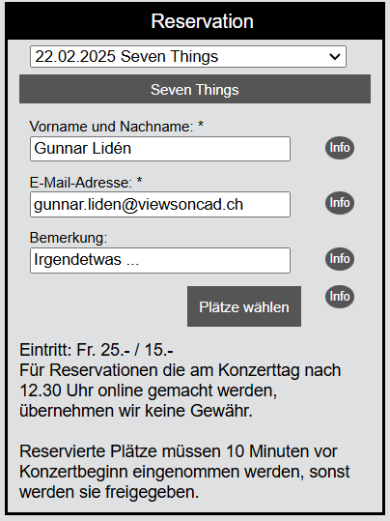
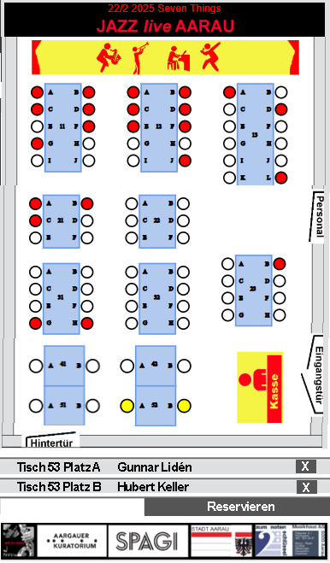
GUI Control InputEventReservation
Ein Fenster zur Eingabe von Person-Daten für eine Reservation

Slide 2
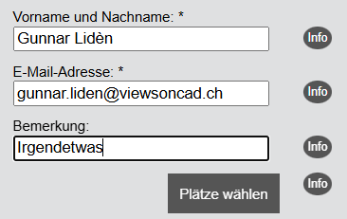
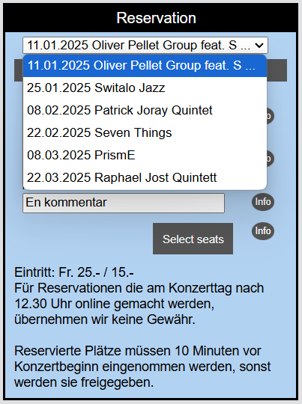
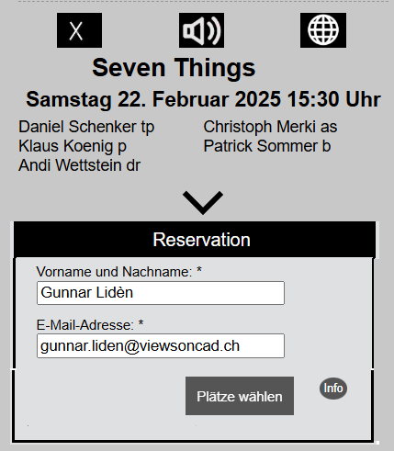
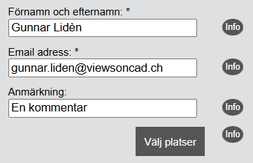
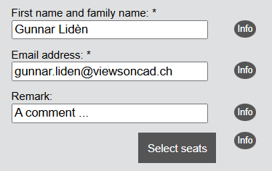
GUI Control InputEventReservation
Kann angepasst werden (Texte, Farben, …)
Elemente wie Dropdown, Preise, Info, … können weggenommen werden
Hat vorprogrammierte Texte in drei Sprachen (Deutsch, English, Schwedisch)
Kann implementiert auf jede Homepage werden
Es gibt eine Web Applikation mit der GUI Control (EventReservation.htm)

Slide 3
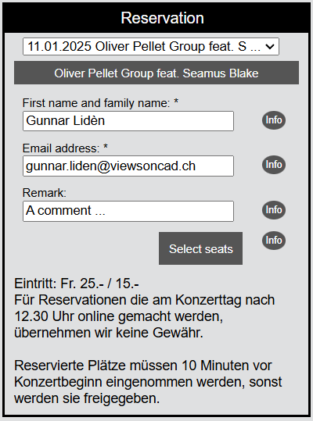
GUI Control InputEventReservation
Textquellen
OrganisationEventProgram.xml
<event>
<Year>2025</Year>
<Month>1</Month>
<Day>11</Day>
<Place>Spagi by Marcello</Place>
<Street>Metzgergasse 8</Street>
<City>5000 Aarau</City>
<EventName>Oliver …</EventName>
<Prices>Eintritt: ..</Prices>
<Instructions>Für Reserv…</Instructions>
</event>
InputEventReservationText.js
defaultLabelName()
{
setGerman("Vorname und Nachname: *");
setEnglish("First name and family name: *");
setSwedish("Förnamn och efternamn: *");
}
defaultInfoOpenReservation()
{
setGerman("Ein Tischplan ...");
setEnglish("A seating plan ...");
setSwedish("En bordsplan ...");
}

Slide 4
GUI Control InputEventReservation
Klassen für die Implementation
InputEventReservation
Form Input data for a reservation
Object global variable
var g_input_xyz = new InputEventReservation
InputEventReservationIdElement
Identities and objects of the form
EventProgramDropdown
Event program dropdown
InputEventReservationStyle
Style strings for the form
ReservationEventXml
Organizers event program
InputEventReservationText
Text strings for the form

Slide 5



id_unique_input_form
id_unique_div_header
id_unique_div_dropdown
id_unique_div_event_name
id_unique_div_label_name
id_unique_div_name_info
id_unique_div_name
id_unique_div_info_name
id_unique_div_label_email
id_unique_div_email_info
id_unique_div_email
id_unique_div_info_email
id_unique_div_label_remark
id_unique_div_remark_info
id_unique_div_remark
id_unique_div_info_remark
id_unique_div_button_info
id_unique_button
id_unique_div_info_button
id_unique_div_prices
id_unique_div_instructions

Slide 6
EventReservation.htm
EventReservation
Web application: Make a reservation
<html>
<header>
Included external Javascripts:
InputEventReservation.js, InputEventReservationIdElement.js, InputEventReservationStyle.js, InputEventReservationText.js,
EventProgramDropdown.js, EventProgramXml.js, Utils_20241111.js
<script>
Global variables:
g_event_program_xml (EventProgramXml)
g_input_event_reservation (InputEventReservation)
Functions:
mainEventReservation:
Sets path and name for the XML file with data about the events
Instantiates EventProgramXml (with callback function callbackAfterLoadingEventProgram)
callbackAfterLoadingEventProgram:
Instantiates InputEventReservation
Creates (displays) the reservation input form
Optionally set InputEventReservation parameters
<body>
Onload function: mainEventReservation
Container <div> with id= id_div_container_input_event_reservation

Slide 7
InputEventReservation.js, EventProgramDropdown.js
InputEventReservation
Form Input data for a reservation
EventProgramDropdown
Event program dropdown
Member variables
m_id_div_container
m_event_program_xml
m_active_event_number
m_id_el = new InputEventReservationIdElement
m_texts = new InputEventReservationText
m_styles = new InputEventReservationStyle
m_id_unique_str
Member functions
create
getDivsHtml
contentHeader, contentLabelName, contentLabelEmail, contentLabelRemark, contentDropdown, contentNameInfo, contentName, contentInfoName, contentEmailInfo, contentInfoEmail, contentRemarkInfo, contentRemark, contentInfoRemark, contentPrices, contentInstructions
dropdownGetEventNumber, dropdownSetEventNumber, dropdownSetTitle, dropdownGetDateFormat, dropdownSetDateFormatToIso, dropdownSetDateFormatToIsoReverse, dropdownSetDateFormatToSwiss, dropdownDisplayDateAndNameInDropdown, dropdownDisplayOnlyNameInDropdown
displayDropdown, hideDropdown
Member variables
m_id_drop_down
m_id_div_container
m_event_program_xml
m_drop_down_name_array
m_drop_down_number_array
m_append_str
m_onchange_function
m_title
m_date_format
m_b_date_name_dropdown
m_active_event_number
m_b_display_dropdown
Member functions
create
getEventNumber
setEventNumber
eventNumberIsSet
setTitle
setDateFormatToIso, setDateFormatToIsoReverse, setDateFormatToSwiss
displayDateAndNameInDropdown
displayOnlyNameInDropdown
displayDropdown, hideDropdown

Slide 8
InputEventReservationIdElement.js, InputEventReservationStyle.js, InputEventReservationText.js
InputEventReservationIdElement
Identities and objects of the form
InputEventReservationStyle
Style strings for the form
InputEventReservationText
Text strings for the form
Member variables
m_form_created
Member functions
getIdInputForm, getElementInputForm
getIdDivHeader, getElementDivHeader
getIdDropdown, getElementDivDropdown
getIdDivEventName, getElementDivEventName
getIdDivLabelName, getElementDivNameInfo
getIdDivLabelEmail, getElementDivLabelEmail
getIdDivEmailInfo, getElementDivEmailInfo
getIdDivLabelRemark, getElementDivLabelRemark
getIdDivRemarkInfo, getElementDivRemarkInfo
getIdDivButtonInfo, getElementDivButtonInfo
getIdDivPrices, getElementDivPrices
getIdDivInstructions, getElementDivInstructions
getIdDivName, getElementDivName
getIdDivInfoName, getElementDivInfoName
getIdDivRemark, getElementDivRemark
getIdDivInfoRemark, getElementDivInfoRemark
getIdDivEmail, getElementDivEmail
getIdDivInfoEmail, getElementDivInfoEmail
getIdDivButton, getElementDivButton
getIdDivInfoButton, getElementDivInfoButton
Member variables
m_form_style
m_row_style
m_element_left_style
m_element_right_style
m_header_style
m_label_name_style
m_label_email_style
m_label_remark_style
m_event_dropdown_style
Member functions
default, defaultForm, defaultRow, defaultLeftElement, defaultRightElement, defaultHeaderStyle, defaultLabelDivStyle, defaultLabelNameStyle, defaultLabelEmailStyle, defaultLabelRemarkStyle, defaultEventDropdownStyle
getForm, setForm, getLeftElement, setLeftElement, getRightElement, setRightElement, getRow, setRow, getHeader, setHeader, getLabelName, setLabelName, getLabelEmail, setLabelEmail, getLabelRemark, setLabelRemark, getEventDropdown, setEventDropdown
Member variables
m_header_text
m_label_name
m_label_email
m_label_remark
m_button_open_reservation_caption
m_info_name
m_info_email
m_info_remark
m_info_open_reservation
Member functions
Returns a default text in the active language
default, defaultHeaderText, defaultLabelName, defaultLabelEmail, defaultLabelRemark, defaultCaptionButtonOpenReservation, defaultInfoName, defaultInfoEmail, defaultInfoRemark, defaultInfoOpenReservation
Set and get functions
getHeaderText, setHeaderText, getLabelName, setLabelName, getLabelEmail, setLabelRemark, getCaptionButtonOpenReservation, setCaptionButtonOpenReservation, getInfoName, setInfoName, getInfoEmail, setInfoEmail, getInfoRemark, setInfoRemark, setInfoOpenReservation

Slide 9
DefaultText.js
Language global variable
var g_reservation_language = ‘german’
InputEventReservation
Form: Input of data for a reservation
InputEventReservationText
Text strings for the form
DefaultText
Text in different languages
Language global variable
var g_reservation_language = ‘german’
Member variables
m_header_text
m_label_name
m_label_email
m_label_remark
m_button_open_reservation_caption
m_info_name
m_info_email
m_info_remark
m_info_open_reservation
Member functions.
For example
defaultLabelName
defaultInfoEmail
getLabelName
setLabelName
getInfoEmail
setInfoEmail
Member variables
m_description (for debug)
m_german
m_english
m_french
m_Italian
m_swedish
Member functions
setDescription, setGerman, setEnglish, setFrench, setItalian, setSwedish
getText
Global variable g_reservation_language determinss the language text that will be returned
isImplemented
DefaultText
Text in different languages
Constructor
Get the active language
(g_reservation_language)
Set member variables with functions deaultLabelName, defaultInfoEmail, ..
Organization developer (optional)
In main application function add a call to a customization function
Organization’s function: Set other values than the default values

Slide 10
InputEventReservation
Form: Input of data for a reservation
InputEventReservationStyle
Text strings for the form
Member variables
m_form_style
m_row_style
m_element_left_style
m_element_right_style
m_header_style
m_label_name_style
m_label_email_style
m_label_remark_style
m_event_dropdown_style
Member functions.
For example
defaultLabelNameStyle
defaultLabelEmailStyle
getLabelName
setLabelName
getLabelEmail
setILabelEmail
Constructor
Set member variables with functions defaultLabelNameStyle, defaultLabelEmailStyle , ..
Organization developer (optional)
In main application function add a call to a customization function
Organization’s function: Set other values than the default values

Slide 11
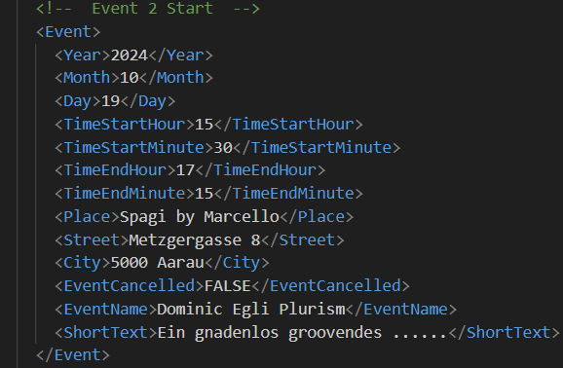
EventProgramXml.js
EventProgramXml
Holds all data for an event program
EventProgramXmlTags
Holds all tag names of the XML file
EventProgramSample.xml
Member variables
m_subdir_xml
m_event_program_file_name
m_callback_function_name
m_tags = new EventProgramXmlTags
Member functions
loadOneXmlFile
getXmlEventProgramFileName
getNumberOfEvents
getEventNameArray
getEventDateArray
Set and get functions for the tag names defined in the class EventProgramXmlTags like for instance getEntName and setEventName
Member functions
getEvent
getDay
getMonth
getYear
getStartHour
getStartMinute
getEndHour
getEndMinute
getPlace
getCancelled
getEventName
getShortText

Slide 12
UtilDate
Functions for date formats
Member functions.
getSwissDateString
getIsoDateString
getIsoReverseDateString
getYyyyMmDdDateString
getMonthName
getDateArrayFromIsoDateString
DateIsPassed
numberOfDaysToCurrentDate
getTimeStamp

