Slide 1
IBM Data Science capstone project
Vigneshkumar
Course 9

Slide 2
Introduction
coronavirus (COVID-19)
infections and death tolls has been exponentially increasing
Italy ->lockdown.
highly risk of being exposed to the virus
drastic measures (closing of restaurants and schools)
THIS PROJECT IS ABOUT…
analysis of neighborhoods specifically in Enfield, London
to identify the availability of essential amenities in the neighbourhoods than others in this crucial time.
To identify the neighborhoods that do not have access or have access to some amenities.
aid Government or social volunteers to focus on the efficient resource distribution in these areas in times of need.

Slide 3
what are the essential amenities?
business insider article [3],
food sources that are available in grocery stores or any type of markets
medicines from pharmacies for self-care and hygiene purposes like Panadol and sanitizers

Slide 4
Business problem
To identify and explore the similarities and differences in food availability and medical needs among the neighborhoods in Enfield, London based on the number of amenities (markets, pharmacies and etc.) in the times of COVID-19 outbreak.

Slide 5
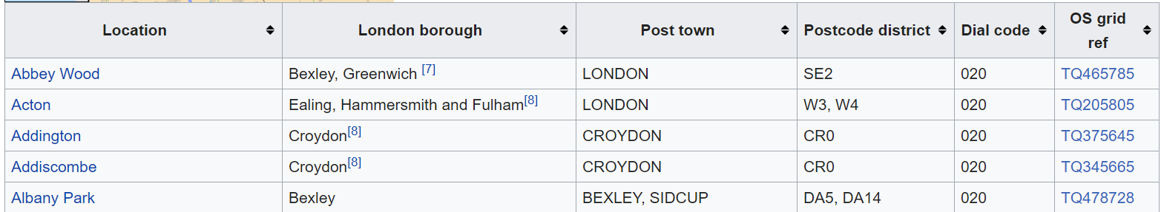
Data collection
neighbourhoods in Enfield -> scraped from Wikipedia using BeautifulSoup.
https://en.wikipedia.org/wiki/List_of_areas_of_London

Slide 6
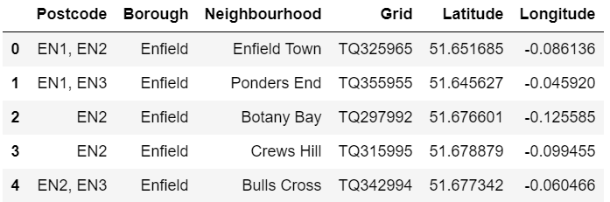
Data collection
The coordinates of these neighbourhoods are obtained manually by individually searching for neighbourhood coordinates.

Slide 7
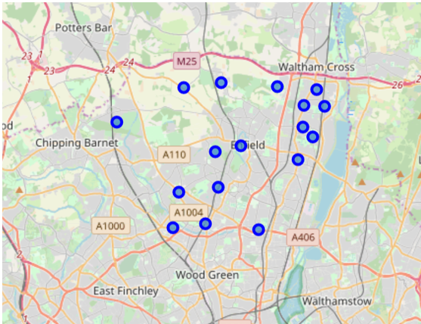
Data collection
17 neighbourhoods = Enfield Town, Ponders End, Botany Bay, Crews Hill, Bulls Cross, Brimsdown, Enfield Highway, Enfield Lock, Enfield Wash, Freezywater, Hadley

Slide 8
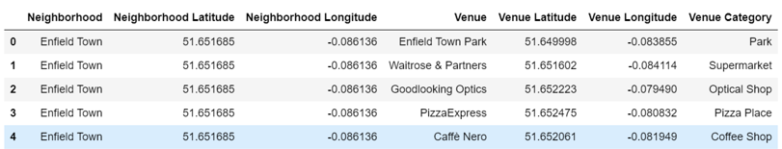
Data collection
Foursquare API -> 200 locations
1500m radius -> safe travelling distance

Slide 9
methodology
1. Data Collection for input
2. Filter out the venues by “Venue’s Category” from Foursquare API
(associated to grocery stores/markets and pharmacies)
3. After filtering, the data can be then clustered through k-means to explore how similar or how different the neighbourhoods are.

Slide 10
methodology
1. Data Collection for input
2. Filter out the venues by “Venue’s Category” from Foursquare API
a) For medical needs: 'Pharmacy' b) For groceries/food/basic items: 'Supermarket', 'Grocery Store','Convenience Store','Department Store'
3. After filtering, the data can be then clustered through k-means to explore how similar or how different the neighbourhoods are.

Slide 11
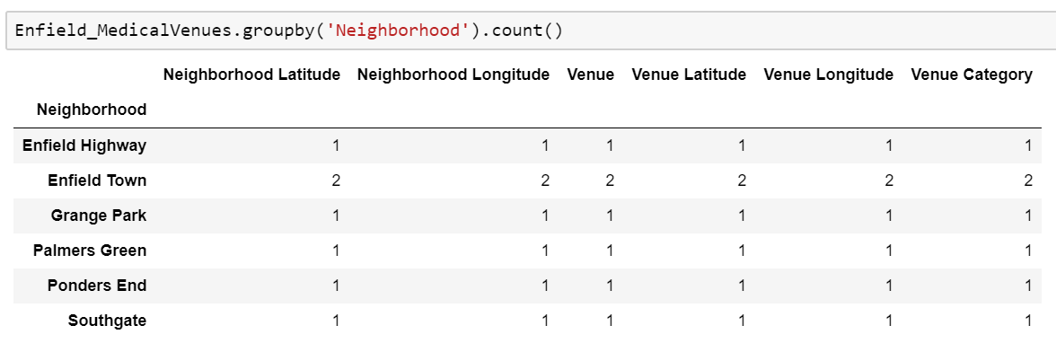
METHODOLOGY
Medical:
only 7 /17 neighbourhoods contain minimum of 1 pharmacy within 1500m

Slide 12
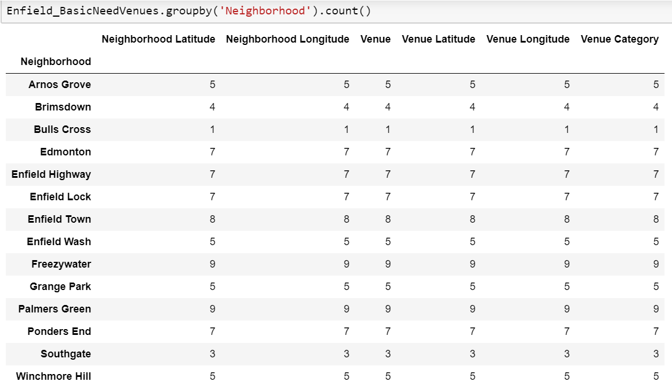
METHODOLOGY
Other basic needs:
14 out of 17 neighbourhoods contain minimum of 1 basic need shop within 1500m.

Slide 13
METHODOLOGY
Other basic needs:
14 out of 17 neighbourhoods contain minimum of 1 basic need shop within 1500m.

Slide 14
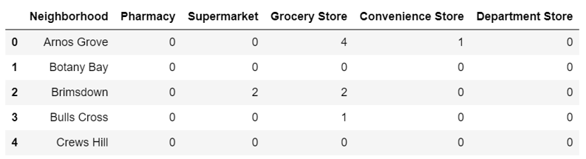
METHODOLOGY
For clustering, the model used is K-Means. The input data to this model is the total number of each selected venue categories each neighbourhood has. Through coding, a sample of the table data will look as follows:

Slide 15
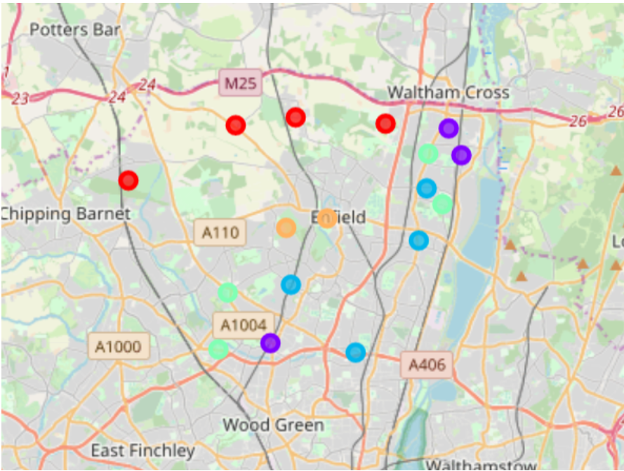
Results of clustering
5 clusters
the highest number of neighbourhoods 4
lowest number of neighbourhoods found 2

Slide 16
Results of clustering
Among the 5 clusters, the highest number of neighbourhoods found similar is 4 while the lowest number of neighbourhoods found is 2.

Slide 17
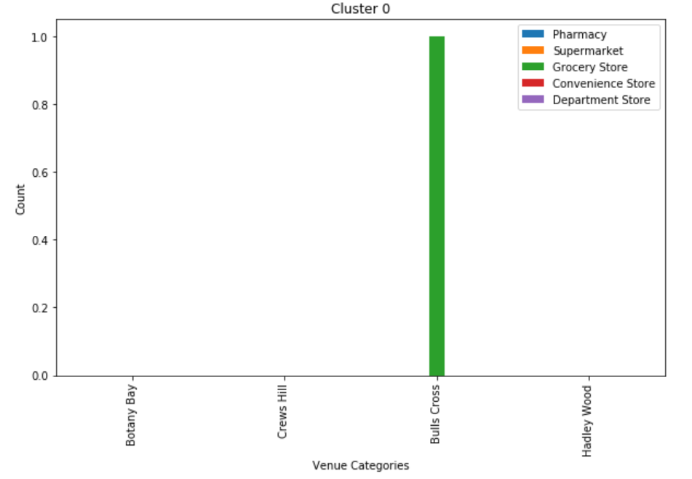
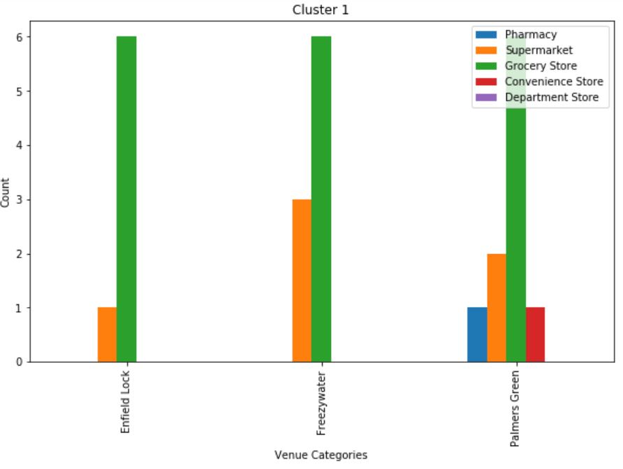
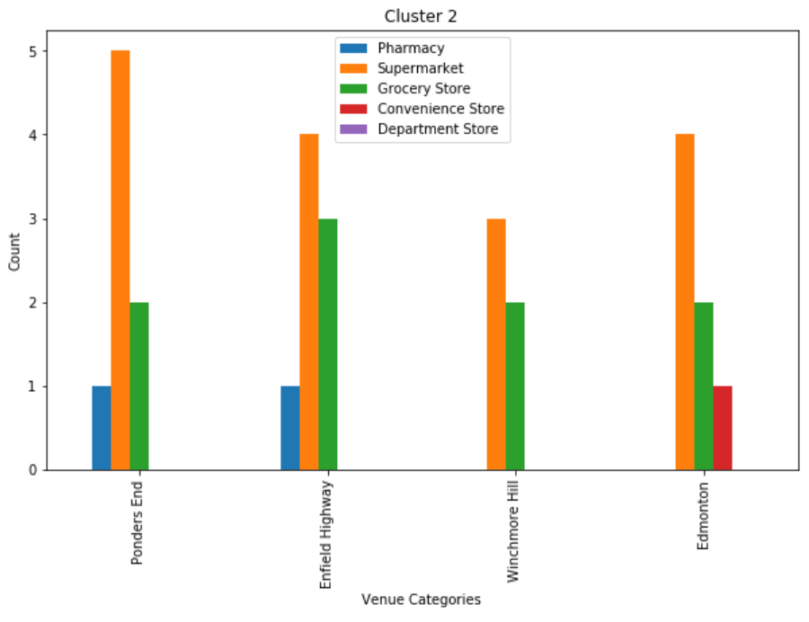
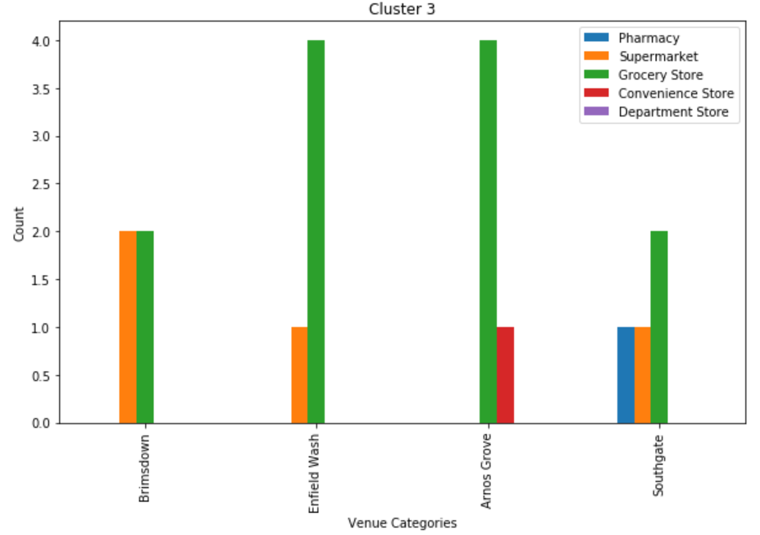
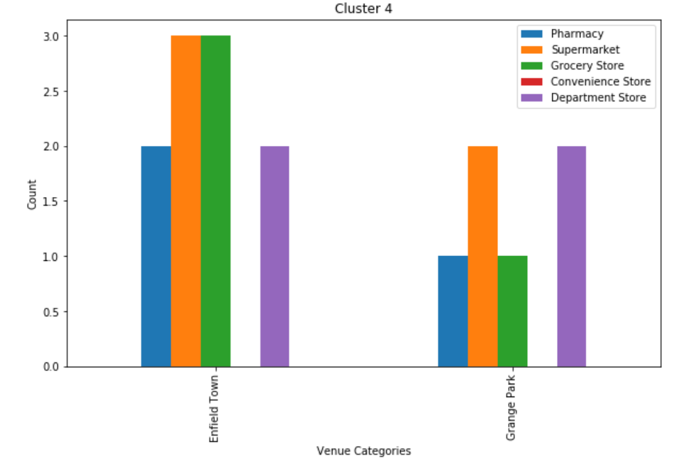
Results of clustering

Slide 18
Cluster 0:
The similarity is that these neighbourhoods lack bascic amenities. Only 1 of the neighbourhoods contains 1 grocery store. Hence, more focus on resource allocation is required for the neighbourhoods in this cluster.
Cluster 1:
In this cluster, the neighbourhoods have grocery store as the highest number of amenities followed by supermarket. In fact, these places have the maximum number of grocery stores.
Cluster 2:
On the contrast to cluster 1, the neighbourhoods in cluster 2 contains more number of supermarkets than grocery stores.
Cluster 3:
Similar to cluster 1, the neighbourhoods contain grocery stores as highest number of amentities but lower when compares to cluster 1.
Cluster 4:
There is a wide range of amenities in each neighbourhood and their count is approximately same as compared to other clusters. In fact, this is the only cluster where all neighbourhoods have pharmacies.

Slide 19
Results of clustering
Cluster 4 ->most variety of amenities.
Cluster 0 -> none. Hence, maximum attention is required for monitoring and the resource allocation to Cluster 0.
All clusters require more medical attention

Slide 20
obstacles
One major obstacle:
Collect the coordinates of the neighbourhoods in Enfield
Geocoder and web scraping of many webpages were not able to provide coordinates for all neighbourhoods.
Work around:
Manually obtained by using GeoHack in Wikipedia for each neighbourhood.

Slide 21
Improvements
Population density of the neighbourhoods
total number of each type of venue categories (amenities) can be standardized by dividing by the population density in each neighbourhood
neighbourhoods with lower population density -> lower number of amenities
Less attention by the Government officials for resources
Clustering the neighbourhoods with the distance range of the amenities
exploredistribution of venue categories (amenities) within each neighbourhood
Better model: desity based clustering -> filter anomalies

Slide 22
conclusion
Cluster 0 requires most amount of resources.
All clusters require medical attention.
Result is limited due to no consideration of population to see number of amenities per head.
An advanced analysis: number of amenities within intervals of distances to understand distribution of existing resources.

Slide 23
references
[1] M. Robinson, "Prince George and Princess Charlotte's school becomes the latest to send pupils home for coronavirus isolation - as NINE shut - despite advice it's 'unnecessary' - offices close and sports fixtures are cancelled across UK," Mailonline, 27 02 2020. [Online]. Available: https://www.dailymail.co.uk/news/article-8047195/Is-Britain-heading-coronavirus-lockdown-amid-confusion-dangers-Europe.html. [Accessed 14 03 2020].
[2] G. Diebelius, "Coronavirus: Entire UK cities could be placed on lockdown in bid to contain spread," Mirror, 02 03 2020. [Online]. Available: https://www.mirror.co.uk/news/uk-news/coronavirus-entire-uk-cities-could-21612813. [Accessed 14 03 2020].
[3] K. Warren, "What to buy if you’re quarantined at home during the coronavirus pandemic," Business Insider US, 11 03 2020. [Online]. Available: https://www.businessinsider.sg/what-to-buy-for-home-quarantine-coronavirus-2020-3?r=US&IR=T. [Accessed 15 03 2020].

