Slide 1
Visual Cryptography
Vighanesh Sharma
2017csb1118
Mentor – Dr. Somitra Sanadhya

Slide 2
Definition
A Cryptographic scheme
Printed material is divided into several transparencies such that information is revealed only when all are stacked together, decrypted by human visual system without requiring any computations.
Each transparency would look like Random noise.
First introduced in 1994 at Eurocrypt by Naor and Shamir

Slide 3
k out of n visual secret sharing scheme
Given a written message
We would like to generate n transparencies
Original message is visible if any k transparencies are stacked
Totally invisible if fewer than k are stacked

Slide 4
The Model
Each pixel appears in N modified versions called shares
Each share is a collection of M B&W subpixels
Structure is NxM Boolean matrix S
Sij = 1 if jth subpixel in ith transparency is black else Sij = 0
i1, i2, i3 …. ir Transparencies properly aligned to see a combined share
Black symbols represented by the “or” of r rows
Grey level is proportional to the Hamming Weight H(V) of the “or”ed m vector V
Interpreted as black if H(V) >= d
Interpreted as white if H(V) < d – am
1 <= d <= m and a > 0

Slide 5
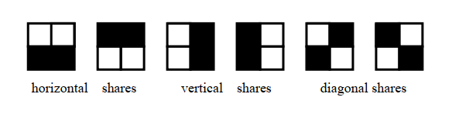
The original problem of visual cryptography
It is the case of 2 out of 2 scheme
Can be solved with 2 subpixels per pixel, but can distort the aspect ratio.
4 subpixels arranged in 2x2 matrix are used
Contrast reduced by 50%

Slide 6
A white pixel is shared into 2 identical arrays from the list.
A black pixel is shared into 2 complementary arrays from the list.
When two are stacked together
Result would be 2 white and 2 black subpixels representing a white pixel (It would look medium-grey)
Or 4 black subpixels representing a black pixel

Slide 7
Implementation

Slide 8
Visual Cryptography for colored Images
The problem involves extending the ideas of visual cryptography to colored images.
Most prominent paper was presented by YC Hou in 2002
He suggested 3 schemes

Slide 9
The Halftoning Technology
General printers can only control single pixels to be printed (color) or not to be printed (White)
The printed dot is of 1 color ink only.
The density of the net dots simulates the color.

Slide 10

A Halftone color image
Source: https://www.shutterstock.com/blog/how-to-halftone-images-in-adobe-photoshop

Slide 11
Basic principles of color
2 Models: Additive and subtractive models
Additive – RGB are primary, if all are mixed result is white color.
More pigment => Brighter is intensity of light
Used in computer monitors.
Subtractive – CMY are primary, if all are mixed result is black color.
More pigment => Lower intensity of light.
Used in printers

Slide 12
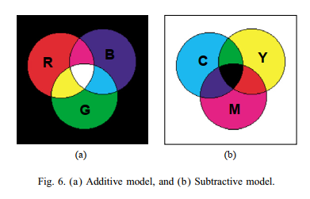

Slide 13
Scheme1
1. Transform the image into 3 halftones – C M Y
2. for each pixel Pij
i) Select a black mask of size 2x2, assign black symbol to 2 of 4 positions.
ii) Determine position of cyan in blocks of sharing image
a) if Cij = 1, (cyan will be revealed) fill the positions corresponding to white with cyan and leave rest blank.
b) if Cij = 0, (cyan hidden)fill the positions corresponding to black with
cyan and leave rest blank
c) add block to share 1
3. Repeat with Magenta and Yellow.
4. After stacking 4 images secret image can be revealed by human eyes

Slide 14
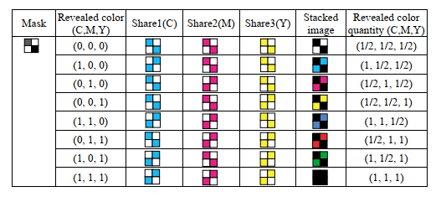
Scheme 1

Slide 15
Discussion
50 % lost in contrast
4 transparencies
Image not visible by combining CMY Shares
Need Black Mask to decrypt

Slide 16
Implementation
I used RGB instead of CMY scheme because of errors in CMY format as OpenCV uses BGR as default.
Black represents Transparent now.
Won’t change properties of the scheme as just colors are changed.

Slide 17
Scheme 2
1. Transform the image into 3 halftones – C M Y
2. For each pixel Pij
A) fill a 2x2 block in Share 1 with C M Y and transparent randomly
B) generate a 2x2 block in Share 2 accordingly, for example to reveal Cyan we need 2 boxes in this block to be Cyan and rest in the same position as Share 1. (refer Figure for example)
3. Repeat step 2 for all.
4. After stacking 2 sharing images, image can be decrypted.

Slide 18
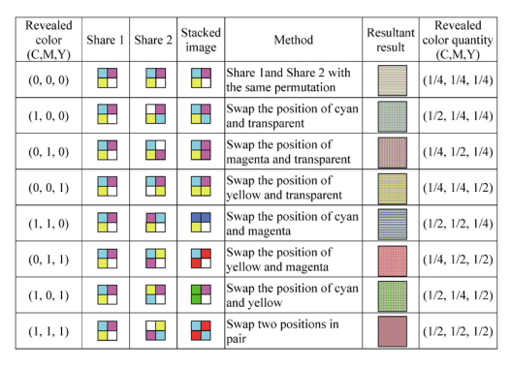
Scheme 2

Slide 19
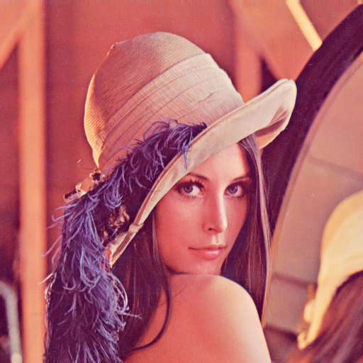
Original Image source- https://en.wikipedia.org/wiki/Lenna

Slide 20
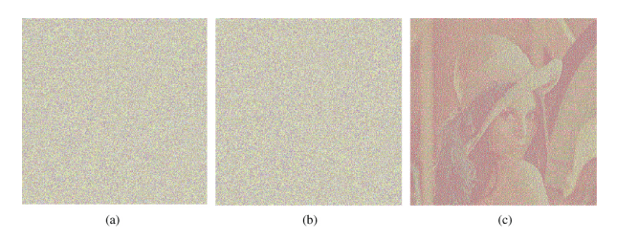
(A) Transparency 1 (B) Transparency 2 (C) Decrypted Image

Slide 21
Discussion
Requires only two sharing images
2 transparencies
Contrast is 25% of the original image
Image will look brighter
Will be good for Dark images

Slide 22
Scheme 3
1. Transform the image into 3 halftones – C M Y
2. For each pixel Pij of the image
A) According to method of B&W Cryptographic scheme, expand C M Y into C1, C2, M1, M2, Y1, Y2
B) Combine C1, M1, Y1 and fill the block in Share1
C) Do B) for Share 2 with C2, M2, Y2
3. Repeat for each Pij, till we obtain 2 transparencies.
4. After stacking, sharing image can be decrypted by human eyes.

Slide 23
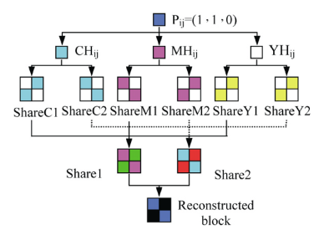
Pixel Decomposition and Reconstruction

Slide 24
Discussion
Requires only 2 sharing images
Loses less image contrast than Scheme 2
50 % loss in contrast

Slide 25
Implementation

Slide 26
References
“Visual Cryptography” by Moni Naor, Adi Shamir
“Visual cryptography for color images” by YC Hou

Slide 27
Thank you!

