Slide 1
DATA BRICKS HACKATHON
LEVERAGE AI TO EXPLORE PROCESS LANDSCAPE

Slide 2



Our Understanding
Problem Statement
Nearly 6,000 RCSA process maps exist at the Enterprise and Consumer Lending levels, which may result in overlapping processes across various Consumer Lending areas like mortgages, credit cards, and auto loans. It is thought that Wells Fargo could use AI to pinpoint these redundancies, potentially saving costs.
Sample Desired Insights
Determining Inquiries for Background Information
Determining Manual Control Systems
Recognizing Processes Affected by Regulatory Changes
Identify where and how background information is obtained for various lending products, uncovering chances to simplify and merge these processes.
Separate manual control processes within Consumer Lending areas to pinpoint key candidates for automation, creating opportunities to enhance operational efficiency.
Examine and identify processes within Consumer Lending areas that may be impacted by new or revised regulatory requirements, allowing for proactive adjustments to ensure compliance.
Advanced AI capabilities enable this challenge to be addressed with unparalleled efficiency.

Slide 3








Solution | TRANSFORM WITH MODERN AI CAPABILITIES
Convert Process Maps into Knowledge Bases
Classify and Tag Automatically
Q/A on Process Content
Q/A Across Broad Scope
Convert intricate process maps into user-friendly knowledge bases
Allow for quick referencing and retrieval of process information
Support ongoing process improvement through centralized access to knowledge
Automatically classify process elements according to established criteria
Improve the searchability and organization of process data
Minimize manual effort in managing and categorizing data
Deliver immediate responses to process-related inquiries
Enhance accuracy through AI-driven content analysis
Support rapid decision-making and problem-solving
Address questions spanning multiple processes and domains
Combine knowledge from different consumer lending sectors
Facilitate thorough analysis through cross-domain insights

Slide 4
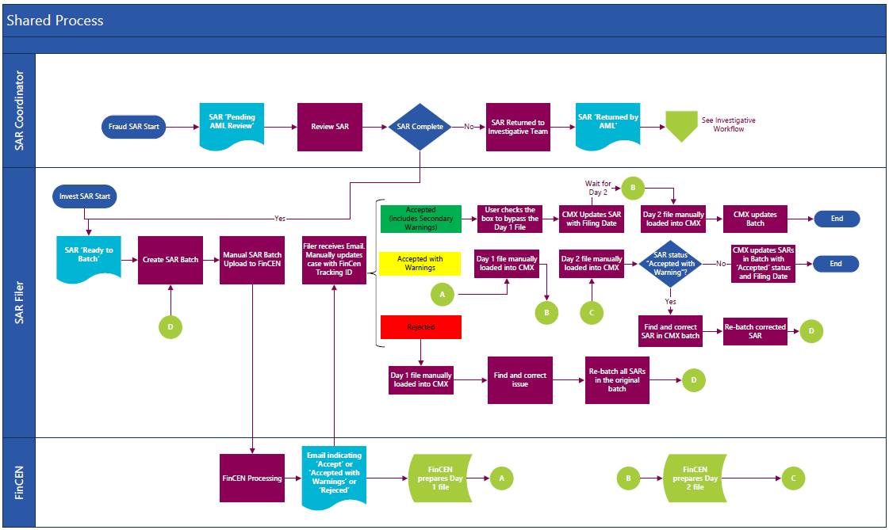
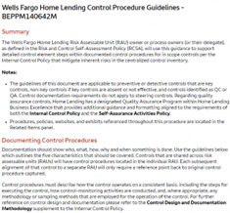
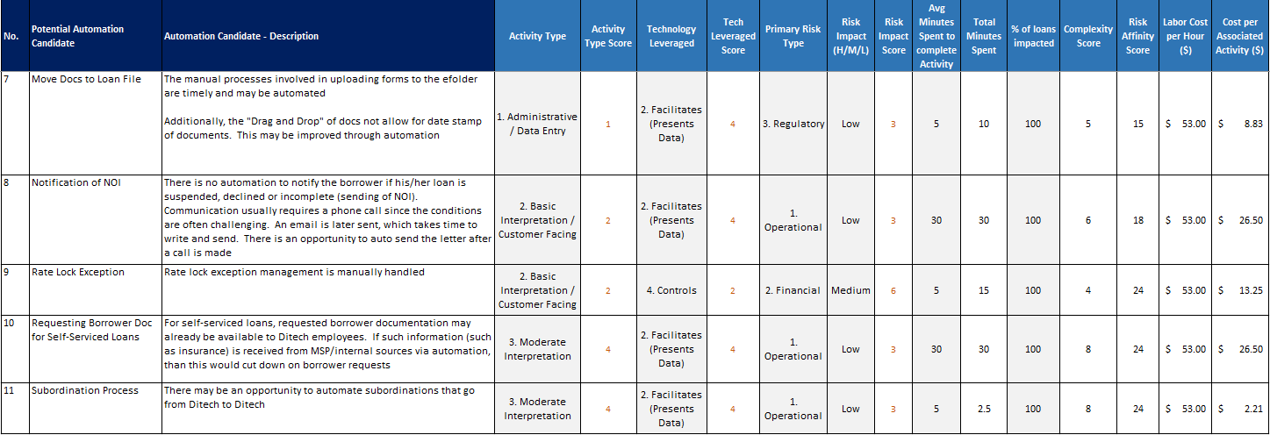
LLM Strategy for Process Optimization
Redundant processes can be identified using prompt engineering, integrating organizational data, and training models.
Process Maps
Meta Data
Information
Procurement
Information is meticulously chosen to train and educate the LLM.
Procedures
Process maps
Meta Data
Data Pool
Data Ingestion & Persona Dev
The LLM's character is tailored to align with the designated activities, and the LLM is set up accordingly.
Query with Prompts
Prompt Engineering
With a frequency of X, LLMs will consistently learn and enhance their performance from 70% to 80% over the same period.
For example, retrieve all procedures where [process] includes “credit check,” “TransUnion,” and “Bankruptcy.”

Slide 5
Prompt Engineering
Using parameters and operational functions to customize queries
Capability: The LLM can process process maps and generate written procedures, which can subsequently be queried using prompt engineering.
Complexity can be categorized as high, medium, or low based on the two attributes mentioned above.
Associated metadata and process information serve as the queryable data for the LLM to leverage within the data pool.
Complexity measured by:
# of steps in process/procedures
# of decision points
Sample Parameters | Example
Roles | Analyst, Credit Officer
$ Amount | 0-$50K, $50k-100k
Time to complete a process | 1-3 days, 3-5 days
Vendors | Precision Lender
Procedure/Process | Credit check, Risk
# Steps | # Decision Points | Complexity
1-5 | 1-3 | Low
5-10 | 3-10 | Medium
10+ | 10+ | High
Sample Query: “Retrieve all processes where [complexity] is High, [procedure/process] includes Credit check, and [amount] is less than $500K, requiring approval from the [role] of credit officer.”

Slide 6
Additional Information
LLM related information and constraints

