Slide 1


Cordeal
The Ideal Earbuds for the ideal person

Slide 2
Road Map
THE IDEA
THE
PRODUCT
PROS
SPECS
QNA

Slide 3

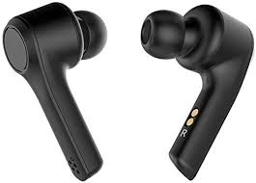
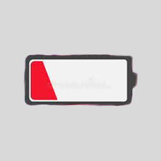


Cord or Cordless?

Slide 4
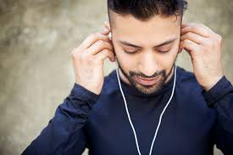
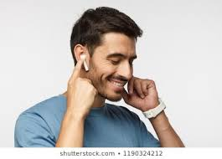
Cordeal: 2in1 wired and wireless earbuds
Cordeal wired
Cordeal wireless
Live the BEST of both worlds

Slide 5
Pros
Comfortable
High durability
CORDIAL, Flexible and multipurpose.

Slide 6
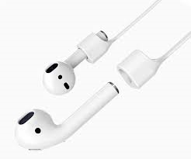
Specifications
Bluetooth - Up to 30 feet (10 m) range
Charging capacity :
15 hours of battery life
Up to 10 hours talk time
Powerful mic
Noise cancellation
Easy to setup
2 different cords provided

Slide 7
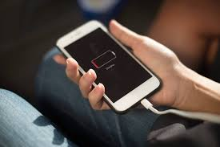
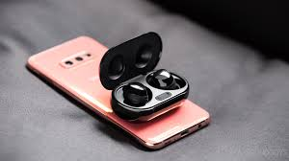
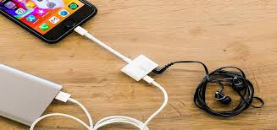
Future Development

Slide 8
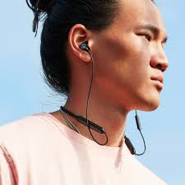
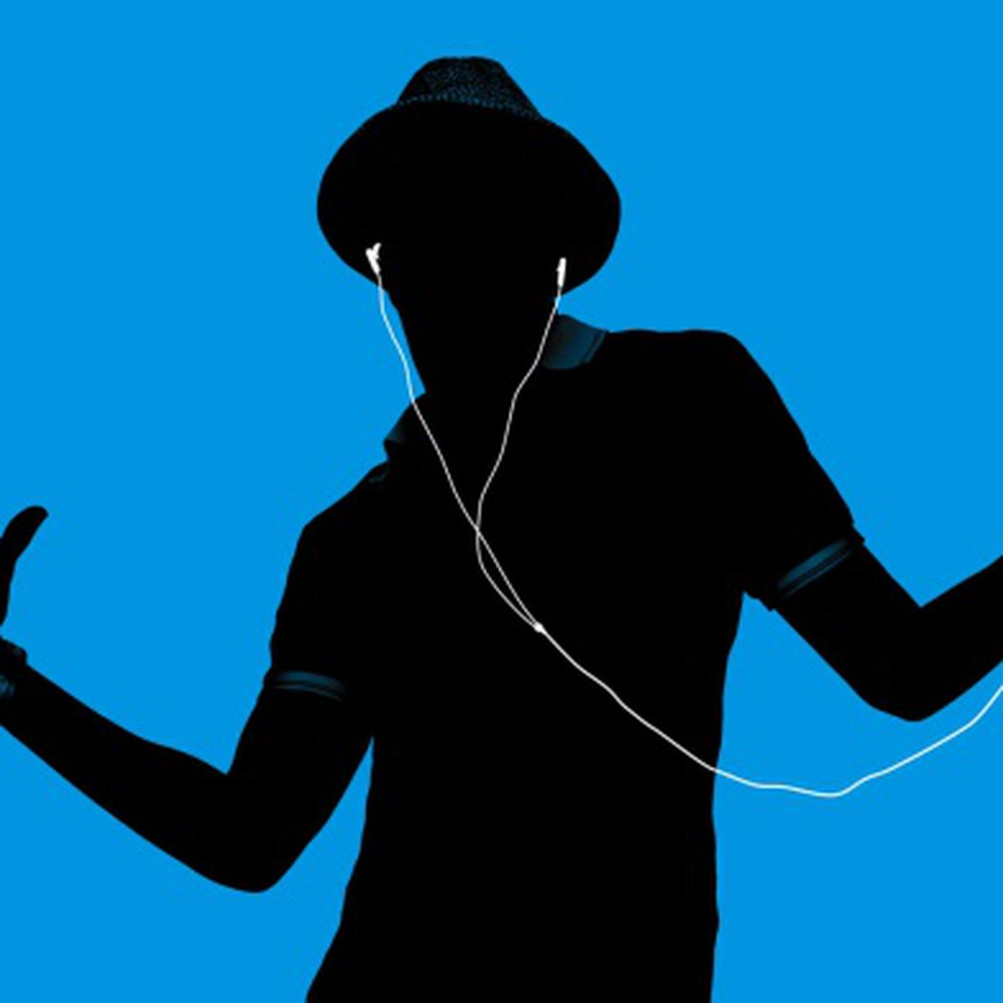
Thank You
The Ideal Earbuds for the ideal person

