Slide 1


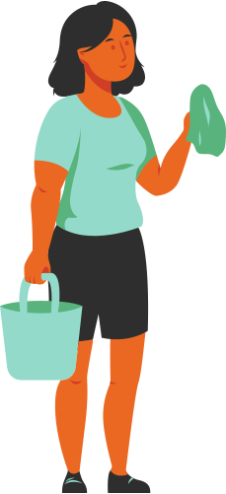

bLink
bLink
bLink

Slide 2
THE PROBLEM
No apps available for part-time/hourly jobs for students in the market.

Slide 3
THE SOLUTION
bLINK acts as a middle man and provides hourly pay for a particular job to be done. The work can range from tutoring to cashier at shops to handle prime time customers.

Slide 4

bLINK
At the blink of an eye
Linking Hirers and Students
bL
We are changing the way students find part-time jobs.

Slide 5


bLINK
Find Jobs Near You
A SIMPLE CONCEPT
AND UI
Work for mentioned
hours
Searching...
Earn your money

Slide 6

HOW IT WORKS
Getting Started is
Fast & Easy
bLINK uses location services to search for hourly job openings near you. All you have to do is choose a km radius you are comfortable with and the app does the rest!
Set your distance radius
to search for suitable jobs near you...
Set Distance Radius
1km
2km
>2km
Search

Slide 7
AVAILABLE JOBS
bLINK
To get you started, bLINK shows you the jobs currently open around the radius you specified. These jobs will have a larger range. Find out jobs best suited for you.
Jobs Near you
10
Find a job you like and want to apply? Wait! not before you setup your profile...

Slide 8


YOUR PROFILE
Customize your
job preferences
Your Name
Age
In your profile section, add details about you which include your interests and skills to find skill specific jobs for you. It is mandatory to have at least 3 skills listed, you can choose to add more later :)
Add Skills/Interests
Pets...
Pet Care
Pet Walking

Slide 9
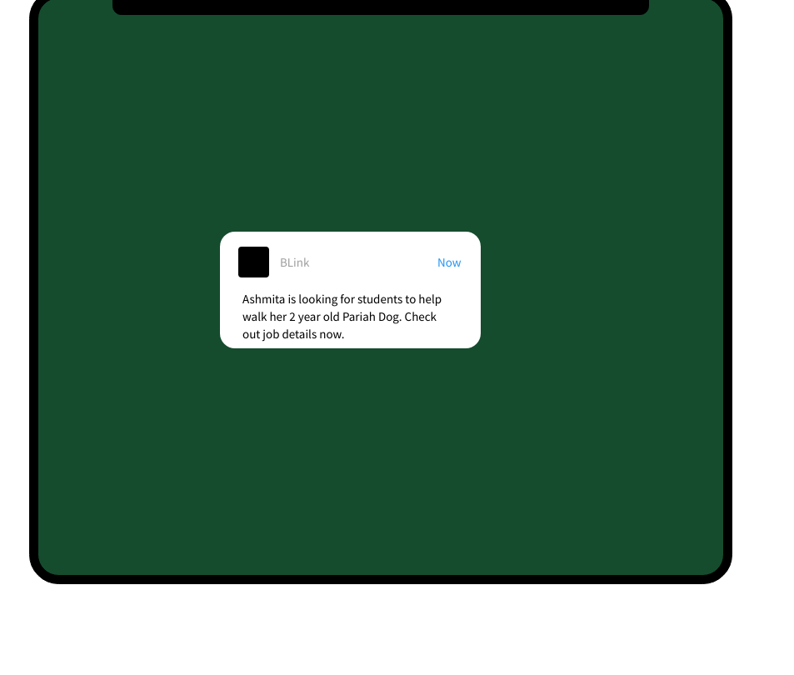
NOTFICATIONS
Get Notified everytime
there is a job opening
around you!
BL
You will get a notification whenever there is a job opening around you. These jobs will be suited according your profile.

Slide 10


JOB DETAILS
Get to know more
about the job you
like.
Ashmita Singh
4.3
Female | 23
JOB OPENINGS
Click on the notifications to know more about your hirer and see if the job details meet your standards and pay interest. The contact button is just a click away.
Walk My Dog
Category : Pet Walking
Required : Must Love Dogs
Time : 2Hrs on
weekends
Pay : 300/Hr
Contact Ashmita

Slide 11
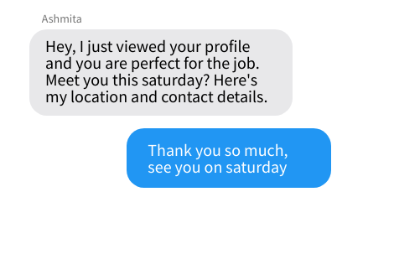
CONTACT
Talk to your hirer
There is absolute no need to share your number or any contact details. Talk to your hirer and they will accept/decline your job request, hasle-free.

Slide 12
PREFERENCES
Add extra details
Your Name
Age
In your profile section, you can add extra details so we can filter out and show the best jobs for you.
Extra Preferences
Hirer Age
Hirer Gender
Hirer Language

Slide 13
MONEY
This is how we safeguard
YOUR money
Show this code to your hirer :
Show this code to the student:
OT345X
GLF67C
As soon as you get selected, your hirer will pay the money but no we won't send it to your right away. bLINK holds the money until the job is done AND your hirer is satisfied with your job.
The hirer can either click the button to pay you right away or can apply for a refund in case there was deceit involved.
Did you arrive?
Enter hirer code....
Did the student
arrive?
OT345X...
START WORK
Work Has Begun
Pay the student
Apply for refund

Slide 14
SOS
We have you protected!
You have started your work.
Notice anything weird or do you feel uncomfortable?
Don't hesitate to use our emergency services. We will also be tracking your live location while you work in order to send necessary details to your emergency contacts.
Always remember you need not do anything that makes you feel unsafe or threatened.
Click here to alert your emergency contacts that you are in danger.
Public emergency contact list

Slide 15



REVIEW SYSTEM
Like your hirer? or
Like the student's service?
Rate them
Ashmita Singh
Your Name
We work on a rating system where both you are your hirer will rate each other's experiences.
Don't like how the hirer or the student behaved? Give them 0 stars and a bad review, they will automatically be blackmarked. These reviews will be checked and acted upon.
Please review your hirer :
Please review the student :
Overall
Rating
Overall
Rating
Please add your comments:
Please add your comments:
Ashmita ma'am was patient and a kind lady. I had a good experience with her.
Wonderful service. My dog
Mika loved spending time with the student.

Slide 16

What we want to achieve...
We acknowledge good conduct and attitude over skills and this is what our app stands for.
We want to link hardworking students to hirers to help them stay independent.

Slide 17
THANK YOU
Brought to you by AGENTS

