Slide 1
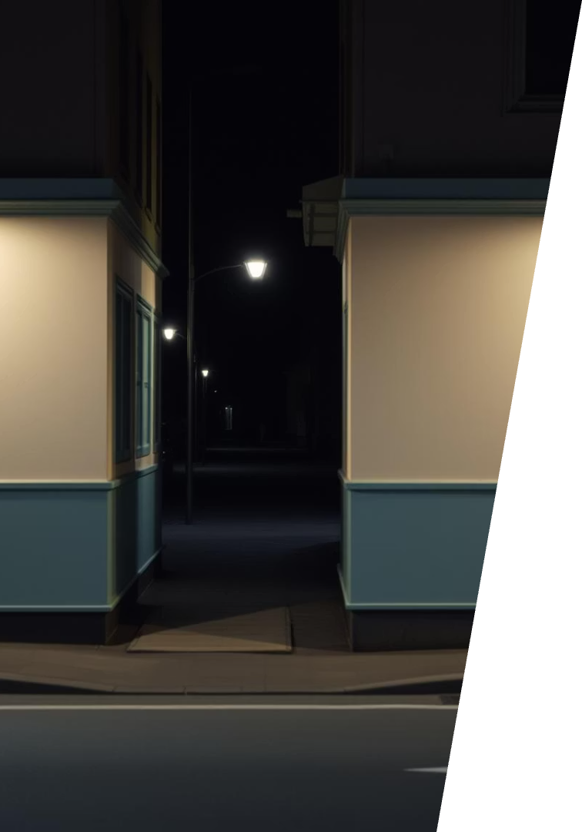
Low-Light Image Enhancement Using the PromptIR Model
Project Team:
Chitturi Sowmya
Vejandla Vighnesh
Tholupuluri Geetha Bhargavi
Project Guide: Prof. Chintakindi Balaram Murthy
School of Computer Science and Engineering

Slide 2
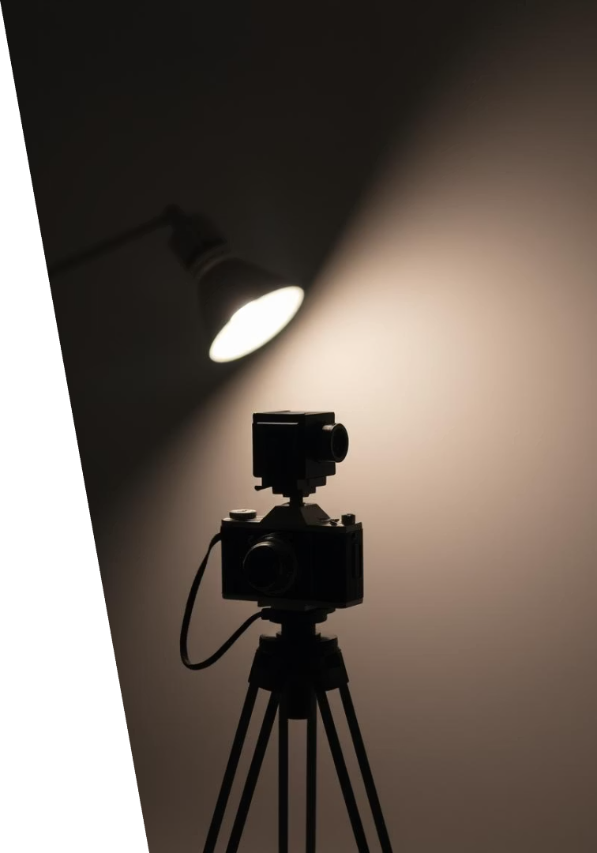
Challenges of Low-Light Images
Common Issues
Applications
Poor brightness
Surveillance
High noise
Photography
Loss of detail
Medical imaging

Slide 3
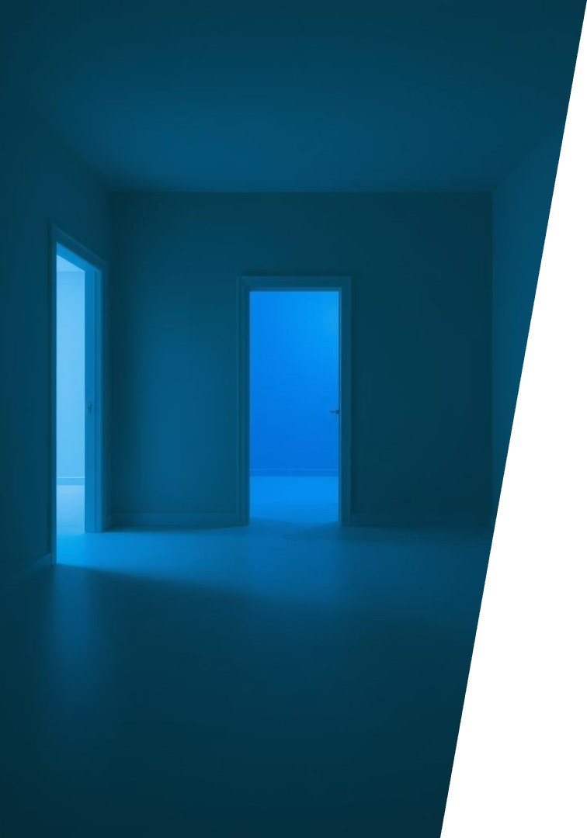
Problem Statement
Traditional Issues
Overexposure, noise amplification, color distortion
Need
Automated, robust enhancement via deep learning

Slide 4

Project Objective
Enhancement Goals
Improve brightness & visibility
Reduce noise
Enhance overall image quality
Approach
Use PromptIR for flexible, efficient enhancement

Slide 5
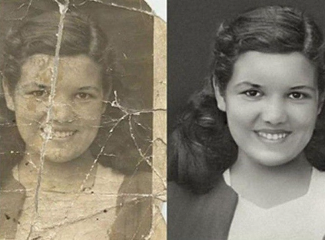
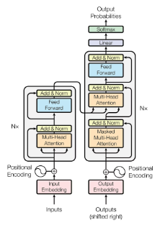
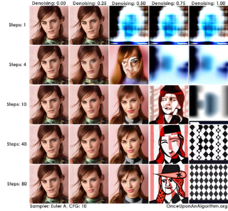
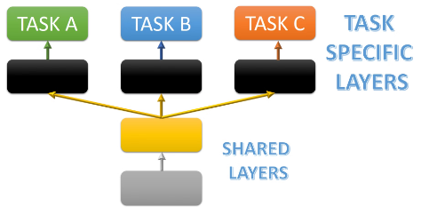
Prompt-Guided Image Restoration: Using AI prompts
to restore and enhance images with precision.
Transformer Architecture: Leveraging powerful transformer models for advanced image processing tasks.
One Model for Multiple Tasks: A unified model approach addressing denoising, deblurring, and enhancement simultaneously.
Denoising, Deblurring & Enhancement: Techniques applied to improve image clarity by reducing noise and correcting blur.

Slide 6





Methodology
Dataset Collection
Low-light images like LOL dataset
Pre-processing
Resize and normalize images
PromptIR Application
Task prompt: "Enhance low-light image"
Evaluation
PSNR
SSIM

Slide 7
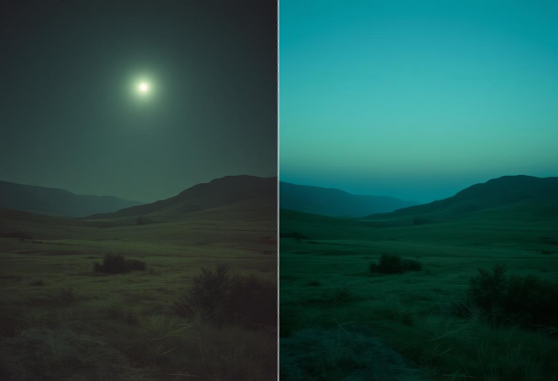
Results
22.98
20%
25%
PSNR (Peak Signal-to-Noise Ratio)
Noise Reduction Achieved
Processing Time Reduction
Average PSNR improvement compared to baseline low-light inputs, indicating enhanced image fidelity
Percentage decrease in noise artifacts measured via signal-to-noise ratio metrics
Faster enhancement processing through optimized transformer-based PromptIR model
Visual Enhancements
Restoring and enhancing low-light images is a challenging task that requires sophisticated techniques. The PromptIR model offers a powerful solution, leveraging AI-generated prompts to guide the restoration process with precision.
One of the key challenges in low-light image enhancement is preserving important details and fine textures while effectively reducing noise and artifacts. The PromptIR approach addresses this by using textual prompts to precisely control the restoration, ensuring that the final result retains the essential visual information.
The project objective is to develop a robust and versatile image enhancement system that can handle a wide range of low-light conditions. By combining the strengths of AI-powered prompts with advanced restoration algorithms, the PromptIR model aims to deliver high-quality, visually compelling results that can benefit various applications, from photography to scientific imaging.

Slide 8
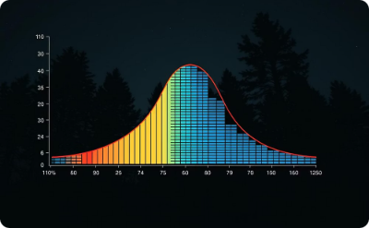

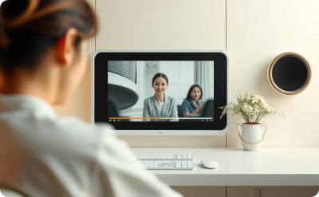
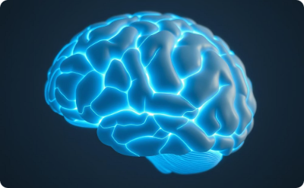
Comparison & Future Work
Compared Methods
PromptIR Advantages
Future Work
Ongoing Innovation
Histogram Equalization
Flexibility
Real-time deployment
Driving advances in low-light image enhancement
Retinex-based
Speed
Extreme low-light testing
Deep learning baselines
Visual quality
Combine with GANs
Generalization
Video enhancement

