Slide 1
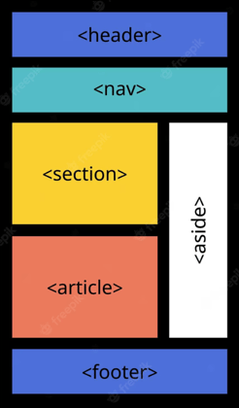
HTML Semantic Elements

Slide 2
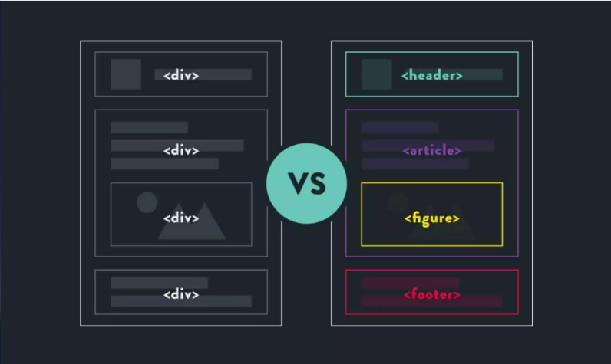

Slide 3

HTML Semantic Elements
A semantic element clearly describes its meaning to both the browser and the developer.
Examples of non-semantic elements: <div> and <span> Tells nothing about its content.
Examples of semantic elements: <form>, <table>, and <article> - Clearly defines its content.
Many web sites contain HTML code like: <div id="nav"> <div class="header"> <div id="footer"> to indicate navigation, header, and footer.

Slide 4
In HTML there are some semantic elements that can be used to define different parts of a web page:
<details>
<figcaption>
<figure>
<footer>
<header>
<main>
<mark>
< nav>
<section>
<summary>
<time>

Slide 5
HTML <section> Element:
The <section> element defines a section in a document.
According to W3C's HTML documentation: "A section is a
thematic grouping of content, typically with a heading."
Examples of where a <section> element can be used:
Chapters
Introduction
News items
Contact information

Slide 6
HTML <article> Element:
The <article> element specifies independent, self- contained content. An article should make sense on its own, and it should be possible to distribute it independently from the rest of the web site.
Examples of where the <article> element can be used:
Forum blog
Blog posts
Newspaper article
User comments

Slide 7
HTML <header> Element:
The <header> element represents a container for
introductory content or a set of navigational links.
A <header> element typically contains:
one or more heading elements (<h1> - <h6>)
logo or icon
authorship information.

Slide 8
HTML <footer> Element:
The <footer> element defines a footer for a document or section.
A <footer> element typically contains:
Authorship information
Copyright information
Contact information
Sitemap

Slide 9
HTML <aside> Element:
The <aside> element defines some content aside from
the content it is placed in (like a sidebar).
The <aside> content should be indirectly related to the
surrounding content.
HTML <nav> Element:
The <nav> element defines a set of navigation links.

Slide 10
Why Semantic HTML5 Elements?
With HTML4, developers used their own favorite attribute
names to style page elements:
header, top, bottom, footer, menu, navigation, main,
container, content, article, sidebar, topnav, …
This made it impossible for search engines to identify the
correct web page content.
With HTML5 elements like:
<header> <footer> <nav> <section> <article>, this will
become easier.
"Allows data to be shared and reused across applications,
enterprises, and communities."

Slide 11
Thank You

