Slide 1

DEPARTMENT OF COMPUTER SCIENCE AND ENGINEERING
Professional Training I
Disease Risk Prediction System project
Mohamed Shafi S GUIDE
Thanga Vignesh Raja S Dr.R.Rajalakshmi

Slide 2
AGENDA
Certificate
Abstract
Introduction
Objective
System Architecture / Ideation Map
Module Implementation
Results and Discussions
Conclusion
References

Slide 3
COURSE CERTIFICATE

Slide 4
ABSTRACT
Heart disease is a leading cause of death worldwide, and early screening can support timely medical consultation.
This project is a web-based Heart Disease Risk Prediction System that estimates a patient's risk from 13 clinical parameters.
A Flask REST API validates the input, scales it with a StandardScaler and predicts using a pre-trained Random Forest model.
The probability is mapped to Low (0–39%), Medium (40–69%) or High (70–100%) risk and shown with the most influential factors.
Users register, log in with JWT authentication, and keep a private prediction history in MongoDB Atlas.
The tool is for educational screening only and is not a medical diagnosis.

Slide 5
INTRODUCTION
Cardiovascular disease is often detected late because routine risk assessment is manual and not easily accessible.
Machine-learning models trained on clinical datasets (UCI heart-disease style data) can quickly estimate risk from simple test values.
Most existing work stops at a notebook or model file; patients cannot use it directly.
This project wraps a trained model into a complete, secure application: form, API, database, dashboard and history.
Version 1 covers heart disease only; the modular design allows other disease predictors to be added later.

Slide 6
OBJECTIVE
Build an accessible web application that estimates heart-disease risk from 13 clinical inputs.
Integrate the supplied model and scaler with strict feature ordering and input validation.
Provide secure user registration, login and per-user prediction history.
Present results as clear risk categories with top contributing factors and a dashboard of past assessments.
Keep the architecture modular, testable and ready for future disease modules.

Slide 7
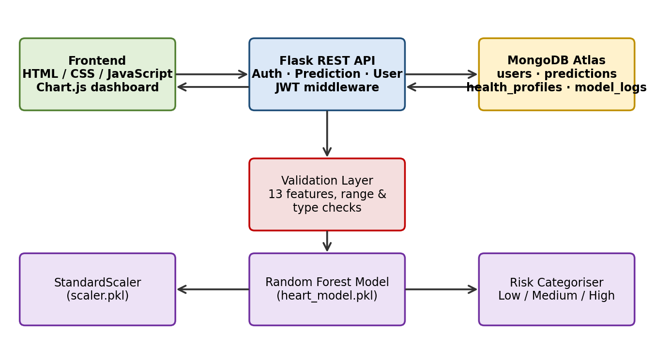
SYSTEM ARCHITECTURE
Fig 1: Three-tier architecture – Frontend, Flask API with ML engine, MongoDB Atlas

Slide 8
MODULES – BACKEND
Authentication: register, login, logout, /me; passwords hashed with Werkzeug; HS256 JWT tokens (24 h expiry).
Preprocessing: validates 13 features (type, integer / range checks) and fixes the feature order.
Predictor: loads heart_model.pkl and scaler.pkl, returns prediction, probability, risk level and top-5 factors.
Prediction API: POST /api/prediction/heart, GET /history, GET /<id>; records are scoped to the logged-in user.
User API: profile view and update; health check endpoint for monitoring.
Training scaffold: compares Logistic Regression, Random Forest and SVM using accuracy, precision, recall, F1 and ROC-AUC.

Slide 9
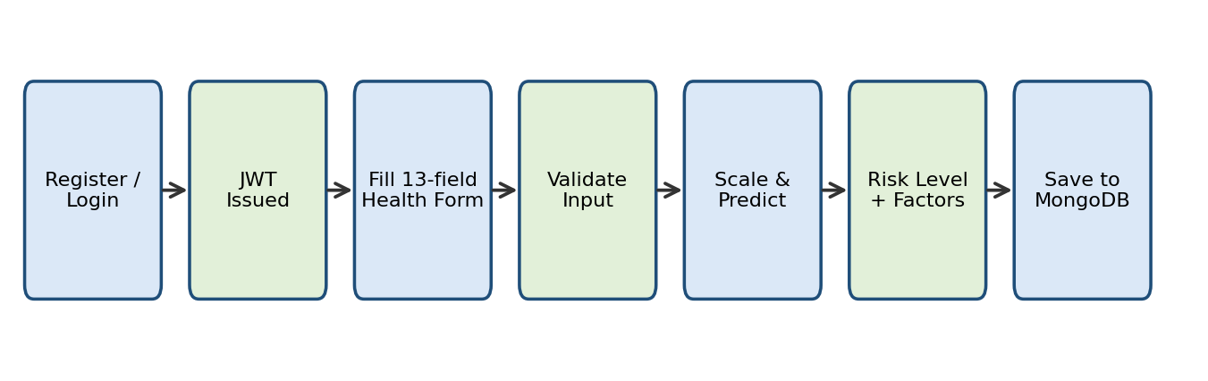
MODULES – FRONTEND & DB
Frontend: static HTML/CSS/JS pages – login, register, health form, results, history, dashboard with Chart.js doughnut.
MongoDB: users, predictions, health_profiles, model_logs; indexes on users.email and predictions(user_id, created_at).
Fig 2: End-to-end user workflow

Slide 10
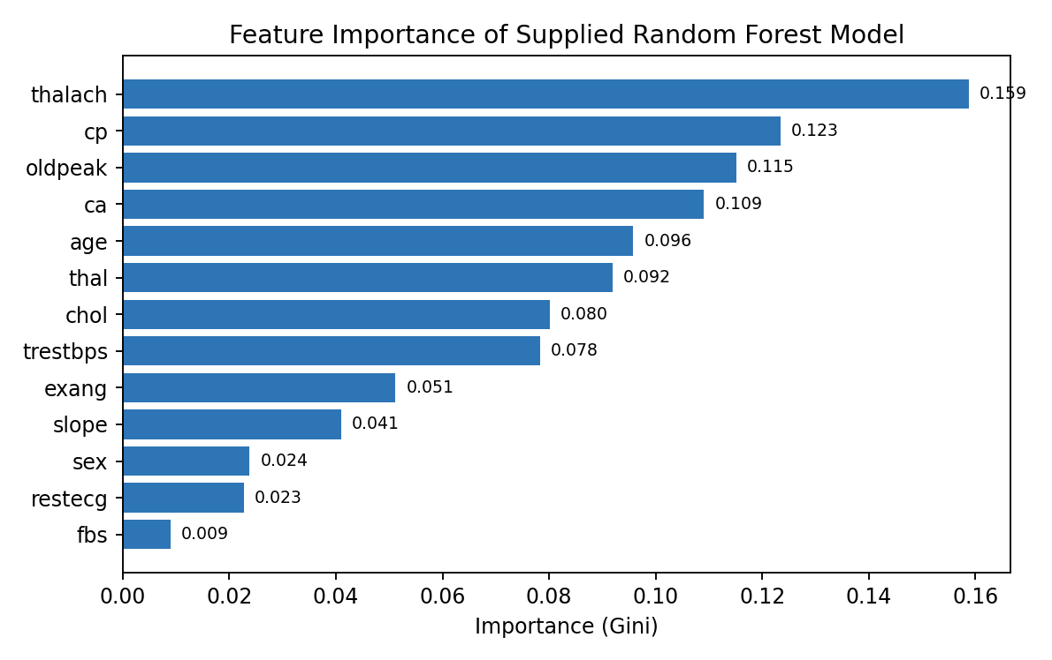
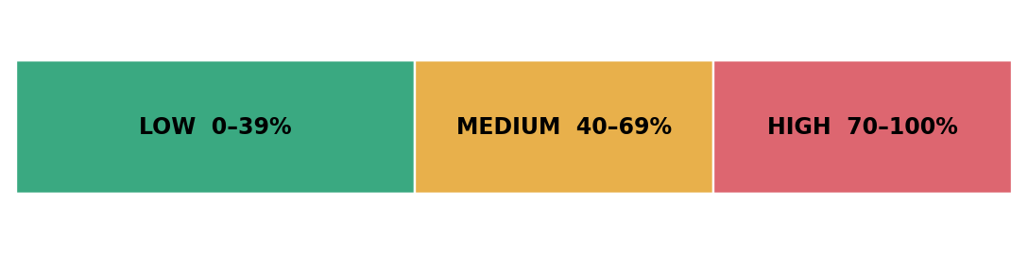
RESULTS AND DISCUSSIONS
Sample input (age 65, chol 300, 3.5 ST depression, 2 vessels) → probability 0.75 → HIGH risk.
Top factors: max heart rate, chest-pain type, ST depression, major vessels, age.
Validation: out-of-range or missing inputs are rejected with clear errors.
Note: no accuracy claim is made for the supplied model; metrics need a held-out dataset.
Fig 3: Feature importance (Random Forest, 100 trees)

Slide 11
CONCLUSION
A complete, secure heart-risk screening application was built around a pre-trained Random Forest model.
The system turns 13 clinical values into an understandable risk category and stores each assessment per user.
Modular layers (UI, API, ML engine, database) make testing and extension easy.
Future work: more disease modules, validated clinical evaluation, model monitoring and report export.
The output is an educational estimate, not a medical diagnosis.

Slide 12
REFERENCES
[1]. Ali, M.M. et al.: Heart disease prediction using supervised machine learning algorithms. Computers in Biology and Medicine 136, 104672 (2021).
[2]. Benjamin, E.J. et al.: Heart disease and stroke statistics – 2019 update. Circulation 139(10), e56–e528 (2019).
[3]. Breiman, L.: Random forests. Machine Learning 45(1), 5–32 (2001).
[4]. Chodorow, K.: MongoDB: The Definitive Guide, 3rd ed. O'Reilly Media (2019).
[5]. Detrano, R. et al.: International application of a new probability algorithm for the diagnosis of coronary artery disease. American Journal of Cardiology 64(5), 304–310 (1989).
[6]. Fielding, R.T.: Architectural styles and the design of network-based software architectures. PhD thesis, UC Irvine (2000).
[7]. Grinberg, M.: Flask Web Development, 2nd ed. O'Reilly Media (2018).
[8]. Hastie, T., Tibshirani, R., Friedman, J.: The Elements of Statistical Learning, 2nd ed. Springer (2009).
[9]. Jones, M., Bradley, J., Sakimura, N.: JSON Web Token (JWT). RFC 7519, IETF (2015).
[10]. Krittanawong, C. et al.: Machine learning prediction in cardiovascular diseases: a meta-analysis. Scientific Reports 10, 16057 (2020).
[11]. Mohan, S., Thirumalai, C., Srivastava, G.: Effective heart disease prediction using hybrid machine learning techniques. IEEE Access 7, 81542–81554 (2019).
[12]. Pedregosa, F. et al.: Scikit-learn: machine learning in Python. Journal of Machine Learning Research 12, 2825–2830 (2011).
[13]. Rajkomar, A., Dean, J., Kohane, I.: Machine learning in medicine. New England Journal of Medicine 380(14), 1347–1358 (2019).
[14]. Weng, S.F. et al.: Can machine-learning improve cardiovascular risk prediction using routine clinical data? PLoS ONE 12(4), e0174944 (2017).

Slide 13
THANK YOU
We thank God, Our Department, Guide, Panel Members, Supportive Professors and all Technical and non Technical staff who helped us in our Project.

