Slide 1

DATA BASE SYSTEMS PROJECT (ARMY DATABASE)
Submission Date-07 July 2022
Submitted to: Dr. DEBANJAN SADHYA
Submitted by :
MARAM VIGNESH

Slide 2
CONTENTS
Overview
ER Diagram
Assumptions
Entity Sets
Relationship Sets and Cardinality
Converting ER Diagram to Tables
Functional Dependencies
Decomposition(Using Normalisation)
Final Tables
Tables and Data
Queries in Relational Algebra
Queries in Structured Query Language
Conclusion

Slide 3
1.Overview
The Indian Army is the land-based branch and the largest component of the Indian Armed Forces. The primary mission of the Indian Army is to ensure national security and national unity, to defend the nation from external aggression and internal threats, and to maintain peace and security within its borders.This database is used for storing the details of soldiers,weapons they use,their biodata,armory. With the help of this database we can keep a track of availability of weapons,man power and hierarchy in Indian Army.

Slide 4
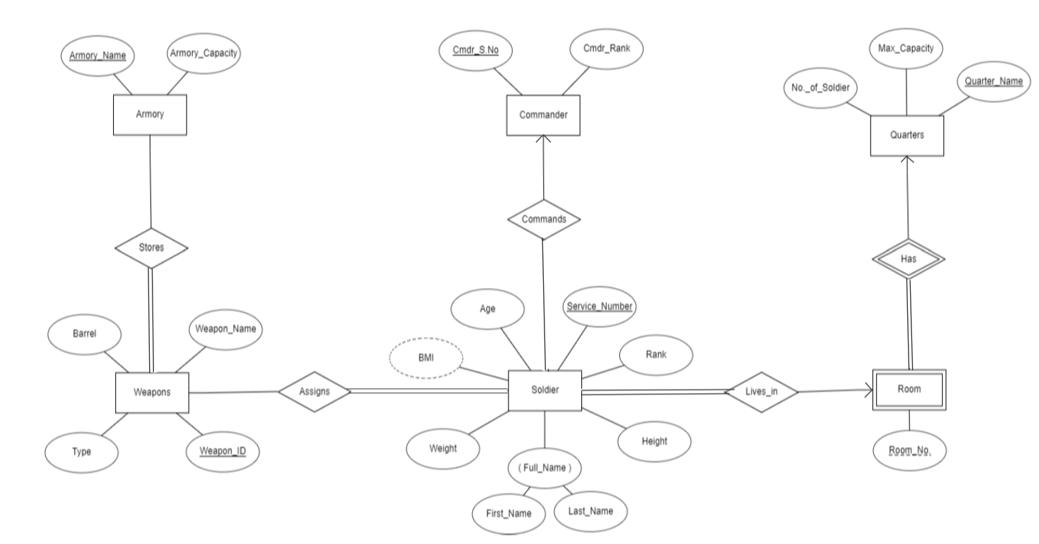
2.ER DIAGRAM

Slide 5
3.Assumptions
1)Many Soldiers can live in one room.
2)Soldiers are assigned weapons based upon their rank.
3)A group of soldiers is commanded by a single commander.
4)Assuming the rank of soldiers in the order(Highest to Lowest)
Field Marshal
Major
Colonel
Lieutenant
Sepoy
5)The soldier with higher rank can command the soldiers with immediate lower rank.

Slide 6
4.Entity Sets
Soldier
(Service_Number,Rank,First_Name,Last_Name,Age,Weight,Height,BMI)
Here Service_Number is the Primary key and BMI is the Derived Attribute.Remaining attributes gives us detailed information about the soldier.
Quarters
(Quarter_Name,Max_Capacity,No_of_Soldier)
Here Quarter_Name is the primary key.Remaining attributes gives us detailed information about the quarters and number of soldiers in the quarters.
Weapons
(Weapon_ID,Weapon_Name,Type,Barrel)
Here Weapon_ID is the primary key and other attributes gives detailed information about weapons.

Slide 7
Armory
(Armory_Name,Armory_Capacity)
Here Armory_Name is the primary key and Armory_Capacity gives us the maximum number of weapons it can store.
Commander
(Cmdr_S.No,Cmdr_Rank)
Here Cmdr_S.No is the primary key and Cmdr_Rank gives us the information about the commanders rank and service number.
Room(Weak Entity Set)
(Room_No.)
Here Room_No. is the partial key.

Slide 8
5.Relationship Sets and their Cardinality
Assigns
(Weapon_ID,Service_Number)
Assigns is a Many to Many relationship between Weapons and Soldier as multiple weapons can be assigned to a soldier and multiple soldiers can be assigned a same weapon.Here ‘Soldier’ entity set shows total participation as every soldier is assigned a weapon whereas weapons shows partial participation as all weapons are not assigned to soldiers.
Stores
(Weapon_ID,Armory_Name)
Stores is a Many to Many relationship between Armory and Weapons as multiple weapons can be stored in an armory and multiple armories can store the same weapon.Here ‘Weapons’ entity set shows total participation as every weapon is stored in some armory whereas Armory shows partial participation as all armories need not store weapons.

Slide 9
Lives_in
Lives_in is a Many to One relationship from Soldiers to Room as multiple soldiers can live in a single room but many rooms can not be assigned to a soldier.Here ‘Soldier’ entity set shows total participation as every soldier is alloted a room whereas ‘Room’ shows partial participation as all rooms need not be alloted to soldiers.
Commands
Commands is a Many to One relationship from Soldiers to Commander as multiple soldiers will have a single commander but multiple commanders can not command a single soldier.Here both ‘Soldier’ and ‘Commander’ entity sets shows partial participation because there is a Soldier whose Rank is Field Marshal who is not commanded by any soldier and all Commanders need not command a soldier.
Has
It is a Identifying Relationship between weak entity set Room and Strong Entity Set Quarters.

Slide 10
6.Converting ER Diagram to Tables
1)As Soldier is in Many to one relationship with both relationship sets ‘Commands’ and ‘Lives_in’ and total participation is on many side i.e.Soldier, so in the relationship set (‘Commands’) between ‘Soldier’ and ‘Commander’, the attribute ‘Cmdr_S_No’ will be included in Soldier as a foreign key and in the relationship set(‘Lives_in’) between ‘Soldier’ and ‘Room’ ,the attributes Quarter_Name and Room_No will be included in Soldier as foreign keys because ‘Room’ is a weak entity set.
Soldier(Service_Number,Quarter_Name,Room_No,Cmdr_S.No,Rank,First_Name,Last_Name,Age,Weight,Height,BMI)
2) Weapons is in many to many relation with Soldier,we get a new schema for the relationship set ‘Assigns’ which consists of attributes Service_Number and Weapon_ID which are primary keys of the involved entity sets.
Assigns(Service_Number,Weapon_ID)

Slide 11
3) Commander(Cmdr_S.No,Cmdr_Rank)
4) Quarters(Quarter_Name,Max_Capacity,No_of_Soldier)
5) Weapons(Weapon_ID,Weapon_Name,Type,Barrel)
6)Weapons is in many to many relationship with Armory,so we get a new schema
name‘Stores’ with attributes Armory_Name and Weapon_ID which are primary keys
of the involved entity sets.
Stores(Armory_Name,Weapon_ID)
7) Armory(Armory_Name,Armory_Capacity)
8)The entity set ‘Room’ is a weak entity set,while converting a weak entity set from ER diagram to schema we include the primary key of Identifying entity set(‘Quarters’) i.e.discriminator(‘Quarter_Name’),so the schema will be
Room(Quarter_Name,Room_No)
9)There is a Identifying relationship set ‘Has’ in the ER diagram but we don’t create a schema for it because it leads to redundancy.

Slide 12
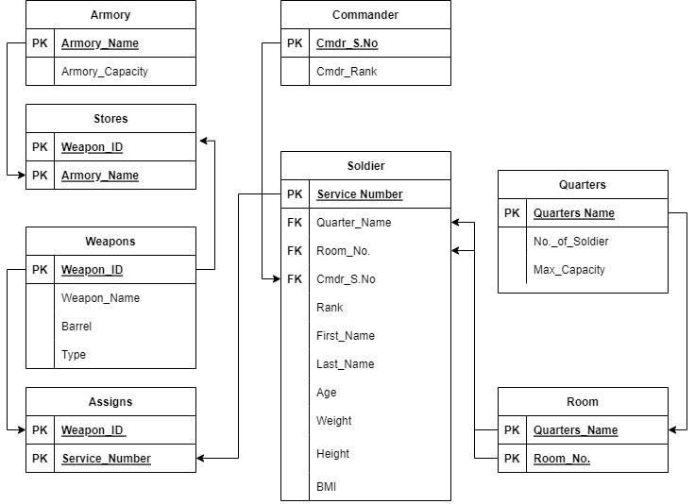

Slide 13
7.FUNCTIONAL DEPENDENCIES
SCHEMA | FUNCTIONAL DEPENDENCIES
Soldier | Height, Weight -> BMI Service_Number -> Quarter_Name, Room_No., Cmdr_S.No, Rank, First_Name, Last_Name, Height, Weight, BMI, Age
Commander | Cmdr_S.No -> Cmdr_Rank
Quarters | Quarters_Name -> No._of_Soldiers, Max_Capacity
Weapons | Weapon_Name -> Type Weapon_ID -> Weapon_Name, Type, Barrel
Armory | Armory_Name -> Armory_Capacity
Stores | -
Assigns | -
Room | -

Slide 14
8.DECOMPOSITION(Using Normalisation)
1)Soldier:
1NF:Since the attributes are atomic i.e., attributes can’t be divided into sub-attributes,
It is in 1NF.
2NF:Since there is no partial dependency,It is in 2NF.
3NF:Since there is a transitive dependency i.e.,
Service_Number -> Height, Weight
Height, Weight -> BMI
So, we need to split the Soldier relation into two separate relations i.e.,
R1 (Service_Number, Quarter_Name, Room_No., Cmdr_S.No, First_Name, Last_Name, Height, Weight, Age)
R2 (Height, Weight, BMI)
BCNF:
Since there is no non-prime attribute defining a prime attribute,
R1, R2 are in BCNF.
Now new Schemas are:
R1 = Soldier (Service_Number, Quarter_Name, Room_No., Cmdr_S.No, First_Name, Last_Name, Height, Weight, Age)
R2 = Biodata (Height, Weight, BMI)

Slide 15
2) Commander:
1NF:Since the attributes are atomic i.e., attributes can’t be divided into sub-attributes,It is in 1NF.
2NF:Since there is no partial dependency,It is in 2NF.
3NF:Since there is no transitive dependency,
It is in 3NF.
BCNF:
Since there is no non-prime attribute defining a prime attribute,
It is in BCNF.
3) Room:
1NF:Since the attributes are atomic i.e., attributes can’t be divided into sub-attributes,
It is in 1NF.
2NF:Since there is no partial dependency,
It is in 2NF.
3NF:Since there is no transitive dependency,
It is in 3NF.
BCNF:
Since there is no non-prime attribute defining a prime attribute,
It is in BCNF.

Slide 16
4)Quarters:
1NF:
Since the attributes are atomic i.e., attributes can’t be divided into sub-attributes,
It is in 1NF.
2NF:
Since there is no partial dependency,
It is in 2NF.
3NF:
Since there is no transitive dependency,
It is in 3NF.
BCNF:
Since there is no non-prime attribute defining a prime attribute,
It is in BCNF.

Slide 17
5)Weapons:
1NF:Since the attributes are atomic i.e., attributes can’t be divided into sub-attributes,
It is in 1NF.
2NF:Since there is no partial dependency,
It is in 2NF.
3NF:Since there is a transitive dependency i.e.,
Weapon_ID -> Weapon_Name
Weapon_Name -> Type
So, we need to split the Weapons relation into two separate relations i.e.,
R3 (Weapon_ID, Weapon_Name, Barrel)
R4 (Weapon_Name, Type)
BCNF:
Since there is no non-prime attribute defining a prime attribute,
R3, R4 are in BCNF.
Naming New Schemas:
R3 = Weapons (Weapon_ID, Weapon_Name, Barrel)
R4 = Weapon_Type (Weapon_Name, Type)

Slide 18
9.FINAL TABLES
1. Soldier (Service_Number, Quarter_Name, Room_No., Cmdr_S.No, Rank, First_Name, Last_Name, Height, Weight, Age)
2. Biodata (Height, Weight, BMI)
3. Commander (Cmdr_S.No, Cmdr_Rank)
4. Quarters (Quarter_Name, Max_Capacity, No._of_Soldiers)
5. Room (Quarter_Name, Room_No.)
6. Weapons (Weapon_ID, Weapon_Name, Barrel)
7. Armory (Armory_Name, Armory_Capacity)
8. Weapon_Type (Weapon_Name, Type)
9. Stores (Armory_Name, Weapon_ID)
10. Assigns (Service_Number, Weapon_ID)

Slide 19
10.FINAL TABLES CREATING AND INSERTING DATA INTO TABLES
Creating a Database named Army
group: Army
1)Creating and Inserting data in Soldier Table
Soldier = {
Service_Number, Quarter_Name, Room_No, Cmdr_SNo, Rank, First_Name, Last_Name, Age, Weight, Height
'C3497213', 'Q3', 101, 'M1378861', 'Colonel', 'Sanjay', 'Kumar', 40, 70, 176
'L7231291', 'Q2', 101, 'C7193499', 'Lieutenant', 'Vikram', 'Sharma', 28, 60, 162
'S3432197', 'Q1', 101, 'L7231291', 'Sepoy', 'Kuldeep', 'Singh', 21, 60, 165
'S1734321', 'Q1', 102, 'L3765421', 'Sepoy', 'Saurabh', 'Kalia', 21, 62, 172
'L3765421', 'Q2', 102, 'C3497213', 'Lieutenant', 'Sandeep', 'Unnikrishnan', 28, 65, 178
'C7193499', 'Q3', 102, 'M1378861', 'Colonel', 'Jaswant', 'Singh', 38, 61, 170
'S7776779', 'Q1', 201, 'L7231291', 'Sepoy', 'Mohammed', 'Usman', 21, 56, 172
'F7893421', 'Q4', 101, 'NULL', 'Field Marshal', 'Karam', 'Singh', 50, 63, 168
'M1378861', 'Q4', 102, 'F7893421', 'Major', 'Manoj', 'Patil', 45, 64, 179
'S3366143', 'Q1', 202, 'L3765421', 'Sepoy', 'Vivek', 'Gupta', 20, 61, 176
}

Slide 20
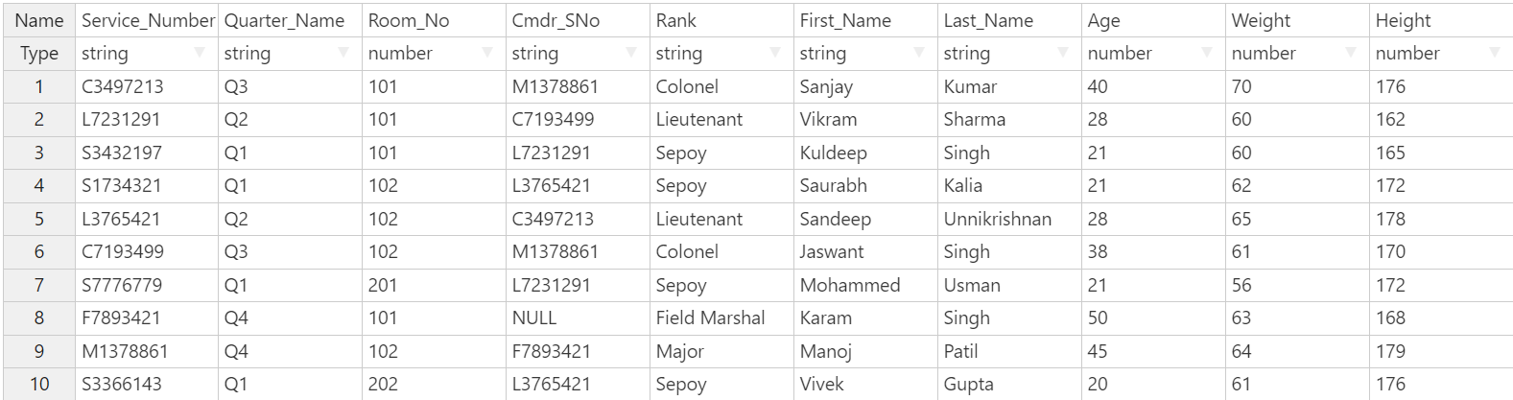
Soldier

Slide 21
2) Creating and Inserting data in Weapons Table
Weapons = {
Weapon_ID, Weapon_Name, Barrel
'H107', 'Pistol Auto 1A', 'Normal'
'H108', 'Pistol Auto 1A', 'Silenced'
'H109', 'Glock', 'Normal'
'G999', 'MMHG', 'NULL'
'S100', 'Heckler', 'Unchromed'
'S101', 'Heckler', 'Chromed'
'S123', 'Brugger', 'Unchromed'
'S129', 'Carbine', 'Unchromed'
'A211', 'SIG 716i', 'Short'
'A212', 'SIG 716i', 'Long'
'A277', 'Vz.58', 'Normal'
'R711', 'Dragunav SVD', 'Savage'
'R712', 'Dragunav SVD', 'Sako'
'R727', 'AWM', 'Savage'
'M555', 'M2 Browning', 'Normal'
}

Slide 22
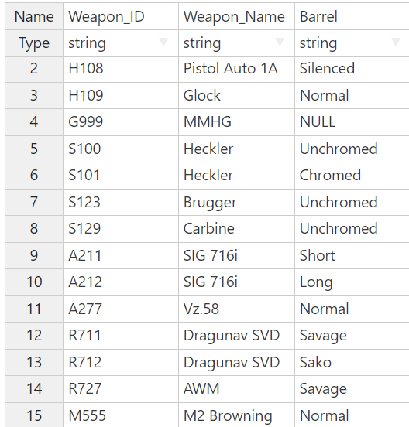
Weapons

Slide 23
3) Creating and Inserting data in Weapon_Type Table
Weapon_Type = {
Weapon_Name, Barrel, Type
'Pistol Auto 1A', 'Normal', 'Semi-Automatic Pistol'
'Pistol Auto 1A', 'Silenced', 'Semi-Automatic Pistol'
'Glock', 'Normal', 'Semi-Automatic Pistol'
'MMHG', 'NULL', 'Grenade'
'Heckler', 'Unchromed', 'SMG’s'
'Heckler', 'Chromed', 'SMG’s'
'Brugger', 'Unchromed', 'SMG’s'
'Carbine', 'Unchromed', 'SMG’s'
'SIG 716i', 'Short', 'Assault Rifles'
'SIG 716i', 'Long', 'Assault Rifles'
'Vz.58', 'Normal', 'Assault Rifles'
'Dragunav SVD', 'Savage', 'Sniper Rifles'
'Dragunav SVD', 'Sako', 'Sniper Rifles'
'AWM', 'Savage', 'Sniper Rifles'
'M2 Browning', 'Normal', 'Machine Gun'
}

Slide 24
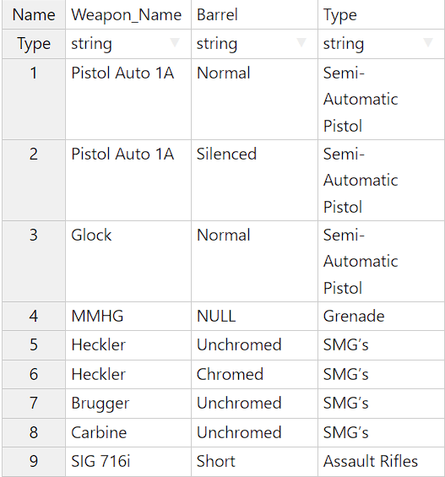
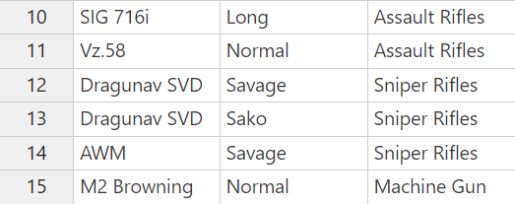
Weapon_Type

Slide 25
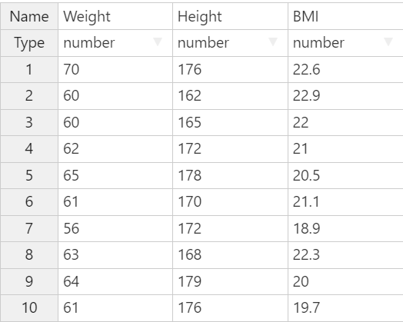
4)Creating and Inserting data in Biodata Table
Biodata= {
Weight, Height, BMI
70, 176, 22.6
60, 162, 22.9
60, 165, 22
62, 172, 21
65, 178, 20.5
61, 170, 21.1
56, 172, 18.9
63, 168, 22.3
64, 179, 20
61, 176, 19.7
}
Biodata

Slide 26
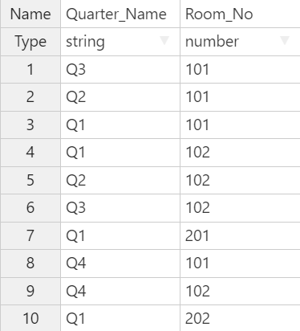
5)Creating and Inserting data in Room Table
Room = {
Quarter_Name, Room_No
'Q3', 101
'Q2', 101
'Q1', 101
'Q1', 102
'Q2', 102
'Q3', 102
'Q1', 201
'Q4', 101
'Q4', 102
'Q1', 202
}
Room

Slide 27
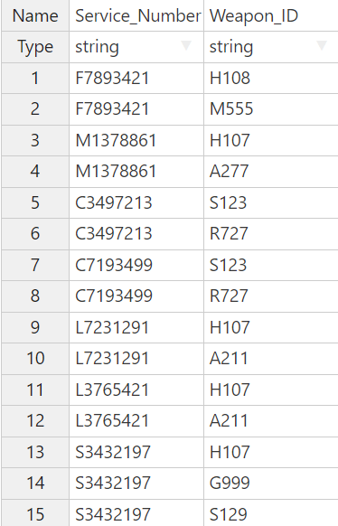
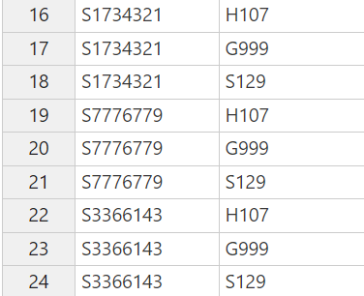
Assigns
6)Creating and Inserting data in Assigns Table
Assigns = {
Service_Number, Weapon_ID
'F7893421', 'H108'
'F7893421', 'M555'
'M1378861', 'H107'
'M1378861', 'A277'
'C3497213', 'S123'
'C3497213', 'R727'
'C7193499', 'S123'
'C7193499', 'R727'
'L7231291', 'H107'
'L7231291', 'A211'
'L3765421', 'H107'
'L3765421', 'A211'
'S3432197', 'H107'
'S3432197', 'G999'
'S3432197', 'S129'
'S1734321', 'H107'
'S1734321', 'G999'
'S1734321', 'S129'
'S7776779', 'H107'
'S7776779', 'G999'
'S7776779', 'S129'
'S3366143', 'H107'
'S3366143', 'G999'
'S3366143', 'S129'
}

Slide 28
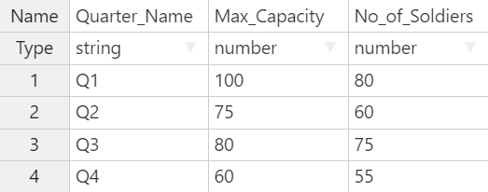
7)Creating and Inserting data in Quarters Table
Quarters = {
Quarter_Name, Max_Capacity, No_of_Soldiers
'Q1', 100, 80
'Q2', 75, 60
'Q3', 80, 75
'Q4', 60, 55
}
Quarters

Slide 29
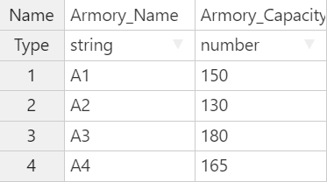
8)Creating and Inserting data in Armory Table
Armory = {
Armory_Name, Armory_Capacity
'A1', 150
'A2', 130
'A3', 180
'A4', 165
}
Armory

Slide 30
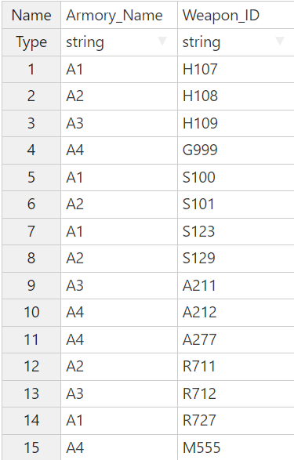
Stores
9)Creating and Inserting data in Stores Table
Stores = {
Armory_Name, Weapon_Id
'A1', 'H107'
'A2', 'H108'
'A3', 'H109'
'A4', 'G999'
'A1', 'S100'
'A2', 'S101'
'A1', 'S123'
'A2', 'S129'
'A3', 'A211'
'A4', 'A212'
'A4', 'A277'
'A2', 'R711'
'A3', 'R712'
'A1', 'R727'
'A4', 'M555'
}

Slide 31
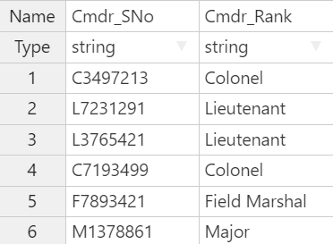
10)Creating and Inserting data in Commander Table
Commander = {
Cmdr_SNo, Cmdr_Rank
'C3497213', 'Colonel'
'L7231291', 'Lieutenant'
'L3765421', 'Lieutenant'
'C7193499', 'Colonel'
'F7893421', 'Field Marshal'
'M1378861', 'Major'
}
Commander

Slide 32
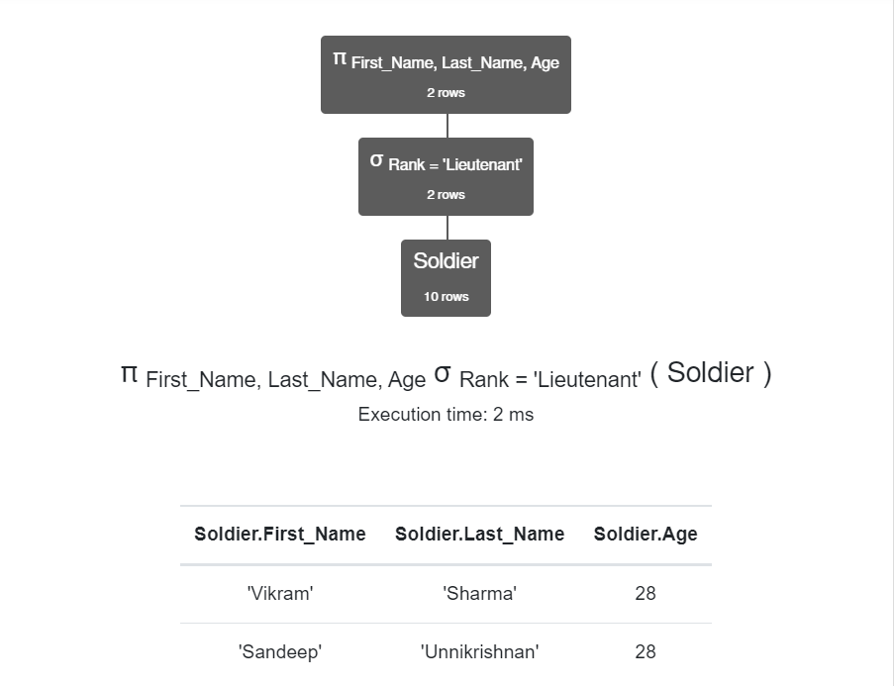
11.QUERIES IN RELATIONAL ALGEBRA
1)Find the full name and age of the soldiers who are of rank 'Lieutenant‘
π _{<First_Name, Last_Name, Age>} σ _{Rank = 'Lieutenant'} (Soldier)

Slide 33
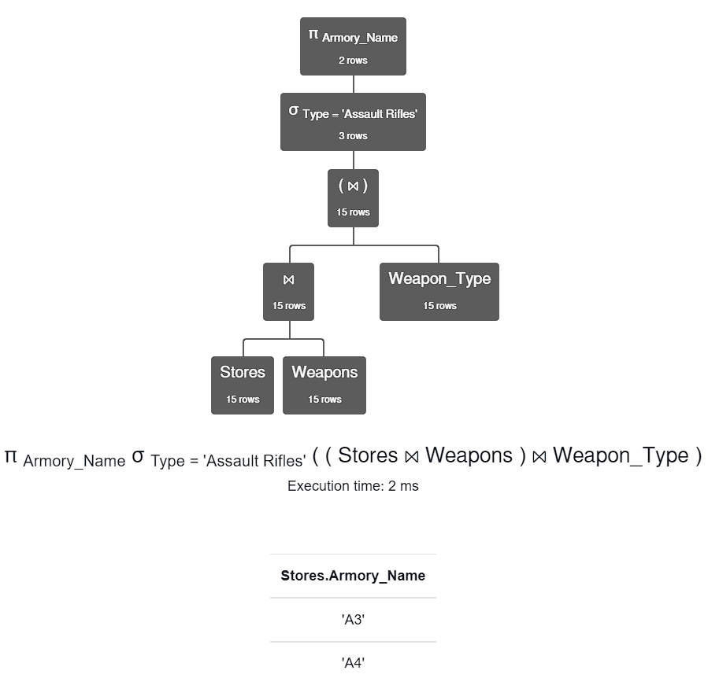
2)Find the names of the armories having the weapon of type 'Assault Rifles'
π _{<Armory_Name>} σ _{Type = 'Assault Rifles'} (Stores ⨝ Weapons ⨝ Weapon_Type)

Slide 34
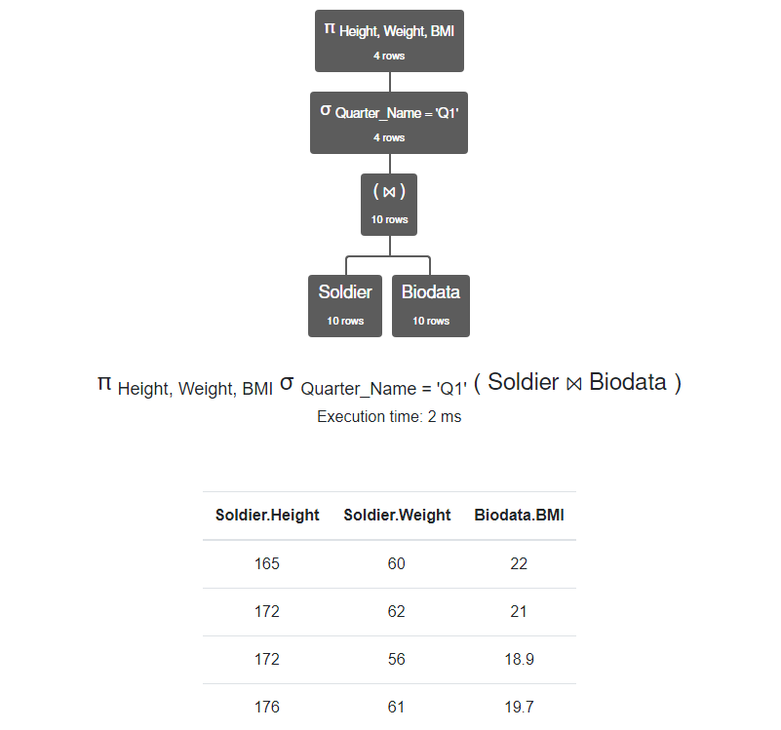
3) Find the biodata of the soldiers who live in Q1
π _{<Height, Weight, BMI>} σ _{Quarter_Name ='Q1'} (Soldier ⨝ Biodata)

Slide 35
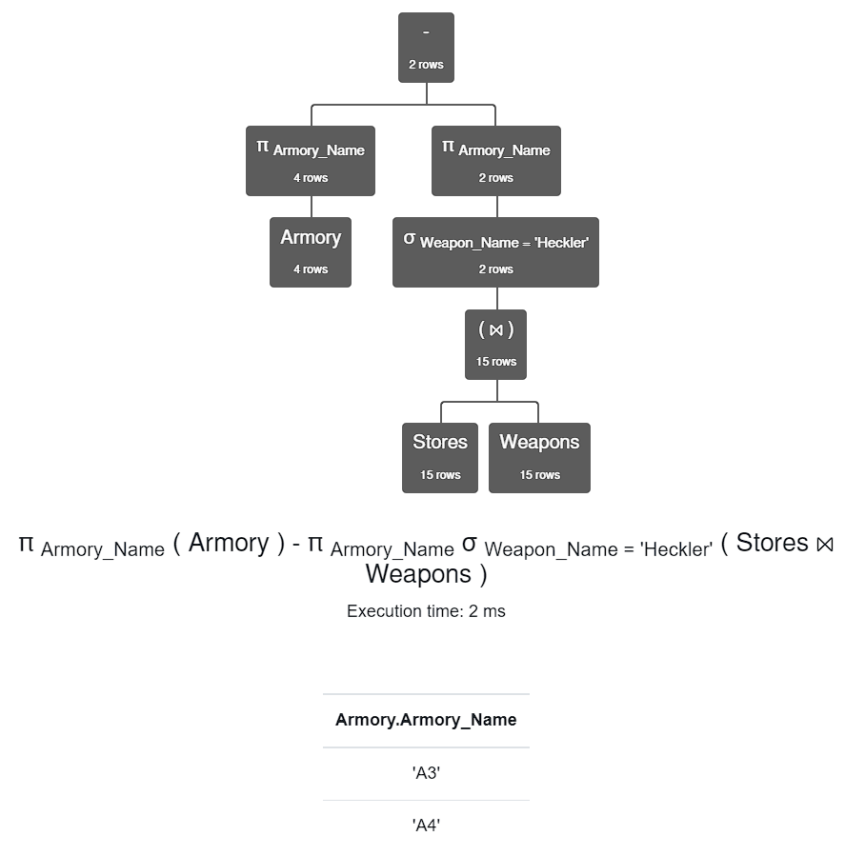
4) Find the names of the armories that do not contain the weapon 'Heckler'
π _{Armory_Name} (Armory) - π _{Armory_Name} σ _{Weapon_Name = 'Heckler'} (Stores ⨝ Weapons)

Slide 36
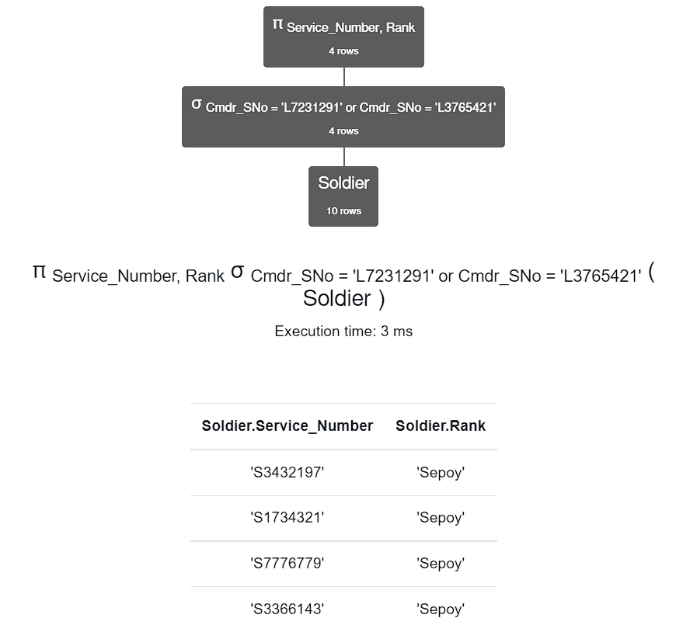
5) Find the service number and rank of the soldiers who are under commanders whose S.Nos are ‘L7231291’ or ‘L3765421’
π _{<Service_Number, Rank>} σ _{Cmdr_SNo = 'L7231291'} ∨ _{Cmdr_SNo = 'L3765421'} (Soldier)

Slide 37
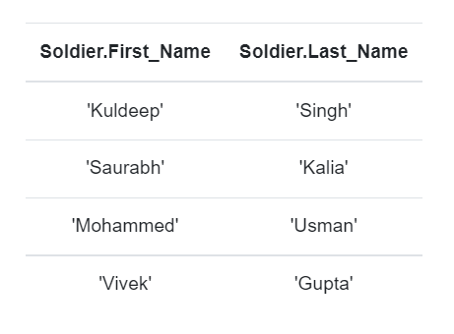
12.QUERIES IN STRUCTURED QUERY LANGUAGE(SQL)
Find the names of the soldiers who can use the gun 'Carbine‘
QUERY:
select First_Name, Last_Name
from Soldier natural join Assigns natural join Weapons
where Weapon_Name = 'Carbine';

Slide 38
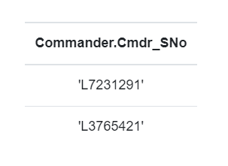
2) Find the Cmdr_SNo of the commander who commands the soldiers who live in Quarter ‘Q1’
QUERY:
select Cmdr_SNo
from Commander natural join Soldier
where Quarter_Name = 'Q1‘;

Slide 39
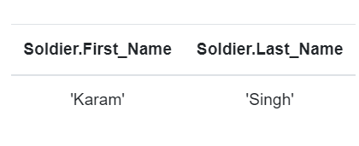
3) Find the names of the soldiers who are not 'Sepoy' and uses a silenced weapon
QUERY:
(select First_Name, Last_Name
from Soldier natural join Assigns natural join Weapons
where Barrel='Silenced') except (select First_Name,Last_Name
from Soldier
where Rank='Sepoy');

Slide 40
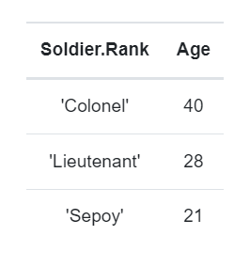
4)Find the age of the oldest soldiers of the ranks ‘Sepoy’, 'Lieutenant' and 'Colonel‘
QUERY:
select Rank, max(Age) as Age
from Soldier
group by Rank
having Rank = 'Colonel' or Rank = 'Lieutenant' or Rank = 'Sepoy‘;

Slide 41
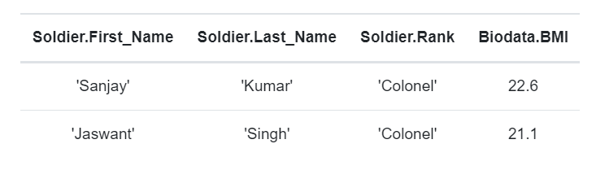
5)Find the full name, rank and BMI of the soldiers whose service number starts with ‘C’
QUERY:
select First_Name, Last_Name, Rank, BMI
from Soldier natural join Biodata
where Service_Number like 'C%‘;

Slide 42
13.CONCLUSION
To Summarise this is the Army Database which gives information about Soldiers in the army,weapons used by them and many more.This will help them to track the availability of weapons,number of soldiers in the quarters etc.
THANK YOU

