Slide 1


St. Joseph’s College of Engineering Department of C S E
Batch : 2017 – 2021
Project Review 2

Slide 2
Candidate Details:
 | Candidate I: | Candidate II:
Name: | SURIYAA V | VIGNESH K G
Register number: | 312317104168 | 312317104173
Guided by: | Dr. PARVARTHAVARTHINI, M.E.,M.B.A.,Ph.D, Dean ( Research ) Department of Computer Science and Engineering
Domain | Web Security, Machine Learning
Proposed Title: | Detection of Phishing website using Extreme Gradient Boost Algorithm
Review 2
2

Slide 3
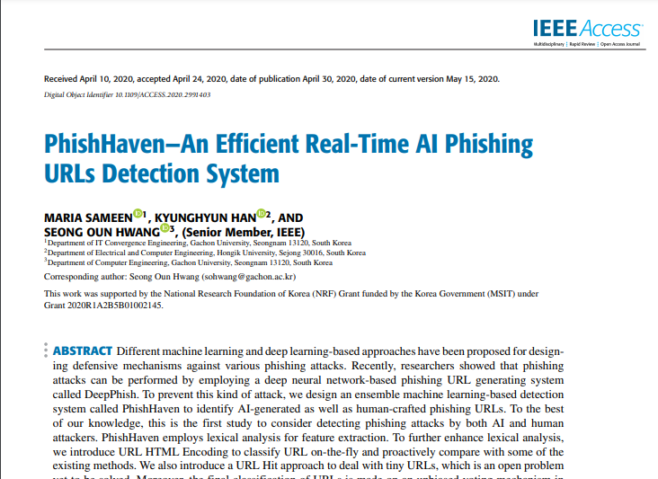
Base Paper:
TITLE: PhishHaven - An Efficient Real-Time AI Phishing URLs Detection System
Authors: Maria Sameen, Kyunghyun Han and Seong Oun Hwang
Publication: IEEE Access (Vol. 8), 30 April 2020

Slide 4
Proposed title:
Detection of Phishing website using Extreme Gradient Boost Algorithm
Base paper title:
PhishHaven - An Efficient Real-Time AI Phishing URLs Detection System

Slide 5
Literature Survey (1):
Paper details | Concepts/ Findings / Observations Technique/ Idea used | Pros and Cons
S. Marchal, K. Saari, N. Singh, and N. Asokan, ``Know your phish: Novel techniques for detecting phishing sites and their targets,‘’ in Proc. IEEE 36th Int. Conf. Distrib. Comput. Syst. (ICDCS), Jun. 2016, pp. 323333. | They proposed a scalable and language independent phishing website detection method. In terms of URL and HTML, 212 features were chosen and Gradient Boosting was used to detect phishing websites and produced a high accuracy. Phishing detection based on the combined features majorly represents the website, hence, the detection effect is better. However, it is required to download a webpage or gather data from a third-party website, and few issues persist there, particularly, that the feature extraction is arduous, and real-time detection cannot be fulfilled. | Pros: Phishing detection based on the combined features more fully represents the website, and therefore, the detection effect is better. Cons: Necessary to download a webpage or obtain data from a third-party website. Feature extraction is complicated. Real-time detection cannot be satisfied.

Slide 6
Literature Survey (2):
Paper details | Concepts/ Findings / Observations Technique/ Idea used | Pros and Cons
Ozgur Koray Sahingoz, Saide Işilay Baykal and Deniz Bulut, “ Phishing Detection from URLs by using Neural Networks”, International Conference on Computer Science engineering and Applications, 2018 | In the paper “Phishing Detection from URLs by using Neural Networks” [9], two classification methods specifically Artificial Neural Network and Deep Neural Network are considered. An overall of 27 features are taken comprising of length of URL and subdomain number. 10-fold cross validation was employed where original dataset was split into 10 parts. In Artificial Neural Network, one hidden layer framework was used. The accuracy achieved using this classification algorithm is 91%. | Pros: The accuracy achieved using this classification algorithm is 91%. Cons: Artificial neural network training time will take long.

Slide 7
Literature Survey (3):
Paper details | Concepts/ Findings / Observations Technique/ Idea used | Pros and Cons
PENG YANG, GUANGZHEN ZHAO , AND PENG ZENG “Phishing Website Detection Based on Multidimensional Features Driven by Deep Learning”, IEE Access ( Volume 7 ), Date of publication January 11, 2019, | They proposed a multidimensional feature phishing detection approach based on a fast detection method by using deep learning. In the first step, character sequence features of the given URL are extracted and used for quick classification by deep learning. In the second step, we combine URL statistical features, webpage code features, webpage text features, and the quick classification result of deep learning into multidimensional features. | Pros: Detection accuracy of 98% . Both character sequence and URL features were used. Cons: They used both CNN and XG boost which takes long time to predict.

Slide 8
Literature Survey (4):
Paper details | Concepts/ Findings / Observations Technique/ Idea used | Pros and Cons
M. Zouina and B. Outtaj, ”A novel lightweight URL phishing detection system using SVM and similarity index”, Hum.-Centric Comput. Inf. Sci., vol. 7, no. 1, p. 17, Jun. 2017. | The Approach utilised only six URL features respectively, the URL size, the number of hyphens, the number of dots, the number of numeric characters plus a discrete variable that corresponds to the existence of an IP address in the URL, and the similarity index. The features extracted are completely based on URLs, and because of their low features, the detection speed is swift. Anyhow, the amount of experimental data was relatively small. | Pros: Detection speed is fast. Cons: The amount of experimental data was relatively small. Very less features.

Slide 9
Literature Survey (5):
Paper details | Concepts/ Findings / Observations Technique/ Idea used | Pros and Cons
G. Xiang, J. Hong, C. P. Rose, and L. Cranor, ”CANTINAC: A feature rich machine learning framework for detecting phishing Web sites”, ACM Trans. Inf. Syst. Secur., vol. 14, no. 2, p. 21, Sep. 2011. | Xiang et al. [19] conferred the CANTINAC phishing website detection framework based on CANTINA. The method used highly identical phishing websites and webpages, Left out login forms and then extracted 15 highly differentiated features from URL vocabulary, HTML DOM, WHOIS information and search engine information, thus implementing phishing website prediction using a machine learning algorithm. | Pros: Less time consuming No computation overhead since only less features are used. Cons: Missed out other important features to classify websites.

Slide 10
Literature Survey (6):
Paper details | Concepts/ Findings / Observations Technique/ Idea used | Pros and Cons
Waleed Ali ” Phishing Website Detection based on Supervised Machine Learning with Wrappers Features Selection”, IJACSA (International Journal of Advanced Computer Science and Applications, Vol. 8 No. 9, Issue:2017 | The method employed is Wrappers Feature Selection that adopts a classifier to predict significant features in Predicting phishing websites. The primary idea is to eliminate redundant features by training the classifier. For each features subset, a score is accredited depending on classification error rate of model. The small dataset is divided into ‘n’ equal datasets and the model is trained using remaining datasets. This process is repeated n times. The final accuracy achieved is the average of n-accuracies obtained after running the classifier model n times. | Pros: It provides most important features used for Classifier Improves the performance of phishing website detection. Cons: It is more time-consuming. Involves extra computational overhead.

Slide 11
Literature Survey (7):
Paper details | Concepts/ Findings / Observations Technique/ Idea used | Pros and Cons
Suleiman Y. Yerima and Mohammed K. Alzaylaee, ” High Accuracy Phishing Detection Based on Convolutional Neural Networks”, 2020 3rd International Conference on Computer Applications & Information Security (ICCAIS). | The proposed approach utilizes convolutional neural networks (CNN) for high accuracy classification to distinguish genuine sites from phishing sites. Based on the results of extensive experiments, CNN based models proved to be highly effective in detecting unknown phishing sites. Furthermore, the CNN based approach performed better than traditional machine learning classifiers evaluated on the same dataset. | PROS: Little dependence on pre processing. easy to understand and fast to implement. CONS: CNN works well on images, speech where feature engineering is tricky and takes lot of effort. Deep learning approach is slower compared to non-deep learning in processing limited data.

Slide 12
Literature Survey (8):
Paper details | Concepts/ Findings / Observations Technique/ Idea used | Pros and Cons
Shraddha Parekh, Dhwanil Parikh , Srushti Kotak , Prof. Smita Sankhe, ” A New Method for Detection of Phishing Websites: URL Detection”, IEE Second International Conference on Inventive Communication and Computational Technologies (ICICCT), 20-21 April 2018 | The primary focus of this paper is to put forth a model as a solution to detect phishing websites by using the URL detection method using Random Forest algorithm. There are 3 major phases such as Parsing, Heuristic Classification of data, Performance Analysis in this model and each phase makes use of a different technique or algorithm for processing of data to give better results. | PROS: Lower risk of overfitting. Works well with non-linear data. CONS: Random forests are found to be biased while dealing with categorical variables. Not suitable for linear methods with a lot of sparse features

Slide 13
Existing system
There are lot of phishing website detection approach that utilizes only the URL features of the website to build detection models.
With those URL features, they combined Convolutional Neural Networks (CNN) and Recurrent Neural Networks (RNN) to build the detection system.
In some cases, URL or character sequence features has been extracted from CNN and fed along with webpage features into the other traditional classification algorithm for detection purpose ( Hybrid models ).
Also, there are some phishing website detection whose features that are categorized into four types (URL Based, Domain Based, Type Based and Word Based features) and then used simple classification algorithms like Decision Tree Classifier, Random Forest, Support Vector Machines, etc.

Slide 14
Disadvantages of the existing system:
An URL cannot be classified as phishing or valid based upon only address bar features or URL text features.
Deep Learning approach as CNN always outperform supervised algorithms on large datasets, but when it comes to small-medium and structured datasets, supervised classification algorithms tend to produce good results in quick time.
The main limitation of random forest is that a large number of trees can make the algorithm too slow and ineffective for real-time predictions.
All the existing systems either lack in number of categories of features or by selected algorithms for prediction of phishing websites.

Slide 15
Proposed system:
In our proposed system, Extreme Gradient Boosting Algorithm is used for classification of phishing websites.
Apart from that, four categories of features will be used:
Address Bar Based Features ( 11 features )
Abnormal Based Features ( 6 features )
HTML and JavaScript based Features ( 4 features )
Domain based Features ( 5 features )
A total of 26 features will be taken into account for classification.
All the features value take one among the set {1,0,-1} where,
1 - Valid or Legitimate
0 - Suspicious
-1 - Phishing

Slide 16
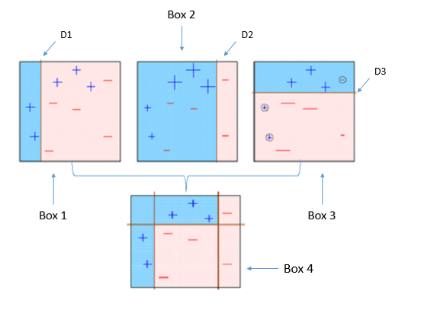
Proposed system:
EXTREME GRADIENT BOOST
XG Boost belongs to a family of boosting algorithms
that convert weak learners into strong learners.
Boosting is an ensemble technique where new models
are added to correct the errors made by existing models.
Gradient boosting is an approach where new models are created that predict the residuals or errors of prior models and then added together to make the final prediction.
It is called gradient boosting because it uses a gradient descent algorithm to minimize the loss when adding new models.

Slide 17
Advantages of Proposed system:
Our system uses both URL text features and webpage content features in order to classify the given URL.
Extreme Gradient Boost have the following advantages
Parallel Computing - Uses all the cores in the CPU
Tree Pruning - grown up to max_depth and then prunes backward
Regularization - to avoid over fitting in tree-based models
Enabled Cross Validation - have internal CV function
Missing Values - handles missing values internally
XG Boost is really fast when compared to other implementations of gradient boosting and therefore it can be used to avoid delay in prediction.

Slide 18
System requirements
Hardware requirement:
4GB RAM
512GB HDD
4+ cores
Software Requirement:
Python 3.5+
Libraries Used: Scikit-Learn API, Whois, Pandas, Bs4.
Data set Source :
UCI Machine Learning Repository:
https://archive.ics.uci.edu/ml/datasets/phishing+websites

Slide 19

Architecture diagram:
User
XG
PHISHING
OR
VALID URL
Input URL
URL FEATURE EXTRACTION
XG BOOST CLASSIFIER
ADDRESS BAR
ABNORMAL
DOMAIN BASED
HTML JS BASED
IP address
Long URL
Having @
Redirection
…….
Request URL
URL Anchor
<Meta>
<Script> links
……..
Domain Age
DNS Record
Web Traffic
Google Index
Stats Reports
Forwarding
Status Bar
Right Click
iframe Redirect

Slide 20
System flow:
ST
ST
Start
End
Get URL from User
Phishing
Or
Valid URL
Feature Vector
Address Bar
Abnormal Based
Trained Model
[0,0,-1,1,1…….1]
HTML JS
Domain
26 Columns
XG BOOST

Slide 21
Modules:
Address Bar Feature Extraction
Abnormal Feature Extraction
HTML and JS Feature Extraction
Domain Based Feature Extraction

Slide 22
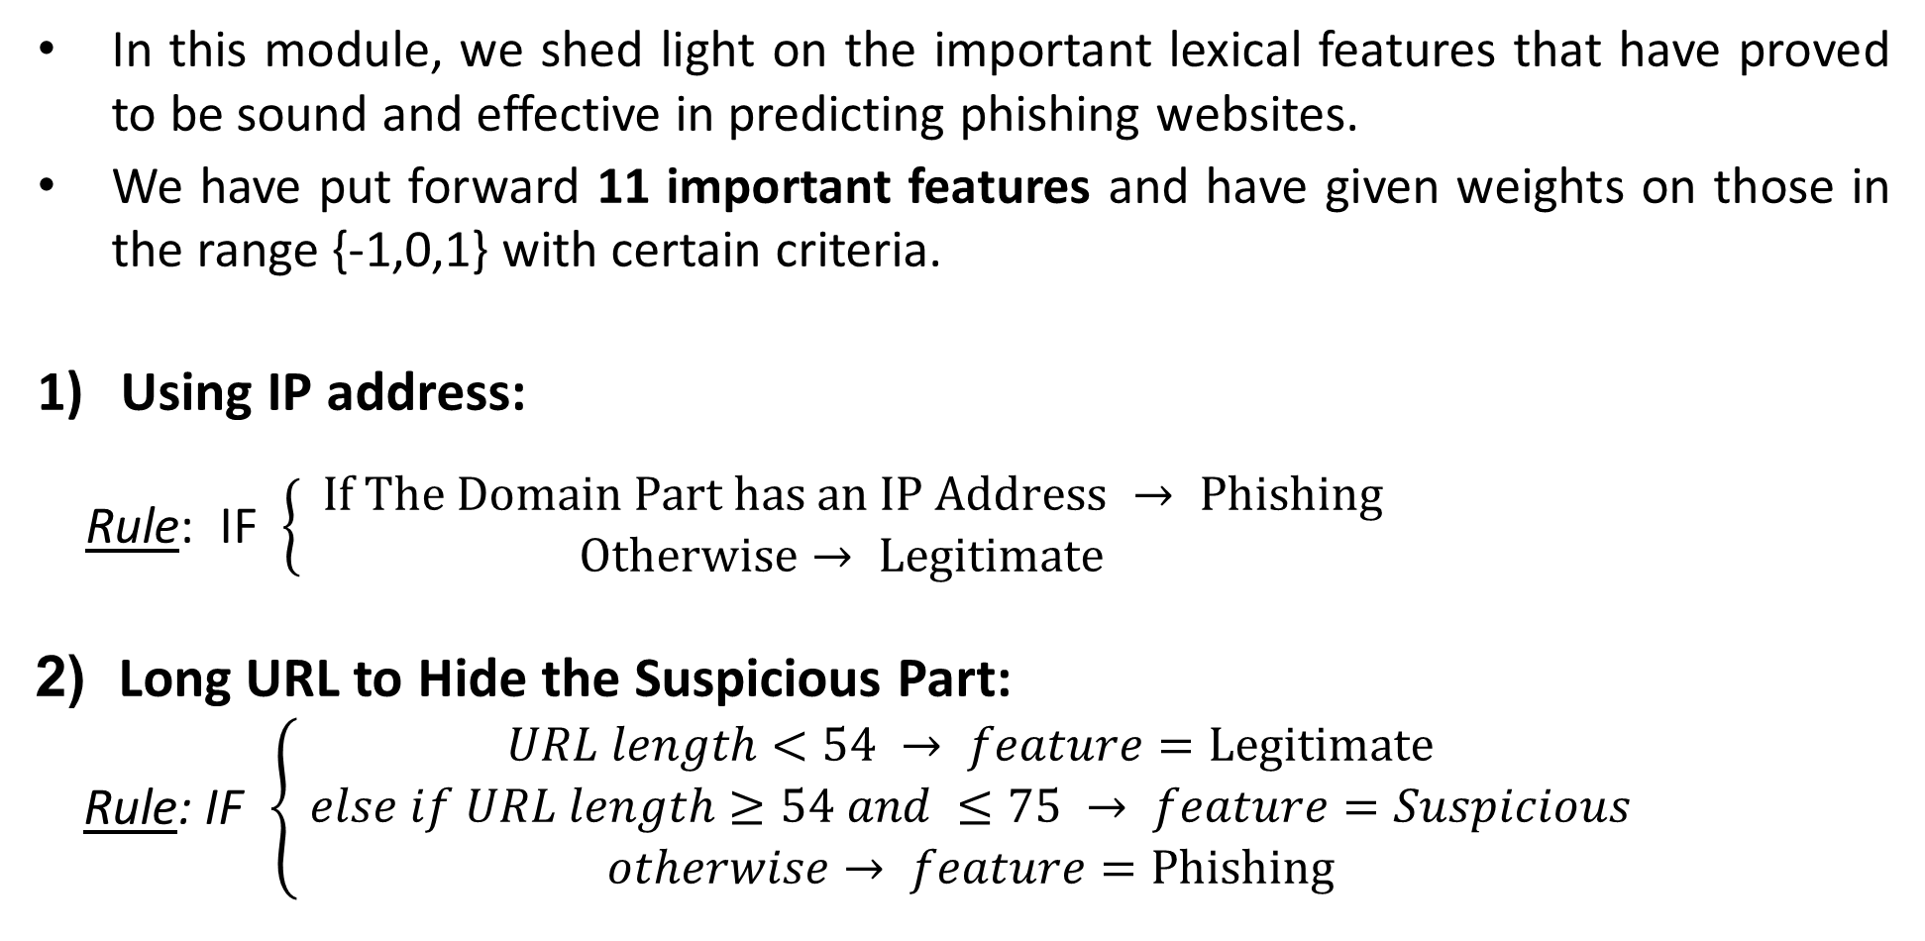
Module name : Address Bar Feature Extraction
In this module, we shed light on the important lexical features that have proved to be sound and effective in predicting phishing websites.
We have put forward 11 important features and have given weights on those in the range {-1,0,1} with certain criteria.
Using IP address:
Rule: IF $\left\{\begin{aligned} If The Domain Part has an IP Address → Phishing \\ Otherwise→ Legitimate\end{aligned}\right.$
2) Long URL to Hide the Suspicious Part:
Rule: IF $\left\{\begin{aligned}URL length<54 → feature=Legitimate \\ else if URL length≥54 and ≤75 → feature=Suspicious \\ otherwise→ feature=Phishing\end{aligned}\right.$

Slide 23
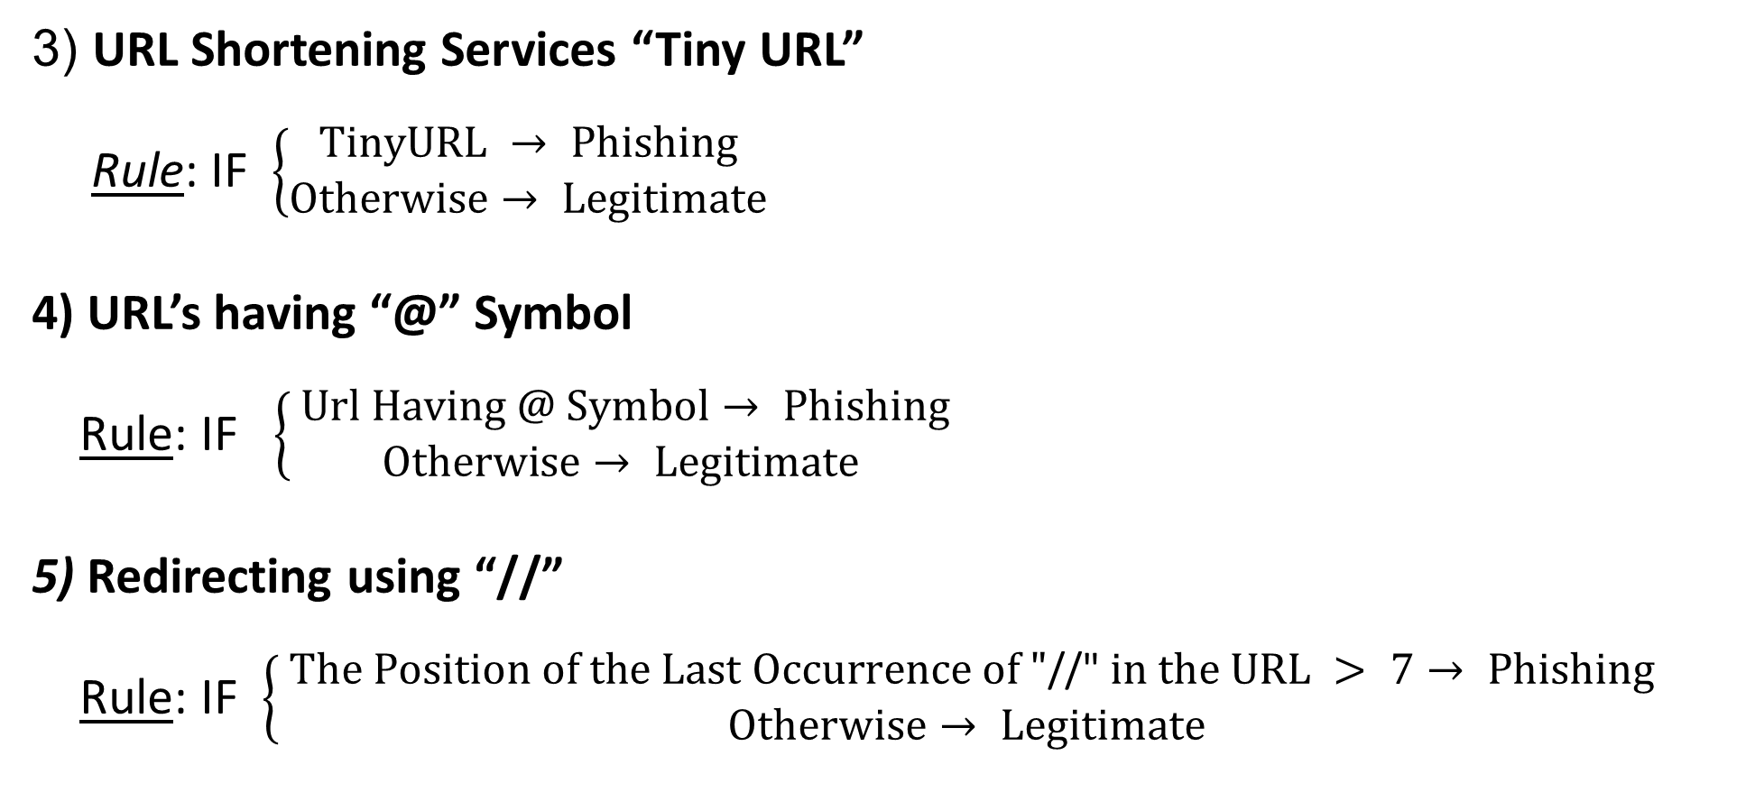
Module name : Address Bar Feature Extraction
3) URL Shortening Services “Tiny URL”
Rule: IF $\left\{\begin{aligned}TinyURL → Phishing \\ Otherwise→ Legitimate\end{aligned}\right.$
4) URL’s having “@” Symbol
Rule: IF $\left\{\begin{aligned} Url Having @ Symbol→ Phishing \\ Otherwise→ Legitimate\end{aligned}\right.$
5) Redirecting using “//”
Rule: IF $\left\{\begin{aligned} The Position of the Last Occurrence of "\text{//" }in the URL > 7→ Phishing \\ Otherwise→ Legitimate\end{aligned}\right.$

Slide 24
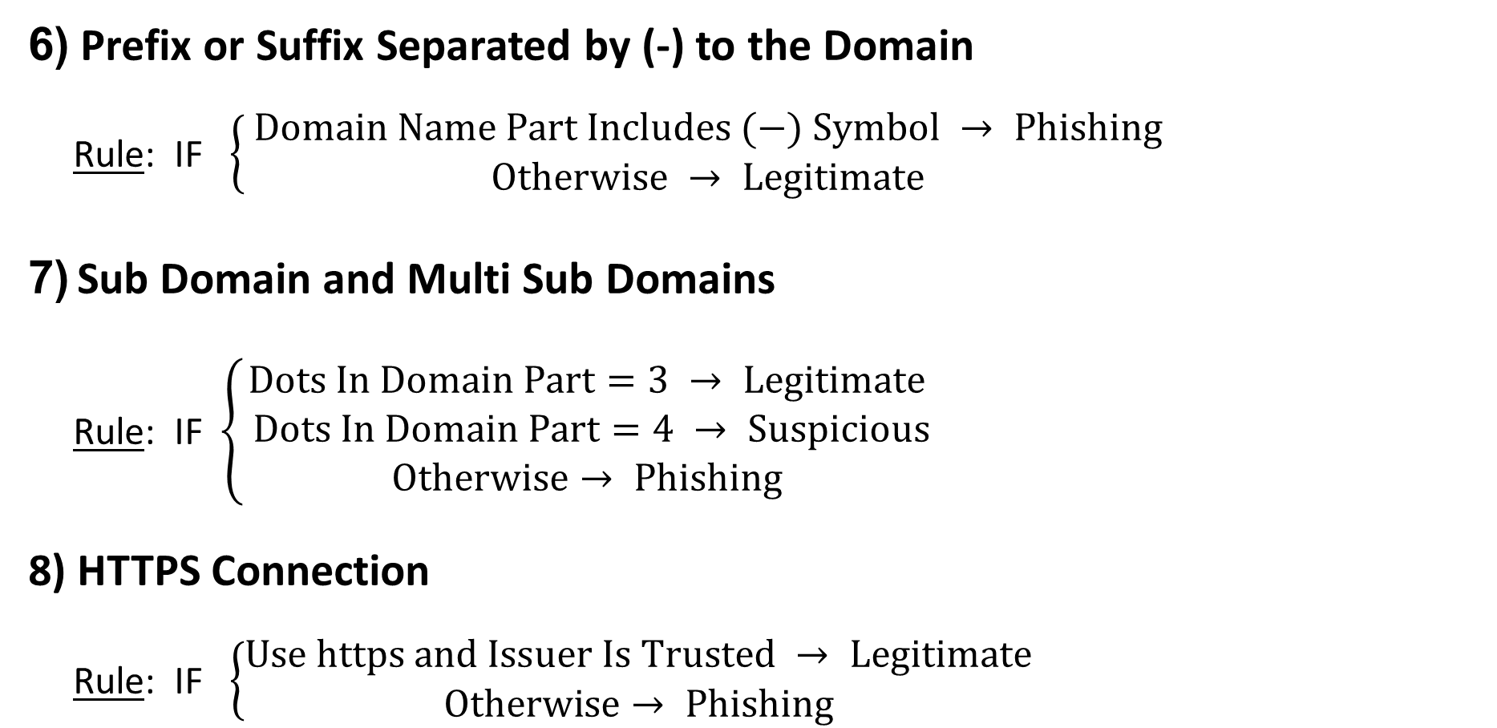
Module name : Address Bar Feature Extraction
6) Prefix or Suffix Separated by (-) to the Domain
Rule: IF $\left\{ \begin{aligned}Domain Name Part Includes (−) Symbol → Phishing \\ Otherwise → Legitimate\end{aligned}\right.$
7) Sub Domain and Multi Sub Domains
Rule: IF $\left\{\begin{aligned}Dots In Domain Part=3 → Legitimate \\ Dots In Domain Part=4 → Suspicious \\ Otherwise→ Phishing\end{aligned}\right.$
8) HTTPS Connection
Rule: IF $\left\{\begin{aligned}Use https and Issuer Is Trusted → Legitimate \\ Otherwise→ Phishing \end{aligned}\right.$

Slide 25
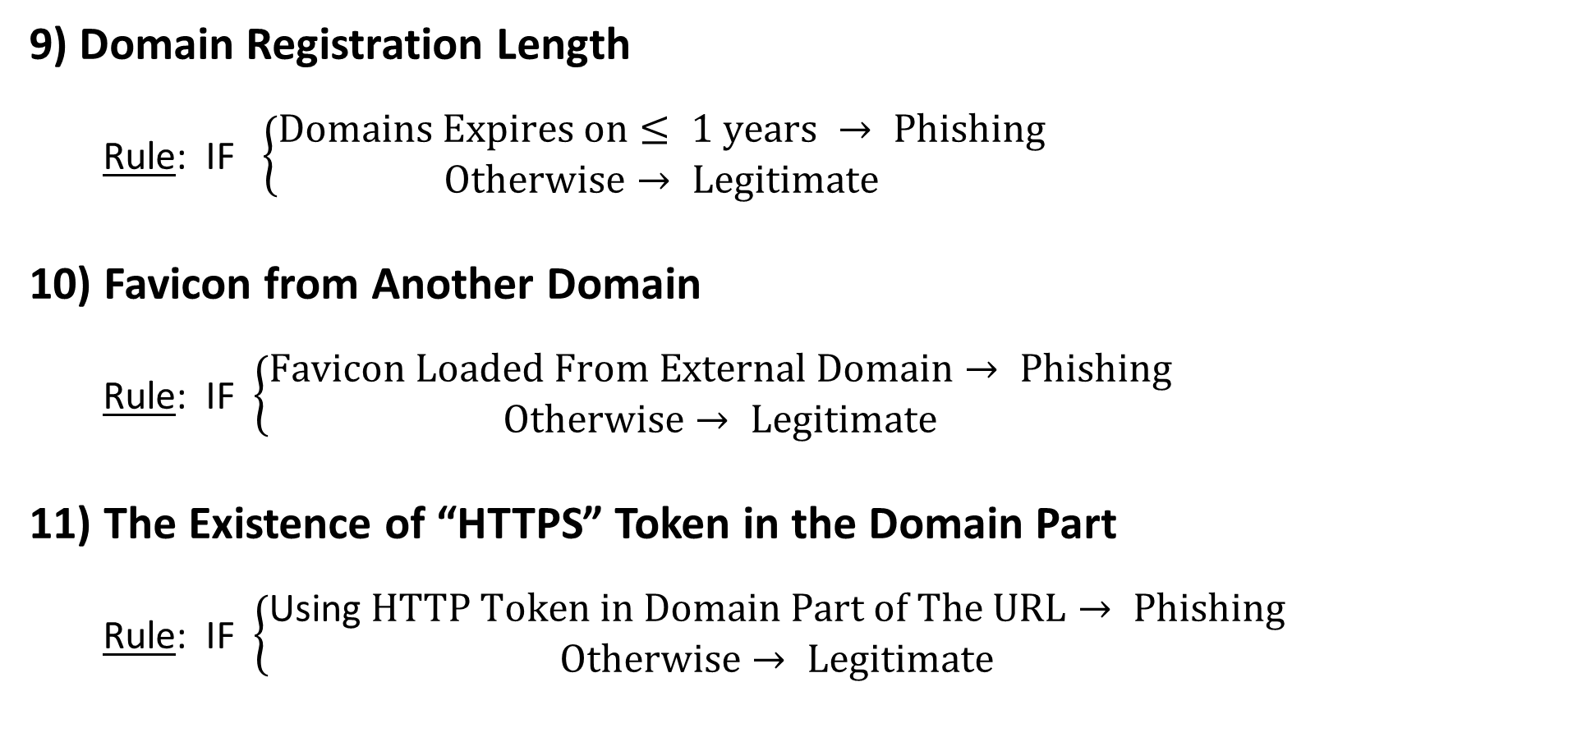
Module name : Address Bar Feature Extraction
9) Domain Registration Length
Rule: IF$\left\{\begin{aligned}Domains Expires on≤ 1 years → Phishing \\ Otherwise→ Legitimate\end{aligned}\right.$
10) Favicon from Another Domain
Rule: IF $\left\{\begin{aligned}Favicon Loaded From External Domain→ Phishing \\ Otherwise→ Legitimate\end{aligned}\right.$
11) The Existence of “HTTPS” Token in the Domain Part
Rule: IF $\left\{\begin{aligned}\text{Using} HTTP Token in Domain Part of The URL→ Phishing \\ Otherwise→ Legitimate\end{aligned}\right.$

Slide 26
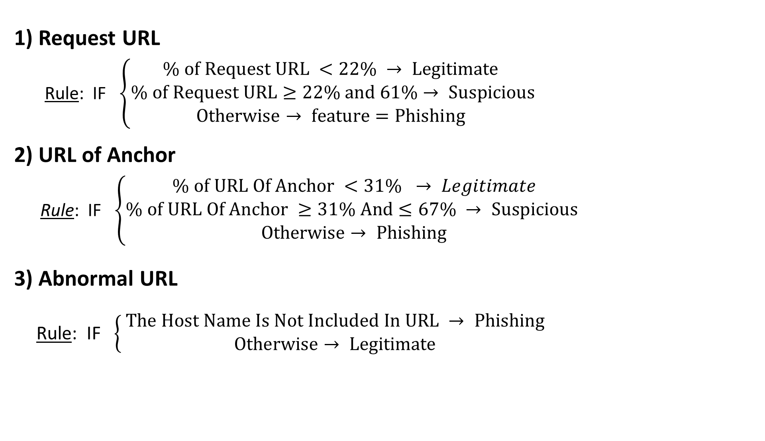
Module name : Abnormal based Feature
1) Request URL
Rule: IF $\left\{\begin{aligned}\% of Request URL <22\% → Legitimate \\ \% of Request URL≥22\% and 61\%→ Suspicious \\ Otherwise→ feature=Phishing \end{aligned}\right.$
2) URL of Anchor
Rule: IF $\left\{\begin{aligned}\% of URL Of Anchor <31\% → Legitimate \\ \% of URL Of Anchor ≥31\% And≤67\% → Suspicious \\ Otherwise→ Phishing\end{aligned}\right.$
3) Abnormal URL
Rule: IF $\left\{\begin{aligned} The Host Name Is Not Included In URL → Phishing \\ Otherwise→ Legitimate\end{aligned}\right.$

Slide 27
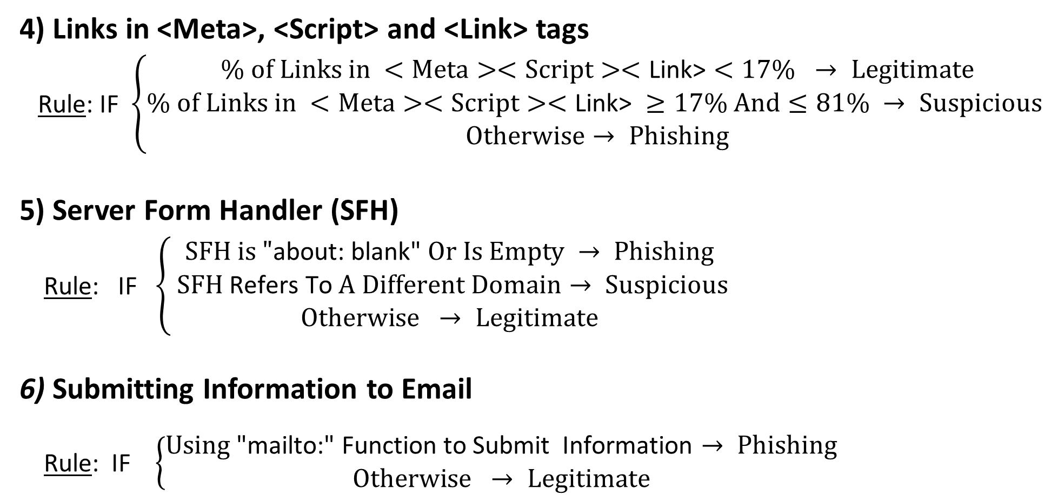
Module name : Abnormal based Feature
4) Links in <Meta>, <Script> and <Link> tags
Rule: IF $\left\{\begin{aligned}\% of Links in <Meta><Script><\text{Link}\text{>}<17\% → Legitimate \\ \% of Links in <Meta><Script><\text{Link}\text{>} ≥17\% And≤81\% → Suspicious \\ Otherwise→ Phishing\end{aligned}\right.$
5) Server Form Handler (SFH)
Rule: IF $\left\{\begin{aligned}SFH is "\text{about}\text{: }\text{blank}\text{"} Or Is Empty → Phishing \\ SFH \text{Refers} \text{To} A Different Domain→ Suspicious \\ Otherwise → Legitimate\end{aligned}\right.$
6) Submitting Information to Email
Rule: IF $\left\{\begin{aligned}Using\text{ "}\text{mailto}\text{:" }\text{Function} \text{to} \text{Submit} \text{Information}→ Phishing \\ Otherwise → Legitimate\end{aligned}\right.$

Slide 28
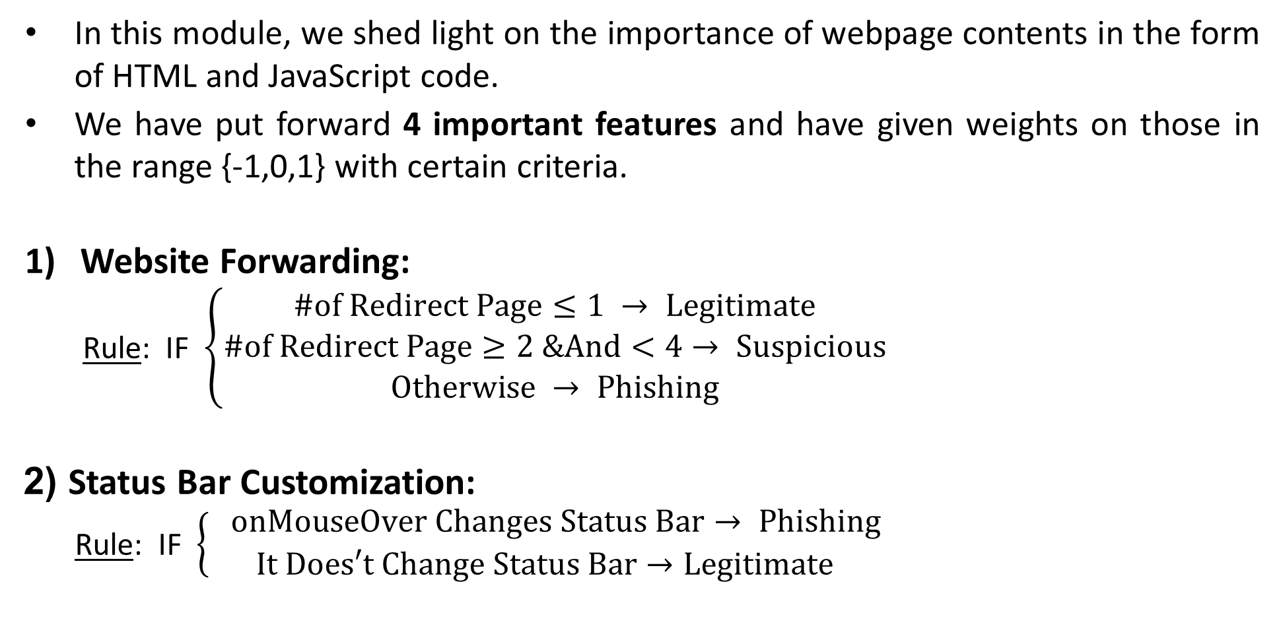
Module name : HTML & JS Feature Extraction
In this module, we shed light on the importance of webpage contents in the form of HTML and JavaScript code.
We have put forward 4 important features and have given weights on those in the range {-1,0,1} with certain criteria.
Website Forwarding:
Rule: IF $\left\{\begin{aligned}\#of Redirect Page≤1 → Legitimate \\ \#of Redirect Page≥2 &And<4→ Suspicious \\ Otherwise → Phishing\end{aligned}\right.$
2) Status Bar Customization:
Rule: IF $\left\{\begin{aligned} onMouseOver Changes Status Bar→ Phishing \\ It Does′t Change Status Bar→Legitimate\end{aligned}\right.$

Slide 29
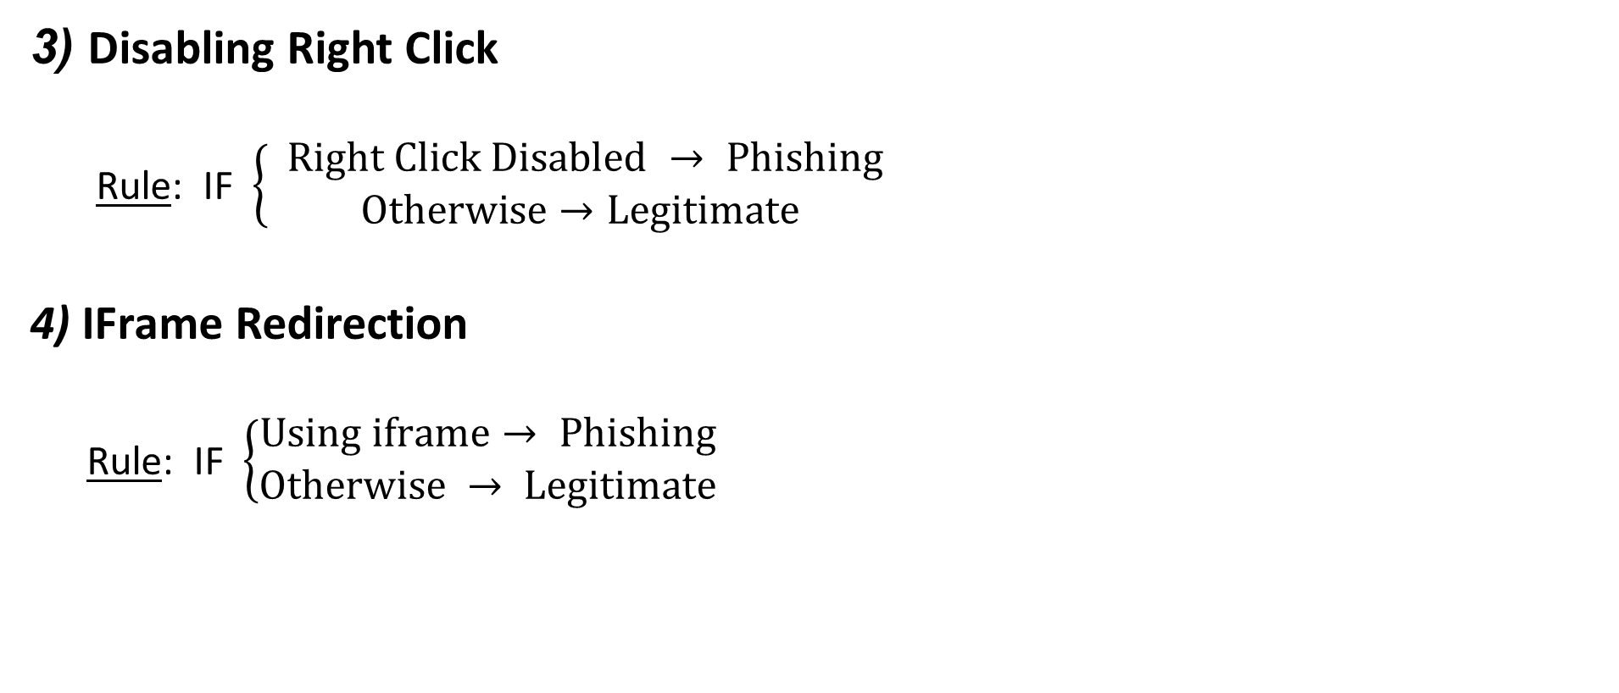
Module name : HTML & JS Feature Extraction
3) Disabling Right Click
Rule: IF $\left\{\begin{aligned} Right Click Disabled → Phishing \\ Otherwise→Legitimate\end{aligned}\right.$
4) IFrame Redirection
Rule: IF $\left\{\begin{aligned}Using iframe→ Phishing \\ Otherwise → Legitimate\end{aligned}\right.$

Slide 30
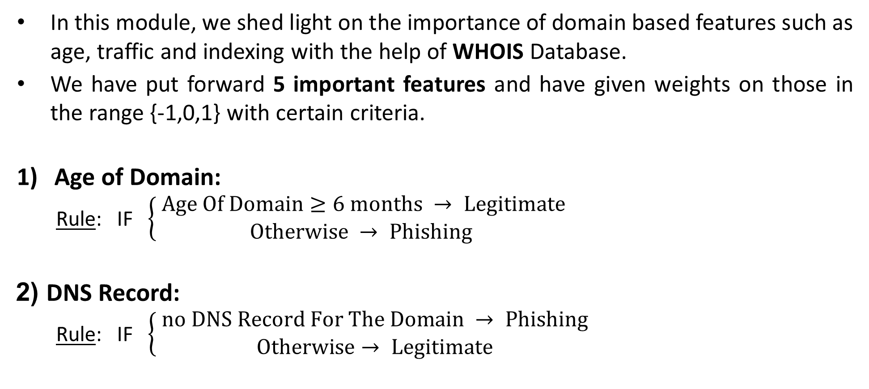
Module name : Domain Based Feature Extraction
In this module, we shed light on the importance of domain based features such as age, traffic and indexing with the help of WHOIS Database.
We have put forward 5 important features and have given weights on those in the range {-1,0,1} with certain criteria.
Age of Domain:
Rule: IF $\left\{\begin{aligned} Age Of Domain≥6 months → Legitimate \\ Otherwise → Phishing\end{aligned}\right.$
2) DNS Record:
Rule: IF $\left\{ \begin{aligned}no DNS Record For The Domain → Phishing \\ Otherwise→ Legitimate\end{aligned}\right.$

Slide 31
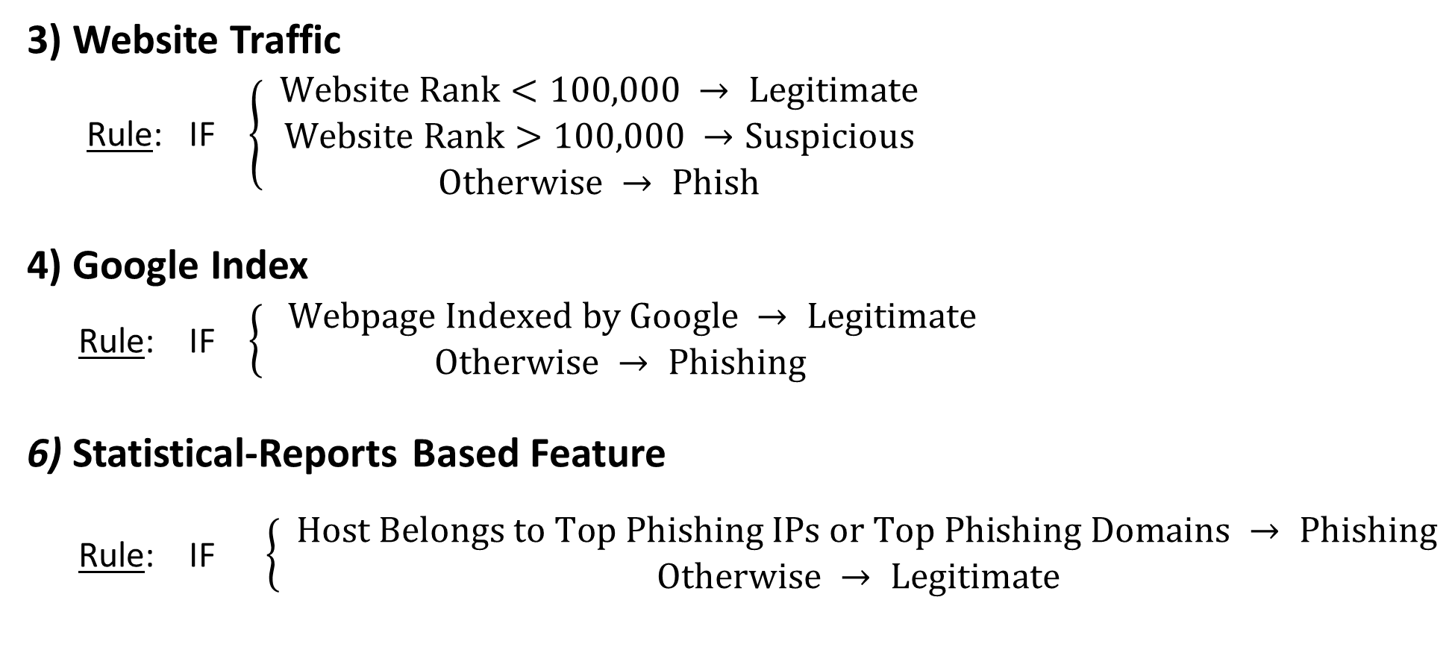
Module name : Domain Based Feature Extraction
3) Website Traffic
Rule: IF $\left\{ \begin{aligned}Website Rank<100,000 → Legitimate \\ Website Rank>100,000 →Suspicious \\ Otherwise → Phish\end{aligned}\right.$
4) Google Index
Rule: IF $\left\{\begin{aligned} Webpage Indexed by Google → Legitimate \\ Otherwise → Phishing\end{aligned}\right.$
6) Statistical-Reports Based Feature
Rule: IF $\left\{\begin{aligned} Host Belongs to Top Phishing IPs or Top Phishing Domains → Phishing \\ Otherwise → Legitimate\end{aligned}\right.$

Slide 32
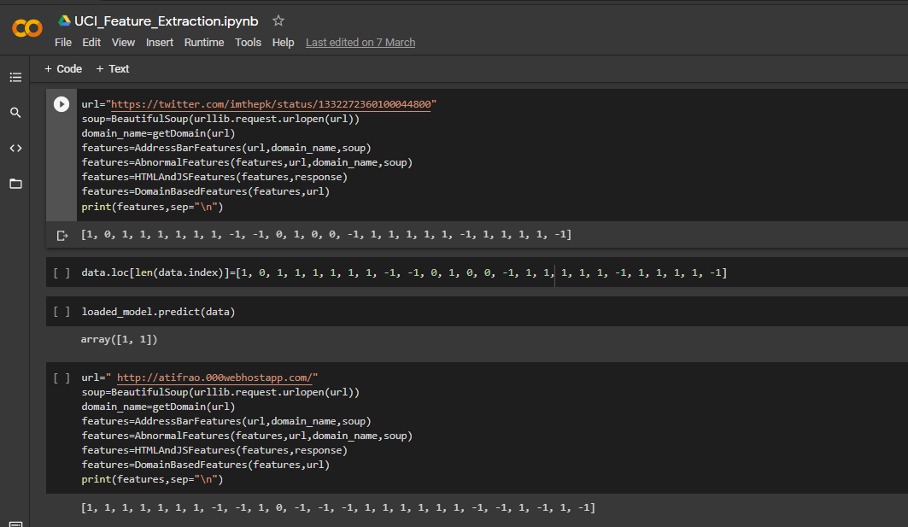
Sample output:
Feature Extraction of URL

Slide 33
Reference:
A. K. Jain and B. B. Gupta, “A novel approach to protect against phishing attacks at client side using auto-
updated white-list,” EURASIP Journal on Information Security, vol. 2016, no. 1, p. 9, 2016.
2. A. Blum, B. Wardman, T. Solorio, and G. Warner, ‘‘Lexical feature based phishing URL detection using
online learning,’’ in Proc. 3rd ACM Workshop Artif. Intell. Secur., 2010, pp. 54–60.
B. B. Gupta, A. Tewari, A. K. Jain, and D. P. Agrawal, ‘‘Fighting against phishing attacks: State of the art and future challenges,’’ Neural Comput. Appl., vol. 28, no. 12, pp. 3629–3654, 2016.
Che-Yu Wu, Cheng-Chung Kuo , Chu-Sing Yang, ”A Phishing Detection System Based on Machine Learning”, International conference on Intelligent Computing and its Emerging Applications (ICEA) 2019.
H. Yuan, X. Chen, Y. Li, Z. Yang, and W. Liu, ‘Detecting Phishing Websites and Targets Based on URLs and
Webpage Links’, in 2018 24th International Conference on Pattern Recognition (ICPR), 2018.

Slide 34
Reference:
6. Peng Yang, Guangzhen Zhao , And Peng Zeng, “Phishing Website Detection Based on Multidimensional
Features Driven by Deep Learning”, date of publication January 11, 2019.
7. PhishTank Website URL : http://phishtank.org/
8. Smita Sindhu, Sunil Parameshwar Patil, Arya Sreevalsan, Faiz Rahman, “Phishing Detection using Random
Forest, SVM and Neural Network with Backpropagation”, December 19,2020 from IEEE Xplore.
UCI Dataset Link : https://archive.ics.uci.edu/ml/datasets/phishing+websites.
https://www.hackerearth.com/practice/machine-learning/machine-learning-algorithms/beginners-tutorial-on-xgboost-parameter-tuning-r/tutorial/

Slide 35
THANK YOU

