Slide 1
Objects & Classes
Fresher Learning Program
January, 2012
Notes:
© 2006 Capgemini - All rights reserved

Slide 2
Objectives of Objects & Classes
Purpose:
  To understand Classes, its members, object instantiation, constructors, method calling, passing arguments to a method, sub class and super class, overriding and overloading
Product:
  Understand how to instantiate an object, what is constructor
  Understand how to call a method and pass arguments
  Understanding of Static and non static members
  To know what is sub-class and super class
  Understand overriding and overloading
Process:
  Theory Sessions along with relevant assignments
  A recap at the end of the session in the form of Quiz.
© 2012 Capgemini - All rights reserved

Slide 3
Table of Contents
Objects and Classes
  Concepts of class
  Class (Static) and instance (non static) variable
  Method (static and non static methods)
  Constructor
  Overloading and Overriding
  Inner Classes
  Nested Classes
© 2012 Capgemini - All rights reserved
Notes:
© 2006 Capgemini - All rights reserved

Slide 4
Concepts : Objects and Classes
Singly rooted hierarchy
Object class is parent class for all the classes created in Java.
Object
Bank Acct
Savings Acct
Checking Acct
© 2012 Capgemini - All rights reserved

Slide 5
Concepts : Objects and Classes
Order of code execution (when creating an object)
static variables initialization.
static initializer block execution. (in the order of declaration, if multiple blocks found)
constructor header ( super or this – implicit or explicit )
instance variables initialization / instance initializer block(s) execution
rest of the code in the constructor
© 2012 Capgemini - All rights reserved

Slide 6
Introduction : Classes
Class is the logical construct upon which the entire Java language is built because it defines the shape and nature of an Object.
public class StudentRecord {
//we'll add more code here later
}
public - means that our class is accessible to other classes
outside the package
class - this is the keyword used to create a class in Java
StudentRecord - a unique identifier that describes our
class
© 2012 Capgemini - All rights reserved
Notes:
Coding Guidelines:
Think of an appropriate name for your class. Don't just call your class XYZ or any random names you can think of.
● Class names starts with a CAPITAL letter - not a requirement, however.
● The filename of your class must have the SAME NAME as your class name.
Ver 1.0 © 2006 Capgemini - All rights reserved

Slide 7
Instance Variables vs.Static Variables
Instance Variables
– Belongs to an object instance
– Value of variable of an object instance is different from the ones of other object instances
Class Variables (also called static member variables)
– variables that belong to the whole class.
– This means that they have the same value for all the object instances in the same class.
© 2012 Capgemini - All rights reserved

Slide 8
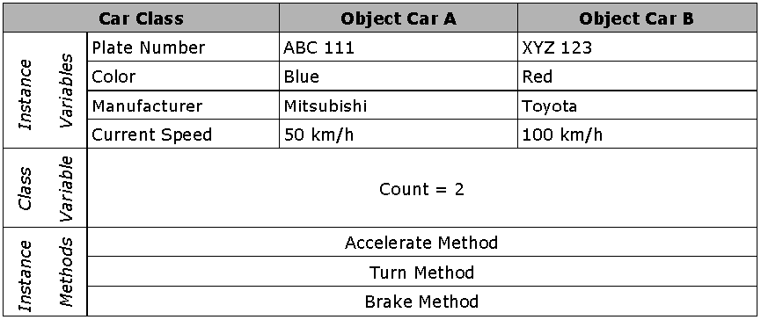
Class Variables Example
© 2012 Capgemini - All rights reserved

Slide 9
Instance Variables
public class StudentRecord {
// Instance variables
private String name;
private String address;
private int age;
//we'll add more code here later
}
private - here means that the variables are only accessible within
the class.
Other objects cannot access these variables directly.
We will cover more about accessibility later.
© 2012 Capgemini - All rights reserved
Notes:
Coding Guidelines
● Declare all your instance variables right after “public class Myclass {“
● Declare one variable for each line.
● Instance variables, like any other variables should start with a SMALL letter.
● Use an appropriate data type for each variable you declare.
● Declare instance variables as private so that only class methods can access them directly.
● Encapsulation
Ver 1.0 © 2006 Capgemini - All rights reserved

Slide 10
Static Variables
public class StudentRecord {
//static variables we have declared
private static int studentCount;
//we'll add more code here later
}
– we use the keyword static to indicate that a variable is a static variable.
© 2012 Capgemini - All rights reserved

Slide 11
Declaring Methods
Defines a particular functionality(behavior) using the properties of a class.
Ex: class A {
int a,b;
void AnMethod() {
int c=a+b;
}/
/ “AnMethod “ method defining an addition
behaviour(Functionality) //using the property a & b of class A.
}
© 2012 Capgemini - All rights reserved

Slide 12
Static methods
public class StudentRecord {
private static int studentCount;
public static int getStudentCount(){
return studentCount;
}
}
Public - means that the method can be called from objects outside the class
Static - means that the method is static and should be called typing,[ClassName].[methodName].
© 2012 Capgemini - All rights reserved

Slide 13
Declaring Methods
For example, in this case,
we call the method StudentRecord.getStudentCount()
int- is the return type of the method. This means that the method should return a value of type int
getStudentCount- the name of the method
()- this means that our method does not have any parameters
© 2012 Capgemini - All rights reserved
Notes:
Coding Guidelines
●Method names should start with a SMALL letter.
●Method names should be verbs
● Always provide documentation before the declaration of the method. You can use Javadocs style for this. Please
see example.
Ver 1.0 © 2006 Capgemini - All rights reserved

Slide 14
Constructors
Constructors are important in instantiating an object. It is a method where all the initializations are placed.
The following are the properties of a constructor:
– Constructors have the same name as the class
– A constructor is just like an ordinary method, however only the following information can be placed in the header of the constructor,
– scope or accessibility identifier (like public...), constructor's name and parameters if it has any.
– Constructors does not have any return value
– You cannot call a constructor directly, it can only be called by using the new operator during class instantiation.
© 2012 Capgemini - All rights reserved

Slide 15
Constructors
To declare a constructor, we write,
<modifier> <className> (<parameter>*) {
<statement>*
}
The default constructor (no-arg constructor)
– is the constructor without any parameters.
– If the class does not specify any constructors, then an implicit default constructor is created.
public StudentRecord() {
//some code here
}
© 2012 Capgemini - All rights reserved

Slide 16
Overloading Constructor Methods
public StudentRecord() {
//some initialization code here
}
public StudentRecord(String temp) {
this.name = temp;
}
public StudentRecord(String name, String address) {
this.name = name;
this.address = address;
}
© 2012 Capgemini - All rights reserved

Slide 17
this
“this()” constructor call
Constructor calls can be chained, meaning, you can call another constructor from inside another constructor.
We use the this() call for this
There are a few things to remember when using the this() constructor call:
When using the this constructor call, IT MUST OCCUR AS THE FIRST STATEMENT in a constructor
It can ONLY BE USED IN A CONSTRUCTOR DEFINITION. The this call can then be followed by any other relevant statements.
© 2012 Capgemini - All rights reserved

Slide 18
Example
public StudentRecord() {
this("some string");
}
public StudentRecord(String temp) {
this.name = temp;
}
public static void main( String[] args) {
StudentRecord annaRecord = new StudentRecord();
}
© 2012 Capgemini - All rights reserved

Slide 19
A sample Hello World Program
class A {
int i;
void show(){
System.out.println(“Hello World”);
}
}
public class B {
public static void main(String args[]) {
A obj = new A();
obj.show();
}
}
Output: Hello World
© 2012 Capgemini - All rights reserved

Slide 20
Overloading and Overriding :
Overriding methods :
the throws clause of the overriding method may only include exceptions that can be thrown by the super class method, including it's subclasses
the actual method called depends on the object being passed to the method
Java uses late-binding to support polymorphism; which means the decision as to which of the many methods should be used is deferred until runtime
© 2012 Capgemini - All rights reserved

Slide 21
Overloading Methods
Method overloading
– allows a method with the same name but different parameters, to have different implementations and return values of different types
– can be used when the same operation has different implementations.
Always remember that overloaded methods have the following properties:
– the same method name
– different parameters or different number of parameters
– return types can be different or the same
© 2012 Capgemini - All rights reserved

Slide 22
Example
public void print( String temp ){
  System.out.println("Name:" + name);
  System.out.println("Address:" + address);
  System.out.println("Age:" + age);
}
public void print(double eGrade, double mGrade, double sGrade)
  System.out.println("Name:" + name);
  System.out.println("Math Grade:" + mGrade);
  System.out.println("English Grade:" + eGrade);
  System.out.println("Science Grade:" + sGrade);
}
© 2012 Capgemini - All rights reserved

Slide 23
Overriding :
Method Signature - The signature of a method uniquely identifies a method
The signature consists of the name of the method and the number, type, and order of the arguments required of the method
The signature of a method is:
access-modifier return-value-type method-name(parameter-list){ // body }.
Examples:
static void TestMethod1(){ }
public void TestMethod2("Bill") { }
private void TestMethod3("Bill", 55) { }
© 2012 Capgemini - All rights reserved

Slide 24
Inner Classes : Objects and Classes
Inner classes are non-static classes defined within other classes.
class Outer {
class Inner {
// code inside inner class
}
}
the compiled class files for the above are: Outer.class and Outer$Inner.class
the Inner class type is: Outer.Inner
© 2012 Capgemini - All rights reserved

Slide 25

Inner Classes : Objects and Classes
Instances of inner classes can be created in a number of ways
Create an Outer class object:
Outer o1 = new Outer();
Then create an Inner class object:
Outer.Inner i1 = o1.new Inner();
Or
Create the inner class directly:
Outer.Inner i2 = new Outer().new Inner();
Or,
create one from within the outer class constructor
class Outer {
Outer() {
new Inner();
}
}
© 2012 Capgemini - All rights reserved

Slide 26
Inner Classes : Objects and Classes
Inner classes may be declared default (friendly), public, protected, private, abstract, static or final
e.g. :
class Outer {
class Inner {}
public class PublicInner{}
protected class ProtectedInner {}
private class PrivateInner{}
abstract class AbstractInner {}
final class FinaIInner {}
static class StaticInner {}
}
© 2012 Capgemini - All rights reserved
Notes:
© 2006 Capgemini - All rights reserved

Slide 27
Inner Classes : Objects and Classes
Each instance of a non-static inner class is associated with an instance of their outer class. static inner classes are a special case called as Nested Classes.
inner classes may not declare static initializers or static members unless they are compile time constants i.e. static final var = value;
you cannot declare an interface as a member of an inner class; interfaces are never inner.
© 2012 Capgemini - All rights reserved

Slide 28
Inner Classes : Objects and Classes
inner classes may inherit static members.
the inner class can access the variables and methods declared in the outer class
to refer to a field or method in the outer class instance from within the inner class, use Outer.this.fldname
© 2012 Capgemini - All rights reserved

Slide 29
Nested Classes : Objects and Classes
To make objects of a inner class type independent of objects of the enclosing class, you can declare the inner class as static. Such static inner class are called as Nested Classes
a static inner class behaves like any top-level class except that its name and accessibility are defined by its enclosing class i.e. use new Outer.Inner() when calling from another class
formally called top-level nested classes
© 2012 Capgemini - All rights reserved

Slide 30
Nested Classes : Objects and Classes
class Outer {
public static void main (String[] args) {
int x = Inner.value;
}
static class Inner {
static int value = 100;
}
}
they are not associated with an instance of their outer class i.e. you can create an Inner class object from within the Outer class using new Inner(); you do not need to create an Outer class object first as is required with non-static inner classes
static inner classes can directly access static fields of the outer class but must use an instance of the outer class to access the outer classes instance fields
© 2012 Capgemini - All rights reserved

Slide 31
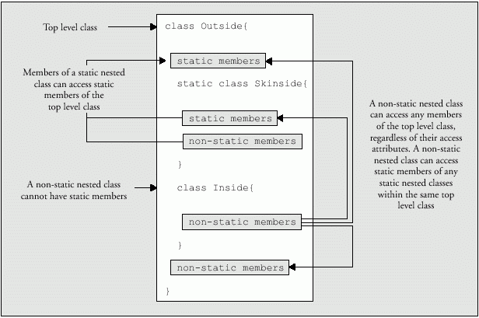
Inner Classes / Nested Classes : Objects and Classes
© 2012 Capgemini - All rights reserved

Slide 32
Recap (Important Keywords)
Overriding
this
Constructor
Inner class
Nested class
Sub class
Static
Overloading
© 2012 Capgemini - All rights reserved
Notes:
Recap – tips : To make it further lighter, many facilitator ask participant that they were allow to leave only if they will answer say 12 correct answers out of 15 questions. And then produce all recaps as questions.
© 2006 Capgemini - All rights reserved

Slide 33
Thank You For Your Time
Notes:
© 2006 Capgemini - All rights reserved

