Slide 1
RegexLab
A Hand-Built Regex-to-DFA Compiler Pipeline
BCSE307L Compiler Design, by Vignesh P C and Ujwal
1
Notes:
SWITCH TO APP: have the dev server already open in a browser tab, pattern (a|b)*abb, test string babb, AST tab selected, ready before you start talking.

Slide 2
The Problem
• Given a regular expression and a string, decide whether the string matches, without reaching for a built-in regex engine.
• Build the actual compiler pipeline that answers this: parser, NFA, DFA, minimization and matcher, not a lookup into an existing library.
• Show every intermediate structure, so the automata-theory constructions are visible, not hidden inside a black box.
2
Notes:
No demo on this slide. State the problem plainly, move on quickly.

Slide 3
Architecture: the Pass Pipeline
Pattern
(text)
Parser
AST
Thompson's
Construction
NFA
Subset
Construction
DFA
Moore's
Minimization
min-DFA
Matcher
match /
no-match
Test string
(text)
• Two inputs: the pattern (compiled once, every stage) and the test string (only the matcher, and now the step playback on every tab).
• Implemented twice: a TypeScript prototype and a C++20 engine compiled to WebAssembly, and the browser runs the C++/WASM build.
• Correctness: differential testing against std::regex and native RegExp, both languages must agree.
3
Notes:
No demo yet. Point at the boxes left to right while saying the pipeline sentence.

Slide 4
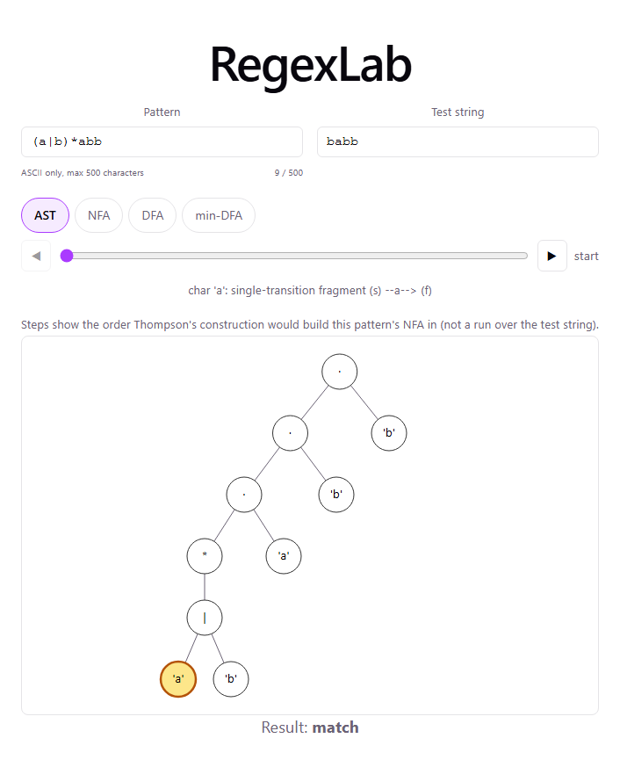
Parsing: Recursive Descent
• regex → term ('|' term)*; term → factor+; factor → atom '*'?
• Precedence by call depth: parseRegex calls parseTerm calls parseFactor calls parseAtom, so the deepest call binds tightest. No precedence table needed.
• No separate lexer: every token is just one character.
Fig. 1. AST for (a|b)*abb, real app output.
4
Notes:
SWITCH TO APP: type (a|b)*abb in Pattern, point at the AST tab. Then type (ab and show the UnmatchedParen error and its position.

Slide 5
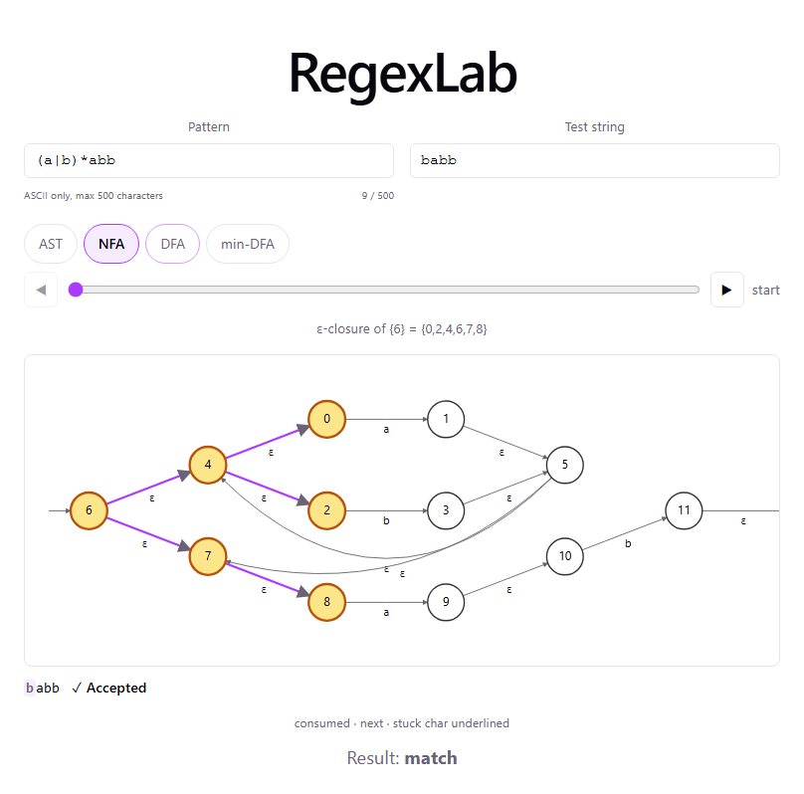
Thompson's Construction: AST → NFA
• Each AST node becomes a fragment: one start state, one accept state.
• A character costs 2 states; '|' and '*' each add 2 more for their own start/accept pair.
• (a|b)*abb: 5 chars × 2 + 2 (for *) + 2 (for |) = 14 states.
Fig. 2. NFA, 14 states, ε-closure of the start state highlighted.
5
Notes:
SWITCH TO APP: NFA tab. Point at an epsilon edge and the active-state highlight.

Slide 6
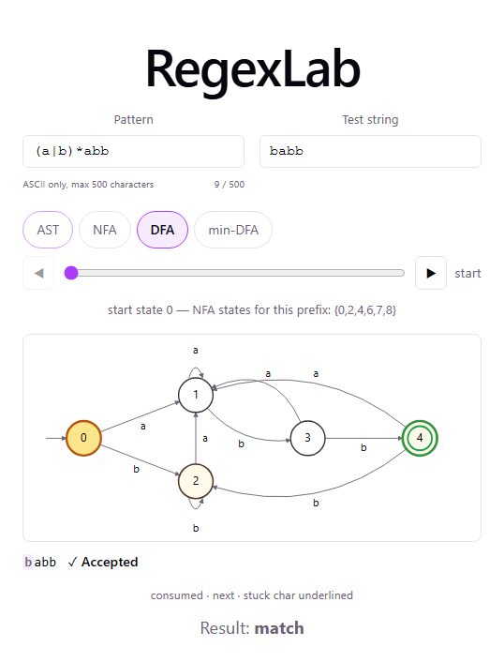
Subset Construction: NFA → DFA
• Each DFA state = a set of NFA states, closed over epsilon moves.
• Worklist-based: from the start set, try every symbol, create a new DFA state only for a never-seen set.
• 14 NFA states → 5 DFA states for this pattern.
Fig. 3. DFA, 5 states; caption shows the NFA set behind the start state.
6
Notes:
SWITCH TO APP: DFA tab. Point at the caption showing the NFA-set-for-this-prefix annotation.

Slide 7
Moore's Minimization: DFA → min-DFA
• Start with 2 groups (accepting, non-accepting); split a group whenever two states react differently to some symbol.
• Stop at a fixpoint, meaning a full pass with zero splits.
• 5 DFA states → 4 minimal states here (states 0 and 2 merge). The result is the unique minimal DFA (Myhill–Nerode theorem).
7
Notes:
No image here, the min-DFA diagram is on the next slide (matching). Say the fixpoint rule clearly since it's a likely question.

Slide 8
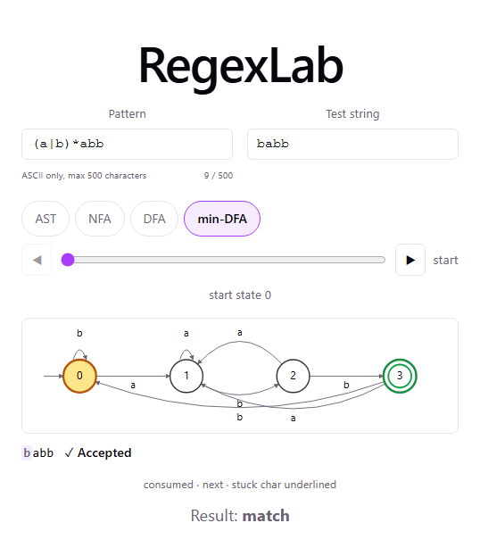
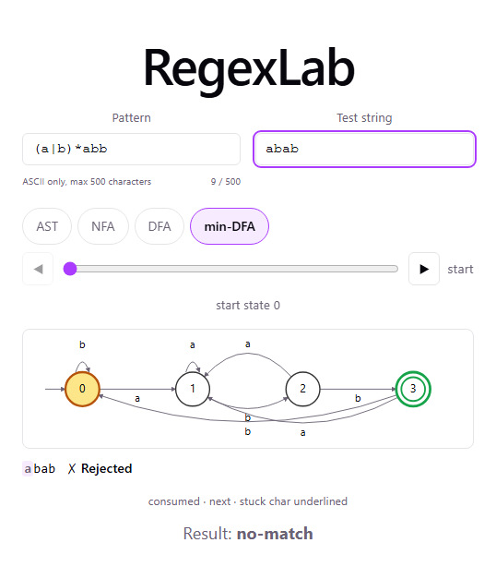
Matching: babb Accepted, abab Rejected
• Matcher walks the min-DFA one character at a time, no backtracking.
• (a|b)*abb only cares whether the string ends in 'abb'.
Fig. 4a. babb ends in abb: Accepted.
Fig. 4b. abab ends in bab, not abb: Rejected.
8
Notes:
SWITCH TO APP: min-DFA tab, test string babb, point at Accepted. Then change to abab, point at Rejected.

Slide 9
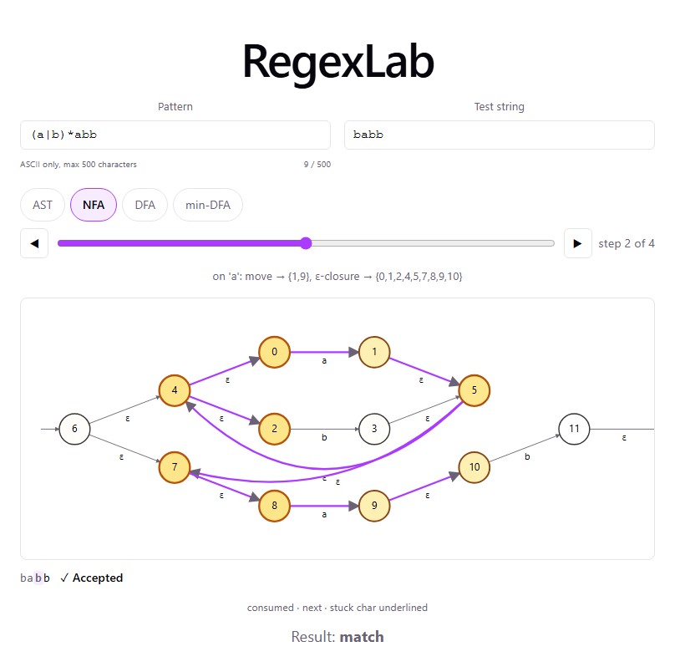
Step Playback (issue #52)
• All four tabs have real, stage-specific playback, not just min-DFA scrubbing.
• NFA shows the FULL active-state set and highlights every traversed edge, epsilon included.
• AST steps through the tree in Thompson's-construction order, with a caption naming the rule.
Fig. 5. NFA tab, step 2 of 4, multi-state + traversed-edge highlighting.
9
Notes:
SWITCH TO APP: NFA tab, click the step-forward arrow a couple of times, point at the multiple highlighted states and the purple traversed edges.

Slide 10
Testing: How We Know It's Correct
• Differential testing: thousands of random (pattern, input) pairs checked against std::regex in C++ and native RegExp in TypeScript. Both independent implementations have to agree.
• Measured today: 125 TypeScript tests / 10 files; 4,608 C++ assertions / 41 cases.
– How: npm test feeds each known pattern through the real pipeline and checks the answer is exactly right.
– How: ./engine_tests runs the same checks ported to C++, one assertion per fact checked (e.g. an exact state count).
• WASM build verified: 25/25 guard probes passed (length cap, nesting cap, non-ASCII handling) against the real compiled module.
10
Notes:
No demo. If asked how counts were obtained: npm ci + vitest run; cmake build + ./engine_tests, run fresh today, not recalled.

Slide 11
Scope Decisions, Stated Honestly
• Direct method (firstpos/followpos) not built. We chose the indirect Thompson-plus-subset-construction route on purpose.
• Hopcroft's minimization not built. Moore's is simpler to implement and explain fully, and Hopcroft's stays a planned, gated upgrade.
• No dedicated DFA state-count guard against subset construction's exponential worst case. The 500-char pattern cap bounds it indirectly, not tightly.
11
Notes:
No demo. These are deliberate scope decisions, so say that plainly and don't apologize for them.
Also mention if there's time: character classes, +, and ? are literal characters today, not operators, scoped out on purpose; backreferences and lookahead are permanently out of scope since they are not regular languages.

Slide 12
Questions
12
Notes:
Have docs/review-prep-plan.md section (d) open off-screen for the 12 prepped questions.

