Slide 1
Enhancing Analytics for a Restaurant Business
Internship Final Review
Presented by: Vignesh and Team
Mentor : Charitha

Slide 2
Problem Identification
Enhancing Analytics for a Food Delivery Platform
In today's fast-paced world, food delivery services have become an integral part of daily life. Customers rely on online platforms to order meals conveniently, while restaurants leverage these systems to expand their reach and maximize revenue. To ensure customer satisfaction and operational efficiency, analyzing food delivery data is essential. The internship project focuses on studying and extracting insights from food delivery transactions using structured data Points.
Problem Statement
Despite the growing reliance on food delivery platforms, businesses lack actionable insights into customer behavior, operational efficiency, and profitability. This project aims to bridge that gap by analyzing structured delivery data to uncover trends, inefficiencies, and opportunities for strategic improvement.

Slide 3
Objectives
Analyze food delivery data to gain insights into:
Customer behavior
Restaurant performance
Overall business efficiency
Examine key aspects such as:
Order trends
Payment methods
Peak ordering times
Customer feedback and ratings
Develop actionable insights to:
Improve service quality
Enhance operational efficiency
Increase profitability

Slide 4
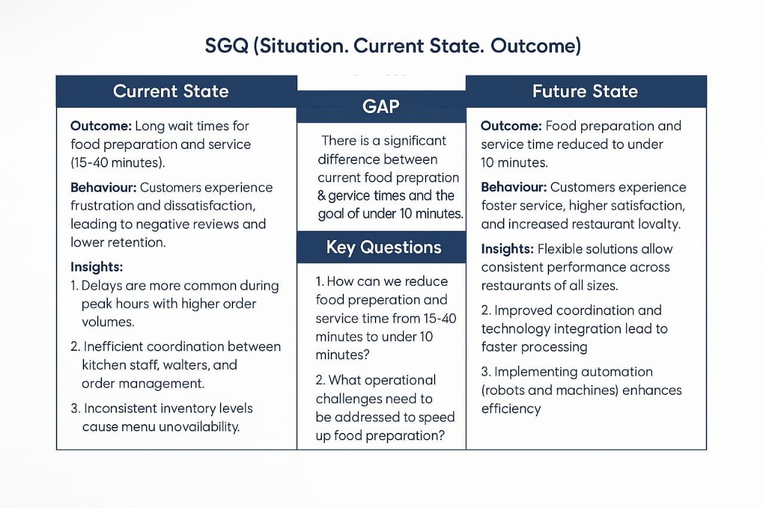
SGQ Matrix Based on OBI Principle

Slide 5
Key Questions
1.How can we reduce food preparation and service time from 15-40 minutes to under 10 minutes?
2.What operational challenges need to be addressed to speed up food preparation?
3.How can we improve coordination between kitchen staff, waiters, and inventory management?
4.What technologies or automation can be implemented to simplify order processing and reduce delays?
5.How can we ensure consistent service speed across different restaurant branches and peak hours?
6. How can we reduce order errors that contribute to delays and dissatisfaction?
7. How can we improve the customer waiting experience during peak hours?
8.What customer feedback mechanisms can be used to monitor satisfaction in real time?
9.What kind of training or upskilling is needed to boost staff efficiency and responsiveness?
10.How can shift planning and staff allocation be optimized for different traffic patterns?

Slide 6
Key Insights
• Peak demand between peakhours with high weekend orders.
• Promo codes increase volume but reduce margins.
• Loyalty members contribute 40%+ revenue.
• Orders with combo food and drink items result in 18% higher average order value compared to food-only orders.

Slide 7
Solutions / Recommendations
• Use promo codes for new or infrequent customers.
• Optimize menu to feature top-performing items.
• Add delivery staff in peak time zones.
• Improve loyalty programs with exclusive offers.

Slide 8
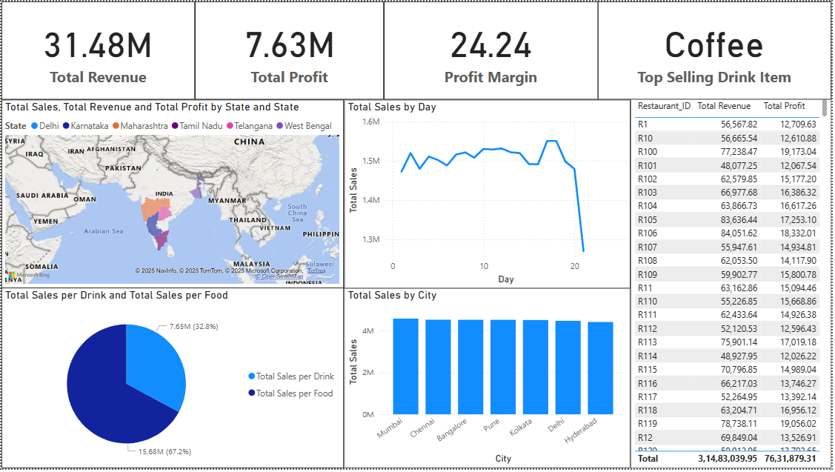
CEO Dashboard

Slide 9
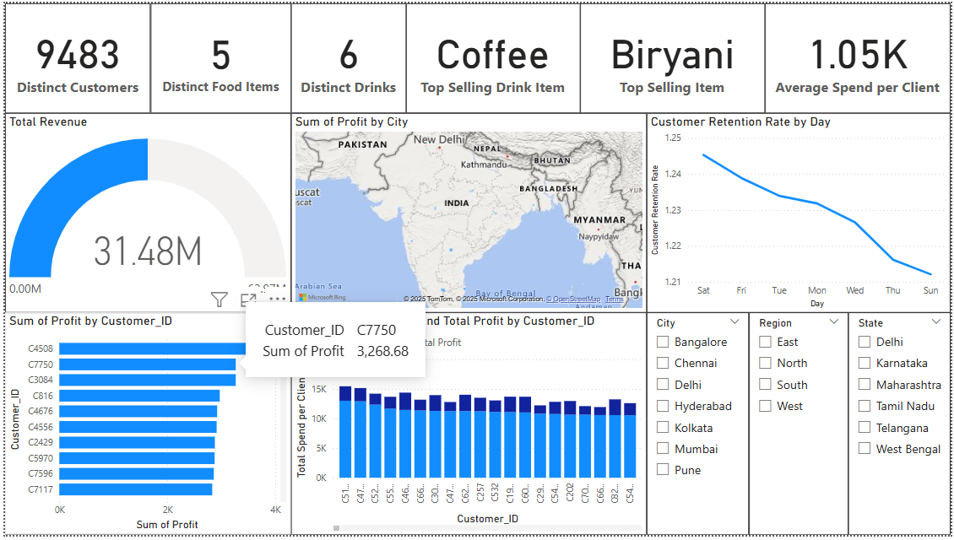
Client Dashboard

Slide 10
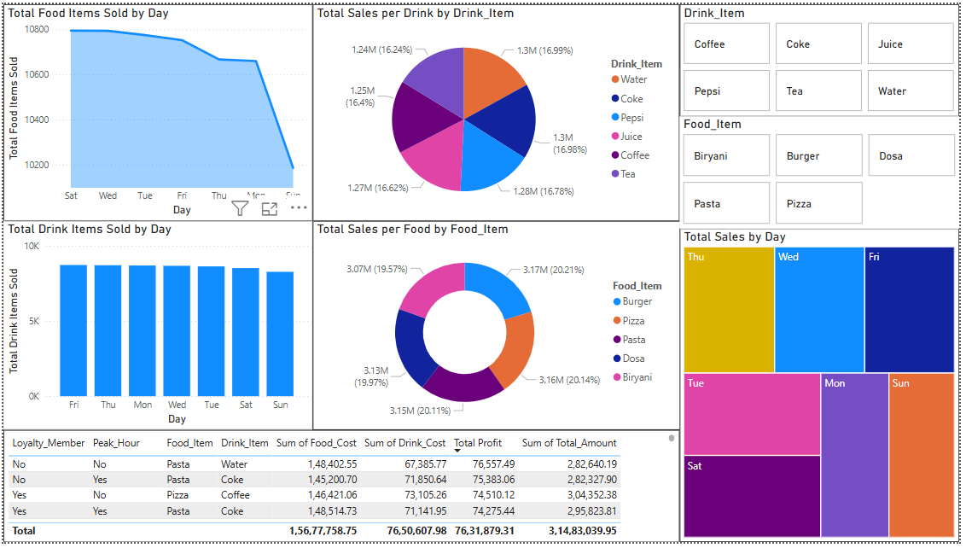
Restaurant Dashboard

Slide 11
Conclusion
• This internship project demonstrated how data analytics can optimize food delivery.
• Dashboards built in Power BI support strategic decisions for various stakeholders.
• Future work can enhance churn prediction, dynamic pricing, and customer segmentation.

