Slide 1

Complaint Management System using Java and MySQL
STUDENT : VIGNESH B ( 43111007 )

Slide 2
AGENDA
Abstract
Existing model
Proposed System
Advantages
Disadvantages
Hardware requirement
Software requirements
Modules
Module Description
Sample Output
Conclusion

Slide 3
ABSTRACT
This project aims to develop a simple Complaint Management System using Java and MySQL. It allows users to register complaints and view them from a central database. The application demonstrates Java’s JDBC (Java Database Connectivity) feature to connect, insert, and retrieve data from MySQL. It’s designed for beginners to understand how real-time data-driven applications work.

Slide 4
EXISTING MODEL
In most organizations or colleges, complaints are managed manually using registers or paper forms. This manual process often leads to:
Missing or misplaced complaints
Delayed responses
Lack of tracking and reporting

Slide 5
PROPOSED SYSTEM
The proposed system digitalizes the complaint process using a Java-based application connected to a MySQL database. Users can:
Add complaints with their name and description
View all stored complaints instantly
Store data securely in a central database
This system improves accessibility, reduces manual errors, and provides quick data retrieval.

Slide 6
ADVANTAGES
Easy to use and beginner-friendly
Real-time data storage using MySQL
No manual record-keeping
Portable and expandable
Demonstrates JDBC connectivity

Slide 7
DISADVANTAGES
System Downtime – When servers or databases fail, users cannot submit or track complaints.
Maintenance Overhead – Regular updates and database maintenance are needed to keep the system functional.
Dependency on Internet/Database Connectivity – The system fails if the database or internet connection is down.
User Misuse – Users may submit false or duplicate complaints, affecting response efficiency.

Slide 8
MODULES
Database Connection Module Establishes a connection between Java and MySQL using JDBC.
Add Complaint Module Allows users to enter their name and complaint text, and stores it in the database.
View Complaint Module Displays all complaints stored in the MySQL table.
Exit Module Gracefully exits the application.

Slide 9
MODULE DESCRIPTION
1. Database Connection Module
Uses JDBC driver (com.mysql.cj.jdbc.Driver)
Connects to complaint_db database via DriverManager.getConnection()
2. Add Complaint Module
Uses PreparedStatement to insert data securely.
Prevents SQL Injection.
3. View Complaint Module
Uses ResultSet to retrieve and display all records from complaints table.
4. Exit Module
Provides a clean exit from the system using System.exit(0)

Slide 10
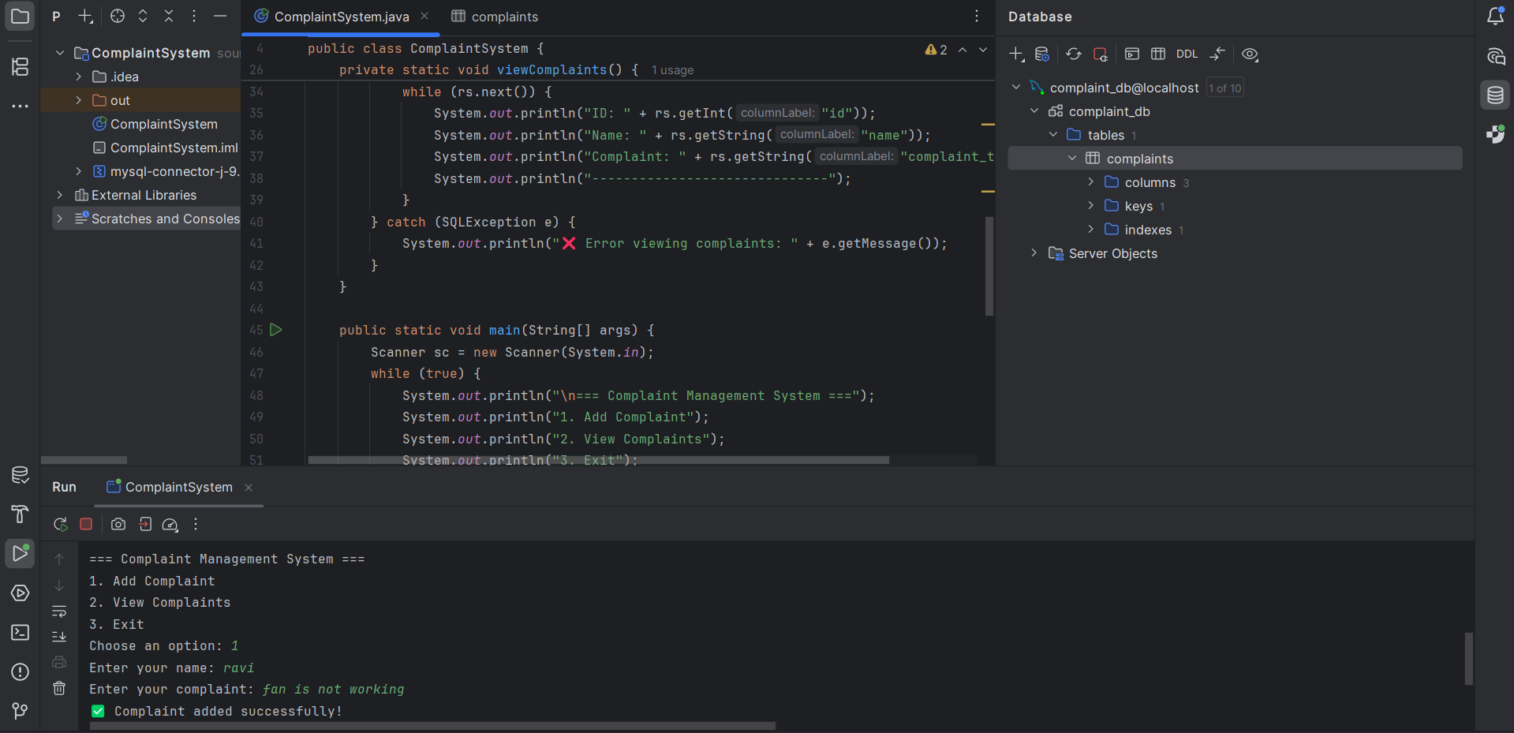
SAMPLE OUTPUT (SCREENSHOT)
MAIN WINDOW

Slide 11
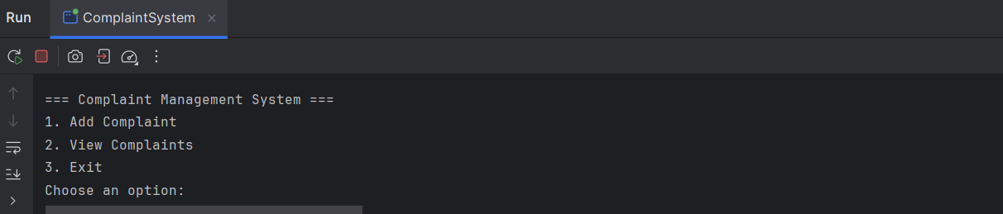
SAMPLE OUTPUT (SCREENSHOT)
ASKING THE USER INPUT TO FILE THE COMPLAINT

Slide 12
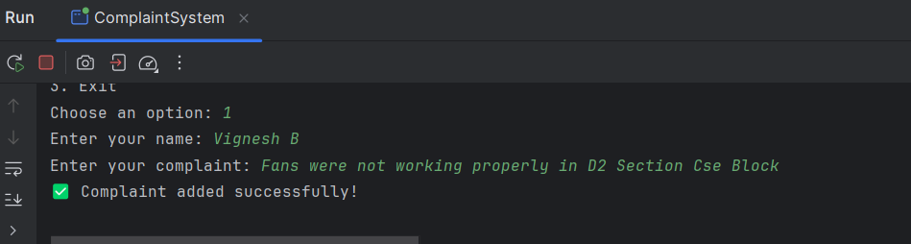
SAMPLE OUTPUT (SCREENSHOT)
GIVEN THE INPUT IN TERMINAL AND GOT SAVED IN DATABASE

Slide 13
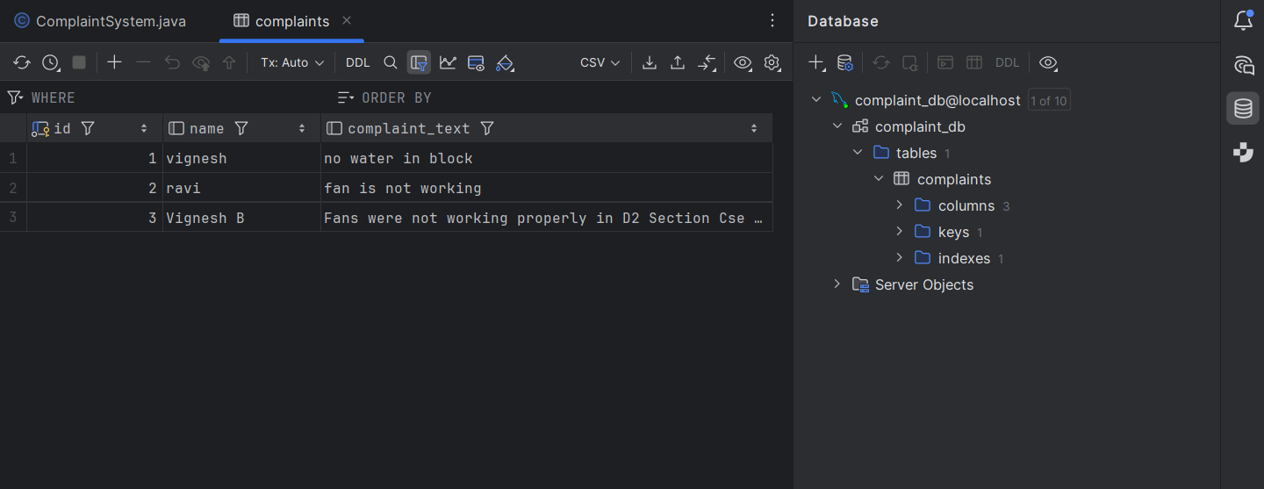
SAMPLE OUTPUT (SCREENSHOT)
MYSQL DATABASE VIEW IN INTELLIJ IDEA

Slide 14
CONCLUSION
This project demonstrates how Java can interact with relational databases like MySQL using JDBC. The Complaint Management System automates the traditional complaint process and stores data in a structured, retrievable format. It serves as a foundational project to understand backend connectivity and can later be upgraded into a GUI or web-based system.

