Slide 1
ANALYSING OF MOTOR CHARACTERISTICS FOR SHELL ECO MARATHON PROJECT
STUDENT NAME : VIGNESH MUNUSAMY
SID NO : 16077465
COURSE : MSc IN ELECTRICAL AND ELCTRONIC ENGINEERING
PROJECT SUPERVISOR : NURUL BHUIYAN
AMR SALEH

Slide 2
Table of contents:
Motivation & Background
Aim & observation
Block diagram
Broad and narrow topic area
Literature review
Working principle
Methodology
Future work
Future scope
Results
Conclusion
References

Slide 3
Motivation / Background
Why this topic is important in electrical engineering?
Electric vehicles and renewable energy systems rely heavily on PMSMs due to their high efficiency and torque density.
What problem does this project address?
Accurate understanding of motor parameters (Rs, Ld, Lq, and Back-EMF) is necessary for optimal performance, but these parameters are frequently unknown.
why is parameter identification needed?
Infective control, power losses, and shortened motor lifespan can result from incorrect parameter values.
How does this project contribute?
The PMSM’s parameters are experimentally determined in this project to support the precise Filed-Oriented control (FOC) method and enhanced motor efficiency and performance.

Slide 4
Aim:
The main goal of this project is to experimentally identify and analyse key electrical parameters of a Permanent Magnet Synchronous Motor (PMSM) — such as stator resistance, d- and q-axis inductances, and back-EMF — used in an electric hub motor.
Understanding these parameters will help improve how the motor is modelled and controlled, leading to smoother and more efficient performance.
Objective:
It measures the Stator Resistances (Rs) using DC testing.
Determines D-axis and Q-axis inductances that is (Ld, Lq) through the locked rotor test.
Evaluate Back-EMF constant as (Ke) by mechanical spin test.
To analyse the sinusoidal waveform of back-EMF and it validates proper winding symmetry.
To establish a complete experimental setup for PMSM parameter identification (with brake and speed control).

Slide 5
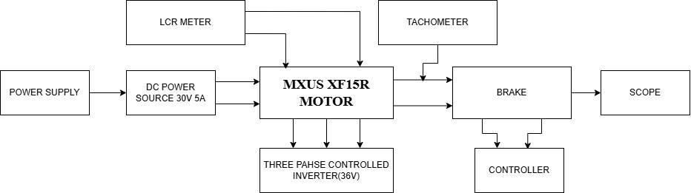
BLOCK DIAGRAM:

Slide 6
Broad Area
Focuses on electrical energy conversion, control, and efficient use systems.
Discusses intelligent automation, renewable energy, electric machines, and EV technologies.
supports the global transition to energy solutions that are smarter, cleaner, and more sustainable.
Narrow Topic Area
The domain of permanent magnet synchronous motors (PMSMs) is narrower than the larger domain and my project targets this narrower domain.
Due to its high-power density and high efficiency, PMSMs is a widespread motor with electric vehicles.
Am of particular interest in the determination of important motor parameters such as stator resistance (Rs), d- and q-axis inductances (Ld, Lq) and the value of the constant of the back-EMF (Ke) as far as experimental determination is concerned.
These parameters will be necessitated to develop and enhance Field-Oriented Control (FOC) systems that can enable the operation of the PMSMs to be effective and efficient.

Slide 7
LITERATURE REVIEW
The working principle of PMSMs was explained by Krishnan (2010) and he demonstrated that during the interaction between the permanent magnet field in the rotor and the rotating magnetic field of the stator, torque was generated.
Strength: The article presented a robust theoretical framework of PMSM control and performance. Weakness: Concentrated on simulations which have not been experimentally validated on a large scale.
Zhu and Howe (2007) invented the Field-Oriented Control (FOC) method where torque (Iq) and flux (I d) are separated to give accurate control.
Strength: Allows efficient control and easy torque of EV drives.
Weakness: It needs proper knowledge of motor parameters (Rs, Ld , Lq, Ke).
Combes et al. (2017) proposed a high-frequency signal injection and DC test technique to accurately estimate L d and L q.
Strength: Good in the determination of inductances, even with magnetic saturation.
weakness: complicated test configuration, not so appropriate with small-scale motors.

Slide 8
Bianchi et al. (2017) experimentally tested the PMSM drive models with changing load conditions.
Strength: Gives very precise results of inductance and flux linkage.
Weakness: Large test rigs and equipment were required.
To calculate the flux linkage (ψ f ) and Back-EMF constant (Ke) Lee et al. (2020) applied the voltage integration method.
Strength: Simple and inexpensive in case of small PMSMs.
Weakness: At very low speeds, there is reduced accuracy.
Recent studies a range of PMSM parameters identification methods to improve the dynamic modelling and FOC (Field-oriented Control). Traditional test- like DC resistances, locked rotor inductance, and no-load back-EMF-remain widely used for extracting Rs, Ld, Lq and Ke(Lee et al., 2020).
Strength: Traditional tests are simple, low cost, and safe especially at standstill.
Weakness: high frequency injection requires special equipment and adds computational complexity.

Slide 9
How my work fits among existing studies:
Most research focuses on bigger motors or simulations. My study tests a small PMSM, particularly.
Previous studies use complex setups; I show it can be done simply at a standstill with basic lab tools.
Literature says that the surface of PMSM has Lq > Ld – my data matches this.
My measurements help to build real-world models for the SEM(Shell Eco Marathon) vehicle, which many don’t cover.
So, my work connects with theory-experimental and real applications, filling a gap in existing research.

Slide 10
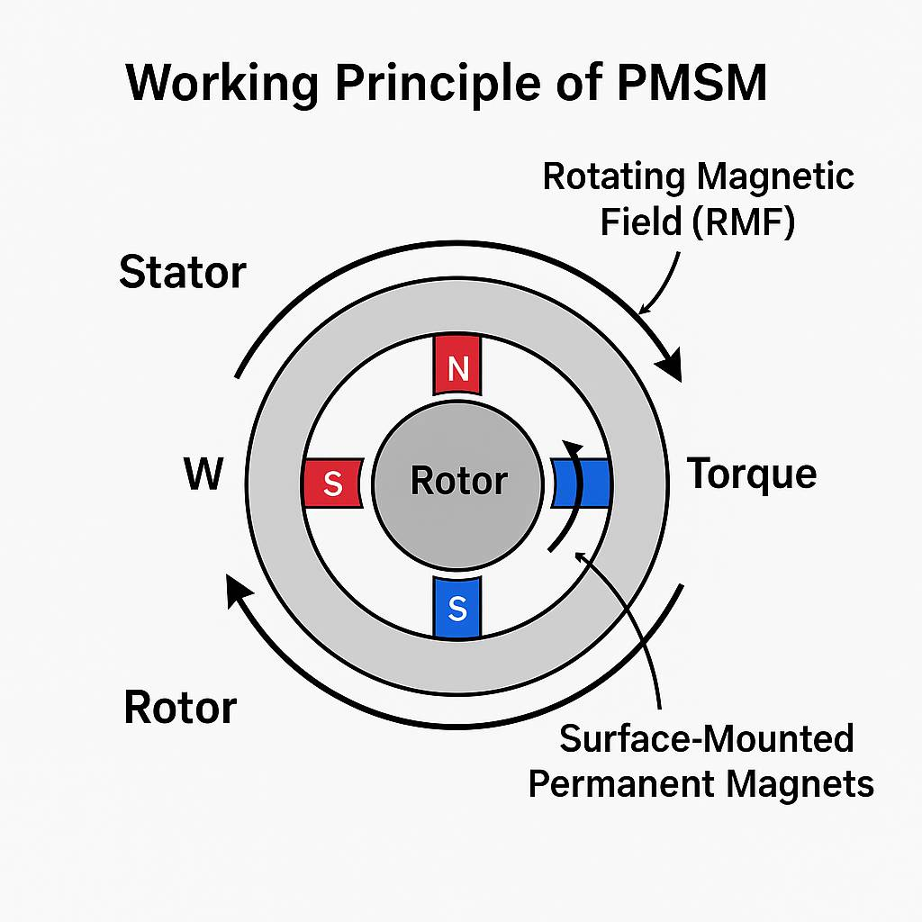
Working Principle of MXUS XF15R MOTOR:
Three-phase AC creates a rotating magnetic field in the stator.
Rotor magnets align with this field and rotate in sync (No slip).
Torque is produced by the interaction of stator and rotor magnetic fields.
Surface-mounted magnets gives smooth sinusoidal Back-EMF and produce steady torque.
Ideal for lightweight electric vehicle especially like EV bikes and (Shell Eco-marathon).

Slide 11
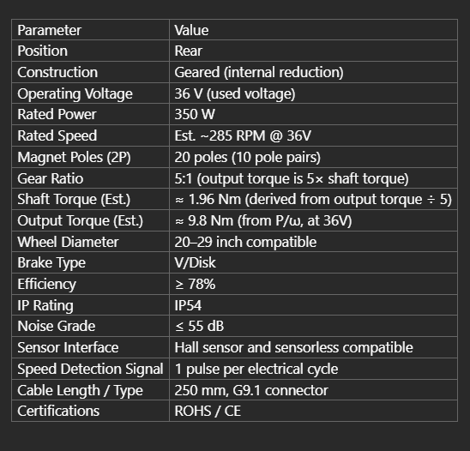
About the MXUS XF15R Motor:
MXUS XF15R is a motorized rear hub with 36V and 350W, which is used in electric bicycles.
It is a three-phase, brushless motor, which has 20 poles (10 pole pairs).
Applies surface-mounted permanent magnets, - providing smooth and sinusoidal back-EMF.
The non-salient rotor design provides L d = L q and low torque ripple.
Has three Hall sensor for position and speed feedback (120 degree phase shifted).
Small and lightweight and suitable to small electric vehicles, such as the Shell Eco-Marathon concept vehicle.
Offers the best balance between efficiency, controllability and safety to research by students.

Slide 12
Justification of methodology:
The motor was tested at standstill, and it was safe to measure Rs, Ld, and Lq without the inverter.
The line-to-line approach takes the same form as the connection of the star on the motor, so that the calculation of Rs is easy and correct.
At 100 kHz, on an LCR meter, we obtained clean and stable values of inductance.
By rotating the rotor softly, we were able to find the lowest (Ld) and highest (Lq) inductance points easily.
In the oscilloscope, a definite Back-EMF signal was observed; this is the usual method of determining K n.
In general, the approach is simple, non-hazardous, cheap, and gives outcomes required in the future FOC regulation.

Slide 13
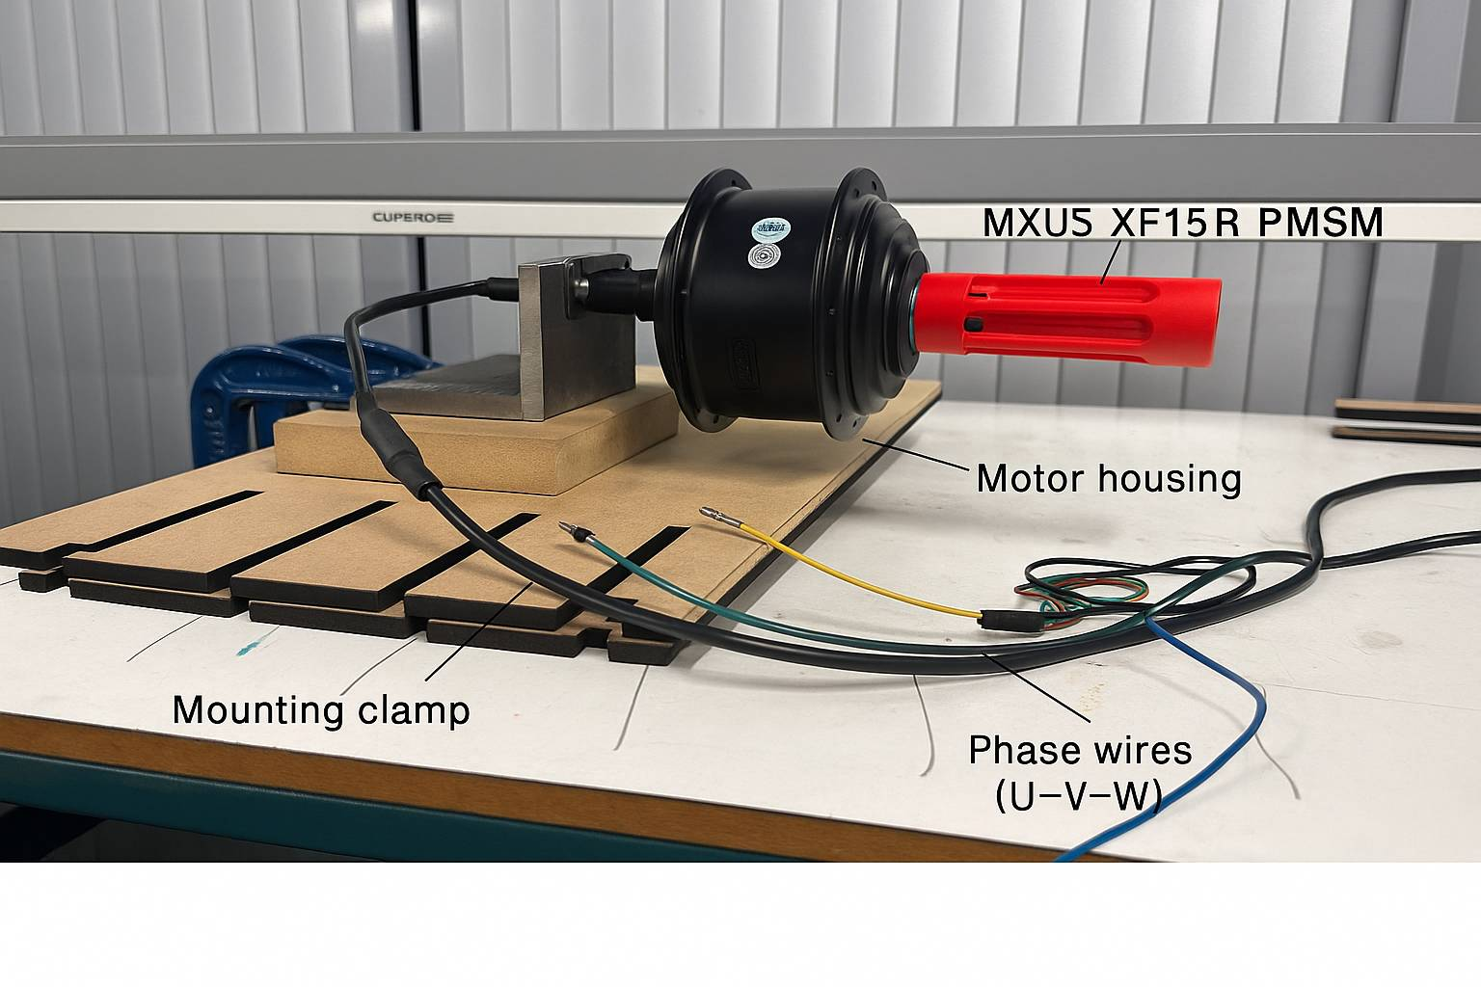
methodology
We performed simple standstill experiments to determine the major parameters of PMSM (Rs, Ld, Lq, and Ke).
These are critical to proper motor modelling and Field-Oriented Control (FOC).
The controller was not connected to the motor so that a safe and controlled test environment would be obtained.
All the necessary electrical measurements were measured with a digital multimeter, LCR meter, and oscilloscope.

Slide 14
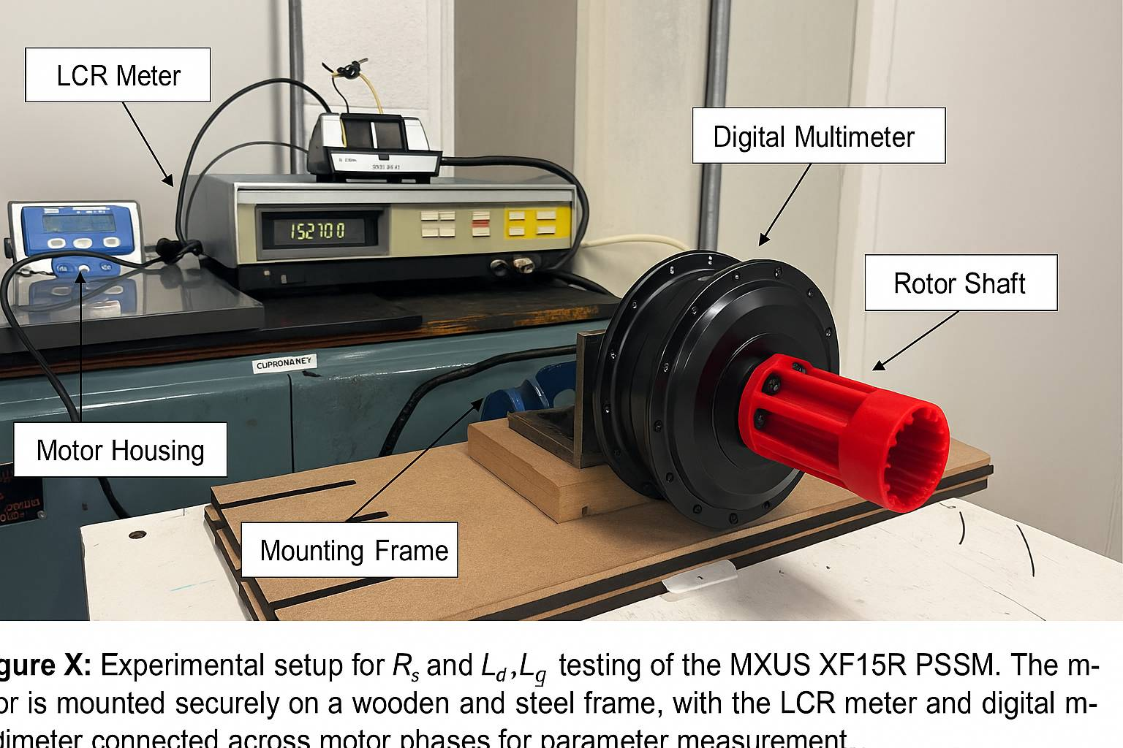

Experimental Procedures:
Stator Resistance (Rₛ)
Inductance (Ld, Lq)
Back-EMF (Ke)
Stator Resistance (Rₛ):
The motor stator is star (Y) connected, and therefore every line-to-line cycle resistance measure is two phase resistances in series.
$${ R}_{s}={R\dot{line−to−line}}/2$$
Measured between phase pairs (U–V, V–W, W–U) using a digital multimeter.
Per-phase resistance obtained as $R_{s}=R_{UV}/2$.
Averaged multiple readings to minimize error.

Slide 15
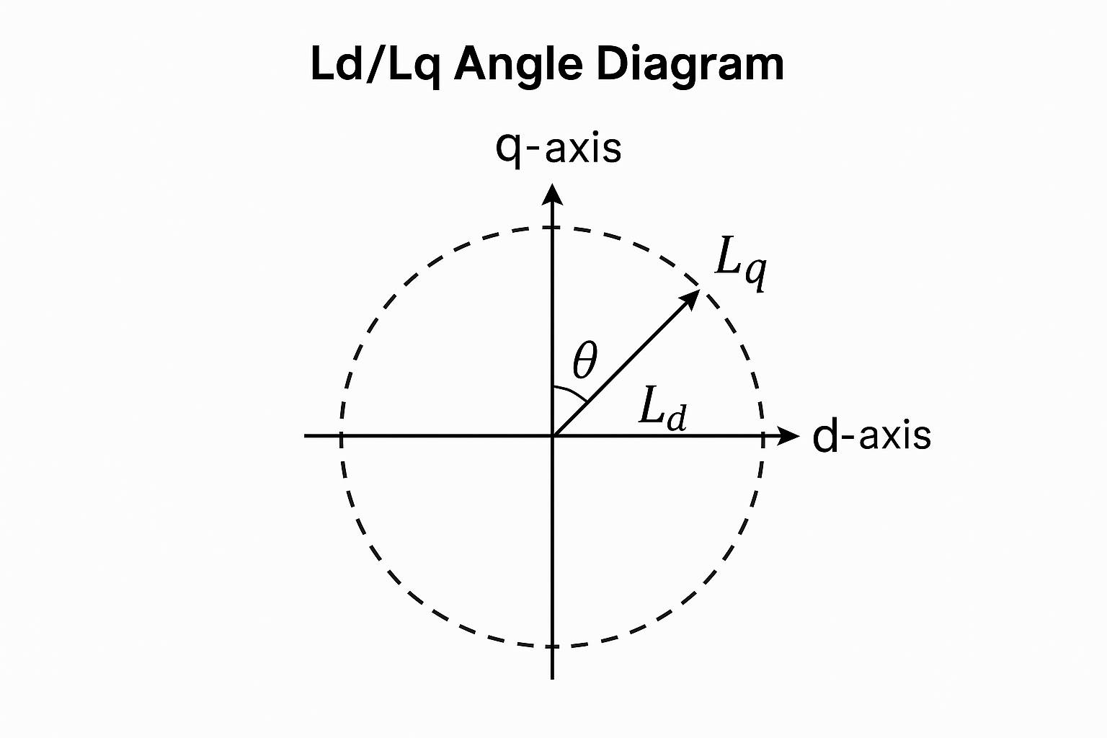

Inductance (Ld, Lq):
Connected LCR meter across U–V, with W terminal open.
Rotor rotated manually; minimum inductance → D-axis, maximum → Q-axis.
Calculated $L_{d}=L_{min}/2$, $L_{q}=L_{max}/2$.
Verified that $L_{q}>L_{d}$, confirming magnetic saliency.

Slide 16
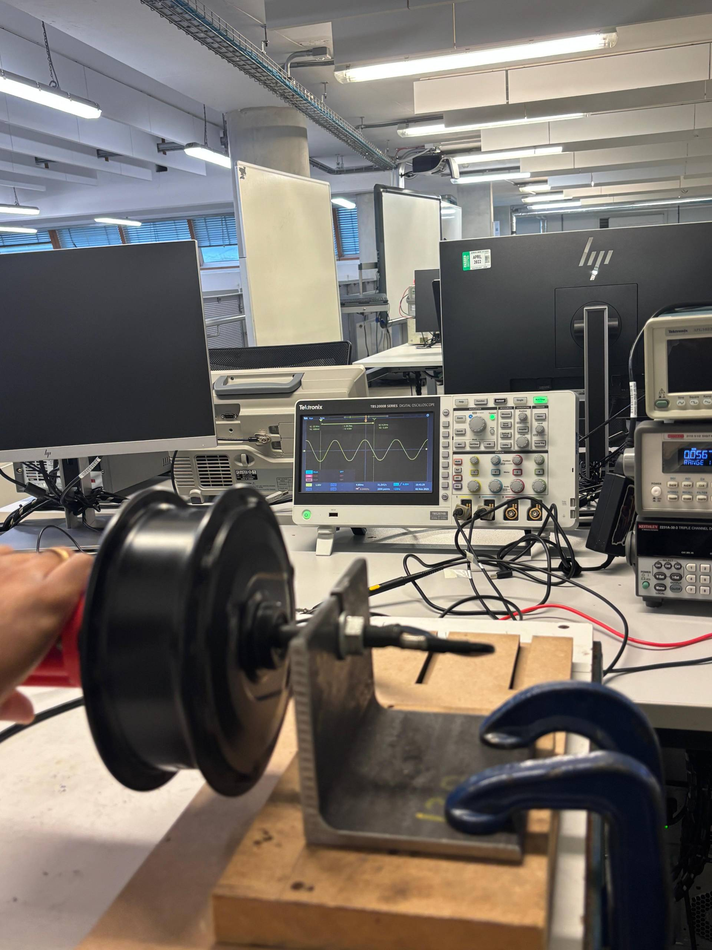
Sinusoidal Back-EMF Waveform Identification :
The U and V motor leads were then connected to the oscilloscope under an open circuit condition.
Small AC voltage was produced by rotating the rotor manually.
An oscilloscope-generated a clear sinusoidal waveform which proved healthy and balanced windings on the stator.
The fact that the waveform is smooth indicates that the PMSM generates AC voltage proportional to the rotor speed.
This also establishes the fact that the motor produces a clean sinusoidal back-EMF that is optimal with FOC and smooth torque generation.

Slide 17
Future Work:
Conduct thorough dynamic testing of the PMSM while it is under load.
Set up a controlled inverter drive to verify the parameters (Rs, Ld, Lq, and Ke).
For this motor, create and fine-tune a Field-Oriented Control (FOC) algorithm.
Calculate torque, speed, and efficiency under various loads.
To investigate how resistance varies with temperature, conduct thermal analysis.
Future scope:
Identified parameters (Rs, Ld, Lq and Back EMF) are used to construct a complete Field-Oriented Control (FOC) system.
Design a prototype motor controller to be used in the Shell Eco-Marathon.
Dynamic and load tests to analyse the performance during real driving.
Test temperature influences on R m and inductance to enhance efficiency.
Produce torque and efficiency maps of advanced controller tuning.
Use the Back-EMF sensor with less control to lessen hardware complexity.
Compare interiors and surface-mounted PMSM designs to investigate the effect of saliency.

Slide 18
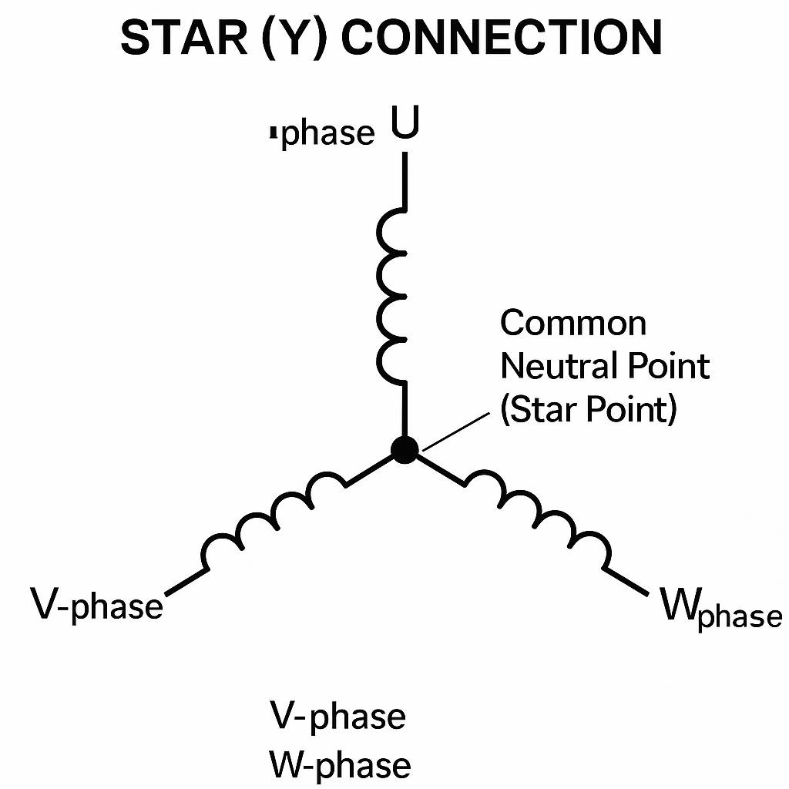

RESULTS
Experimental:
Stator resistances (Rs):
To find stator resistance I measure the three line-to-line resistances between motor terminals.
$R_{Uv}$ = 0.2443
$Rvw$ = 0.185
$Rwu$ = 0.163
U-v path = R1+R2
Now to find the per phase resistances (Rs):
$$R_{s}={R\dot{line−to−line}}/2$$
Now using measured data:
$$R_{s}={0⋅2443}/2=0⋅12215Ω$$

Slide 19

RESULTS
Theoretical:
The motor is star connected and the value of
R1= 2Rs
R2= 1.5Rs
${{ R}_{1}}/{R_{2}}$=$2/{1⋅5}$=1.33$Ω$
Therefore, the Experimental vales of Rs = 0.12215 Ω is close to the theoretical vales.
Experimental:
Measuring of Ld and Lq:
The frequency of the LCR meter was adjusted to 100 kHz to ensure constant inductance values of the meter.
We slowly turned the rotor then and observed the value of inductance decrease.
It was the point at which the inductance was the least and this was the d-axis position.
The minimum value Ld = 135 uH.

Slide 20
RESULTS
Lq measurement:
At Ld position we have rotated the rotor (electrical) 90 degrees.
The maximum inductance occurred at this angle on the LCR meter.
The maximum value Lq = 150 µH.
Key observation for Ld and Lq measurements:
The Lq is higher than Ld slightly indicating that the motor possesses a small saliency effect.
Surface-mounted PMSMs have this behavior as the air gap is almost even.
The inductance values are more precise and consistent when the test frequency is higher (100 kHz).
It eliminates noise, increases sensitivity, and decouples the inductive component and the resistive effects.

Slide 21
CONCLUSION:
Major PMSM parameters (Rs, Ld, Lq and Ke) were obtained.
Findings verify the normal surface-mounted PMSM behaviour (Lq > Ld).
Experimental Rs is close to theory → correct methodology.
Measurement of inductance was made more stable using 100 kHz.
The motor is tested with the results of Back-EMF, which confirm its future use on FOC.
Gives a firm foundation to further modelling and SEM drivetrain development.

Slide 22
References:
Krishnan, R. (2010). Permanent Magnet Synchronous and Brushless DC Motor Drives. CRC Press. – PMSM working principle and torque generation.
Zhu, Z. Q., & Howe, D. (2007). Electrical machines and drives for EV applications. Proceedings of the IEEE, 95(4), 746–765. – FOC control, d–q axis theory.
Lee, K. B., Hyun, D. S., & Ahn, H. S. (2020). Parameter estimation for PMSMs using standstill tests. IEEE Transactions on Industrial Electronics, 67(5), 3902–3914.* – Rs, Ld, Lq, Ke standstill measurement methods.
Bianchi, N., Bolognani, S., & Dai Pré, M. (2017). Estimation of PM flux-linkage and back-EMF constant. IET Electric Power Applications, 11(4), 593–601.* – Supports sinusoidal Back-EMF measurement.
Combes, B., Nahid-Mobarakeh, B., & Meibody-Tabar, F. (2017). High-frequency signal injection for PMSM identification. IEEE Transactions on Power Electronics, 32(5), 3867–3876.* – Advanced Ld/Lq identification.
Shell Eco-Marathon. (2023). Technical Regulations for Prototype Vehicles. Shell Global. – SEM motor application context.

