Slide 1

SMART INDIA HACKATHON 2026
Problem Statement ID - SIH26166
Problem Statement Title - Multi-modal, Sun angle and scale invariant image correspondence using Chandrayaan-2 optical images (OHRC, TMC and IIRS)
Theme - Space Technology | PS Category - Software
Team ID - SIH26-A0H-T363
Team Name (Registered on portal) - Team Zenith
Notes:
[Sources]
Official SIH 2026 Master Catalogue, PS SIH26166 (user-supplied PDF).

Slide 2
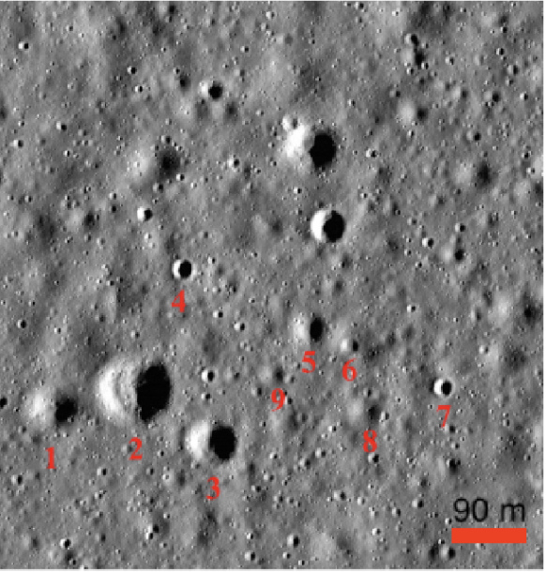
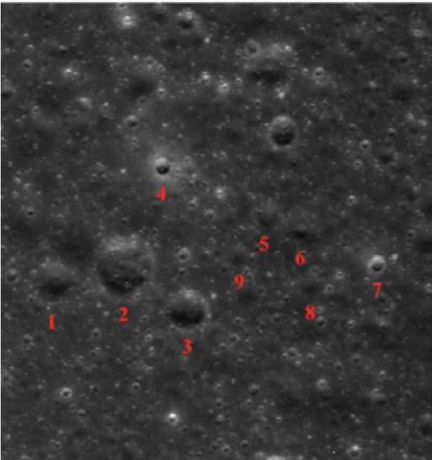
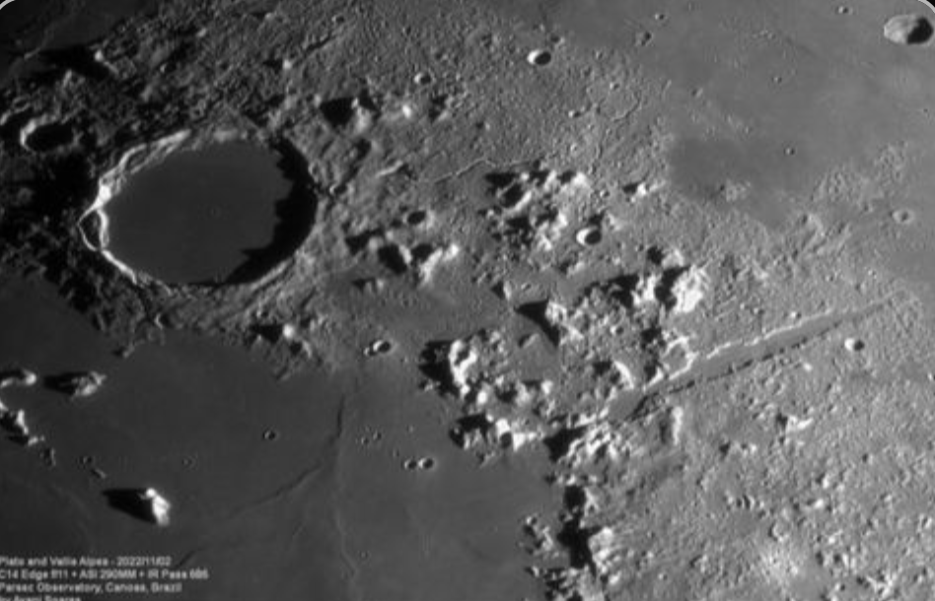
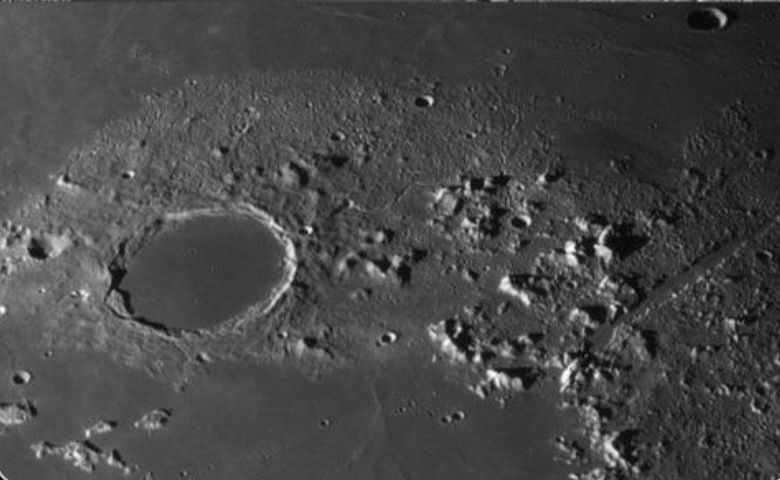
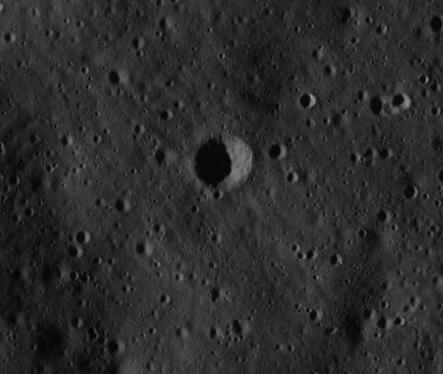
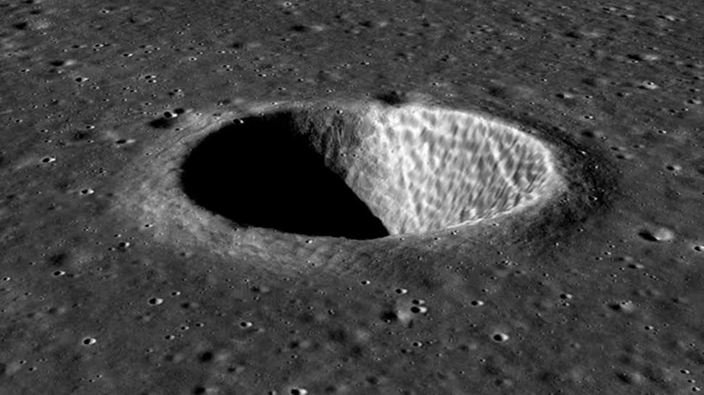

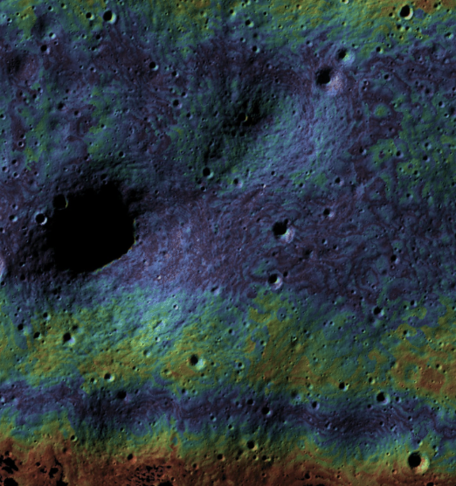
What do we Actually propose
Team Zenith
OUR SOLUTION
The problem and Why is this hard ?
ADDRESSING THE CORE PROBLEM:
1. Sun-angle invariant
Structural representation reduces dependence on changing shadows.
2. Scale-aware
Multi-resolution processing handles very different image resolutions.
3. Multi-modal
Common terrain representation bridges different sensors.
4. Sub-pixel + uniform
Refines trusted matches and distributes them across the scene.
ADAPT
Make both images comparable
Sensor + illumination + scale
Removes differences that make the same terrain look unrelated.
1)Sun angle — "Same crater, different shadows"
Discover matching terrain points
Different appearance ≠ different terrain
FIND
Structural + learned features
2)Scale gap — "0.25 m to ~80 m per pixel"
Finds points that likely represent the same lunar feature.
BEYOND THE PROBLEM STATEMENT
1. Physics-guided
Uses spacecraft geometry and DEM information when available.
2. Adaptive pipeline
Chooses the appropriate matching strategy based on sensor, scale and image conditions.
3. Uncertainty-aware
Reports confidence and can flag unreliable registration instead of forcing a bad result.
4. Operational-ready
Designed as a modular software system, not just an isolated algorithm.
Reject incorrect matches
VERIFY
MAGSAC++ + geometry + DEM
Keeps only matches that agree with the scene's geometry.
🔍 SCALE VARIATION ; OHRC → TMC-2 → IIRS
Very different spatial resolutions using differnt cameras
Make trusted matches precise
3)Sensor type — "Panchromatic vs hyperspectral"
Spatial balancing + sub-pixel refinement
REFINE
Spreads reliable points across the scene and improves their location beyond pixel-level accuracy.
🛰️ SENSOR VARIATION
Different instruments → different image characteristics
ACCURATE LUNAR REGISTRATION
Aligned images + reliable, uniformly distributed match points
Result: conventional correspondence can become unreliable, sparse or spatially clustered.
@SIH Idea submission- Template
Notes:
[Sources]
Official SIH 2026 Master Catalogue, PS SIH26166 (user-supplied PDF).
Proposed system architecture; no performance results are claimed.

Slide 3
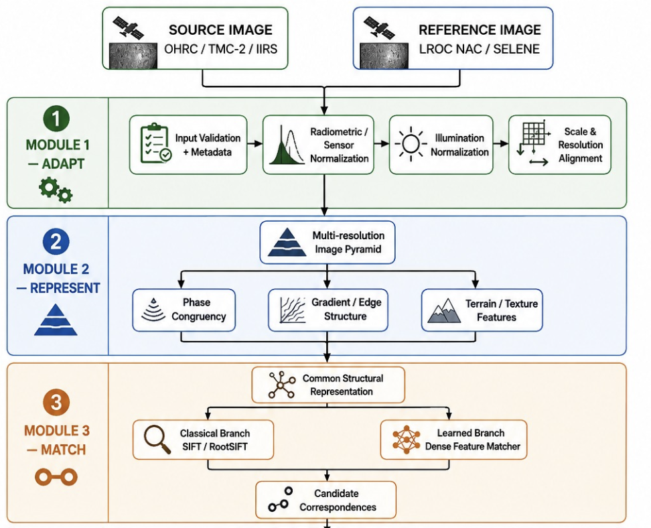
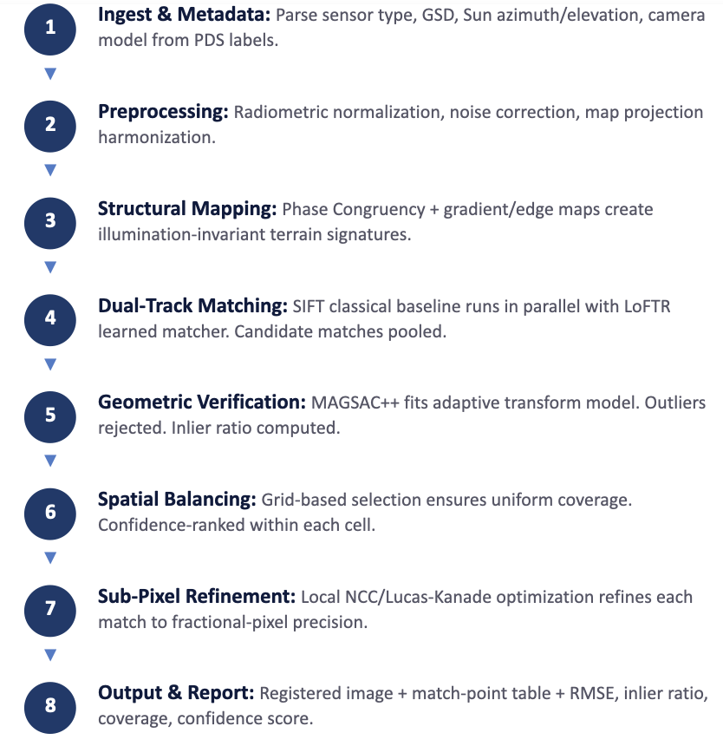
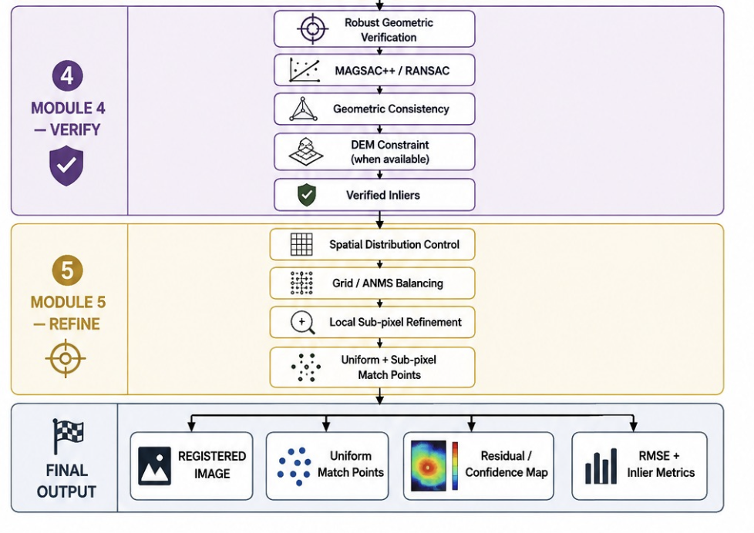





TECHNICAL APPROACH
Team Zenith
Methodology
Tech Stack :
Core & CV:
Python, OpenCV, NumPy, SciPy, scikit-image
Feature Matching:
Phase Congruency (phasepack), SIFT / RootSIFT
Visualization:
Matplotlib, Plotly
Geospatial:
GDAL, Rasterio, pyproj
Deep Learning:
PyTorch, LoFTR / EfficientLoFTR, kornia
Geom. Verification:
MAGSAC++ (pydegensac / OpenCV)
@SIH Idea submission- Template
Notes:
[Sources]
Lowe (2004), Distinctive Image Features from Scale-Invariant Keypoints, IJCV.
Xue et al. (2022), LoFTR: Detector-Free Local Feature Matching with Transformers, CVPR.
Barath et al. (2020), MAGSAC++, CVPR.
Kovesi (1999), Image Features From Phase Congruency, Videre.
Proposed pipeline; matcher choice is evaluated experimentally rather than assumed.

Slide 4
FEASIBILITY AND VIABILITY
Team Zenith
Feasibility Analysis
Challenges and Strategies
Technical
Feasibility
Built entirely on open-source tools: Python, PyTorch, OpenCV, GDAL. SIFT, Phase Congruency, LoFTR, and MAGSAC++ are all published, peer-reviewed, and freely available. No proprietary dependencies.
CHALLENGE
OUR SOLUTION
WHY FEASIBLE
320× scale gap
Hierarchical bridging via TMC-2 as candidate intermediate
~16-20:1 per link; no giant direct-scale search
Data
Feasibility
Chandrayaan-2 data available via ISSDC (chmapbrowse.issdc.gov.in). LRO NAC/WAC data from PDS/LROC archives. SLDEM2015 DEM for geometric reference. All publicly accessible for research.
Modality mismatch
Spectral-to-structural representation for cross-modal matching
Doesn't require raw intensity equivalence
Sun-angle variation
Phase congruency + gradient features (illumination-invariant)
Established CV technique with proven invariance
Hardware
Feasibility
Classical pipeline (SIFT + MAGSAC++ + sub-pixel) runs on any modern CPU. Learned matcher (LoFTR) benefits from GPU but is not a hard dependency. Tiered design ensures a working demo on any hardware.
Outlier matches
MAGSAC++ geometric verification + inlier ratio filtering
Existing robust estimator; no custom model needed
Development
Feasibility
Modular pipeline: each stage is independent and testable. Tiered approach: Prototype (classical core) first, then learned enhancements. Parallel development possible across team members.
Match clustering
Grid-based spatial balancing with per-cell ranking
Lightweight CPU operation; no learning required
Large imagery
Tile-based hierarchical processing
Processes manageable patches; standard approach
Operational
Feasibility
Outputs standard GeoTIFF + match-point CSV. Integrates with existing ISRO/scientific workflows. Confidence scoring allows automated quality control.
@SIH Idea submission- Template
Notes:
[Sources]
Proposed risk controls derived from the SIH26166 requirement for cross-sensor, sun-angle and scale-invariant correspondence.
Barath et al. (2020), MAGSAC++, CVPR.

Slide 5
IMPACT AND BENEFITS
Team Zenith
Projected Outcomes
Benefits
Working Multi-Sensor
Registration System
A functional pipeline that registers Chandrayaan-2 OHRC, TMC-2, and IIRS imagery against LRO NAC/WAC references — the first demonstrated system handling all three sensors in a unified framework.
Enables precise co-registration of multi-sensor lunar data for geological mapping, mineralogical analysis, and landing-site characterization. Supports Chandrayaan-3/4 mission planning. Strengthens India's planetary science capabilities.
Scientific
Automates labor-intensive manual registration workflows at ISRO/NRSC. Reduces processing time from hours to minutes per image pair. Saves expert human effort for higher-level analysis.
Automated Match
Point Generation
Sub-pixel accurate, spatially uniform correspondence points generated automatically. Replaces manual GCP-based workflows currently used at ISRO (Nagori et al., 2026).
Economic
Every registration includes RMSE, inlier ratio, spatial coverage metrics, and an honest confidence label (Registered / Low Confidence / Failed). No false precision claims.
Contributes to India's space program and scientific reputation. Open-source tools empower Indian universities and research institutions. Demonstrates student capability in space-technology R&D.
Confidence-Aware
Quality Output
Social
Benchmark Dataset &
Evaluation Framework
Accurate lunar surface maps support future resource identification (water-ice mapping at poles). Better registration improves remote sensing data quality for environmental monitoring analogues.
The first systematic evaluation protocol for multi-modal Chandrayaan-2 registration, establishing baselines for future research.
Environmental
Modular pipeline integrates into existing ISSDC data-processing chains. Confidence scoring enables automated quality gates. Reduces dependency on specific personnel for registration tasks.
Open-Source
Reproducibility
Built on open-source tools. Every module is independently testable. Can be extended by ISRO or the research community.
Organizational
& Operational
@SIH Idea submission- Template
Notes:
[Sources]
Proposed benefits only; no numeric impact or performance claim is made.
Official SIH 2026 Master Catalogue, PS SIH26166 (user-supplied PDF).

Slide 6





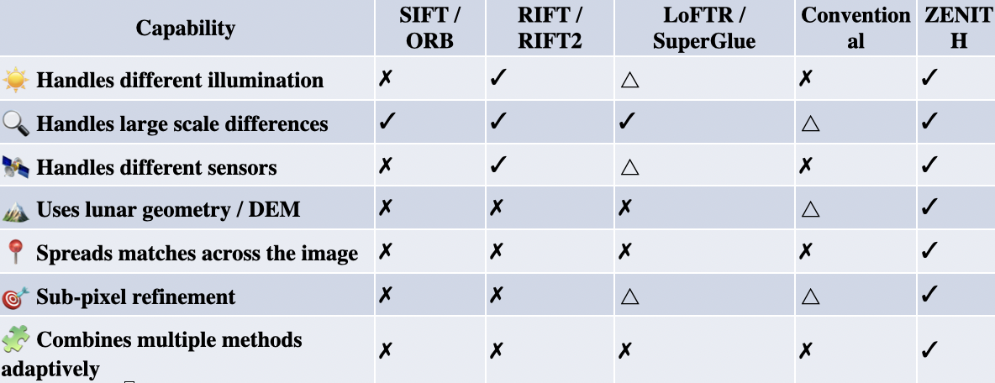
RESEARCH AND REFERENCES
Team Zenith
MISSION DATA:
PRIMARY SOURCES:
ISRO / ISSDC • LROC • USGS Astrogeology • CVPR • IEEE TIP • ISPRS
[1] ISRO/ISSDC — Chandrayaan-2 Data Explorer & Payload Documentation
[2] Li et al. — RIFT: Multi-Modal Image Matching Based on Radiation-Variation Insensitive Feature Transform, IEEE TIP
[3] Sun et al. — LoFTR: Detector-Free Local Feature Matching with Transformers, CVPR 2021
[4] Barath et al. — MAGSAC++, a Fast, Reliable and Accurate Robust Estimator, CVPR 2020
[5] Ge et al. — Automated Registration of Full Moon Remote Sensing Images Based on Triangulated Network Constraints, ISPRS 2024
[6] Comparative evaluation of SIFT / ASIFT / AKAZE / RIFT2 / SuperGlue on Chandrayaan-2 lunar data
[7] NASA PDS / LROC — Lunar Reconnaissance Orbiter Camera Data Archive
[8] USGS Astrogeology — Chandrayaan-2 / ISIS Processing Documentation
CHANDRAYAAN-2
OHRC
~28 cm/pixel • Panchromatic
TMC-2
5 m/pixel • Panchromatic • Stereo
IIRS
80 m/pixel • Hyperspectral
REFERENCE DATA:
LROC NAC / WAC.
The official Chandrayaan Data Explorer confirms the OHRC, TMC and IIRS characteristics, including OHRC's ~28 cm resolution, TMC's 5 m resolution and IIRS's 80 m GSD.
RESEARCH FOUNDATION:
PHASE CONGRUENCY
Illumination & contrast-invariant structure
RIFT
Radiation-invariant multimodal matching
LoFTR
Detector-free coarse → fine correspondence
MAGSAC++
Robust geometric outlier rejection
phase congruency was developed specifically as an illumination/contrast-invariant feature measure; RIFT builds multimodal matching around phase congruency; LoFTR performs coarse-to-fine detector-free correspondence; and MAGSAC++ is a robust estimator for geometric model fitting.
Legend: ✓ = Yes · △ = Partial · ✗ = No
@SIH Idea submission- Template
Notes:
[Sources]
Official SIH 2026 Master Catalogue (user-supplied PDF), PS SIH26166.
Lowe (2004), IJCV; Kovesi (1999), Videre; Xue et al. (2022), CVPR; Barath et al. (2020), CVPR.

