Slide 1



AttUNet : Enhancing ResUNet with Attention Mechanisms for Accurate Brain Tumor Segmentation Paper ID: 779 Track No : 01 VIGNESH S and Dr.RENUKADEVI M.N Dayananda Sagar University Presented by VIGNESH S, Dayananda Sagar University
3rd IEEE International Conference on Interdisciplinary Approaches in Technology and Management for Social Innovation (Hybrid)
March 06-08, 2025, Gwalior, India
Enabling the Change! Social Innovation
for sustainable societies

Slide 2
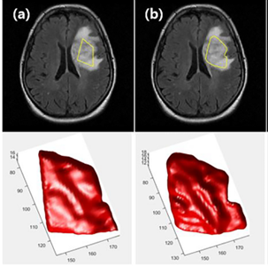
Introduction
Brain Tumor Segmentation: Importance & Challenges
Essential for accurate diagnosis & treatment planning.
Manual segmentation is time-consuming & prone to human error.
Challenges:
Variability in tumor shape, size, and intensity.
Low contrast between tumor & healthy tissue.
Existing models struggle with under-segmentation & false positives.
Research Objective & Contribution:
Develop an AttUNet-based segmentation model with attention mechanisms.
Improve feature extraction & focus on critical tumor regions.
Benchmark performance against state-of-the-art models (U-Net++, Deep Res-UNet, Znet).
Evaluate using IoU, Dice Similarity Coefficient (DSC), and Similarity Index (SI) on the TCGA-LGG dataset.
3rd IEEE International Conference on Interdisciplinary Approaches in Technology and Management for Social Innovation (Hybrid)
March 06-08, 2025, Gwalior, India
Enabling the Change! Social Innovation
for sustainable societies

Slide 3

Related Work
Reference | Focus Area | Methodology | Findings | Challenges
1 | Multi-modal MRI segmentation. | 3D Fully Convolutional Network with multi-route development & dilated convolutions. | Improved feature extraction from multi-modal MRI data. | High computational cost, requires large datasets.
2 | Transfer learning in tumor segmentation. | CNN-based U-Net with VGG16 pre-trained backbone. | Better tumor grading & segmentation accuracy. | Limited feature extraction, reliant on pre-trained weights.
3 | Enhancing encoder-decoder U-Net. | Additional upsampling layers along skip connections. | Improved boundary delineation & segmentation consistency. | Computationally intensive, risk of artifacts in segmentation.
4 | Gradient issues in deep networks. | 3D Deep Residual U-Net with skip connections in ResNet blocks. | Better training stability, improved feature learning. | Increased model complexity, longer training time.
5 | Attention mechanisms for segmentation. | Attention-Guided U-Net with spatial & channel attention. | Improved focus on tumor regions, higher segmentation accuracy. | Requires careful parameter tuning.
6 | Attention + Residual Learning. | Combines attention gates & ResNet blocks for feature refinement. | Higher segmentation accuracy, better tumor boundary detection. | Computationally expensive, may need optimization for real-time use.
3rd IEEE International Conference on Interdisciplinary Approaches in Technology and Management for Social Innovation (Hybrid)
March 06-08, 2025, Gwalior, India
Enabling the Change! Social Innovation
for sustainable societies

Slide 4

Methodology
Overview of AttUNet Architecture
Based on Residual U-Net – Incorporates residual connections to preserve spatial information and improve gradient flow.
Attention Mechanism – Focuses on relevant tumor regions, reducing false positives and improving segmentation accuracy.
Skip Connections – Help retain fine details and mitigate vanishing gradients.
Working Principle of AttUNet
1.Encoder (Feature Extraction):
Uses convolutional layers with residual connections to extract low- and high-level features.
Down sampling captures spatial context from MRI images.
2.Attention Module:
Introduced in skip connections to enhance feature refinement.
Suppresses irrelevant background regions and enhances tumor-relevant features.
3.Decoder (Segmentation Mask Generation):
Up sampling layers reconstruct the segmentation mask with enhanced precision.
Skip connections bridge the encoder and decoder to retain spatial information.
4.Final Output:
Produces a segmented tumor mask with improved boundary delineation.
3rd IEEE International Conference on Interdisciplinary Approaches in Technology and Management for Social Innovation (Hybrid)
March 06-08, 2025, Gwalior, India
Enabling the Change! Social Innovation
for sustainable societies

Slide 5
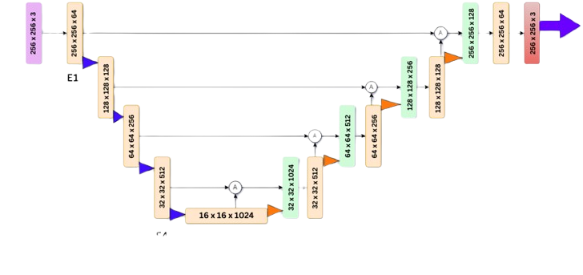
Methodology & Approach
3rd IEEE International Conference on Interdisciplinary Approaches in Technology and Management for Social Innovation (Hybrid)
March 06-08, 2025, Gwalior, India
Enabling the Change! Social Innovation
for sustainable societies

Slide 6
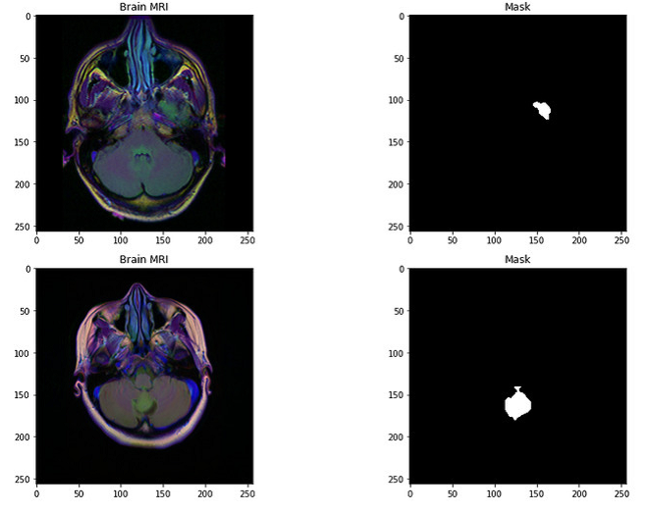
Dataset & Implementation
Dataset Details:
TCGA LGG dataset – Contains brain MRI scans with labeled tumor regions.
FLAIR Modality Only – Highlights tumor-related abnormalities for segmentation.
110 Patient Cases – Preprocessed 3-channel images, where missing sequences are replaced with FLAIR.
Preprocessing Steps:
Normalization & Resizing (256×256) for consistency
Data Augmentation – Rotation, flipping, and contrast adjustments to enhance model generalization.
Implementation Details:
Frameworks: TensorFlow, Keras, OpenCV.
Hardware: NVIDIA GPU (CUDA-accelerated for faster training).
Hyperparameters:
Learning rate: 0.001 (Adam optimizer)
Batch size: 16, Epochs: 50–100
3rd IEEE International Conference on Interdisciplinary Approaches in Technology and Management for Social Innovation (Hybrid)
March 06-08, 2025, Gwalior, India
Enabling the Change! Social Innovation
for sustainable societies

Slide 7
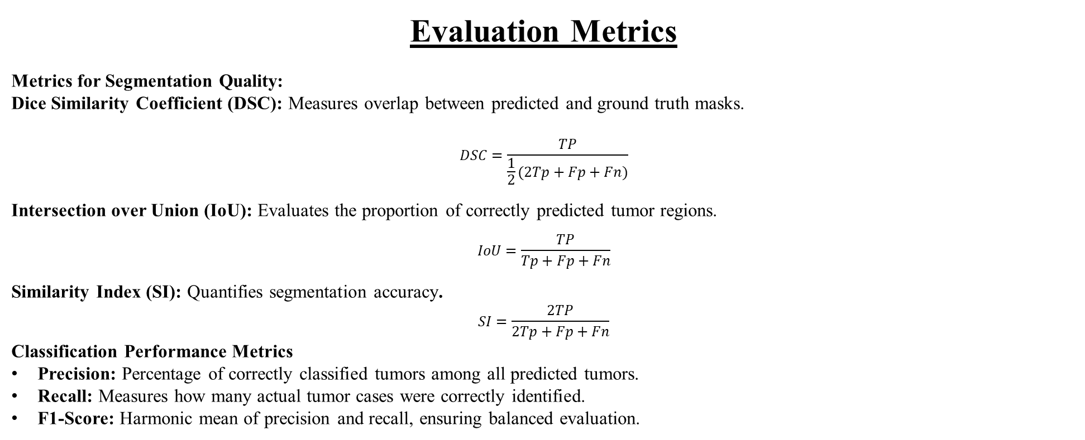
Evaluation Metrics
Metrics for Segmentation Quality:
Dice Similarity Coefficient (DSC): Measures overlap between predicted and ground truth masks.
$$DSC=\frac{TP}{\frac{1}{2}(2Tp+Fp+Fn)}$$
Intersection over Union (IoU): Evaluates the proportion of correctly predicted tumor regions.
$$IoU=\frac{TP}{Tp+Fp+Fn}$$
Similarity Index (SI): Quantifies segmentation accuracy.
$$SI=\frac{2TP}{2Tp+Fp+Fn}$$
Classification Performance Metrics
Precision: Percentage of correctly classified tumors among all predicted tumors.
Recall: Measures how many actual tumor cases were correctly identified.
F1-Score: Harmonic mean of precision and recall, ensuring balanced evaluation.
3rd IEEE International Conference on Interdisciplinary Approaches in Technology and Management for Social Innovation (Hybrid)
March 06-08, 2025, Gwalior, India
Enabling the Change! Social Innovation
for sustainable societies

Slide 8

Experimental Results & Evaluation
Benchmark Comparison
AttUNet outperforms models like U-Net++, Deep Res-UNet, and ZNet in segmentation quality.
Achieved IoU: 0.92, DSC: 0.94, SI: 0.94, surpassing other architectures.
Higher recall and precision indicate better tumor boundary delineation and reduced false positives.
Comparison with Baseline Models:
Model | IoU | DSC | SI
3D UNet | 0.749 | 0.856 | 0.830
Deep Res-UNet | 0.835 | 0.866 | 0.800
Znet Deep Learning | 0.89 | 0.92 | 0.91
UNet++ | 0.92 | 0.89 | 0.87
AttUNet (Proposed) | 0.92 | 0.94 | 0.94
3rd IEEE International Conference on Interdisciplinary Approaches in Technology and Management for Social Innovation (Hybrid)
March 06-08, 2025, Gwalior, India
Enabling the Change! Social Innovation
for sustainable societies

Slide 9


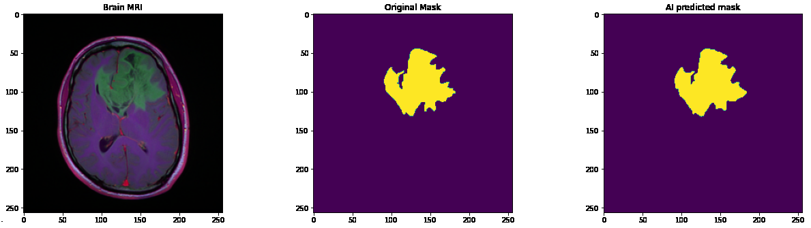
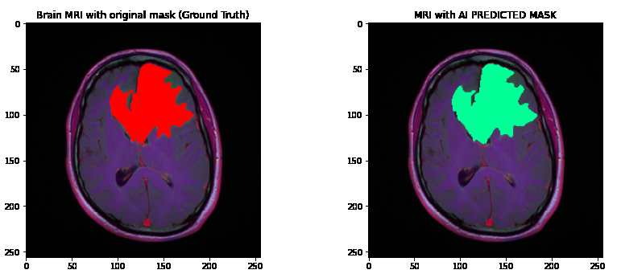
Discussion & Findings
Strengths of the Proposed Model:
Higher segmentation accuracy compared to existing deep learning models.
Attention Gates – Focus on relevant tumor regions, reducing false positives.
Residual Connections – Prevent vanishing gradients, enabling deeper
and more stable trainingLimitations:
Better Feature Extraction – Captures multi-scale tumor characteristics
for improved segmentation.May require further optimization for
real-time applications.
Clinical Impact:
Enhances Early Detection – Aids in accurate tumor diagnosis for timely
interventionPotential for real-world deployment in radiology departments.
Assists in Treatment Planning – Helps radiologists and oncologists in
decision-making.
Potential for AI-Assisted Radiology – Can be integrated into clinical
workflows for automated MRI analysis
3rd IEEE International Conference on Interdisciplinary Approaches in Technology and Management for Social Innovation (Hybrid)
March 06-08, 2025, Gwalior, India
Enabling the Change! Social Innovation
for sustainable societies

Slide 10
Conclusion & Future Work
The proposed AttUNet model improves brain tumor segmentation by incorporating attention mechanisms within a Residual U-Net framework.
Achieved high segmentation accuracy with IoU (0.92), DSC (0.94), and SI (0.94), outperforming traditional models.
Effectively reduces false positives and enhances tumor boundary delineation.
Potential Improvements:
Deeper Networks: Integrating more convolutional layers to capture intricate tumor features and improve segmentation.
Multi-Modal Data: Leveraging additional MRI modalities (e.g., DWI, SWI) for richer feature representation.
Optimization Techniques: Exploring self-supervised learning or transformer-based architectures for enhanced generalization.
Clinical Integration: Adapting the model for real-time deployment in clinical settings with physician feedback loops.
3rd IEEE International Conference on Interdisciplinary Approaches in Technology and Management for Social Innovation (Hybrid)
March 06-08, 2025, Gwalior, India
Enabling the Change! Social Innovation
for sustainable societies

Slide 11
Acknowledgment & References
Acknowledgment:
We acknowledge the contributions of our mentors, collaborators, and institutions for their invaluable support. We also thank the TCGA-LGG dataset providers for facilitating this research.
Key References
1.M. Noori, A. Bahri, and K. Mohammadi, "Attention-Guided Version of 2D UNet for Automatic Brain Tumor Segmentation," IEEE Conference, 2021.
2. Z. Zhou, M. M. R. Siddiquee, and N. Tajbakhsh, "UNet++: Redesigning Skip Connections to Exploit Multiscale Features in Image Segmentation," IEEE Transactions on Medical Imaging, 2021.
3. R. Raza, U. I. Bajwa, and H. Khalid, "dResU-Net: 3D Deep Residual U-Net based Brain Tumor Segmentation from Multimodal MRI," Elsevier Neurocomputing, vol. 2023.
4. The Cancer Genome Atlas (TCGA-LGG Dataset): Available: https://tcga-data.nci.nih.gov/tcga/
5. M. A. Naser and M. J. Deen, "Brain Tumor Segmentation and Grading of Lower-Grade Glioma using Deep Learning in MRI Images," Elsevier Artificial Intelligence in Medicine, vol. 2021.
6. A. A. Asiri, A. Shaf, and R. M. Ali, "Brain Tumor Detection and Classification Using Fine-Tuned CNN with ResNet50 and U-Net Model: A Study on TCGA-HGG and TCIA Dataset for MRI Applications," MDPI Life, vol. 13, no. 7, 2023.
3rd IEEE International Conference on Interdisciplinary Approaches in Technology and Management for Social Innovation (Hybrid)
March 06-08, 2025, Gwalior, India
Enabling the Change! Social Innovation
for sustainable societies

Slide 12

3rd IEEE International Conference on Interdisciplinary Approaches in Technology and Management for Social Innovation (Hybrid)
March 06-08, 2025, Gwalior, India
Enabling the Change! Social Innovation
for sustainable societies

