Slide 1
DONE UNDER
Dr.NABAJYOTI MAZUMDAR SIR
PROJECT MEMBERS
Jayendra Reddy(IIT2021268)
Vignesh(IIT2021262)
Harsha Vardhan Raju(IIT2021258)

Slide 2
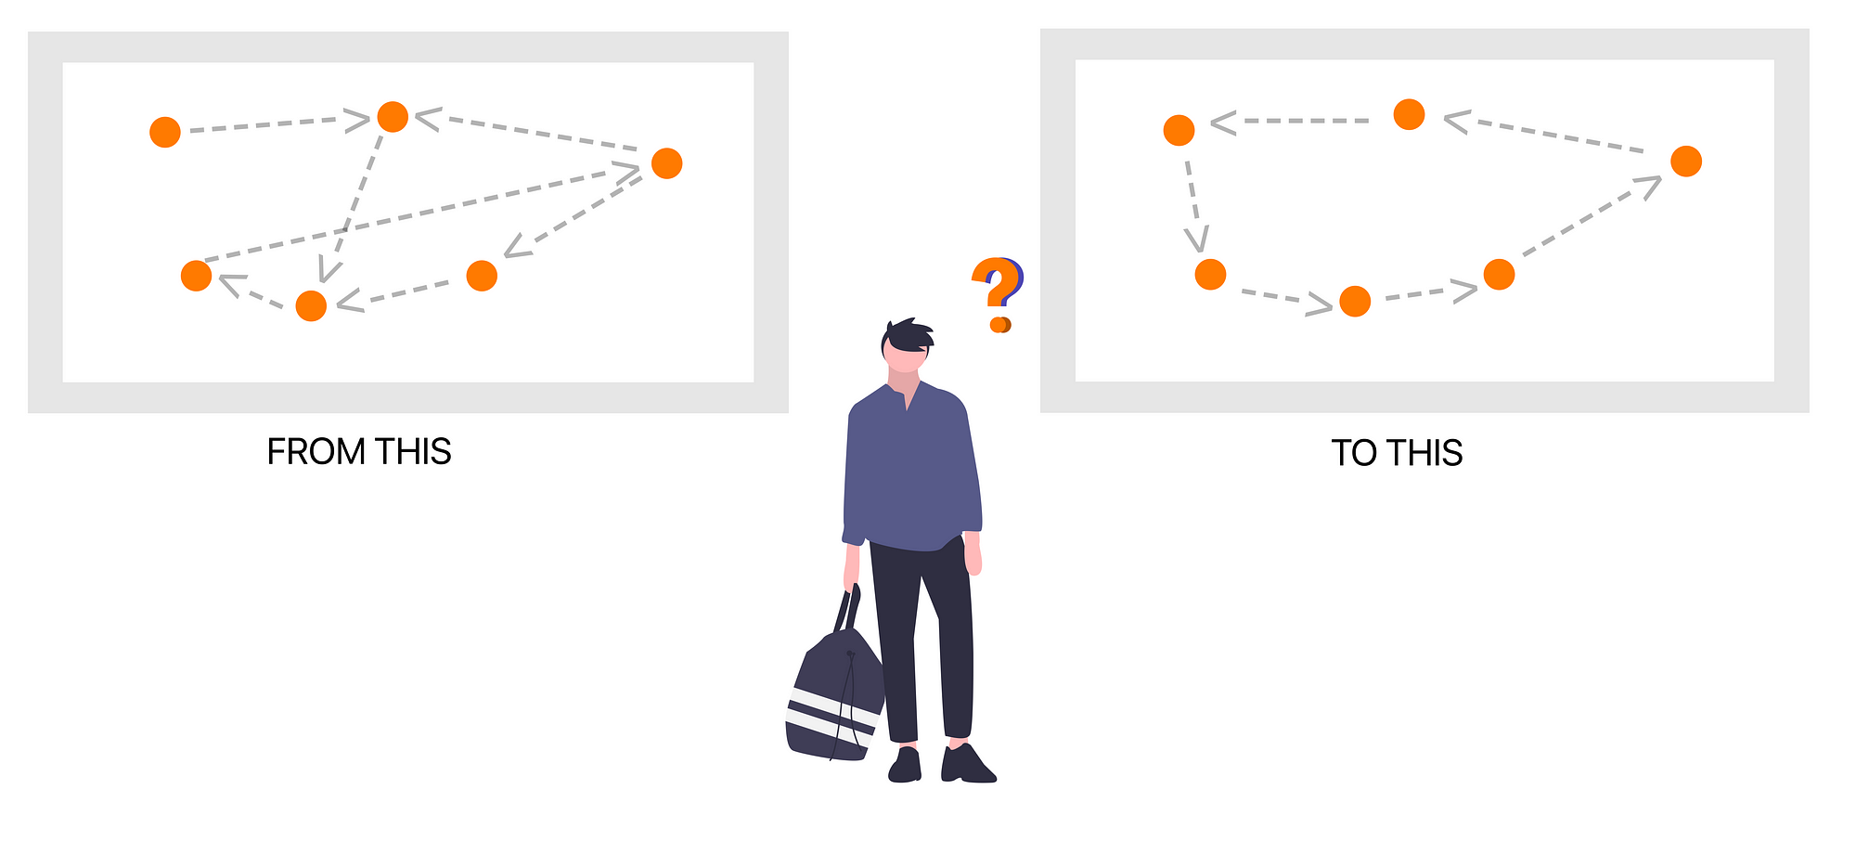
EXPLORING VARIOUS HEURISTICS FOR SOLVING CLASSIC AND VARIANT OF TSP

Slide 3
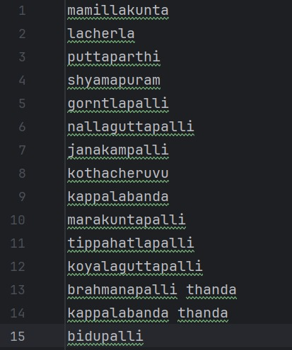
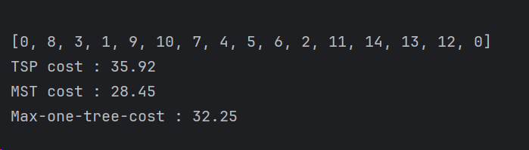
A quick glance on the work till the previous evaluation
Studied about the classical TSP.
Found the lower bound using a dataset.

Slide 4
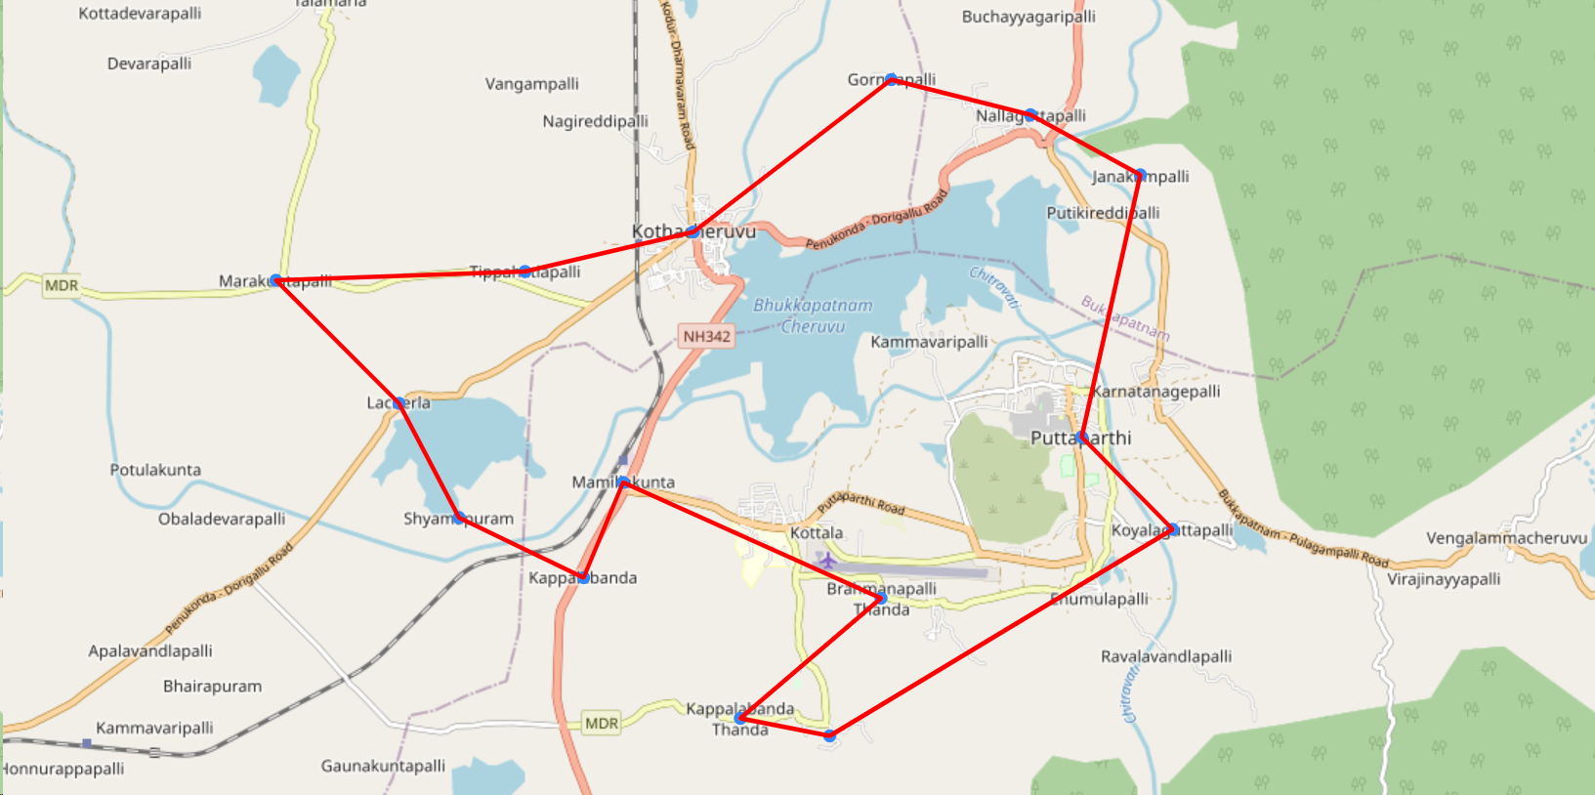
Employed two heuristics to solve the Classical TSP :
1)Genetic Algorithm
2)Ant Colony Optimization(ACO)
Compared the results obtained and found that the ACO gives better results.

Slide 5
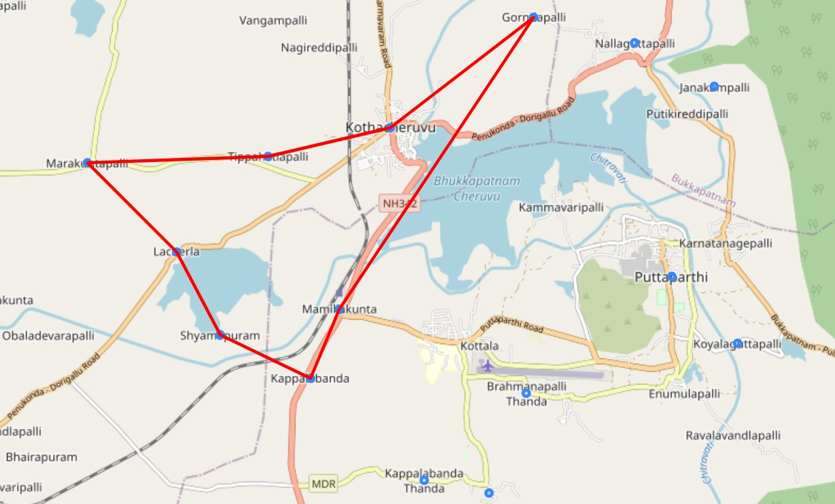
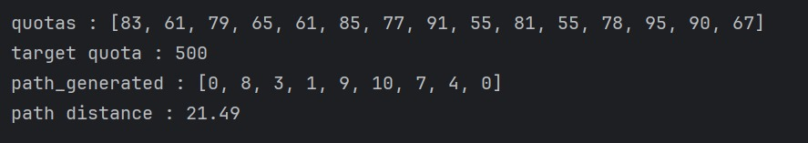
Implemented a variant of the TSP and applied ACO on it.
Quota TSP:

Slide 6
Overview of PPT:
Implemented two more heuristics –
1)Simulated Annealing and
2)Christofides Algorithm
Hyperparameter tuning of the ACO parameters using –
1)Bayesian Optimization
2)Response Surface Methodology
Limitations of the algorithms we explored.
Brief introduction about Reinforcement Learning
Implementation of Reinforcement Learning on classical TSP.
Reinforcement Learning on a variant of the TSP(Quota)
Implemented a practical scenario using :
1)Q-Learning
2)SARSA

Slide 7
Simulated Annealing:
An optimization algorithm inspired by the annealing process in metallurgy.
Starts with an initial combination of cities which can be a random one.
Iteratively explores the solution space by making small changes to the current solution.
Accepting the new solution would be based on the Metropolis criterion.
Parameters :
a) Temperature -
It determines the probability of accepting worse solutions early in the process .
Initially, when the temperature is high, the algorithm has a higher probability of accepting worse solutions, allowing it to escape local optima.
As the temperature decreases, the probability of accepting worse solutions decreases, leading the algorithm towards convergence to an optimal or near-optimal solution.
b) Cooling Rate –
It controls the rate at which the temperature decreases during the annealing process.

Slide 8
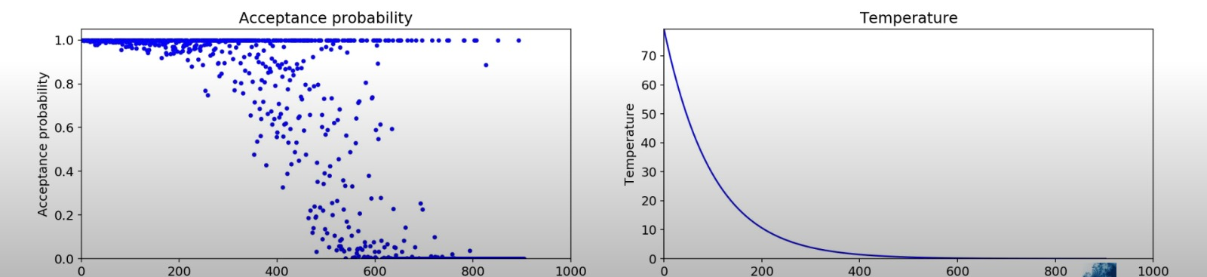
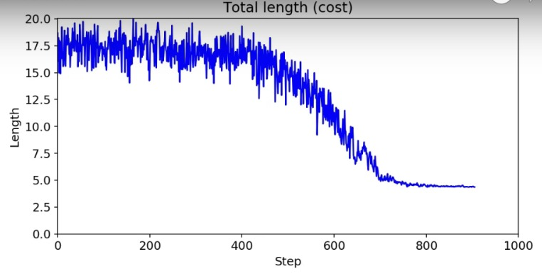

Slide 9
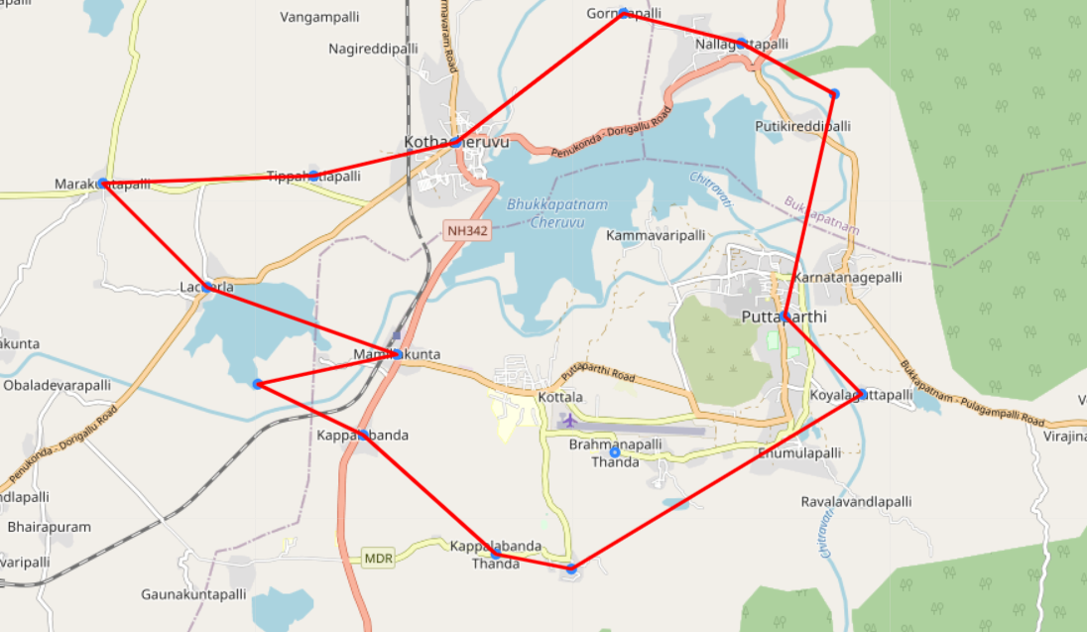
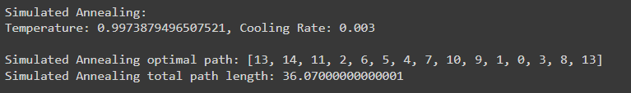
Simulated Annealing Results:

Slide 10
Christofides Algorithm:
It guarantees to find a solution that is within a factor of 3/2 of the optimal solution.
Steps -1:
Minimum Spanning Tree (MST): First, a minimum spanning tree of the given graph (representing the cities and distances between them) is constructed.
Step – 2:
Minimum Weight Perfect Matching: Next, the algorithm finds a minimum weight perfect matching of the odd-degree vertices (vertices with an odd number of edges) in the minimum spanning tree.
Step – 3:
Eulerian Circuit: Combining the minimum spanning tree and the matching, an Eulerian circuit (a circuit that visits every edge exactly once) is formed.
Step – 4:
TSP Tour Construction: Finally, the Eulerian circuit is transformed into a TSP tour by skipping already visited vertices.

Slide 11
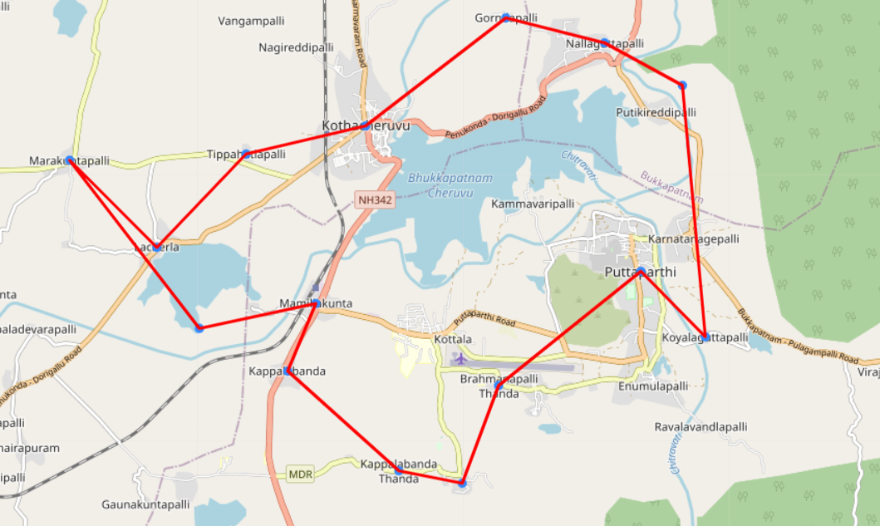
Christofides Results:

Slide 12
Parameter Tuning on ACO:
The results obtained using the ACO vary very much with that of the lower bound we have found.
So, by tuning of the parameters involved in the ACO , better results can be obtained.
The parameters –
Alpha(α)– It accounts for the pheromone level factor in selecting the next step or path.
Beta(β)– It accounts for the distance factor in selecting the next path.
Rho(ρ)– It accounts for the evaporation factor of pheromones released by the ants.
Methods used:
a) Bayesian Optimization
b) Response Surface Methodology

Slide 13
Bayesian Optimization:
Prior Distribution:
We start by defining prior distributions for the parameters of interest, representing our initial beliefs about their values before observing any data.
Likelihood Function:
We then collect data by running the ACO algorithm with different parameter configurations and observe its performance metrics, such as tour length or convergence rate.
Posterior Distribution:
Using Bayes' theorem, we update our beliefs about the parameters based on the observed data, yielding posterior distributions that incorporate both prior knowledge and new evidence.
Parameter Estimation:
We estimate the parameters' values by summarizing the posterior distributions, such as computing posterior means or medians.

Slide 14
Response Surface Methodology:
An optimization technique which can be useful when there are multiple variables effecting a process .
Steps:
Select the parameters to be tuned.
Define the response i.e. the objective function – distance in the classical TSP
Use the experimental design techniques to determine the combination of parameters.
Find the results generated by various set of parameters.
Create a mathematical model to relate the input parameters to the output response.
Optimize the

Slide 15
Reinforcement Learning
What is RL and why RL?
Type of machine learning algorithm where an agent learns to make decisions by interacting with an environment.
It relies on two import terms : action and reward .
And it is about taking suitable action to maximize reward in a particular situation.
Adaptability:
RL algorithms can adapt to changes in the environment and offers a more realistic/practical touch.
They learn from experience and adjust their strategies accordingly.
Exploration-Exploitation Balance:
RL algorithms naturally balance exploration and exploitation, which can help in escaping local optima.
They can explore the search space more efficiently than traditional optimization algorithms.

Slide 16
Q-Learning on traditional TSP:
Initialization:
Initializes parameters like the number of cities, the number of episodes, learning rate, discount factor, and epsilon for epsilon-greedy policy and also initializes a Q-table with zeros.
Epsilon-Greedy Policy:
It defines a function for the epsilon-greedy policy, which chooses a random action with probability epsilon, otherwise chooses the action with the maximum Q-value for a given state
The formula for the epsilon-greedy policy is:
𝜋(𝑎∣𝑠)=random action with probability 𝜖
action with max⁡𝑎′𝑄(𝑠,𝑎′)with probability 1−𝜖

Slide 17
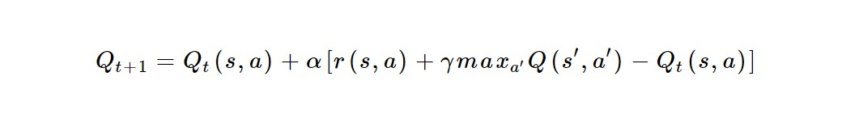
Q-learning Algorithm:
It runs the Q-learning algorithm for a certain number of episodes.
In each episode, it starts from a random city, performs a full tour while updating the Q-table based on the rewards obtained, and finally returns to the starting city.
Finding Optimal Tour:
After training, it finds the optimal tour by choosing the action with the maximum Q-value at each step.
It iterates through all cities to find the shortest tour.

Slide 18
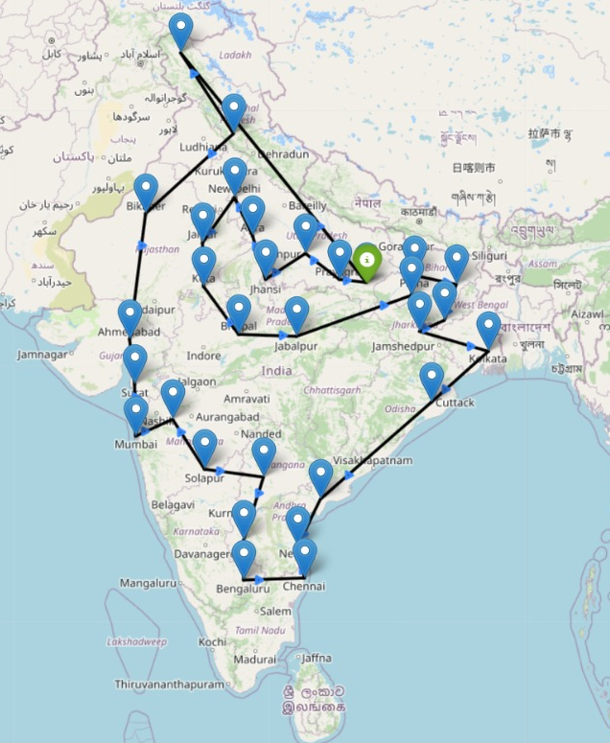
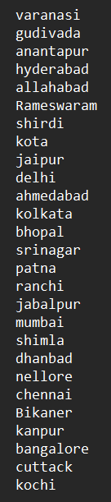
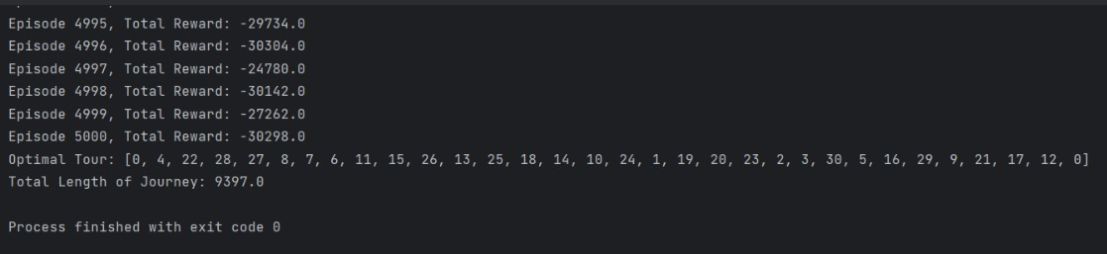
Q-Learning Results:

Slide 19
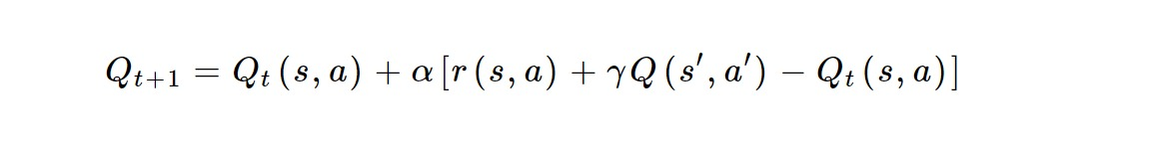
SARSA Algorithm:
It is a modified Q learning algorithm where target policy is same as behavior policy.
The two consecutive state action pairs and the immediate reward received by the agent while transitioning from first state to the next state determine the updated Q value, so this method is called SARSA.
SARSA : State(s) Action (a) Reward (r) State (s’) Action (a’).
As target policy is same as behavior policy , SARSA in an on policy learning algorithm.

Slide 20
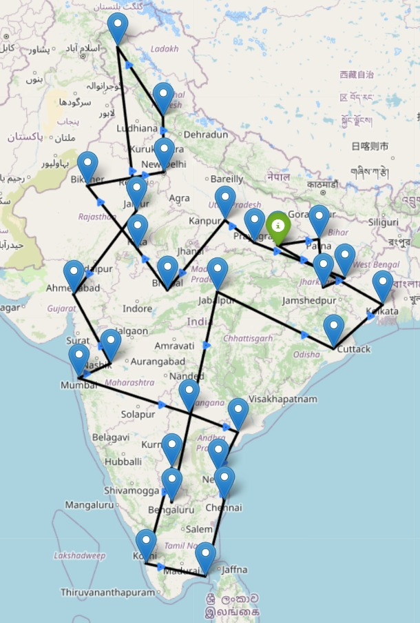
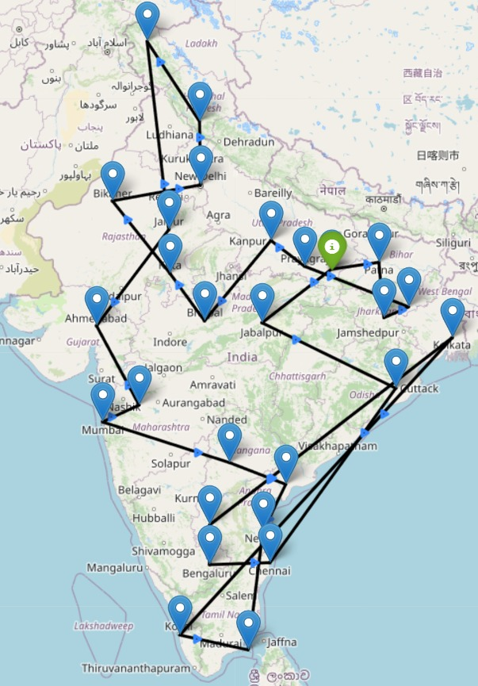
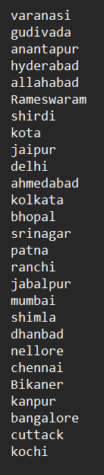
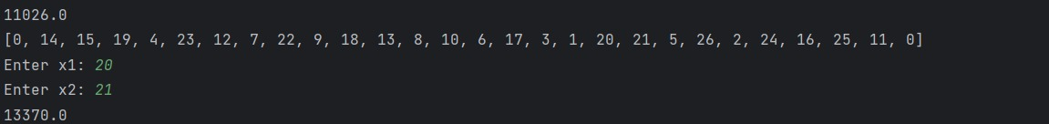
Comparing Q-Learning and ACO on a Real Life Scenario:
If there is a road block at a particular city in the optimal path - ACO

Slide 21
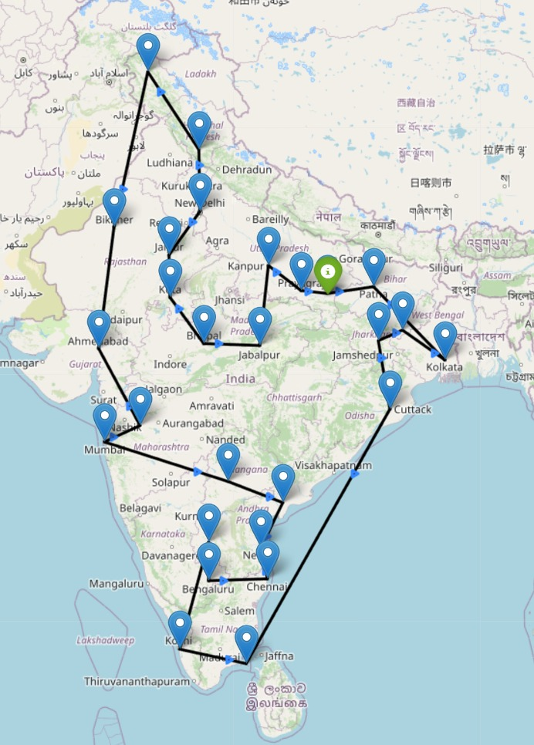
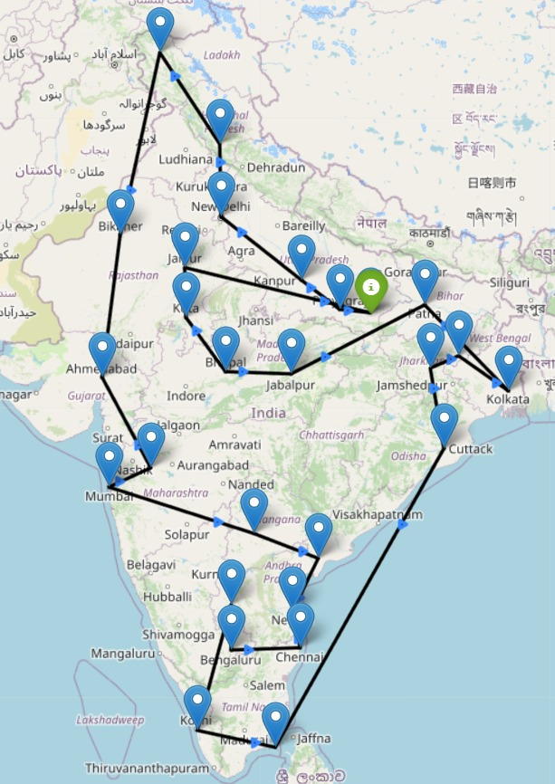
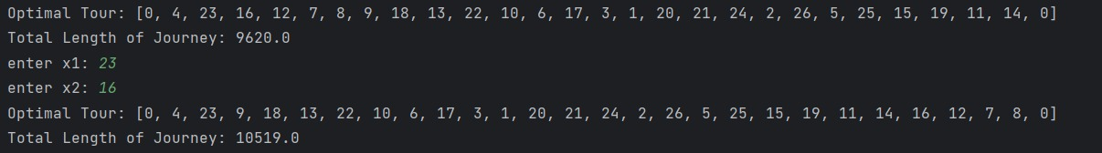
If there is a road block at a particular city in the optimal path – Q-Learning

Slide 22
Conclusion
Starting with the natural heuristics like genetic and ACO algorithms, we have explored the Reinforcement learning algorithms like Q-Learning and SARSA for solving the TSP.
For solving the traditional TSP , there are many algorithms which gives optimal or near optimal solutions. But , Reinforcement learning offers an advantage over the other algorithms in solving more dynamic scenarios in the environment.

Slide 23
THANK YOU

