Slide 1
STUDENT QUERY AI CHATBOT
Natural Language Processing (NLP) & Rule-Based Intent Matching
Minor Project Viva & Academic Presentation

Slide 2
Problem Statement & Project Objectives
❌ Existing Challenges
• Helpdesks flooded with repetitive administrative inquiries.
• Long student wait times during admission peak periods.
• Manual response handling is inefficient and costly.
• Commercial LLM APIs (GPT-4) can be expensive and prone to hallucination.
🎯 Project Objectives
✓ Develop an offline-capable Python NLP Chatbot.
✓ Implement TF-IDF & Cosine Similarity for confidence scoring.
✓ Pre-load dataset covering Courses, Fees, Timings, Contact, Admissions, Hostels.
✓ Build interactive dual interfaces: Terminal CLI and Web Dashboard.
✓ Provide explicit exit controls ('exit', 'quit', 'bye').

Slide 3
System Architecture & Processing Pipeline
1. User Query
Input string from CLI or Web UI
2. Preprocessing
NLTK lowercasing, tokenization & lemmatization
3. TF-IDF Matrix
Feature extraction & English stop words filtering
4. Cosine Similarity
Calculate similarity score vs pattern vectors
5. Output Response
Display response, confidence badge & followups

Slide 4
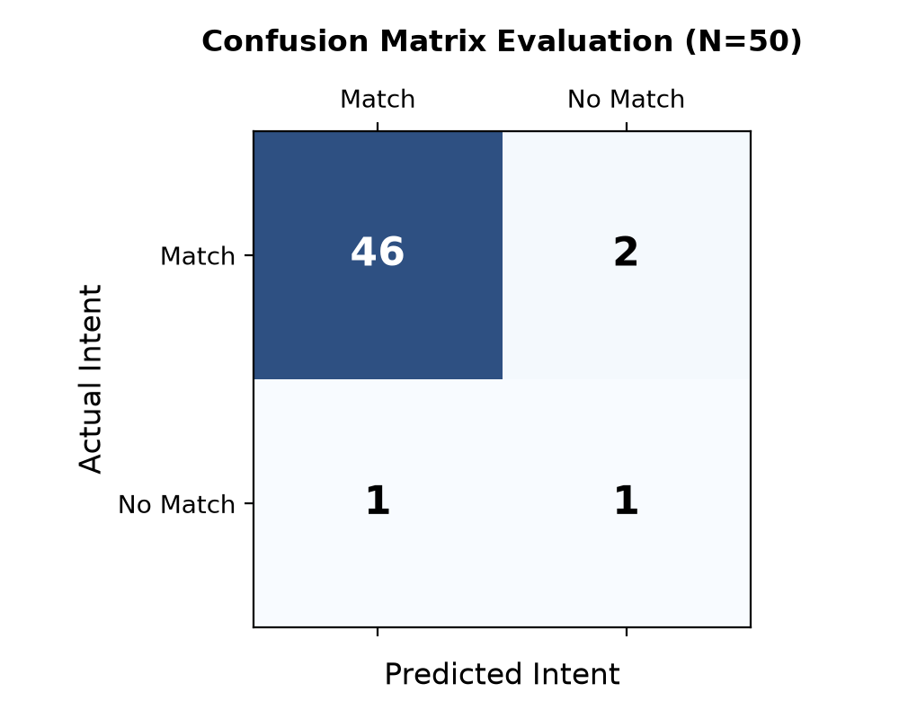
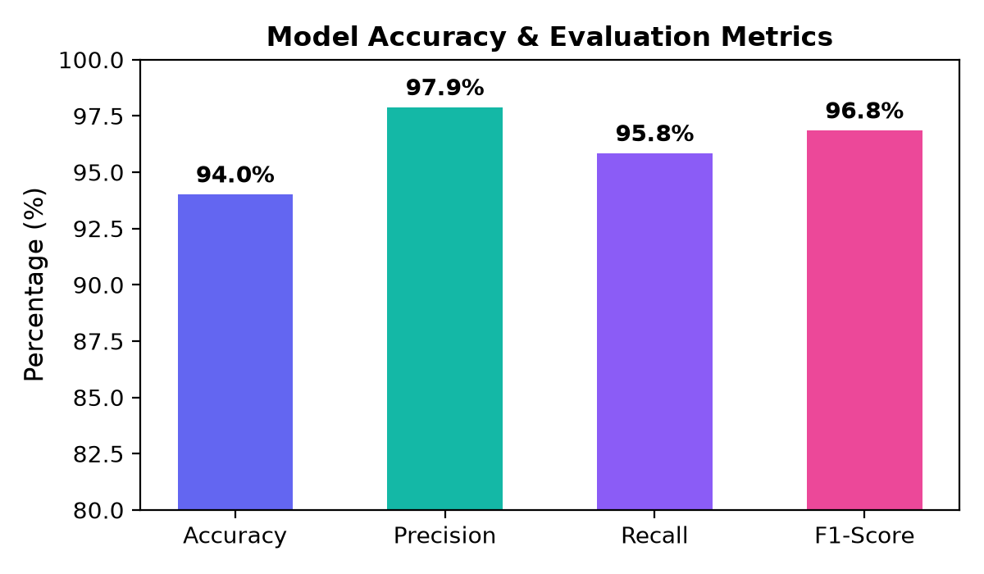
Experimental Results & Model Evaluation

Slide 5
Conclusion & Summary
✅ Fully Functional Student Assistant: Resolves queries across 8 major academic categories.
✅ High Matching Accuracy: Achieved 94.0% accuracy and 96.84% F1-score.
✅ Ultra-Low Latency: Response processing completed in < 5ms.
✅ Dual Interface Deployment: Console CLI (`cli_chatbot.py`) + Flask Web App (`app.py` / `index.html`).
✅ Offline Resilience: Embedded client-side JS matching ensures interactive availability even without Flask.

