Slide 1


Forest Fire Detection Using Deep Learning
B. Vigneshkumaran
STU672108051a62d1730217989

Slide 2

Learning Objectives
Understand the application of Convolutional Neural Networks (CNN) in forest fire detection.
Learn the functionality and role of Conv2D layers in image classification.
Develop and train a CNN model to classify images into two categories: fire and no fire.
Evaluate model performance based on accuracy and other relevant metrics.
Gain insights into building end-to-end AI pipelines for image-based classification problems.
GOAL
Source :
www.freepik.com/

Slide 3
Tools and Technology used
Programming Language: Python – selected for its versatility in AI development.
Frameworks: TensorFlow and Keras – for building and training deep learning models.
Model Architecture: CNN – efficient for pattern recognition in images.
Development Environment: Google Colab – offers GPU T4 acceleration and seamless coding in the cloud.
Dataset Source: Kaggle – contains image datasets labeled for fire and no fire conditions.
( Link: https://www.kaggle.com/datasets/elmadafri/the-wildfire-dataset )
Supporting Libraries: NumPy and Pandas for data manipulation, Matplotlib and Seaborn for data visualization and model performance graphs.

Slide 4
Methodology
Data Collection: Images sourced from kaggle publicly available datasets, ensuring a diverse range of fire conditions.
Data Preprocessing: All images standardized to a common size and pixel format to ensure consistency in input.
Model Design: Three Conv2D layers extract hierarchical image features, followed by fully connected layers for classification.
Training Process: Optimized using a suitable loss function and optimizer, with accuracy monitored per epoch. The model is trained using Google Colab, leveraging GPUs for faster computation.
Evaluation: Performance validated on test data with confusion matrix and accuracy metrics.
Output: Finally got the output, that predicts the fire accurately about 80% approx.

Slide 5
Problem Statement:
Forests are crucial for the environment and human life, but Forest fires cause severe ecological and economic damage each year, often spreading undetected in their early stages.
Manual monitoring systems are limited by human response time, visibility and accessibility in remote locations.
This project uses deep learning with Convolutional Neural Networks to detect fires in real time from images. Early detection allows faster response, reducing harm to forests, wildlife, and nearby communities.

Slide 6
Solution:
A custom CNN-based model is developed to automatically detect the presence of fire in image data.
The system classifies images into two categories: fire and no fire.
Designed for real-time deployment in forest surveillance systems or drone feeds.
Adaptable across different forest types and climates using additional training.
Can be integrated with early-warning systems to alert authorities instantly.
Supports potential expansion into multi-modal systems using thermal or infrared inputs.
GitHub Link: https://github.com/Vignesh1725/week3_assignment_edunet_internship.git

Slide 7

Screenshot of Output:

Slide 8
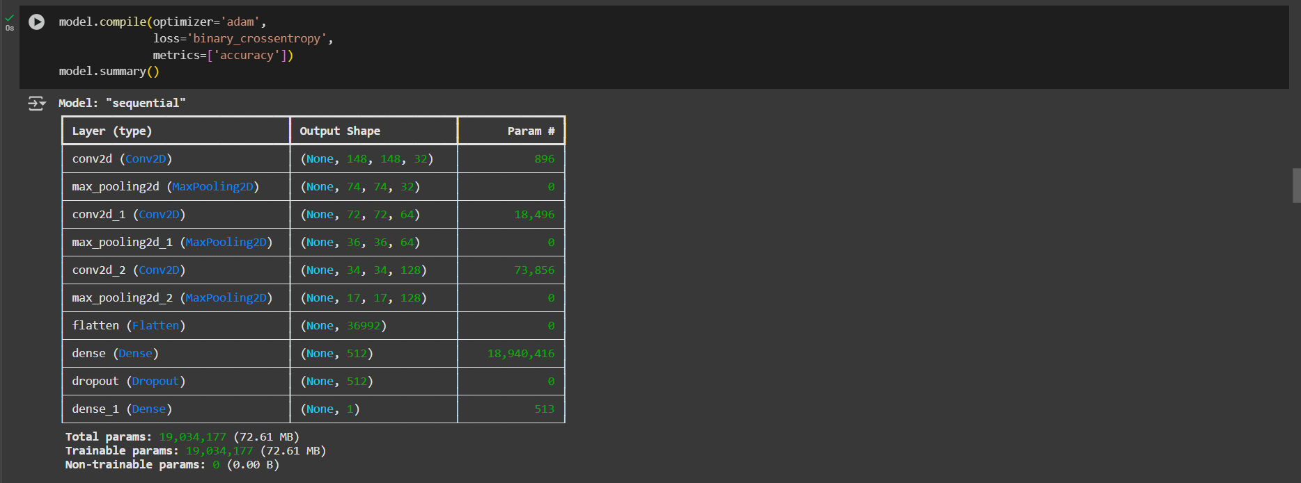
Screenshot of Output:

Slide 9
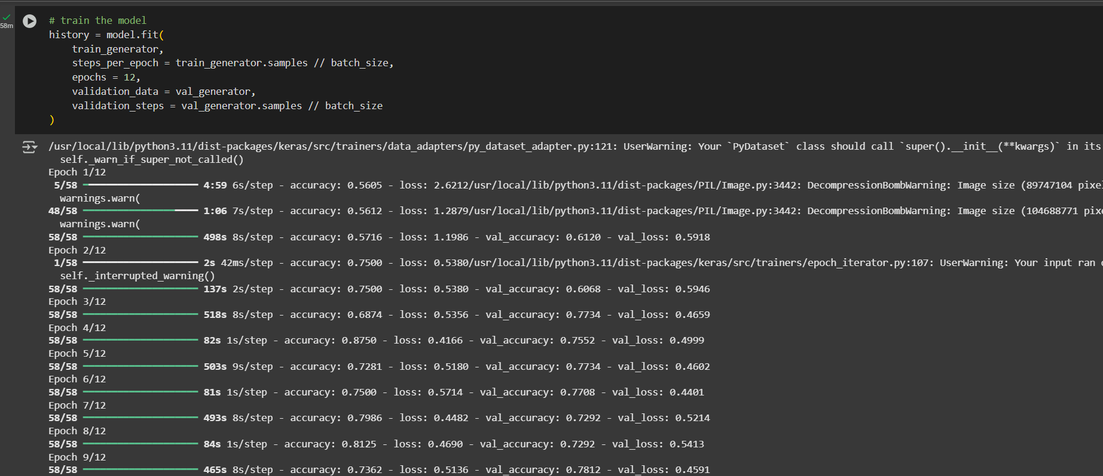
Screenshot of Output:

Slide 10
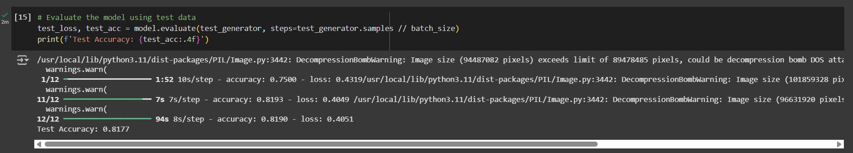
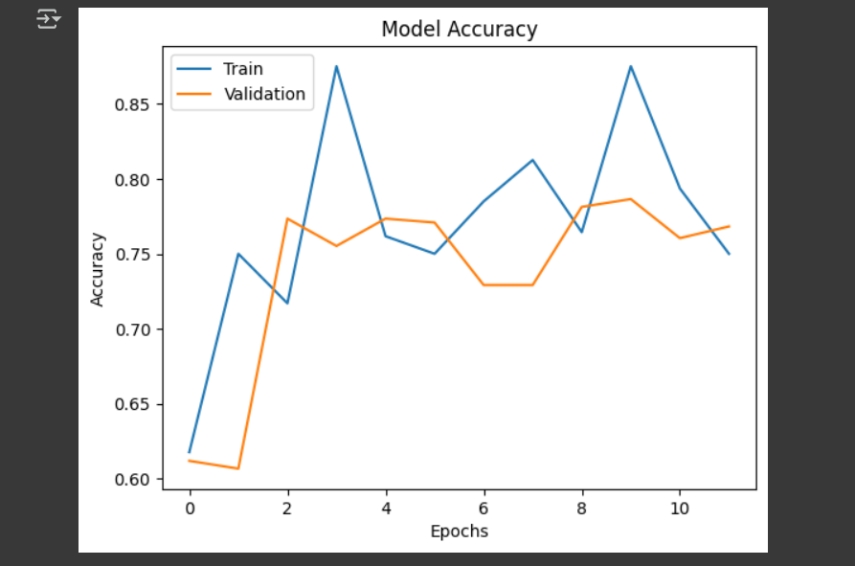
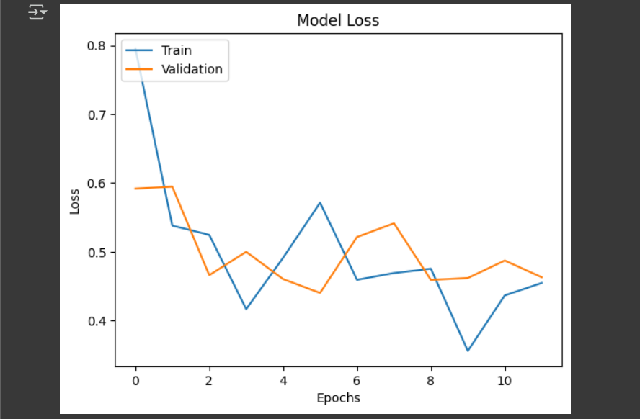
Screenshot of Output:

Slide 11
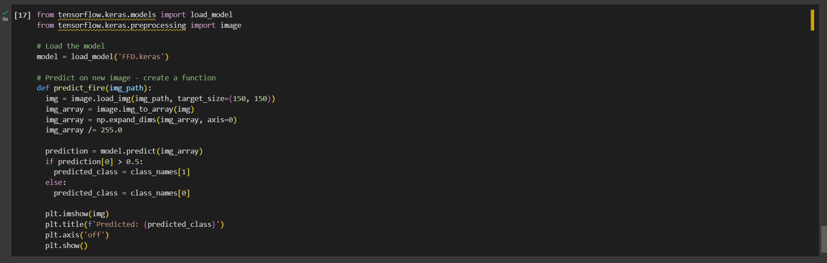
Screenshot of Output:

Slide 12
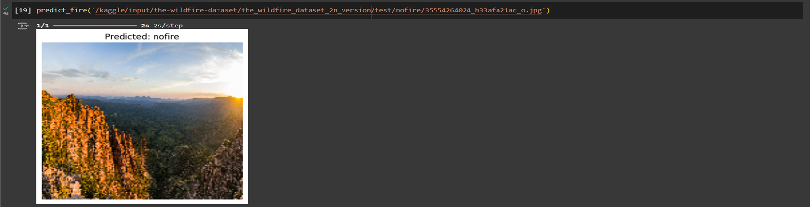
Screenshot of Output:

Slide 13
Conclusion:
The CNN-based model presents a promising approach for early detection of forest fires using image classification.
Model trained for 12 epochs with an achieved accuracy of approximately 80%.
Efficient preprocessing and architecture enable reasonable performance even on basic hardware.
Integration with pre-trained models like VGG16, MobileNetV2 for transfer learning and improved accuracy.
Deployment in UAVs (drones) or edge devices for live forest surveillance.

