Slide 1
GROCERY STORE DATA

Slide 2
Problem Statement
A grocery store shared the transactional data with you. Your job is to conduct a thorough analysis of Point of Sale (POS) data, identify the most commonly occurring sets of items in the customer orders, and provide recommendations through which a grocery store can increase its revenue by popular combo offers & discounts for customers.

Slide 3
PART B
Exploratory Analysis --> Exploratory Analysis of data & an executive summary (in PPT) of your top findings, supported by graphs. --> Are there trends across months/years/quarters/days etc. that you are able to notice?
The overall summary of the data set in terms of info, describe, identification of null values (if any) we made using Jupiter notebook
EDA for Grocery store was done using Tableau tool.
Detailed analysis in terms of yearly, quarterly, monthly and daily analysis are made to provide in depth
information's of the data.

Slide 4
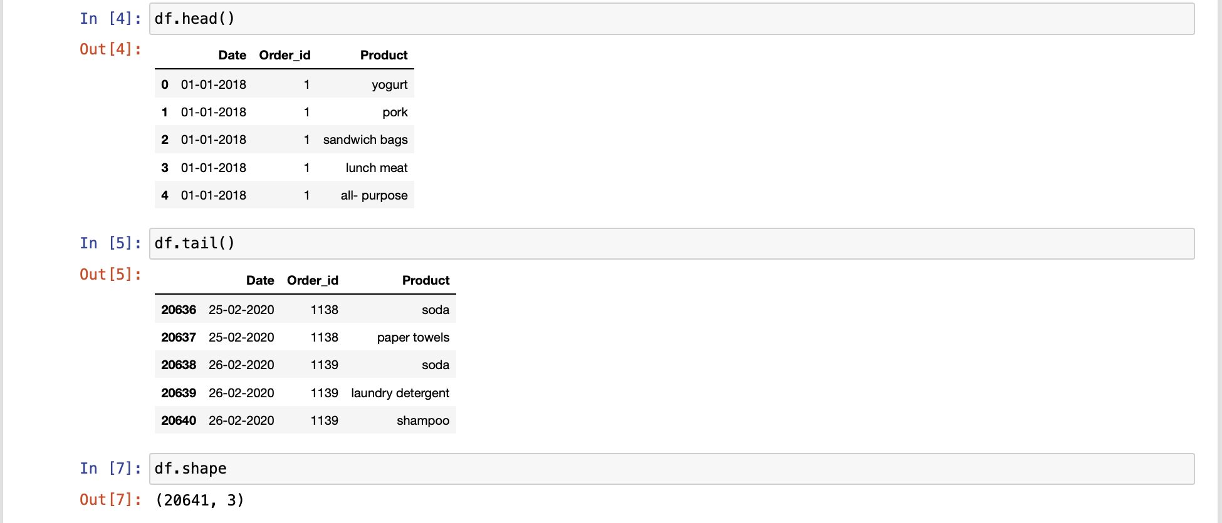
Data Set
The data set was loaded perfectly without any issues.
There were 20641 rows and 3 columns.

Slide 5
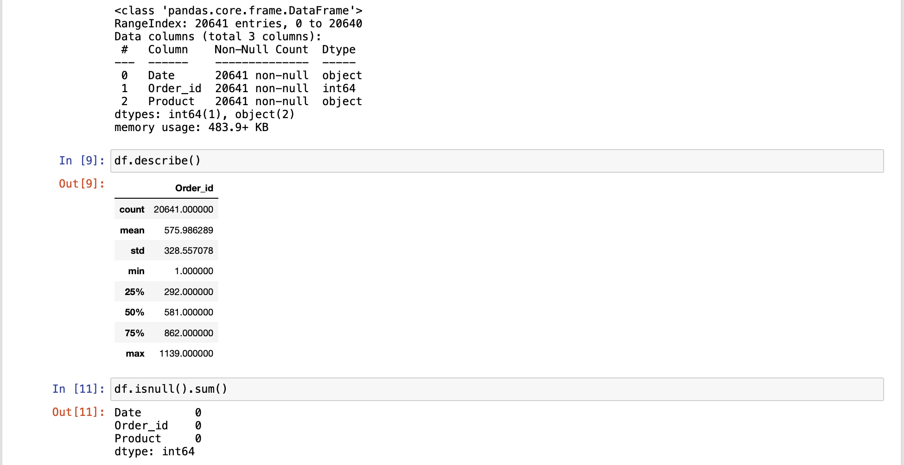
Data Set
There are no null values present in the data set.
A max of 1139 orders were made according to this data set.
Each order can have as many items as possible and there are many listed inside each order id.

Slide 6
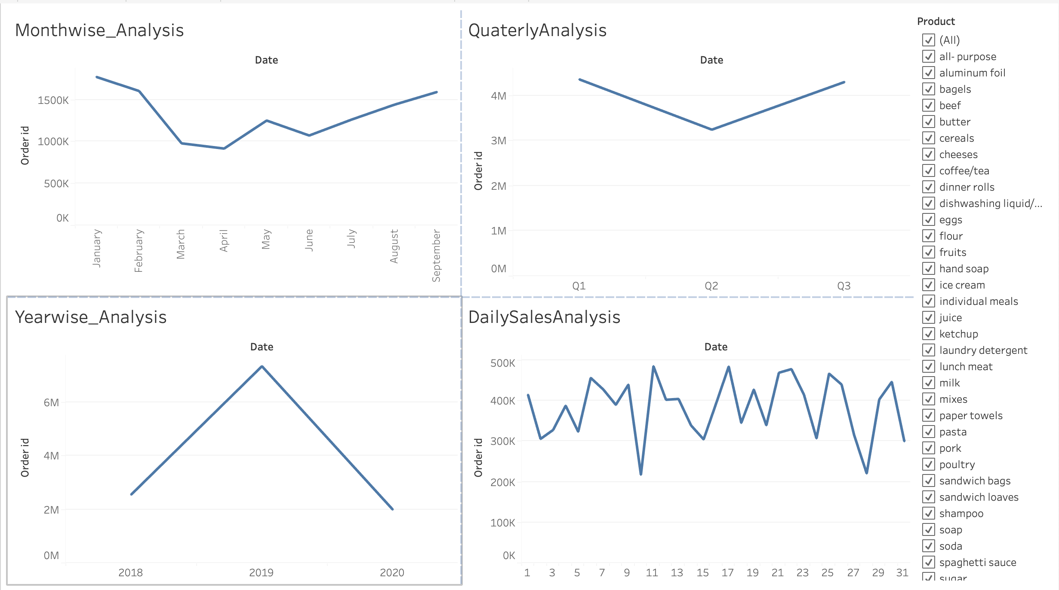
Customer order – Monthwise, Yearwise, Quaterly, Daily
This chart describe how the orders are been made by the customers in terms of years, quarterly, monthly and daily.
This data set consists of order details made for 3 different years from 2018 to 2020 and for first nine months of an year.
Highest orders were made during 2019.
There is slight dip in orders for Q2.
Month wise Jan and Feb has maximum orders and there is a slight dip during the mid of the year, which again starts to gradually increase during end of the year.
This is indication of seasonality present in the data set.

Slide 7
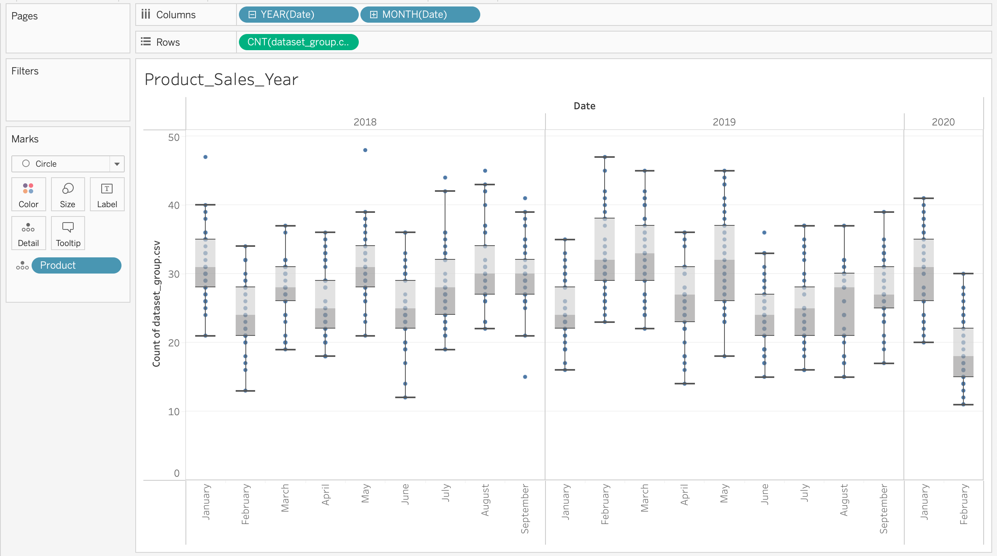
Customer order across years and months
The box plot suggest the orders made across years and months by the customers.

Slide 8
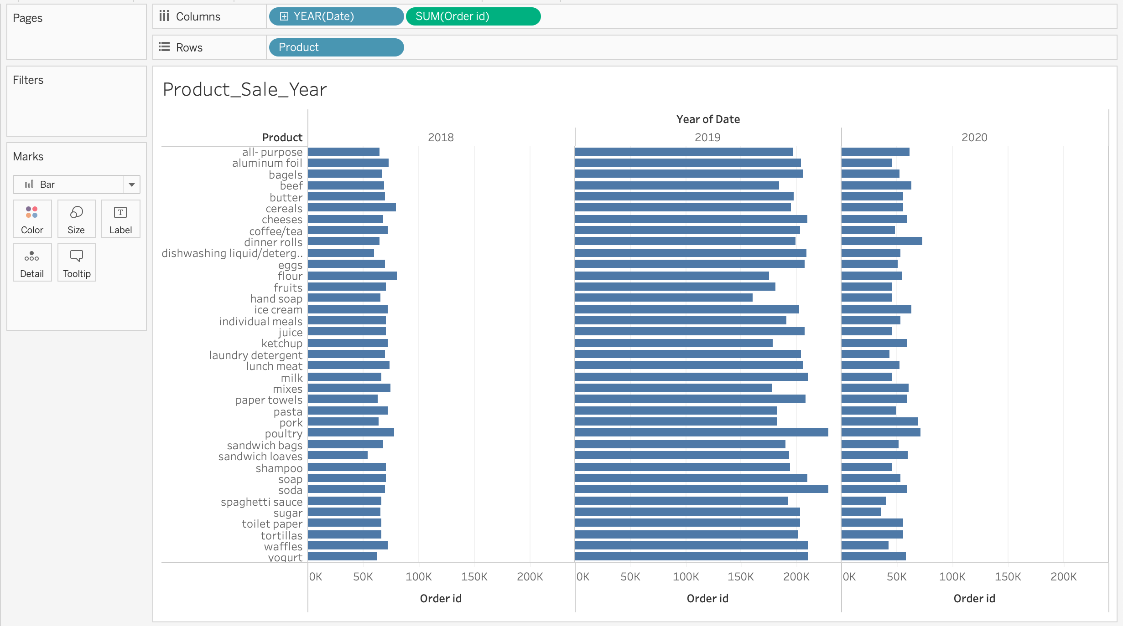
Products ordered by the customers
Each and every product ordered by the customers.
This will certainty help to provide suggestions based on the market basket analysis technique.

Slide 9
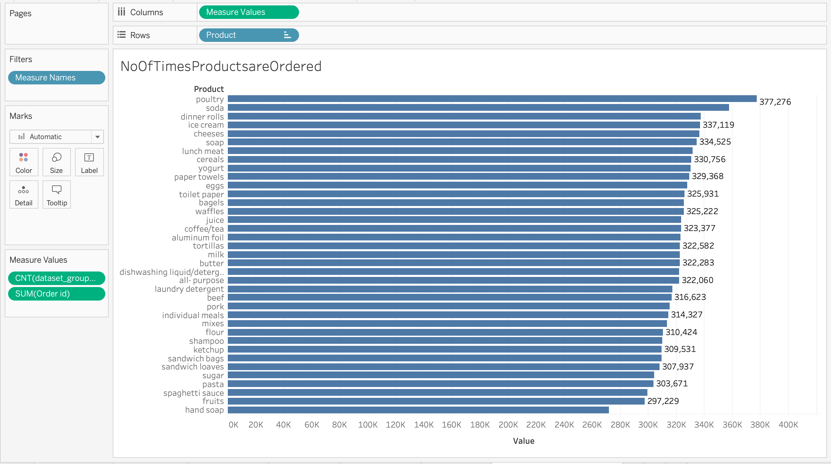
No of times products are ordered
Number of times each product has been ordered by the customers.
In this list, poultry has been ordered for maximum number of time.
Hence the grocery store can provide a package or bundle like stuff to attract the customers purchase more items.

Slide 10
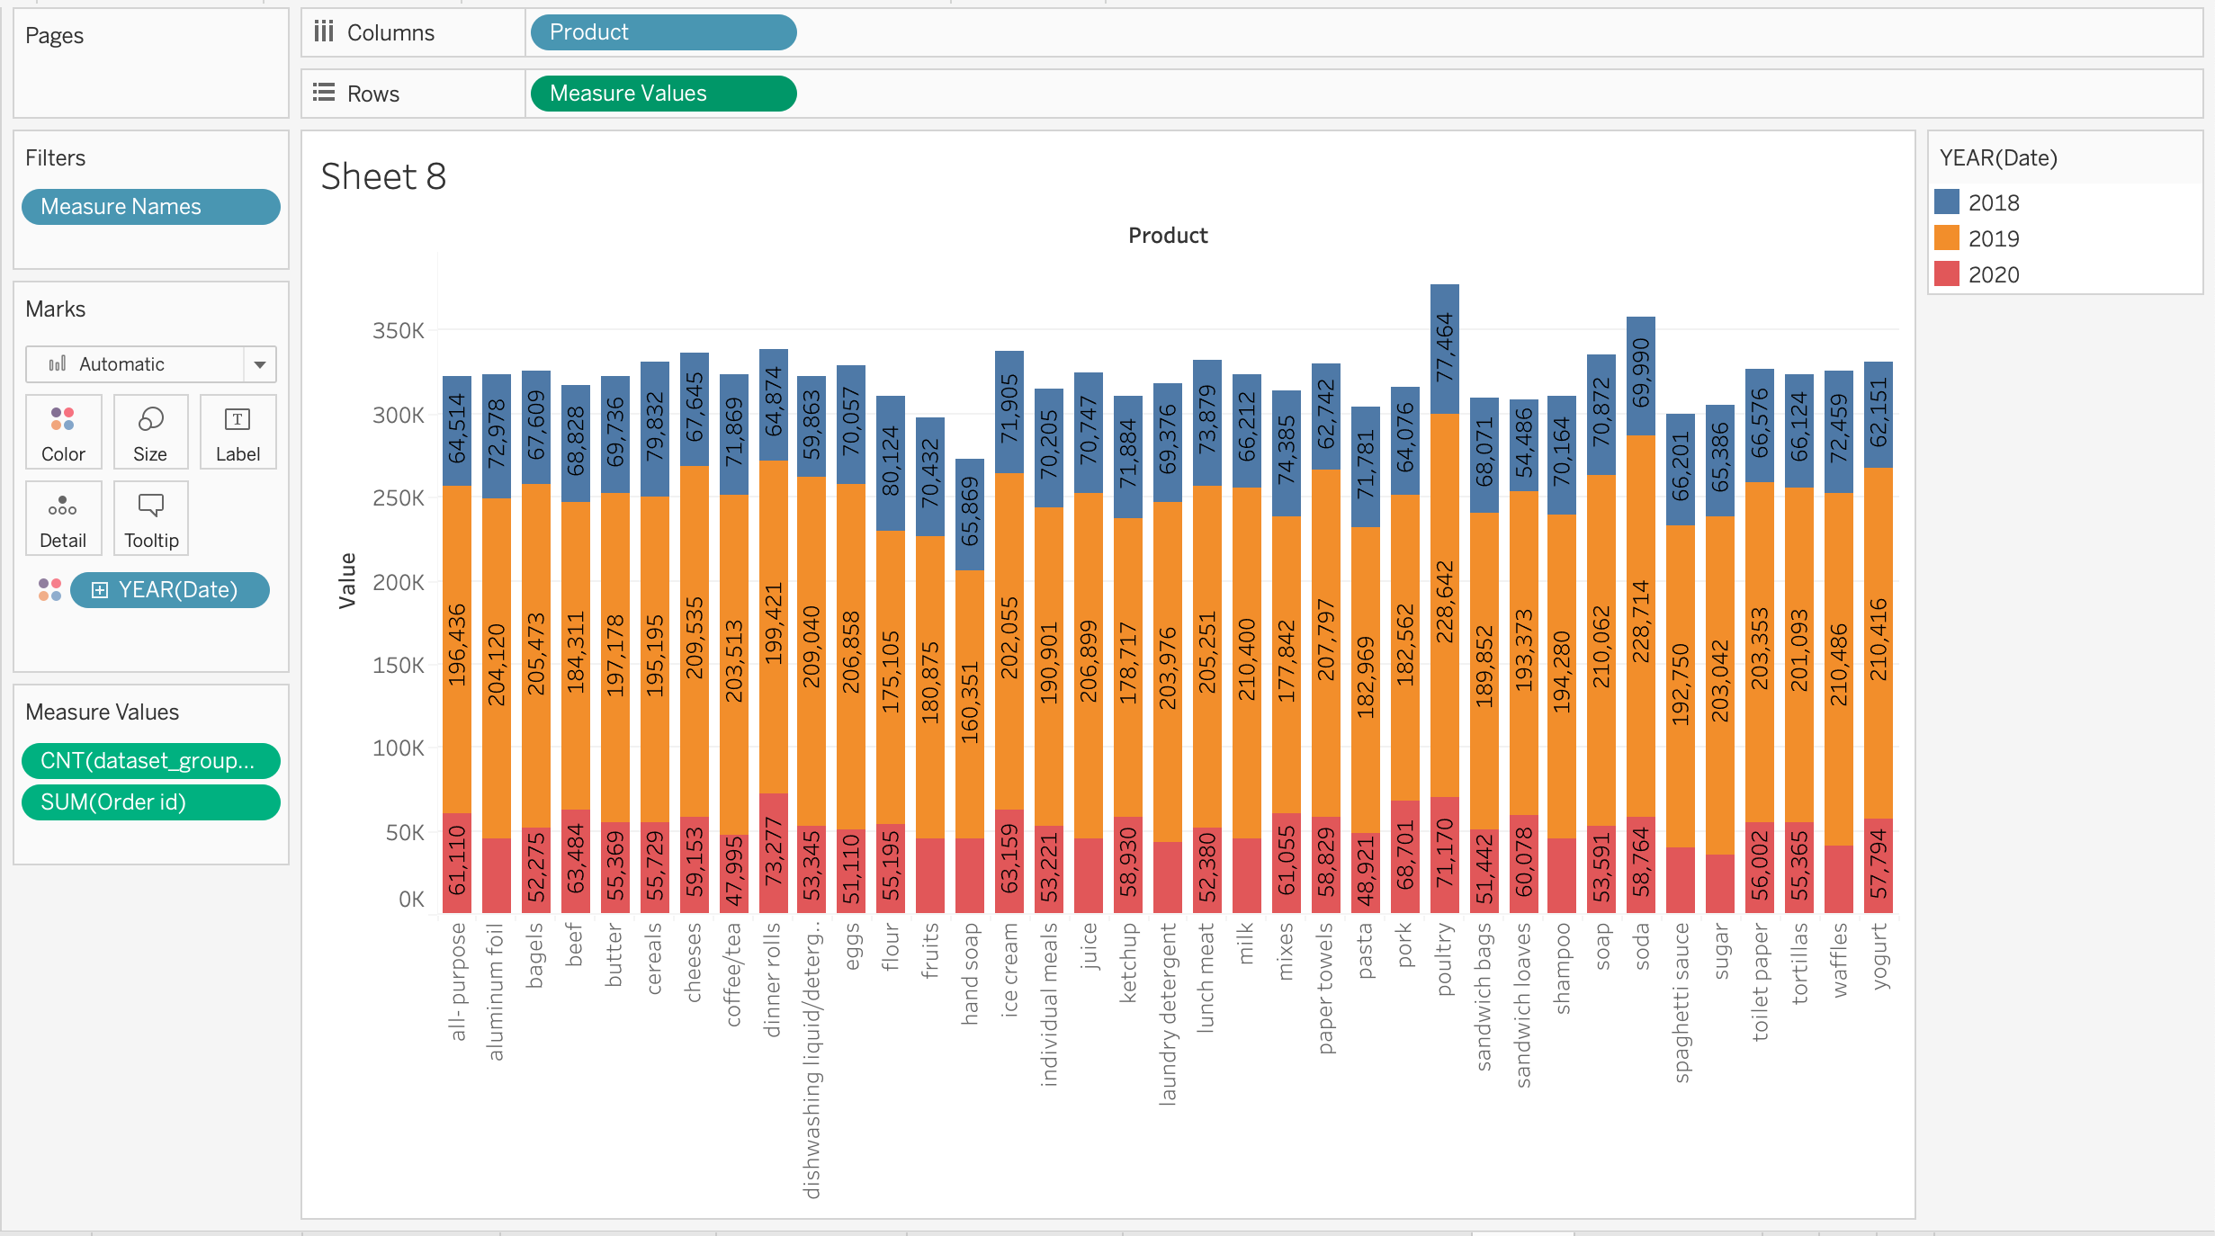
Product ordered every year
Each product or items been ordered for every available years in the data set.

Slide 11
PART B
Use of Market Basket Analysis (Association Rules) -->Write Something about the association rules and its relevance in this case -->Add KNIME workflow image -->Write about threshold values of Support and Confidence

Slide 12
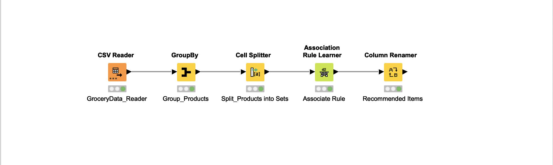
Knime WorkFlow
Knime Workflow

Slide 13
About MBA technique and Association rules
MBA – Market basket analysis certainly talks about the how to influence the customers to buy products
That not initially there in there list.
In this data set there are list of different products been listed which are been purchased by the customers previously.
From this list by using the MBA technique we need to suggest to the customers on what is been or can be purchased.
For instance a customers would have purchased milk, cereal and water bottle previously in the store.
On his next visit to the same store a list in terms of his previous purchase should be displayed and along with this list there
Can also be suggestions made.
For instance customers who buy milk, cereal and water bottle will mostly buy chocolates as well.
This suggestions will definitely influence the customers to buy products which is not in there list also certainly it will help to
Increase the sales and revenue of the store.
There are no certain values which can be given for association rules.
In this data set if the minimum support exceeds 10% the ‘Association Rule Learner’ is not getting executed.
Hence I have given the minimum support to be 0.05% and the minimum confidence to be 0.4%.

Slide 14
PART B
Associations Identified --> Put the associations in a tabular manner -->
Explain about support, confidence, & lift values that are calculated

Slide 15
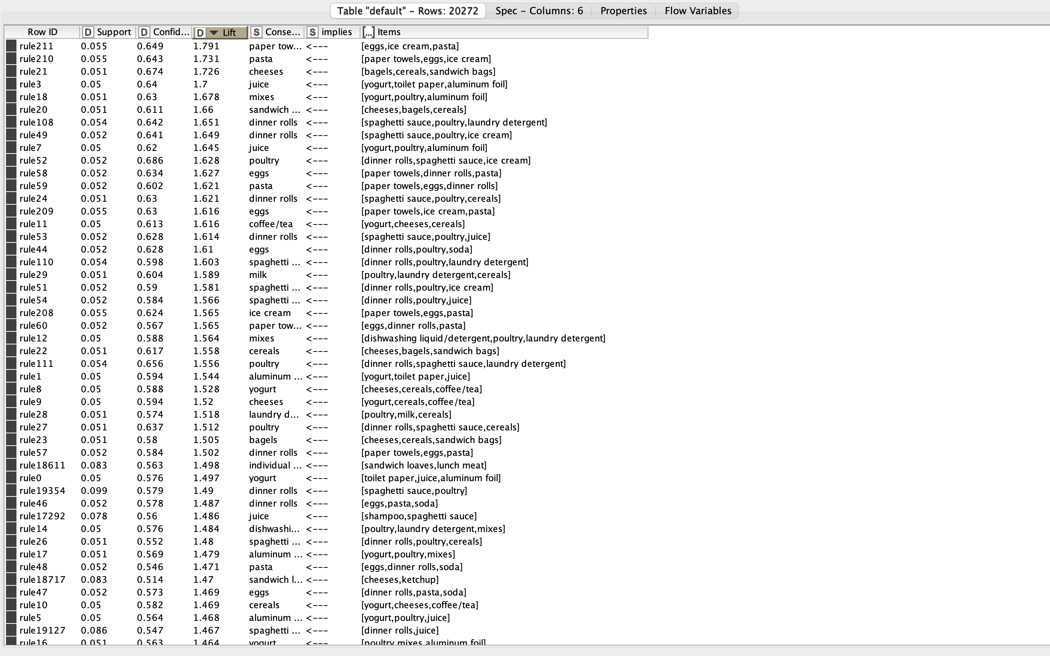
Recommended list of items along with the confidence, support and Lift values.
List of items with confidence, support and lift values

Slide 16
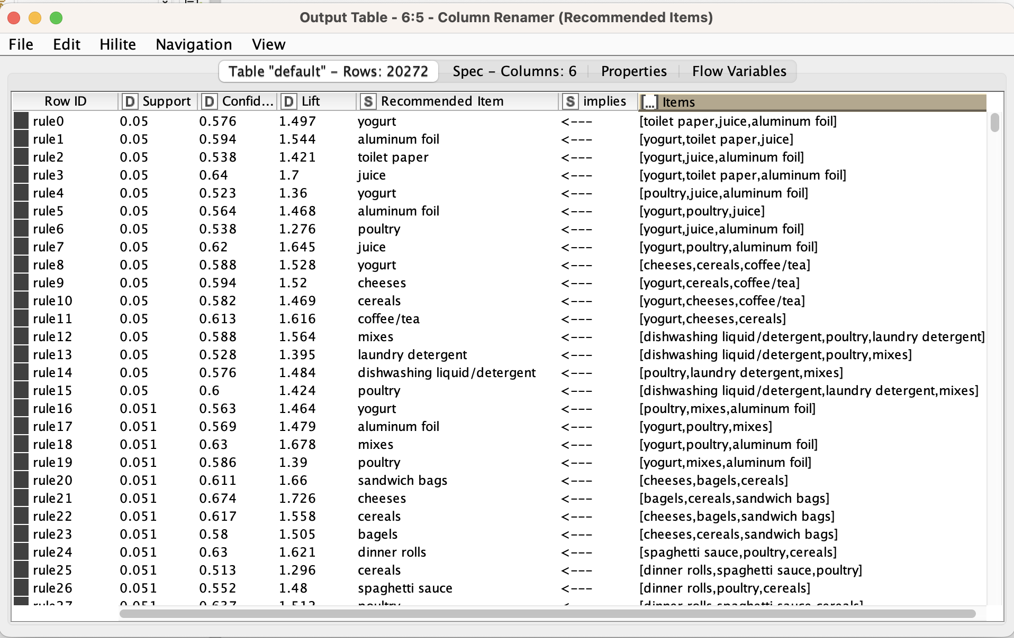
Rename of the column name consequent to ‘Recommended Items’
Recommended Items
Lets compare the items, recommended items and lift from the above screenshot for the first row.
Here it suggests that customer who buys toilet paper, juice, aluminum foil will also tend to buy yougurt.
The Lift value is the most important column which tells us that there are certainly 1.497% of chances that customer
Will tend to buy the suggested items ’yogurt’ as well along with the other list of items.
From the above list of items for the same item list there also can be more than one recommended items.

Slide 17
PART B
PART B: Suggestion of Possible Combos with Lucrative Offers --> Write recommendations --> Make discount offers or combos (or buy two get one free) based on the associations and your experience
Based on these list the store can even go for other options to attract customers such as.
Providing offers.
Introducing packages of items.
In some cases the items that are less soled can be offered for best discount price.
This will certainly help attract customers to be associated with the store for longer period of time.
Say for instance the highest selling product according to the store data is ‘Poultry’ and the least being ‘handsoap’
The store can certainly suggest something like if a customer purchases more than 5 items in the grocery store they can Get an ‘handsoap’ for free of cost.

