Slide 1

Detection of Diabetic Retinopathy
Submitted by
AP20110010049 – Jayanth Bonthala
AP20110010055 – Uday Kiran Nathani
AP20110010058 – Vara Siddha Vignesh Edara
AP20110010051 – Siva Chandra Prasad Panguluri
Under the guidance of
Prof. Sibendu Samanta
Department of Computer Science & Engineering
SRM University-AP
Neerukonda, Mangalagiri, Guntur
Andhra Pradesh - 522 240
May 2024

Slide 2
Introduction to Diabetic Retinopathy
Diabetic retinopathy (DR) is a serious eye disease that can affect people with diabetes.
It rises from high blood sugar levels damaging the blood vessels in the retina, the light-sensitive layer at the back of the eye. This damage can lead to a variety of problems.
If treatment is not received, it destroys the blood vessels in the retina, the light-sensitive tissue located in the back of the eye, resulting in visual impairment and maybe blindness.
Early detection of diabetic retinopathy enables prompt intervention and treatment, which can stop or decrease the disease's progression.
This can lessen the chance of blindness and maintain vision.
Healthcare providers can more closely monitor the development of diabetic retinopathy and modify treatment regimens as necessary when the condition is diagnosed early.

Slide 3
Introduction to Diabetic Retinopathy
The system uses Inception Net to automate the diagnosis of retinopathy.
Classified into following stages:
NO DR
NPDR is further divided into four stages
MILD NPDR
MODERATE NPDR
PROLIFERATE DIABETIC RETINOPATHY (PDR)
SEVERE NPDR

Slide 4
Data Augmentation
Data augmentation is a powerful technique used in Convolutional Neural Networks (CNNs) to address the challenge of limited training data. It essentially involves artificially creating new training data by applying random transformations to existing data points. This helps CNNs become more robust and generalize better to unseen data.
Reduces Overfitting: Model has been trained on a limited data set, and as a result, it performs extremely well on that specific data set but may not generalize well to other datasets.
Improves Invariance: In real-world scenarios, images can vary in terms of rotation, scale, lighting, and other factors.
Geometric Transformations: This includes techniques like random cropping, rotation, scaling, and flipping (horizontal or vertical). These simulate different viewpoints and slight changes in object position.

Slide 5
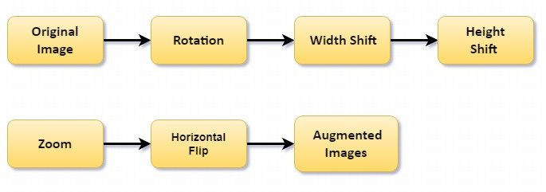
Data Augmentation

Slide 6
Introduction to Inception Net
Inception Net is a convolutional neural network (CNN) designed for image classification tasks and developed for the ImageNet Large Scale Visual Recognition Challenge.
Inception net, commonly referred to as Google Net, as a deep convolutional neural Network (CNN).
It is well known for being effective at classifying images, and many computer vision application have embraced it.
The Inception Net architecture is distinguished by the creative way it employs inception modules, which are stacks of several layers of convolutions with varying sizes and functions.
Inception v3 is a convolutional neural network that helps with image analysis and object detection.
Inception V3 has been shown to achieve greater than 78.1% accuracy on the ImageNet dataset.

Slide 7
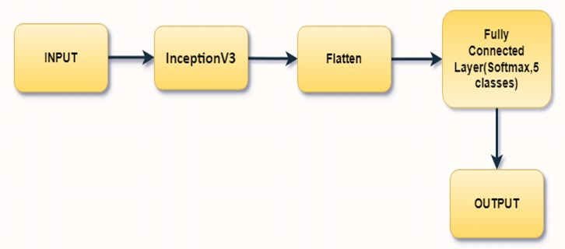
Inception Net Model

Slide 8
DR Using Inception Net
Advantages
Disadvantages
Deep learning, specifically the Inception Net architecture, is being used for detecting diabetic retinopathy (DR) due to its ability to learn intricate patterns and features from raw data, eliminating the need for manual feature engineering.
This is particularly useful in medical imaging tasks, where subtle changes in retinal morphology indicate disease presence.
The automated nature of these systems reduces healthcare professionals' workload.
Deep learning, particularly the Inception Net architecture, is effective for detecting diabetic retinopathy, but it faces limitations such as reliance on quality annotated data, computational resources, and interpretability issues.
Insufficient or biased data can lead to overfitting, while limited access to high-performance computing infrastructure can pose practical challenges.

Slide 9
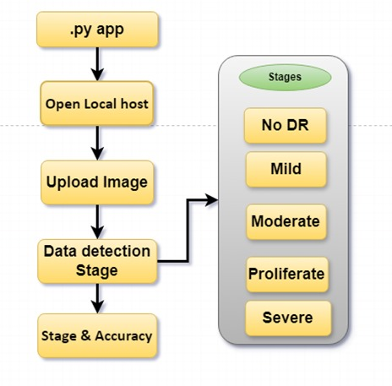
Web Application

Slide 10
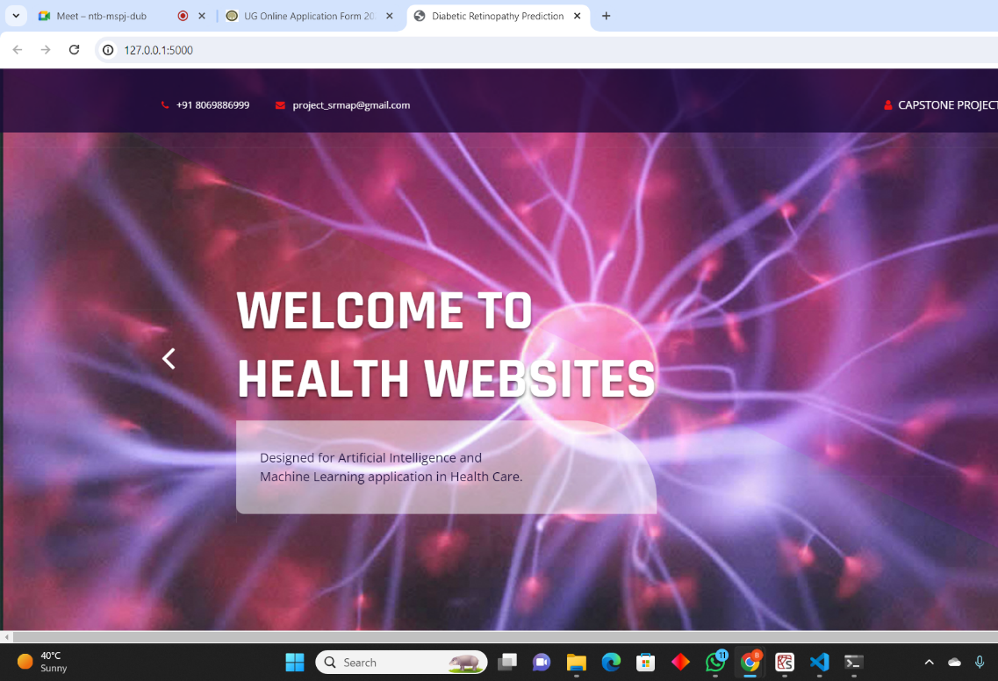

Slide 11
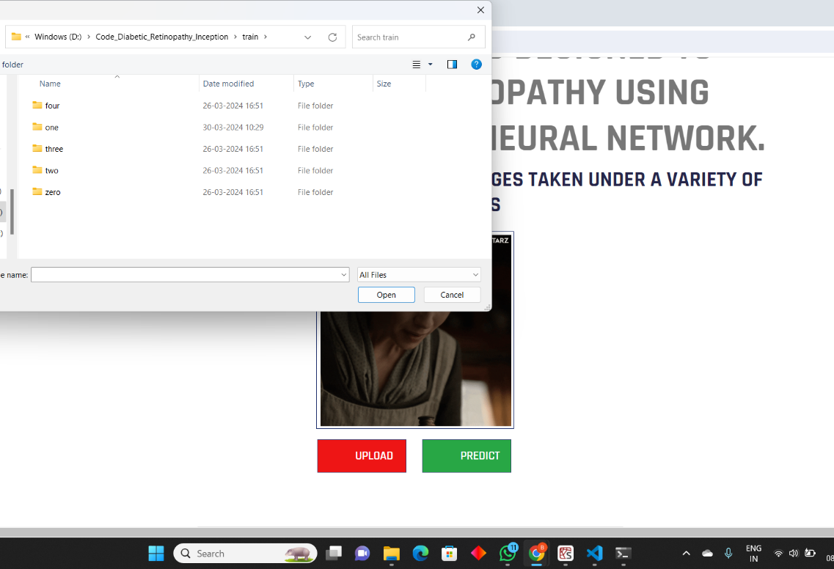

Slide 12
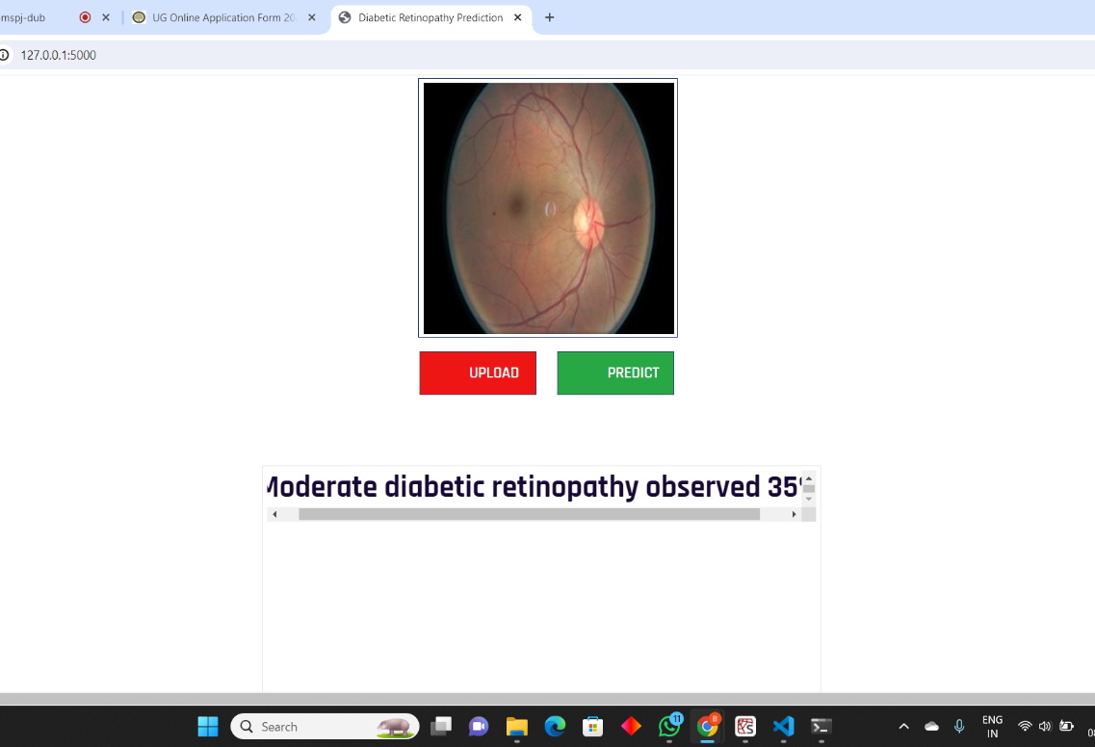

Slide 13
Conclusion
Deep learning with Inception Net architecture has revolutionized diabetic retinopathy detection, enabling early diagnosis, timely intervention, and vision loss prevention.
This advancement in ophthalmic care highlights the transformative potential of artificial intelligence in healthcare.
As technology evolves, federated learning and edge computing will enhance screening tools, potentially revolutionizing diabetic retinopathy management and reducing global burden.

Slide 14
Future Scope
The integration of multimodal data sources such as patient clinical data, genetic data, and longitudinal health records into retinal images is one important avenue to pursue.
Furthermore, edge computing enables real-time inference directly on local servers or medical imaging devices, facilitating prompt diagnosis and intervention.
Explainability of AI models is essential for building trust and acceptance in the medical field. By understanding how CNNs arrive at their decisions, healthcare professionals can make more informed judgements.

Slide 15
REFERENCES
Jegou, Simon, et al. ”The one hundred layers tiramisu: Fully convolutional densenets for semantic segmentation.” Proceedings of the IEEE conference on computer vision and pattern recognition workshops. 2017.
Li, Feng, et al. ”Deep learning-based automated detection for diabetic retinopathy and diabetic macular oedema in retinal fundus photographs.” Eye 36.7 (2022): 1433-1441.
Sinha, R. A., Jones, S. H., Shah, P., Akhtar, T., Scully, T., Barker, L., ... Mishra, A. (2019). Artificial intelligence and the eye: Are we there yet? Ophthalmic Research, 61(3), 147-156.
Bellemo, Valentina, et al. ”Artificial intelligence using deep learning to screen for referable and vision-threatening diabetic retinopathy in Africa: a clinical validation study.” The Lancet Digital Health 1.1 (2019): e35-e44.

Slide 16
REFERENCES
Lee, A. Y., Lee, C. S. (2016). Diagnosis and classification of diabetic retinopathy. Journal of Diabetes Investigation, 7(3), 412-418.
Varadarajan, A. V., Poplin, R. (2019). Assessment of a deep learning model based on transfer learning for the detection of diabetic retinopathy in India. JAMA Ophthalmology, 137(10), 987-993.
Schlegl, Thomas, et al. ”Fully automated detection and quantification of macular fluid in OCT using deep learning.” Ophthalmology 125.4 (2018): 549-558.
Schmidhuber, J. (2015). Deep learning in neural networks: An overview. Neural Networks, 61, 85-117.

Slide 17
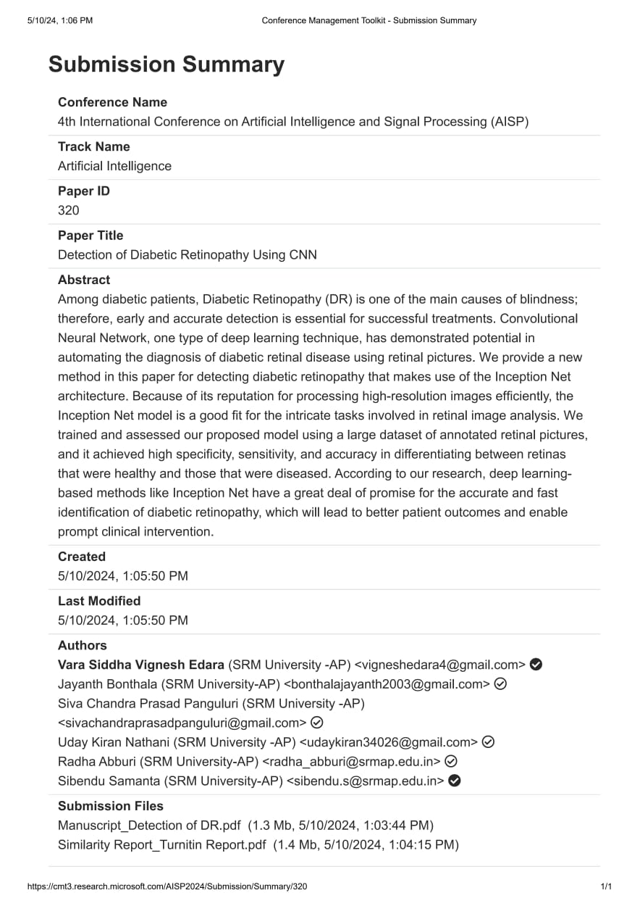

Slide 18



