Slide 1

Face Recognition Using MTCNN

Slide 2
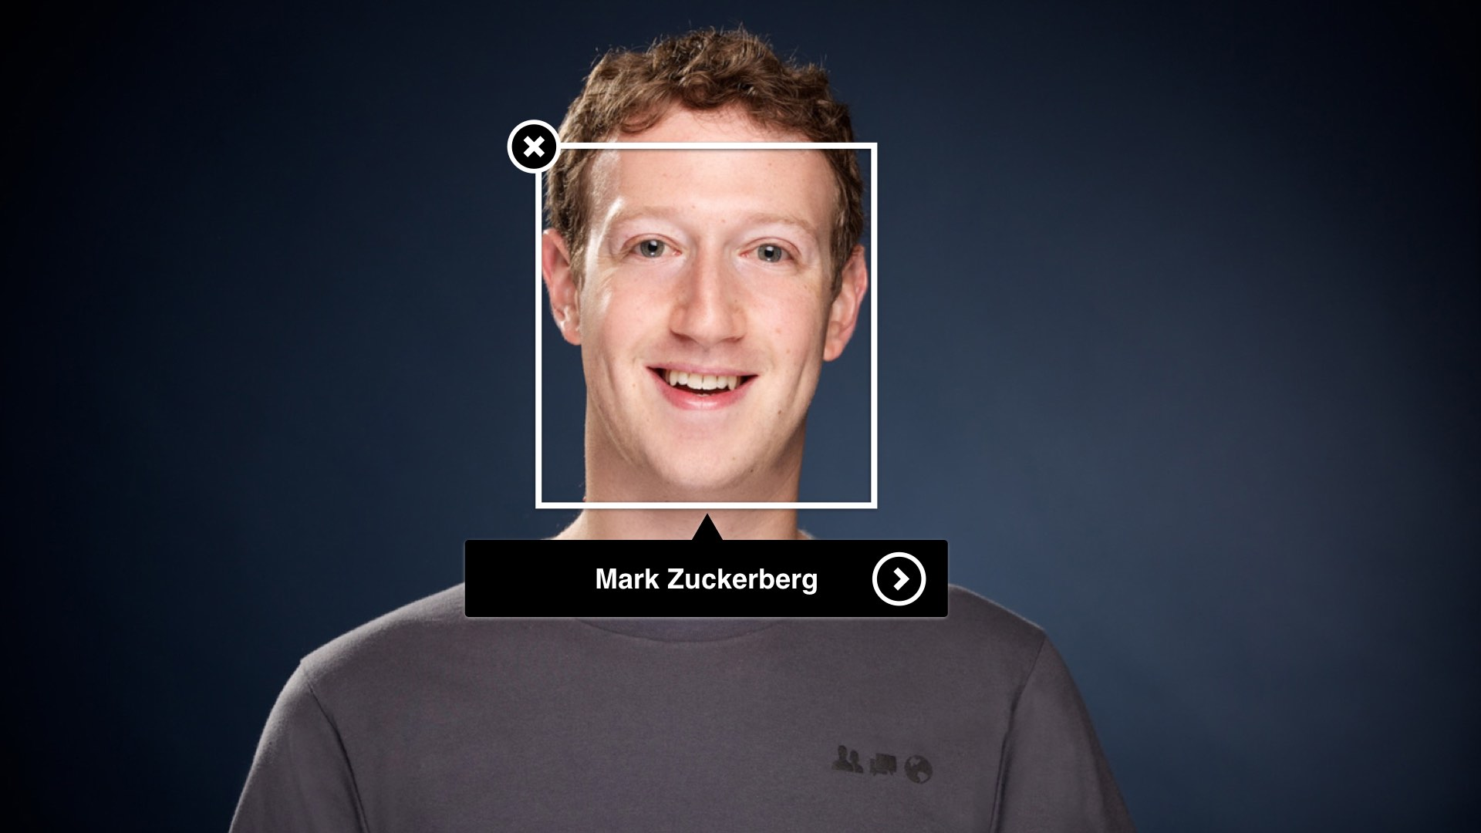
Face Recognition
This Photo by Unknown author is licensed under CC BY.
User input the Photos and the algorithm identifies the person in the given Photos.

Slide 3
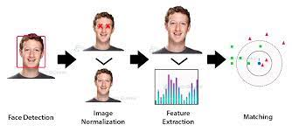
Face Detection
Objective: Identify a specific person by comparing their facial features with a database of known faces.
Techniques: Face recognition often involves deep learning models, including CNNs, for feature extraction. Common architectures include FaceNet and VGGFace. The embeddings generated by these models can be used to compare and identify faces.

Slide 4
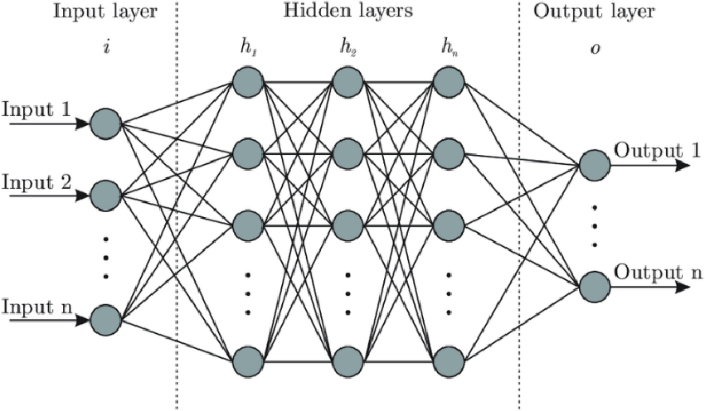
Neural Network General Structure

Slide 5
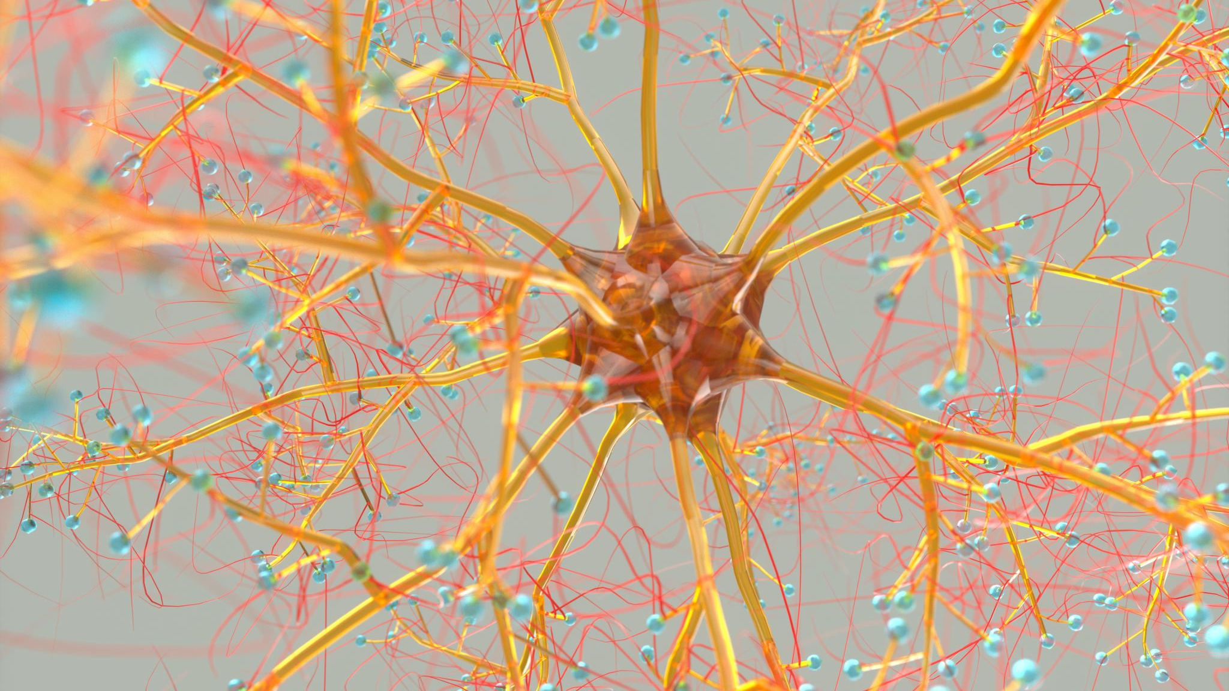
convolutional neural network

Slide 6
Convolutional Neural Network
CNN is a kind of neural network where input is image. Contains less fully connectivity between neurons
CNN layers Input layer Convolutional layer Pooling layer Fully Connected layer Loss layer

Slide 7
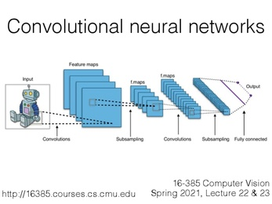

Slide 8
MTCNN
The MTCNN is a sophisticated neural network structure that is utilized for recognizing and detecting faces, which involves a three-stage process consisting of P-Net, R-Net, and O-Net.
Proposal Network (P-Net):
First, the image is resized multiple times to detect faces of different sizes. Then the P network (Proposal) scans images, performing first detection. It has a low threshold for detection and therefore detects many false positives, even after NMS (Non-Maximum Suppression), but works like this on purpose.
Refinement Network (R-Net):
The proposed regions (containing many false positives) are input for the second network, the R-network (Refine), which, as the name suggests, filters detections (also with NMS) to obtain quite precise bounding boxes.
Output Network (O-Net):
The final stage, the O-network (Output) performs the final refinement of the bounding boxes. This way not only faces are detected, but bounding boxes are very right and precise.

Slide 9
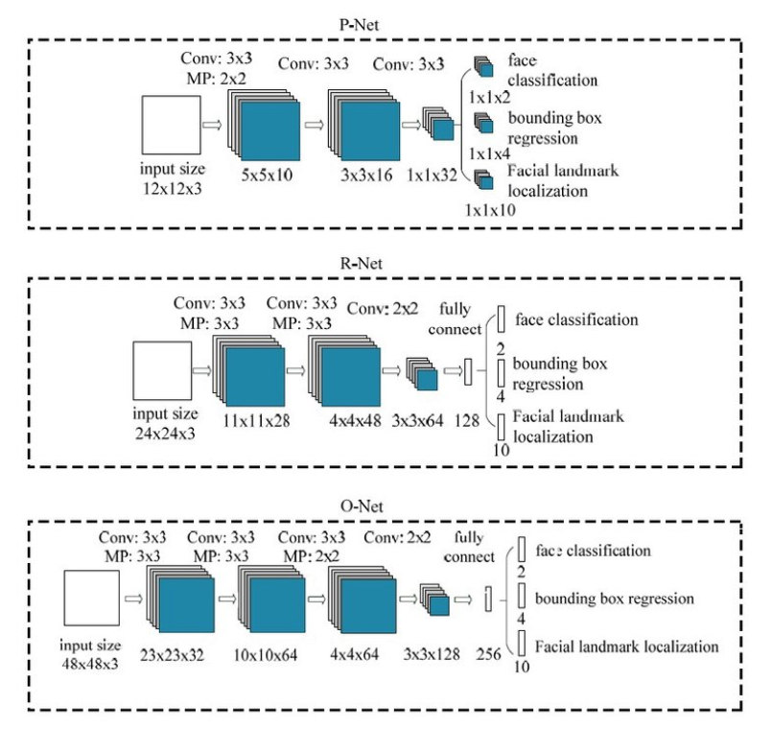

Slide 10
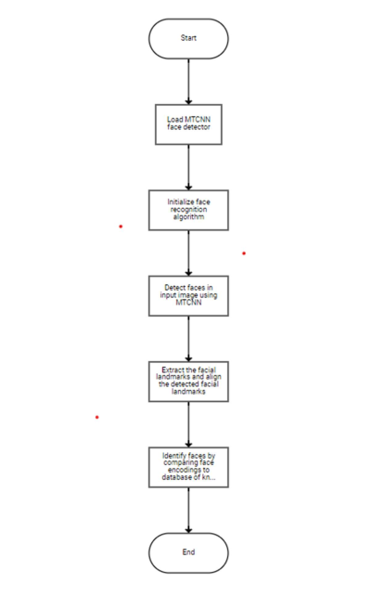
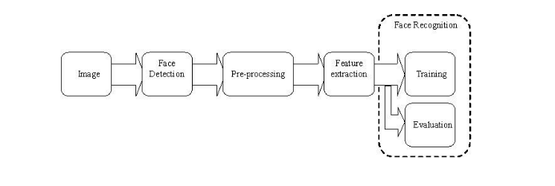
Algorithm and Flowchart

Slide 11
Working Process
In live face recognition, the system interfaces with the device's webcam to process real time input.
It swiftly detects faces, delineates them with bounding boxes, and extracts essential facial features.
These features, represented by 128 nodes, serve as reference points for identifying individuals.
The next involves comparing these reference images to those stored in the data set, There by identifying the person is done.

Slide 12
Working Process
To achieve this identification, the model relies on a robust set of comparisons, scrutinizing the input image against the dataset to ascertain identity.
Notably, the model employs the MTCNN algorithm for face detection, renowned for its accuracy in real time face recognition applications.
In addition, it utilizes popular deep learning techniques, including CNN, in conjunction with libraries like Haar Cascades and TensorFlow to enhance its performance.

Slide 13
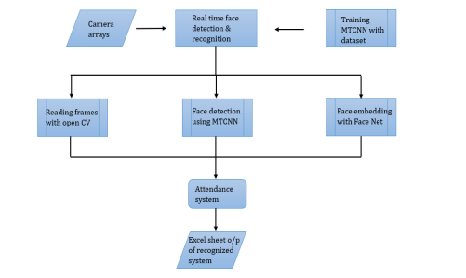

Slide 14
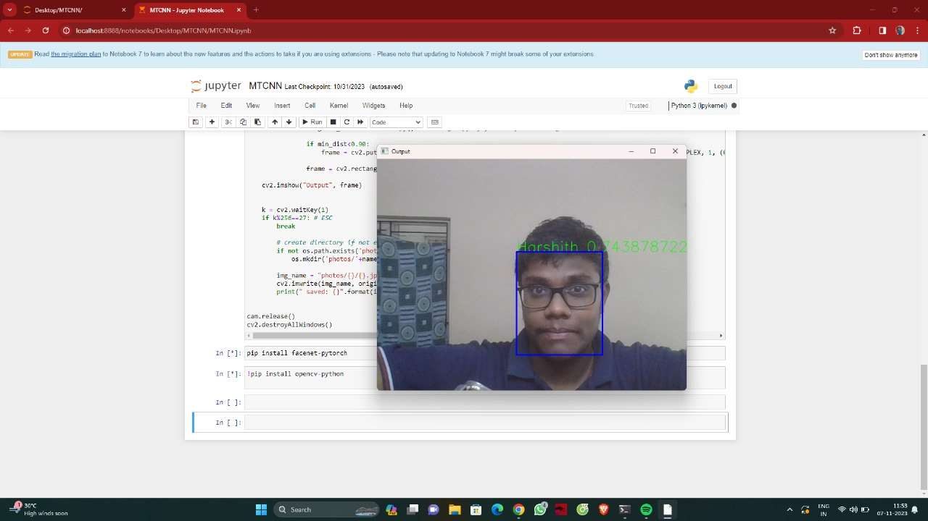
RESULTS

Slide 15
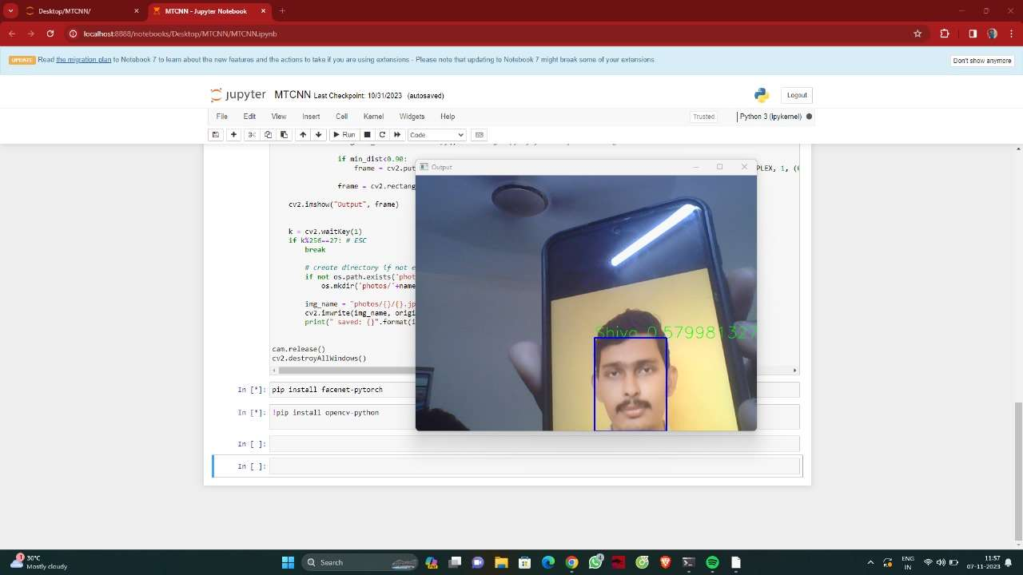

Slide 16
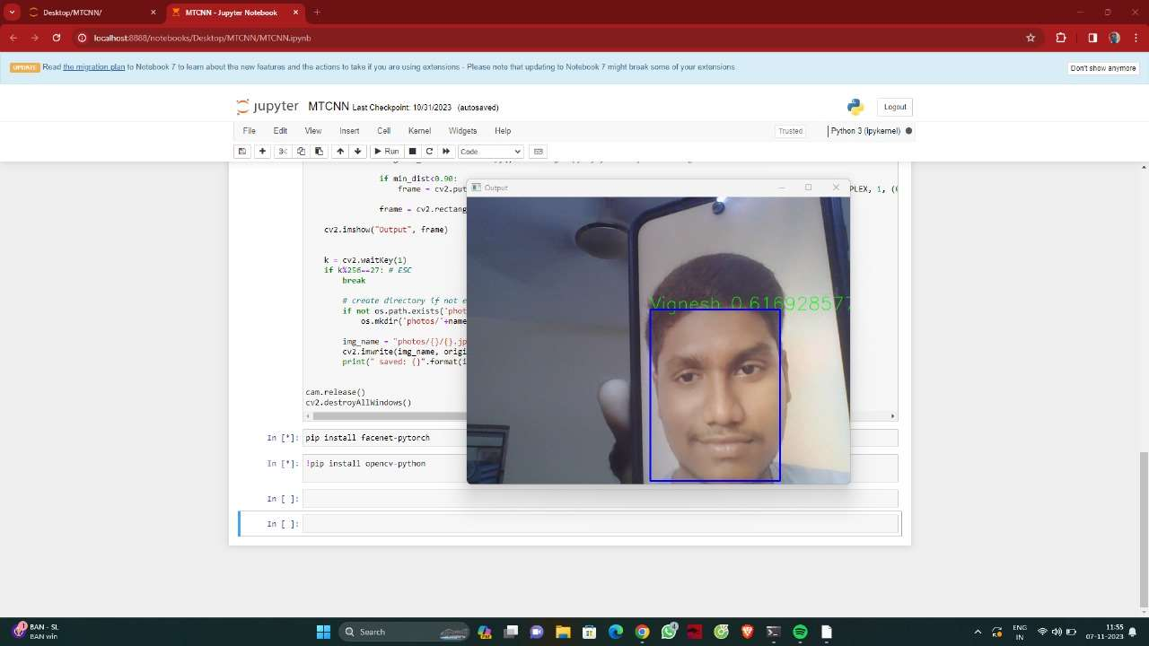

Slide 17
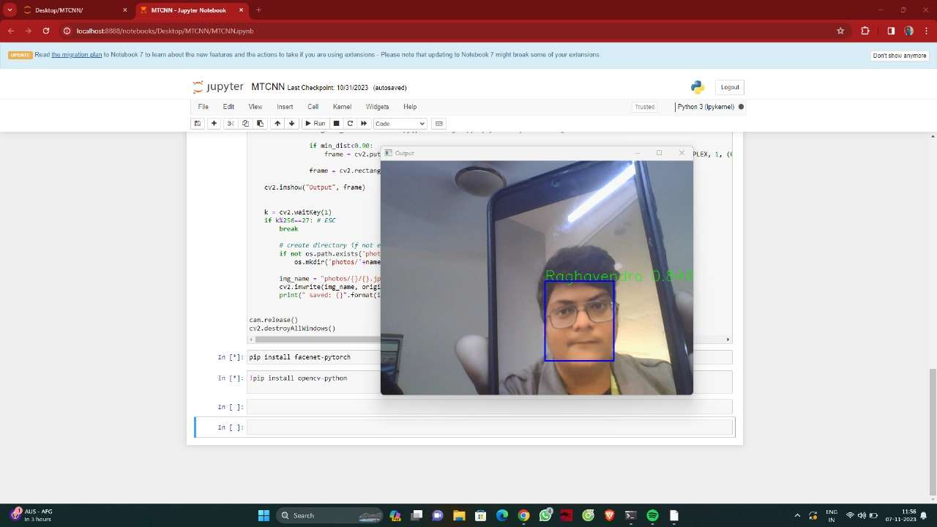

Slide 18


