Slide 1
DSA PROJECT
PARAGRAPH CLASSIFICATION
PROJECT MEMBERS:
1.Y.VIGNESH REDDY-22BEC0658
2.V.GANESH KUMAR REDDY-22BEC0674

Slide 2

AIM:
This aim of the project is to create a graphical user interface in Python that utilizes keyword analysis to automatically check the spelling in a provided paragraph and suggest changes to any incorrectly spelled words, as well as categorizes the text into a relevant subject.

Slide 3
Introduction
This Python program provides a graphical user interface built using “Tkinter” for users to input text to be checked for spelling errors and subject classification. After loading a dictionary from a text file, the application utilizes the “difflib” module to find potential matches for misspelled words. In addition, the code uses predefined sets of keywords to identify the primary subject area of the corrected paragraph which can be politics, science, sports, technology, economics or history.

Slide 4
Problem definition
Spelling Errors: In any user-generated text, misspellings and typos are common. Manually proofreading and correcting text is time-consuming and prone to human error.
Classification of paragraph: Classifying paragraphs into categories can help in organizing information or automating content management. However, this task is challenging when performed manually, especially for large volumes of text or unstructured data.

Slide 5
Objective
Automated spell checker: Perform a typo scan on the input text and use a custom dictionary and similarity matching to provide auto-corrections for the identified misspelled words.
User Feedback: For all provided corrections, give feedback indicating the misspelling and the proposed suggestion along with other necessary details that need to be addressed.
Paragraph categorization: After the corrected text is created, compare its words to a set of predefined keywords for various categories (finance, technology, sports among others) to identify its main topic.
Graphical User Interface: Create an interactive interface whereby users can type their text, view the spelling and suggestion corrections and learn the final corrected text with the assigned category of their paragraph.

Slide 6
Start
Enter the paragraph
Check if word is misspelled in paragraph
Yes
Word is correctly spelled
Word Suggestions of misspelled words
Check the category
Auto correction
No
Yes
No
Yes
No
Display category
End
Display suggested words
End
Closest match from text file
Yes
No
END
Suggest corrected word
No close match found

Slide 7
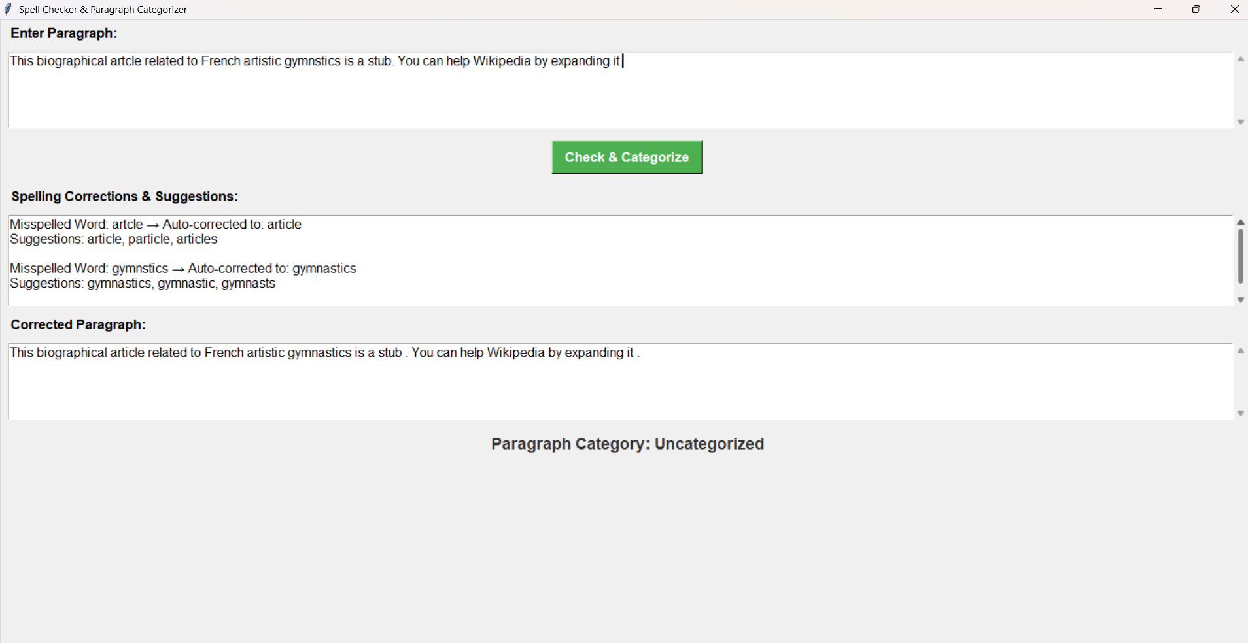
EXPERIMENTAL RESULTS:

Slide 8
EXPLANATION:
Here from the paragraph we can see that the word spelled “artcle” is changed into “article” and it also gives some suggestions like article, articles, particle and it chooses nearest appropriate word.
Similarly from the paragraph we can that the word spelled “gymnstics” is changed into “gymnastics” and it also gives some suggestions like gymnastic, gymnastics, gymnasts and chooses nearest appropriate word.
Based on the given categories it will check the word given in the defined categories.

Slide 9
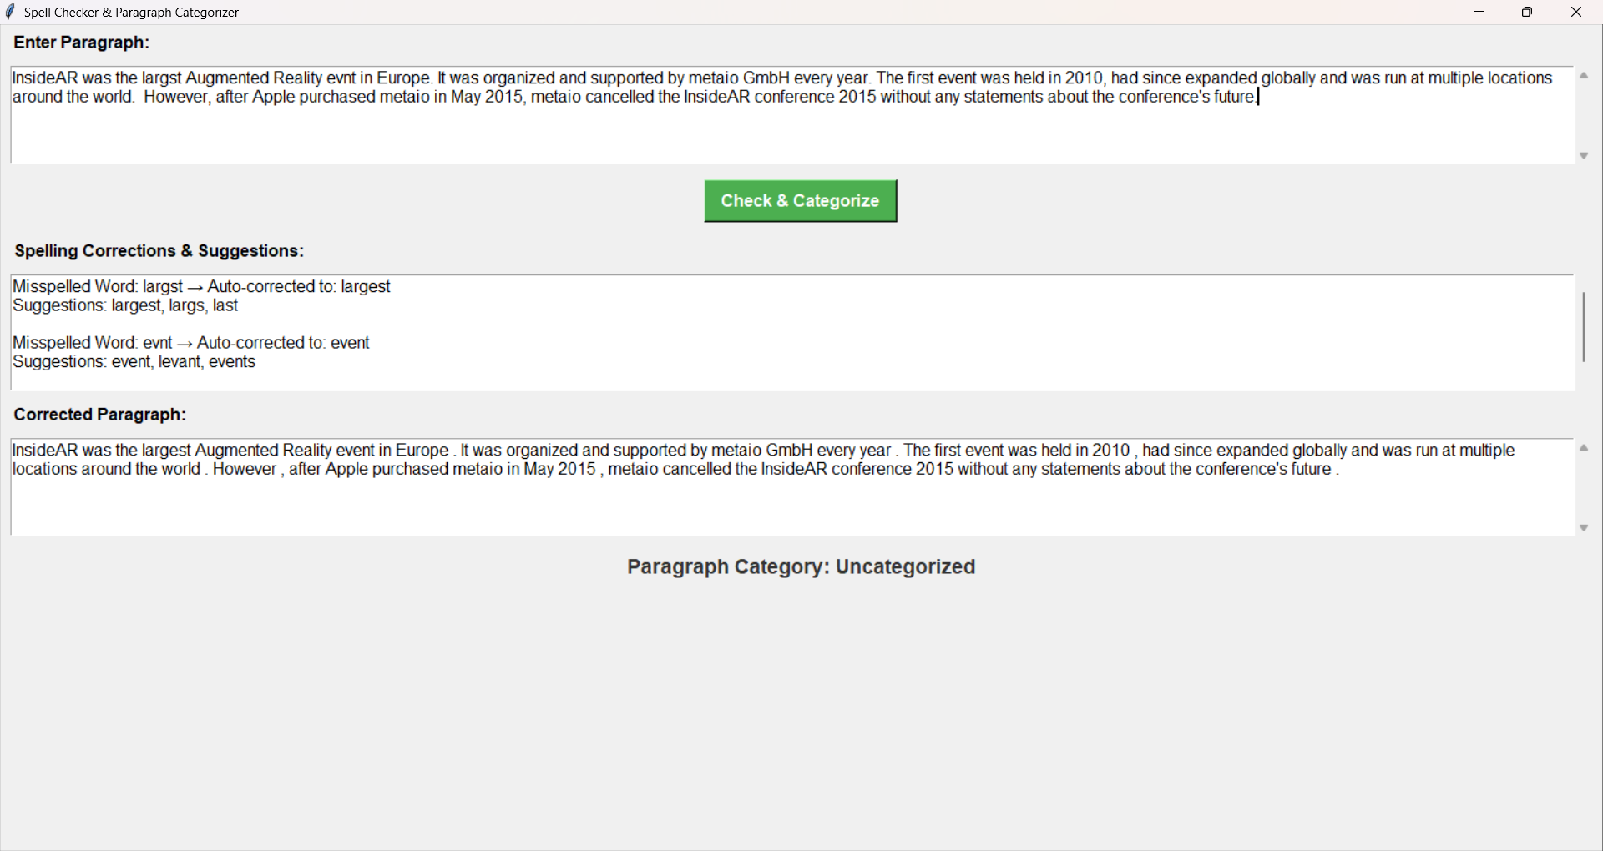
EXPERIMENTAL RESULTS:

Slide 10
EXPLANATION:
Here from the paragraph we can see that the word spelled “largst” is changed into “largest” and it also gives some suggestions like largest, larges, last and it chooses nearest appropriate word.
Similarly from the paragraph we can that the word spelled “evnt” is changed into “event” and it also gives some suggestions like event, levant, events and chooses nearest appropriate word.
Based on the given categories it will check the word given in the defined categories.

Slide 11
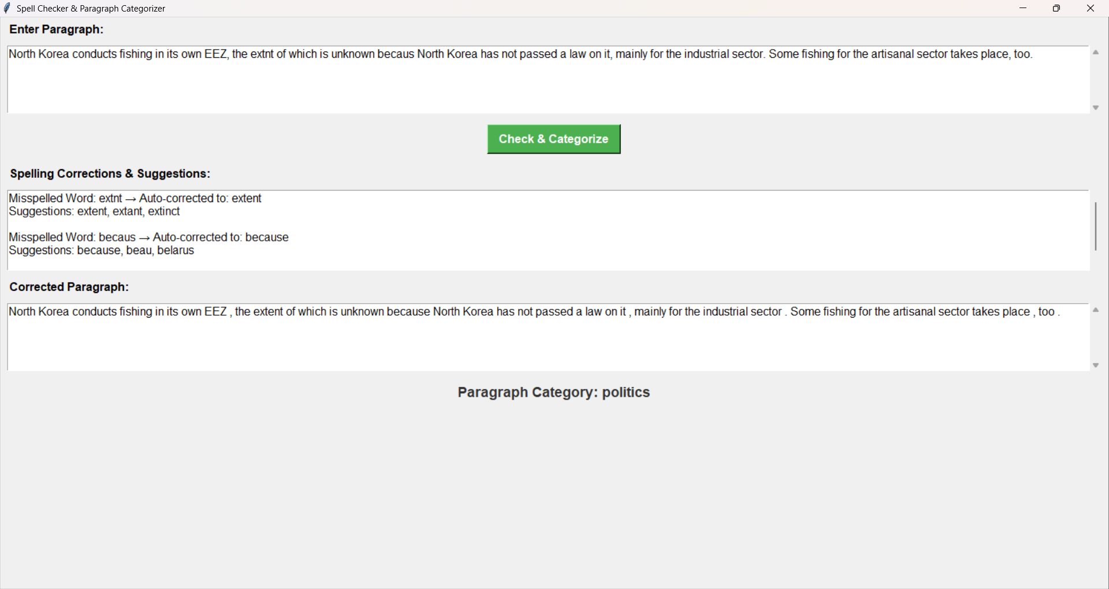
EXPERIMENTAL RESULTS:

Slide 12
EXPLANATION:
Here from the paragraph we can see that the word spelled “extnt” is changed into “extent” and it also gives some suggestions like extent, extant, extinct and it chooses nearest appropriate word.
Similarly from the paragraph we can that the word spelled “becaus” is changed into “because” and it also gives some suggestions like because, beau, belarus and chooses nearest appropriate word.
Based on the given categories it will check the word given in the defined categories.

