Slide 1
LightGBM Regression in Machine Learning
Presented by: T.Vignesh
Date: 11-04-2026

Slide 2
What is LightGBM?
LightGBM stands for Light Gradient Boosting Machine
Fast and efficient boosting algorithm
Used for regression and classification
Grows trees leaf-wise instead of level-wise
Designed for high performance

Slide 3
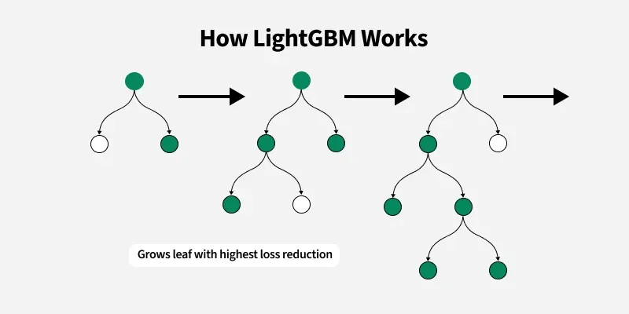
How LightGBM Works
• Starts with an initial prediction
(usually mean value)
• Calculates residual errors
(difference between actual and predicted
values)
• Builds a decision tree to predict these
errors
• Grows trees leaf-wise by splitting the leaf
with maximum error reduction
• Updates predictions by adding new tree
outputs
• Repeats the process using gradient boosting
Insert Image Here

Slide 4
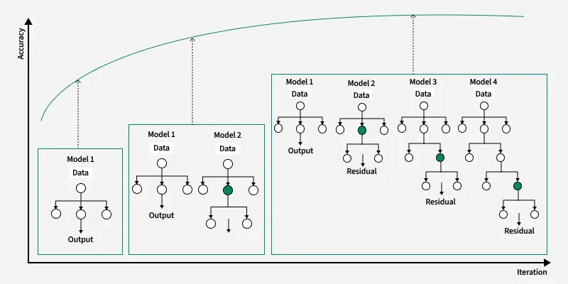
Algorithm Workflow
Insert Image Here
1. Initialize model
2. Compute residuals
3. Grow tree leaf-wise
4. Update predictions
5. Repeat until optimal

Slide 5
Advantages
Faster than XGBoost
High accuracy
Efficient for large datasets
Lower memory usage

Slide 6
Disadvantages
Can overfit on small data
Sensitive to noise
Complex tuning

Slide 7
Use Cases
Fraud detection
Sales prediction
Ranking problems
Recommendation systems

Slide 8
Conclusion
Very fast and powerful algorithm
Best for large datasets
Needs careful tuning
Widely used in competitions

