Slide 1
Boosting Algorithm (Regression) – AdaBoost
Machine Learning Concept
Presented by Vignesh

Slide 2
What is Boosting?
Ensemble technique
Combines weak models → strong model
Sequential learning
Focuses on errors

Slide 3
What is AdaBoost?
Adaptive Boosting(Ada Boost) is an ensemble machine learning technique that improves predictive performance by training multiple weak learners sequentially .
Key Concepts of AdaBoost Regression:
Sequential Learning: Models are built sequentially, where each new model tries to correct the errors of the combined ensemble of previous models.
Weighted Data Points: Initially, all training samples have equal weights. After each iteration, weights of samples with higher regression errors are increased so the next learner focuses on them.
Weak Learners: Typically, small decision trees (stumps) are used, but they can be deeper trees.
Final Prediction: The final output is usually a weighted sum (or weighted median) of the predictions from all the individual trees in the sequence.

Slide 4
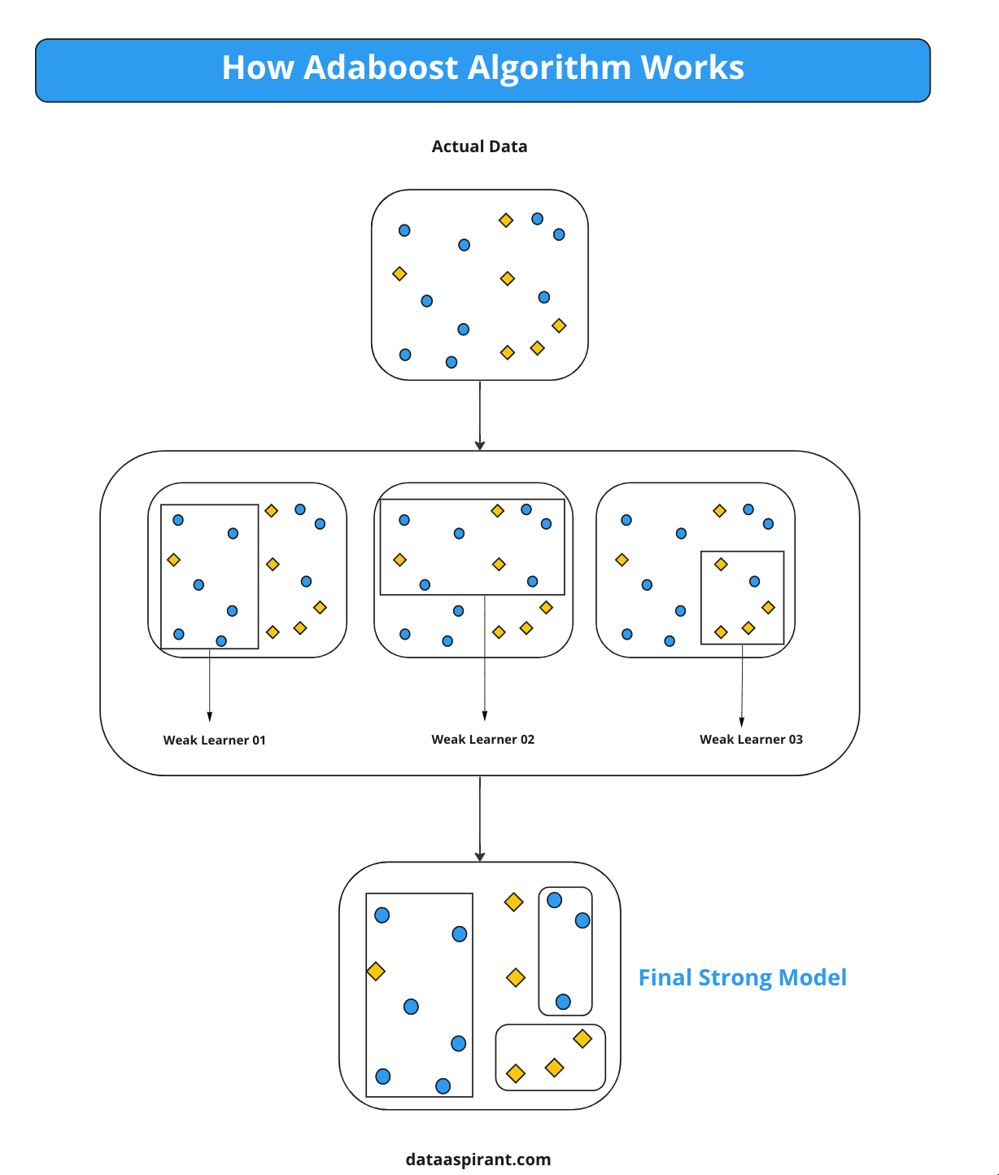
How AdaBoost Works
Equal weights initially
Train weak model
Identify errors
Increase weight of errors
Repeat
Combine models

Slide 5
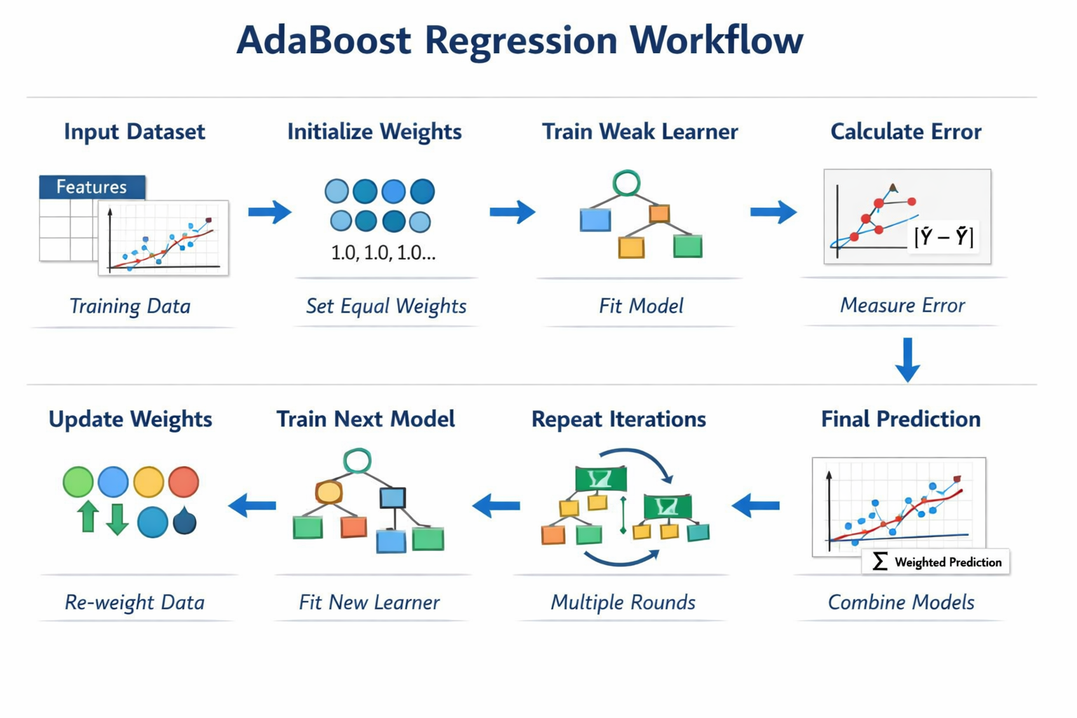
AdaBoost Workflow

Slide 6
Advantages & Disadvantages
Advantages:
High accuracy for complex datasets
Reduces overfitting
Disadvantages:
Sensitive to noise because it over-focuses on correcting large errors.
Slower training

Slide 7
Conclusion
• Learns from mistakes
• Improves weak models
• Works for regression & classification
• Simple and powerful

