Slide 1
Keylogging In LAN
By
Vignesh B
Sriram prabhu r
Surendar R

Slide 2
Introduction
The project aims to explore the concept of keylogging in a Local Area Network (LAN) environment, implement a keylogger tool, and analyse the data collected by the keylogger. The keylogger tool will be designed to monitor and log keystrokes made by users on different computers within the LAN, without their knowledge. The project will also identify potentially sensitive information that is captured by the keylogger, such as passwords, credit card details, and personal data.

Slide 3
Keyloggers and its Working
Keyloggers, also known as keystroke loggers, are malicious software programs that record every keystroke made on a computer or mobile device. They can capture everything from passwords to credit card information, social security numbers, and other sensitive data. Keyloggers can be installed on a device through email attachments, software downloads, or malicious websites. They are often disguised as legitimate programs or applications, making it difficult for users to detect them.
How Keyloggers Work?
Once installed on a device, keyloggers run silently in the background, capturing every keystroke made by the user. This information is then sent back to the attacker, who can use it to steal sensitive information or gain access to user accounts. Keyloggers can also capture screenshots, record audio or video, and log instant messages, making them a powerful tool for cybercriminals

Slide 4
Types
Types of Keyloggers
There are two main types of keyloggers: Hardware and Software.
Hardware keyloggers are physical devices that are attached to a keyboard, while Software keyloggers are installed on a device's operating system. Hardware keyloggers are often used in public places like libraries or internet cafes, where users may not have control over the devices they are using. Software keyloggers, on the other hand, can be installed on any device, making them a more widespread threat.

Slide 5
Overview:
Develop a program that runs in the background and captures the keystrokes that are typed on the computer.
Store the captured keystrokes in a text file.
Set up a mechanism to send the text file to another computer on the local area network using an IP address.
Schedule the transfer to occur after a certain period (in this case, one day).
Once the file has been sent, delete it from the original computer.
On the receiver computer, set up a program to receive the text file and store it in a folder.
Schedule a job on the receiver computer to delete files in the folder that are more than seven days old.
The key idea of the above problem statement is to develop a system that can capture keystrokes and transfer them to another computer on the local network. This system can be used for a variety of purposes, such as monitoring employee activity, tracking internet usage, or as a parental control tool.

Slide 6
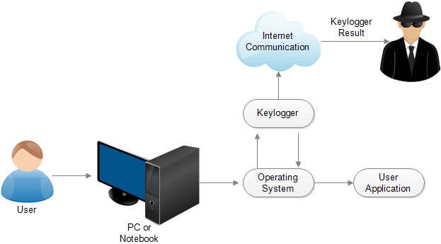
Architecture Diagram:

Slide 7
Existing system:
The existing system in a keylogger in LAN refers to the current state of the Local Area Network (LAN) and computer systems where the keylogger will be implemented.
This includes the hardware and software configurations of the computers and devices on the LAN, as well as the network topology and protocols being used.
For instance, the existing system could include details such as the number of computers and devices connected to the network, the types of operating systems being used, the versions of software applications installed on the computers, and the types of security measures currently in place on the LAN.
Disadvantage:
Most keyloggers software aren’t a open source tool.

Slide 8
Proposed system:
The proposed system could be a keylogger that continuously monitors and captures the keys that are typed on a computer and stores them in a file. The keylogger could then send the file to another computer on the local area network using the IP address. The file could be sent after a certain period (in this case, one day) and then deleted from the original computer.
Here's a high-level overview of the proposed system:
We developed a keylogger program that runs in the background and captures the keys that are typed on the computer. We used a Python library like pynput to implement the keylogger. We set up a file transfer mechanism to send the captured keystrokes to another computer on the local area network and the socket library in Python to send the file to the other computer.
Once the file has been sent, delete it from the original computer by using os library in Python to delete the file.

Slide 9
On the receiver computer, we set up a program to receive the file and store it in a folder. We use socket library to receive the file, and the os library to manage the files in the folder.
We scheduled a job on the receiver computer to delete files in the folder that are more than seven days old by using Python library like schedule to set up the job to occur automatically.
DEVELOPMENT ENVIROMENT:
1. SOFTWARE REQUIREMENT
Windows 10
Python
VS Code
2. HARDWARE REQUIREMENT
Processor: Minimum 1 GHz
Memory (RAM): 4 GB
Hard Drive: 32 GB
Internet Connection

Slide 10
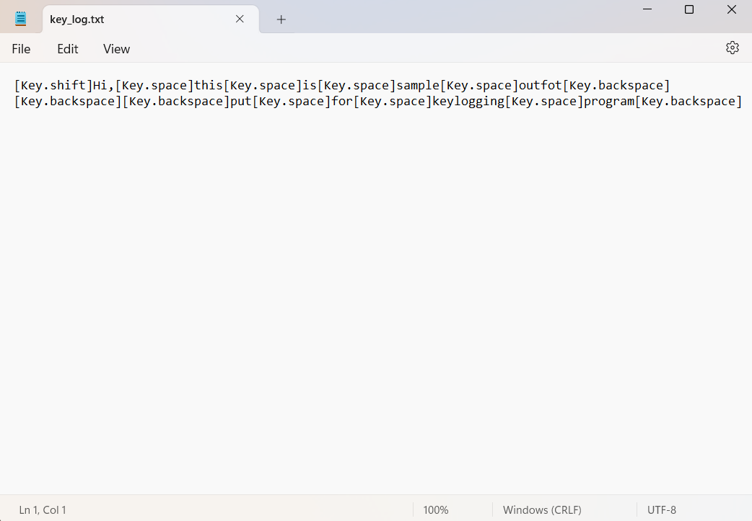
Output:

Slide 11
Conclusion
In conclusion, the Keylogging in Local Area Network project has explored the concept of keylogging in a LAN environment, implemented a keylogger tool, and analyzed the data collected by the keylogger. The project aimed to identify potential risks associated with keylogging in a LAN environment and provide practical solutions to mitigate these risks.
Through the project, we have gained a deeper understanding of the importance of keylogging in today's cybersecurity landscape and the potential damage that can result from keylogging attacks. We have also developed a keylogger tool that can monitor and log keystrokes made by users on different computers within a LAN environment.
Overall, the Keylogging in Local Area Network project has contributed to the development of cybersecurity solutions for LAN environments, and has highlighted the importance of proactive measures to prevent keylogging attacks

