Slide 1
Naan Mudhalvan
1 Billion 1 Million

Slide 2
NAME : VIGNESH S
REGISTER NO. : 812821104075
COLLEGE CODE : 8128
COLLEGE NAME : MOOKAMBIGAI COLLEGE OF ENGINEERING
CLASS : E41B
DEPARTMENT. : COMPUTER SCIENCE AND ENGINEERING

Slide 3
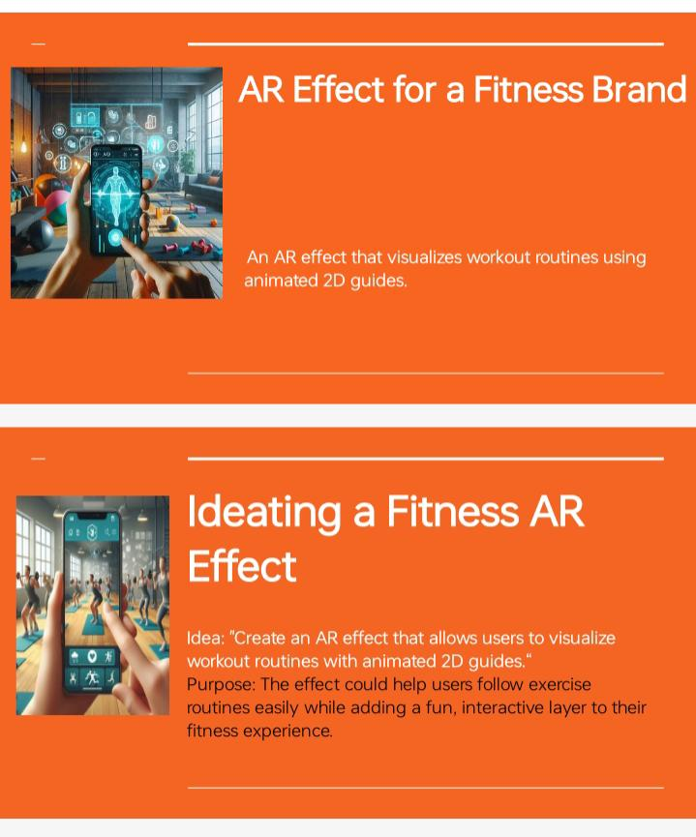
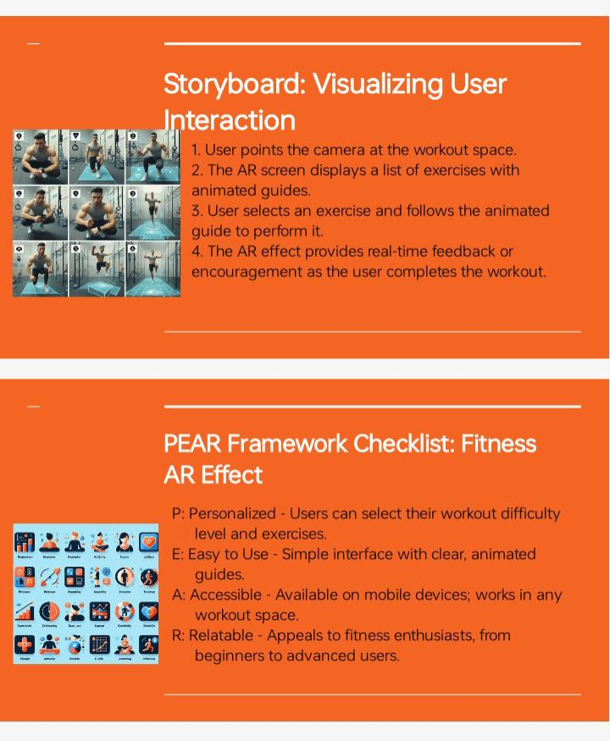
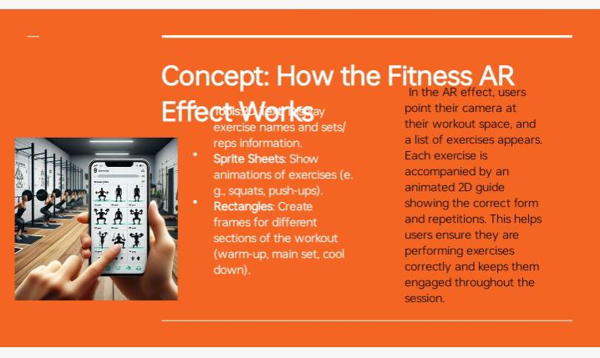
Introduction and Understanding AR & Meta Spark Studio - Make your first AR filter with 2D Screen (Week-2)
Open Meta Spark Studio and the first thing you’ll see is the Welcome Window.
By default you’ll be on the Create New tab.
This is where you can create a new blank scene or use the templates built into Spark.
Template are ready-made effects that you can customize quickly and easily to build all sorts of effects.

Slide 4
Creating Interactive Face Tracking Effects(Week-3)
Link : https://www.instagram.com/ar/7850151915089131/
Begin by adding a face tracker to your project. This feature detects the user's face position and orientation,
enabling your effect to interact with it.
It forms the foundation for any effect that responds to facial movements.

Slide 5
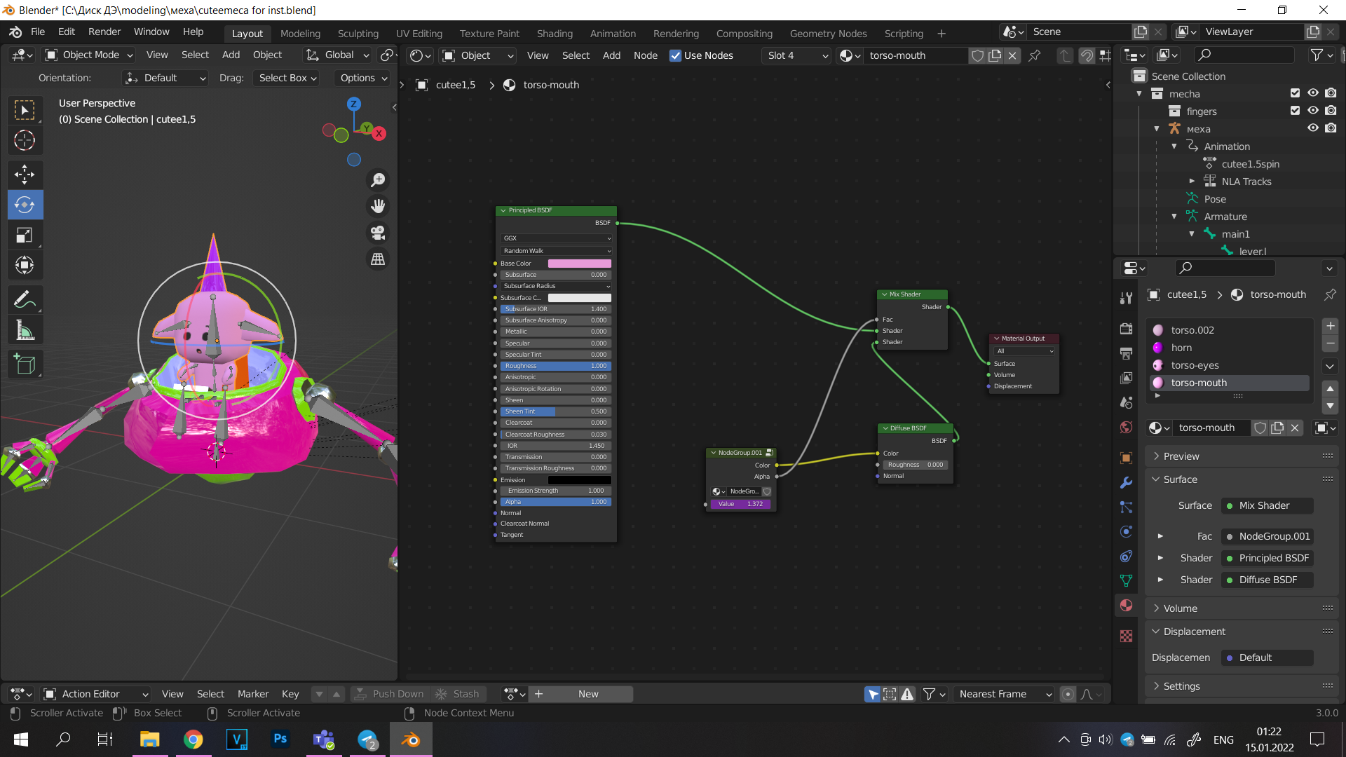
World Effects & 3D Character Animation (Week-4)
Link : https://www.instagram.com/ar/883324043926247/
If you expand the teddy object in the Scene panel, you'll see two objects nested underneath it.
Model group contains a series of mesh that define the shape of the object.

Slide 6
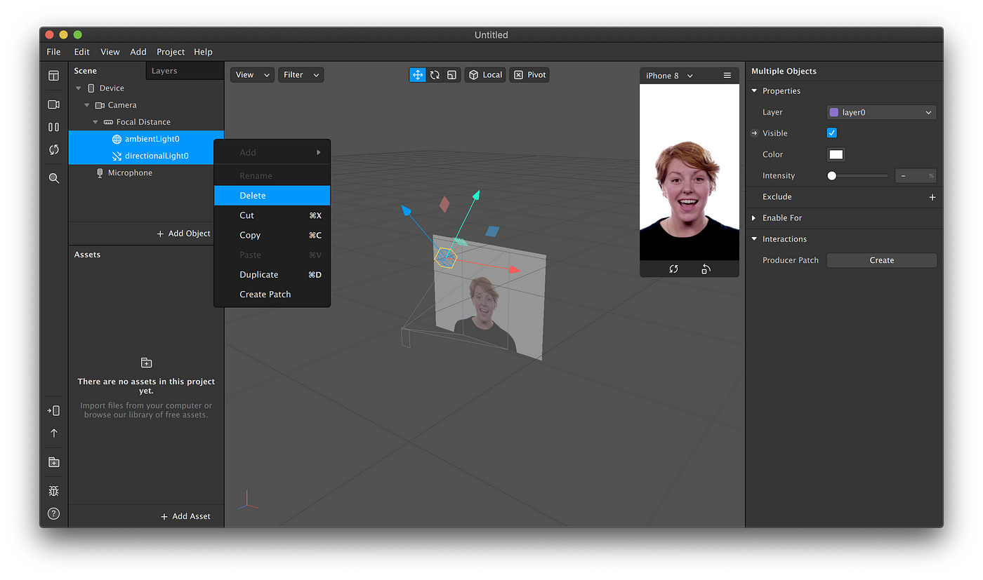
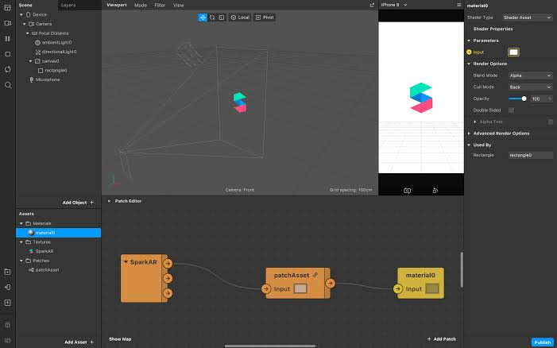
Deep Dive into Visual Programming using Patch Editor (Week-5)
Link : https://www.instagram.com/ar/497892959742999/
To create your effects, you'll build graphs by connecting patches together.
Connecting patches involves linking output ports to input ports, and patches can only be connected from left to right.

Slide 7
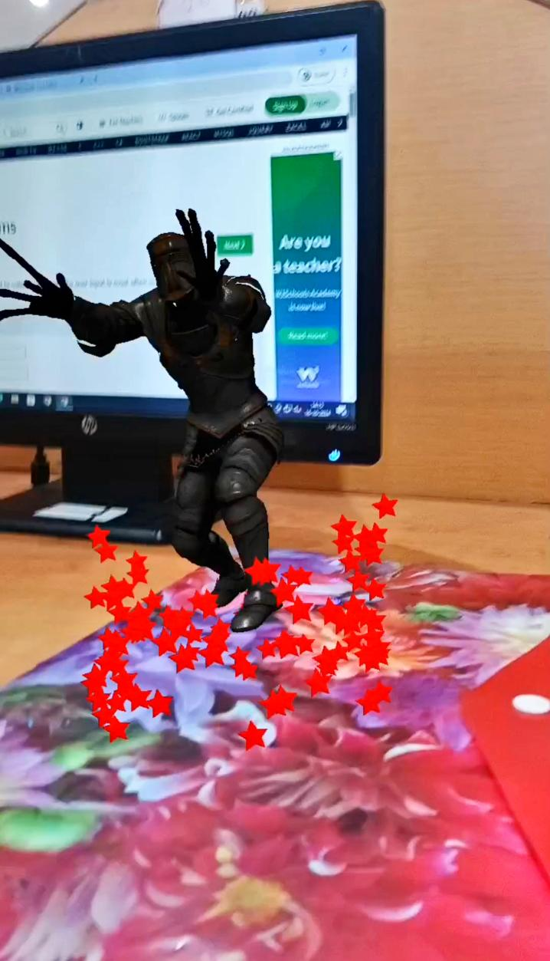
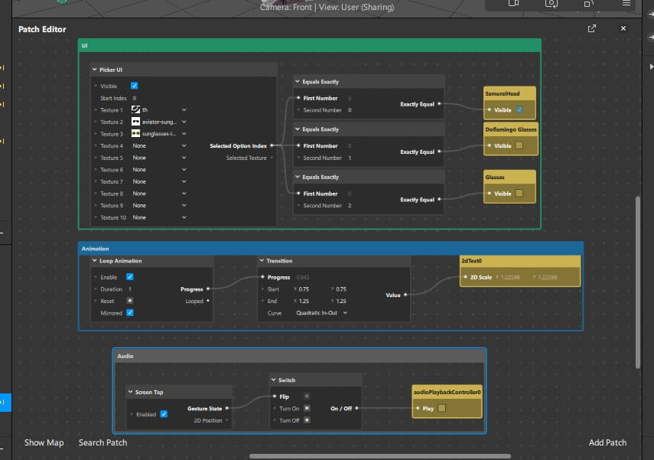
Creating Target Tracking Effects (Week-6)
Link : https://www.instagram.com/ar/1076634983907507/
A 3D object star a simple 3D shape that will appear when the target is detected.
A texture named SparkTargetPoster This will serve as the target image.
Default environment texture Provides realistic lighting to the 3D object.

Slide 8
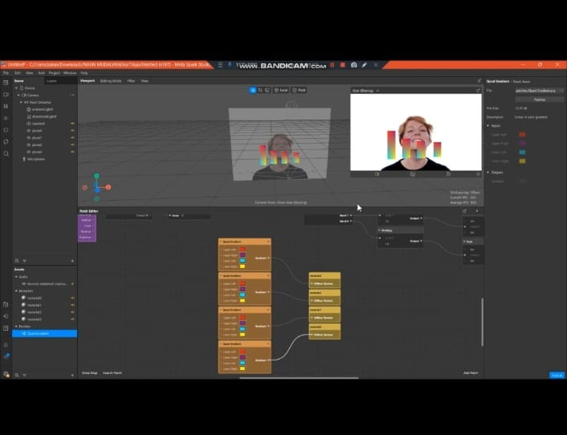
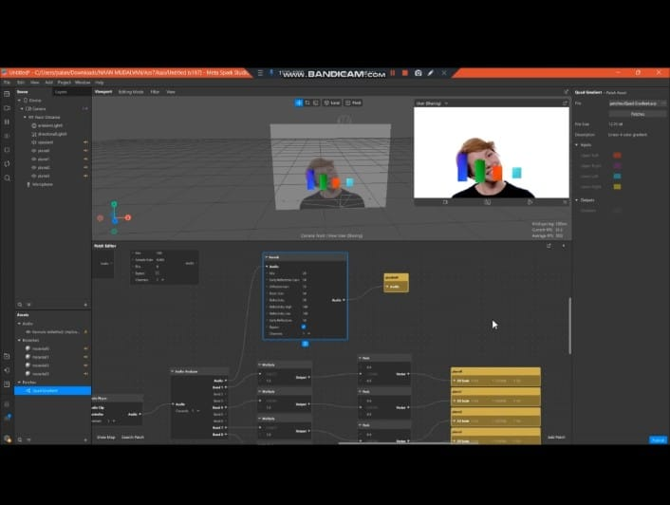
Deep dive into Audio in Meta Spark Studio (Week-7)
Link : https://www.instagram.com/ar/726321136368877/
This category includes sounds that work well as individual design elements,
used to emphasize events like interactions and animations.
For example, sounds from real and imaginary creatures and realistic sound effects like machines and tools.

Slide 9
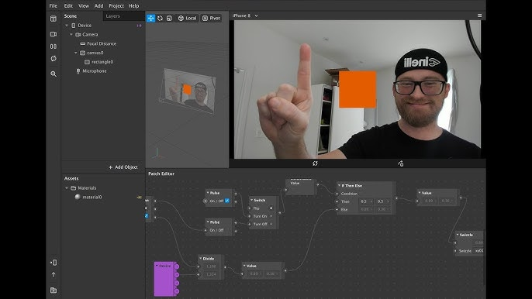
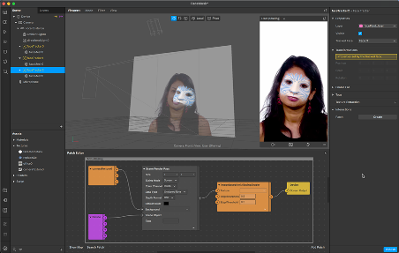
2D Hand Tracking Effects (Week-8)
Link : https://www.instagram.com/ar/1579547952969622/
Hand bounding boxes can be used to create effects that respond to both the position and size of a user's hand.
They plot an invisible rectangle around a selected hand, making the 2D coordinates of all 4 corners
and the center of the rectangle,
As well as its height and width, available for you to use in your effect.

