Slide 1
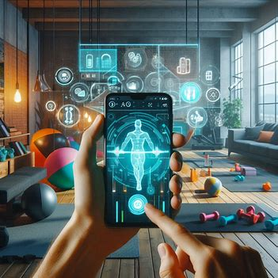
AR Effect for a Fitness Brand
An AR effect that visualizes workout routines using animated 2D guides.

Slide 2
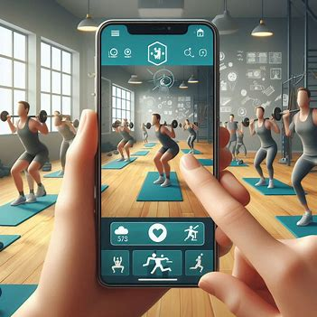
Ideating a Fitness AR Effect
Sent by you:
Title: Ideating a Fitness AR Effect
Idea: "Create an AR effect that allows users to visualize workout routines with animated 2D guides.“
Purpose: The effect could help users follow exercise routines easily while adding a fun, interactive layer to their fitness experience.

Slide 3
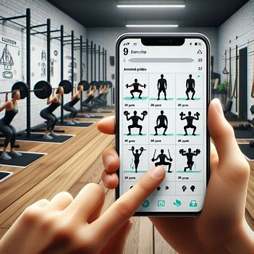
Concept: How the Fitness AR Effect Works
In the AR effect, users point their camera at their workout space, and a list of exercises appears. Each exercise is accompanied by an animated 2D guide showing the correct form and repetitions. This helps users ensure they are performing exercises correctly and keeps them engaged throughout the session.
Tools:2D Text: Display exercise names and sets/reps information.
Sprite Sheets: Show animations of exercises (e.g., squats, push-ups).
Rectangles: Create frames for different sections of the workout (warm-up, main set, cool down).

Slide 4
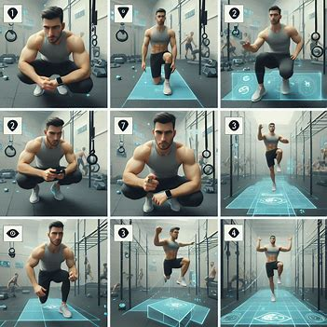
Storyboard: Visualizing User Interaction
1. User points the camera at the workout space.
2. The AR screen displays a list of exercises with
animated guides.
3. User selects an exercise and follows the animated
guide to perform it.
4. The AR effect provides real-time feedback or
encouragement as the user completes the workout.

Slide 5

PEAR Framework Checklist: Fitness AR Effect
P: Personalized - Users can select their workout difficulty level and exercises.
E: Easy to Use - Simple interface with clear, animated guides.
A: Accessible - Available on mobile devices; works in any workout space.
R: Relatable - Appeals to fitness enthusiasts, from beginners to advanced users.

