Slide 1
Google Play Store Apps Analysis
VIGNESH.R

Slide 2
INTRODUCTION
Objective: Perform exploratory data analysis (EDA) on a Kaggle dataset of Play Store apps.
Tools Used: Python, Pandas, Matplotlib, Seaborn
Outcomes:
Cleaned dataset for analysis
Visual insights into app ratings, pricing, and installs

Slide 3
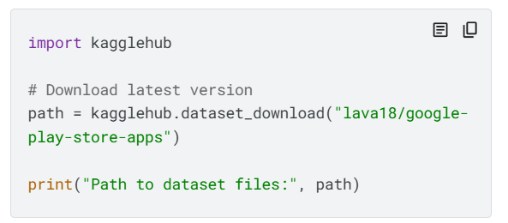
Data Loading & Initial Inspection
Dataset loaded via kagglehub
Initial checks:
data.shape, data.head(), data.info()
Descriptive stats: data.describe()
Purpose:
spot anomalies,
prep for cleaning
Understand structure

Slide 4
Data Cleaning & Preparation
Removed duplicates: data.drop_duplicates()
Handled missing values:
Filled Rating with mean
Dropped rows with nulls in key columns
Removed outlier (Rating = 19.0)
Converted:
Price, Installs, Reviews → numeric
Created isPaid column from Type
Saved cleaned dataset: cleaned_playstore.csv

Slide 5
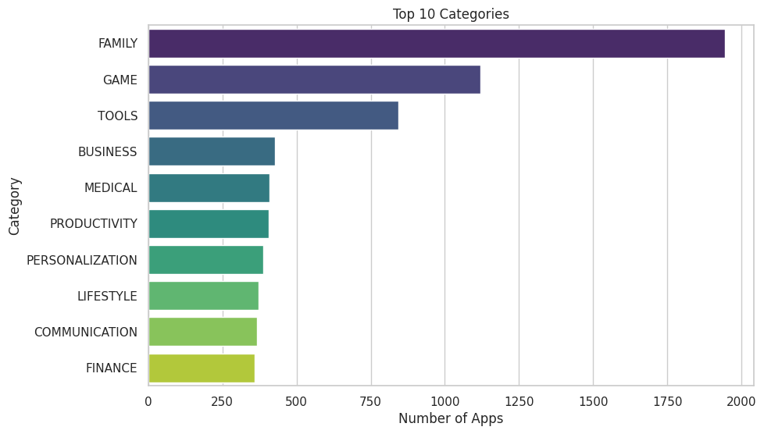
Exploratory Data Analysis (EDA)
Cleaned dataset loaded for visualization.
Top 10 app categories visualized with a bar plot.
App rating distribution visualized using a histogram with KDE.
Scatter plot visualizes 'Price' vs. 'Rating'.
Scatter plot visualizes 'Installs' vs. 'Rating' (log scale, colored by 'Type').
Correlation matrix of 'Rating', 'Reviews', 'Installs', 'Price', and 'isPaid' visualized with a heatmap.

Slide 6
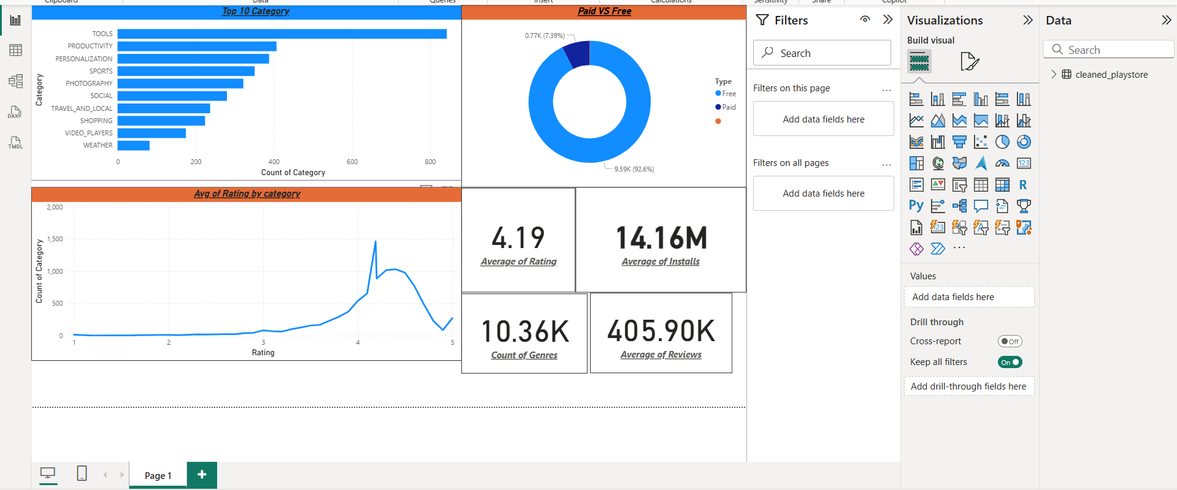
Dashboard

