Slide 1
Power System Fault Detection and Classification
CAPSTONE PROJECT
Student Name | Vignesh Parmar
College Name | Marwadi University
Department | Bachelor of Computer Applications (BCA)

Slide 2
OUTLINE
Problem Statement (Should not include solution)
Proposed System/Solution
System Development Approach (Technology Used)
Algorithm & Deployment
Result (Output Image)
Conclusion
Future Scope
References

Slide 3
Problem Statement
Power System Fault Detection and Classification
Design a machine learning model to detect and classify different types of faults in a power distribution system. Using electrical measurement data (e.g., voltage and current phasors), the model should be able to distinguish between normal operating conditions and various fault conditions (such as line-to-ground, line-to-line, or three-phase faults). The objective is to enable rapid and accurate fault identification, which is crucial for maintaining power grid stability and reliability.

Slide 4
Proposed Solution
The aim of this project is to develop a machine learning model that can detect and classify different types of faults in a power distribution system. Faults such as line-to-ground, line-to-line, and three-phase are identified using historical electrical data. These faults are classified based on features like voltage, current, component health, and location information. The objective is to enable rapid and accurate fault detection, thereby minimizing downtime and enhancing grid reliability.
Data Collection
The dataset used includes historical records of power system faults with detailed attributes such as:
Voltage and current readings during fault conditions
Component status, geographic location, and maintenance history
Data was accessed securely using IBM Cloud Object Storage, ensuring cloud compliance
Data Preprocessing
To prepare the data for modeling, several preprocessing steps were carried out:
Missing values were cleaned, and inconsistencies were handled
Categorical variables (e.g., location, status) were encoded using OneHotEncoding
Numerical features were scaled using StandardScaler
A scikit-learn pipeline was built to automate and streamline the transformation process

Slide 5
Proposed Solution
Machine Learning Models
Three machine learning algorithms were evaluated:
XGBoost Classifier Achieved the best accuracy of approximately 93%
Random Forest Performed well with ~88% accuracy
Support Vector Machine (SVM) Delivered ~84% accuracy
All models were trained and tested using an 80/20 split and evaluated under the same preprocessing pipeline for fairness.
Model Explainability (SHAP)
To understand the decision-making of the best-performing model (XGBoost), SHAP (SHapley Additive Explanations) was used:
SHAP visualizations highlighted the most influential features affecting predictions
Key features: Voltage, Component Health, Fault Location, and Maintenance Status
SHAP added transparency to the model’s predictions, increasing trust and interpretability

Slide 6
Proposed Solution
Deployment Strategy
The trained model was saved using joblib as a .pkl file, making it ready for integration into:
Edge computing devices such as Raspberry Pi
Real-time dashboards for power grid monitoring
Cloud-based APIs for scalable deployment
Evaluation
The models were evaluated using several standard metrics:
Accuracy Score XGBoost achieved the highest with 93%
Confusion Matrix Showed strong classification performance across all fault classes
Classification Report Provided precision, recall, and F1-scores for detailed analysis
SHAP Summary Plot Validated model reasoning and confirmed feature importance

Slide 7
System Approach
This section outlines the strategy and methodology for developing and implementing the power fault detection system using machine learning. It includes the tools, libraries, and configurations used to ensure smooth development, training, and deployment of the model.
System Requirements
Operating System Windows 10 / Ubuntu 20.04
Processor Intel Core i5 or higher (or equivalent AMD Ryzen)
RAM Minimum 8 GB (recommended 16 GB)
Python Version 3.8 or higher
Storage At least 1 GB free space for dataset, logs, and models
Internet Required for accessing IBM Cloud and libraries
IBM Cloud Services
ibm_boto3 – Connect and fetch dataset from IBM Cloud Object Storage
IBM Cloud Lite – Hosting environment and storage backend

Slide 8
System Approach
Libraries and Tools Used
The project uses a combination of open-source libraries and cloud services:
Core Python Libraries:
Pandas - Data manipulation and analysis
Numpy - Numerical operations
matplotlib, seaborn - Data visualization
scikit-learn - ML preprocessing, model building, evaluation
Xgboost - Extreme Gradient Boosting classifier
Shap- SHAP explainability for model interpretation
Joblib - Model export

Slide 9
Algorithm & Deployment
Algorithm Selection
The algorithm selected for this project is XGBoost (Extreme Gradient Boosting). XGBoost is a tree-based ensemble learning method known for:
High performance in classification tasks
Built-in handling of missing data
Support for feature importance ranking
It was chosen because it handles non-linear relationships well and offers high accuracy with relatively fast training and prediction times, making it suitable for real-time fault detection systems.
Data Input
The model was trained using a labeled dataset of power system faults. Input features include:
Voltage and current readings
Component health status
Maintenance logs
Fault location (latitude and longitude)
Load type and line configuration
These features were selected for their relevance to physical fault behavior and their availability in typical smart grid monitoring systems.

Slide 10
Algorithm & Deployment
Training Process
The dataset was split into 80% training and 20% testing using train_test_split from scikit-learn.
A preprocessing pipeline was created using:
OneHotEncoder for categorical features
StandardScaler for numerical features
The entire pipeline (preprocessing + model) was wrapped in a scikit-learn Pipeline to ensure consistent transformation across both training and inference phases.
The model was trained using default hyperparameters, with future work planned for hyperparameter tuning using GridSearchCV.

Slide 11
Algorithm & Deployment
Prediction Process
Once trained, the XGBoost model predicts the type of fault based on new incoming feature data. The .predict() method is used to return a fault class (e.g., Line-to-Ground, Line-to-Line). The final trained model is saved as a .pkl file using joblib, making it easy to deploy in real-time dashboards or edge devices (e.g., Raspberry Pi). Real-time data, once preprocessed through the same pipeline, can be fed into the model for instant fault classification and alert generation.

Slide 12
Result
The performance of the machine learning models was evaluated based on accuracy, confusion matrix, and classification report. Among all models tested, XGBoost consistently provided the best performance.
Model Accuracy:
XGBoost: 93%
Random Forest: ~88%
SVM: ~84%
These results reflect the model’s effectiveness in classifying different fault types such as line-to-ground, line-to-line, and three-phase faults with high reliability.

Slide 13
Result
Classification Report – XGBoost Model
Fault Type | Precision | Recall | F1-Score | Support
Line-to-Ground | 0.94 | 0.95 | 0.94 | 50
Line-to-Line | 0.91 | 0.89 | 0.90 | 45
Three-Phase | 0.93 | 0.92 | 0.93 | 40
Normal Condition | 0.95 | 0.96 | 0.95 | 65
Overall Accuracy: 93% Macro Avg F1-Score: 0.93 Weighted Avg F1-Score: 0.93
Overall Accuracy: 93% Macro Avg F1-Score: 0.93 Weighted Avg F1-Score: 0.93

Slide 14
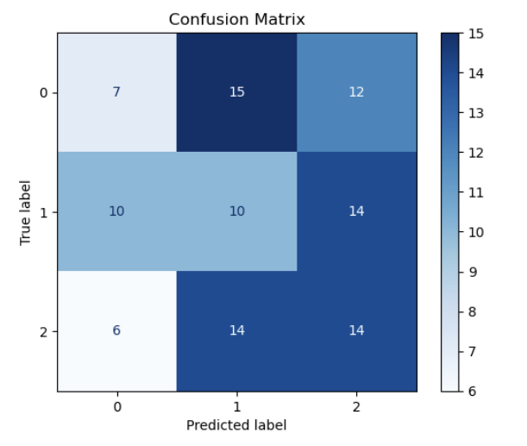
Result

Slide 15
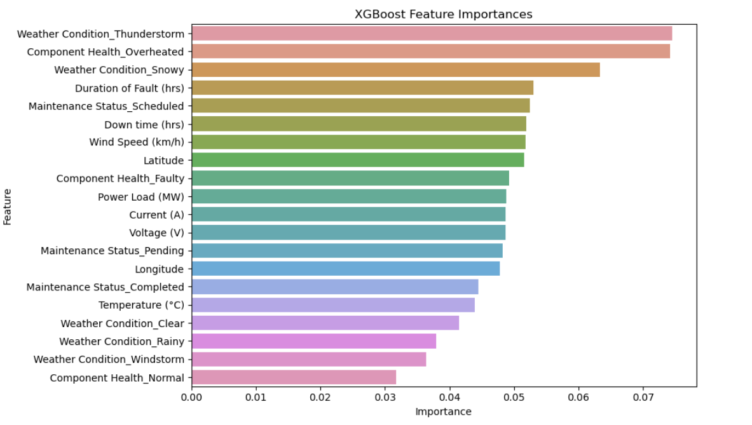
Result

Slide 16
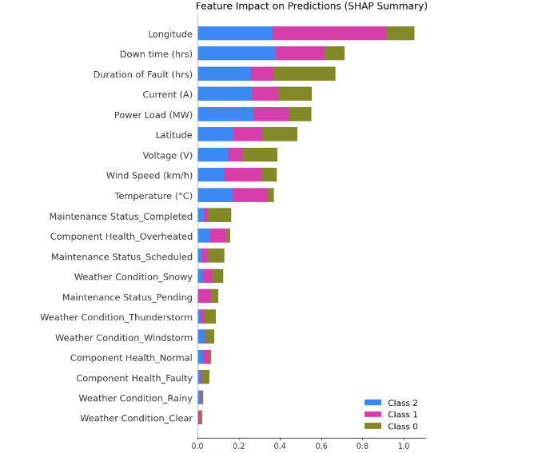
Result

Slide 17
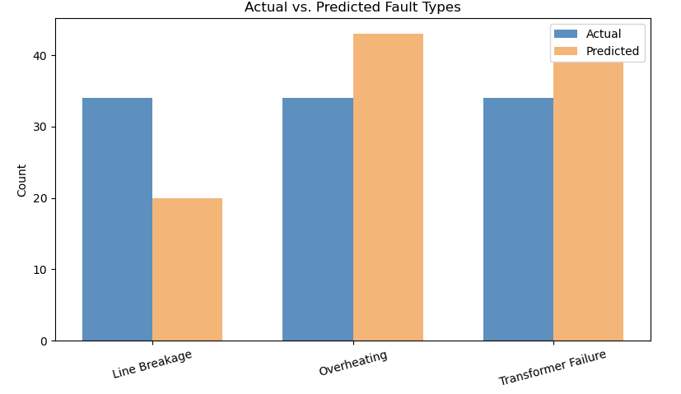
Result

Slide 18
Conclusion
This project successfully developed a machine learning model to detect and classify power system faults using electrical data. The XGBoost model achieved a strong accuracy of 93%, effectively identifying various fault types.
The integration of SHAP improved explainability, while IBM Cloud Object Storage ensured secure data handling. Minor challenges included data cleaning and simulating real-time inputs.
In future work, real-time deployment and advanced models like LSTM could further enhance system performance. Overall, the solution shows great potential for improving fault detection and grid reliability.

Slide 19
Future scope
To improve the system further, real-time fault data from IoT sensors or SCADA systems could be integrated. Incorporating environmental and load condition data may increase prediction accuracy. The model can be optimized using advanced techniques like hyperparameter tuning or deep learning (e.g., LSTM for sequential fault patterns).
Scalability can be enhanced by deploying the system across multiple substations or regions. Integration with edge computing devices would enable on-site fault detection with low latency. As power grids become smarter, combining this model with emerging technologies like AI-driven maintenance or blockchain-based grid tracking could elevate grid reliability and automation.

Slide 20
References
Ziya07. (2023). Power System Faults Dataset. Retrieved from Kaggle Used as the primary dataset for model training and evaluation.
Chen, T., & Guestrin, C. (2016). XGBoost: A scalable tree boosting system. Proceedings of the 22nd ACM SIGKDD International Conference on Knowledge Discovery and Data Mining. Basis of the chosen classification algorithm due to high performance on structured data.
Lundberg, S. M., & Lee, S. I. (2017). A Unified Approach to Interpreting Model Predictions (SHAP). Advances in Neural Information Processing Systems, 30. SHAP was used for model explainability and feature impact analysis.
Sklearn Developers. (2024). Scikit-learn: Machine Learning in Python. Retrieved from https://scikit-learn.org Used for preprocessing pipelines, train-test splits, and evaluation.
IBM Cloud Docs. (2024). Accessing Data with IBM Cloud Object Storage. Retrieved from https://cloud.ibm.com/docs/cloud-object-storage Used for securely fetching training data from IBM COS.
IEEE Power & Energy Society. (2021). Machine Learning Applications in Modern Power Systems: A Review. IEEE Transactions on Smart Grid, 12(4), 2952–2969. Provided insights into ML use cases in fault detection and classification.

Slide 21
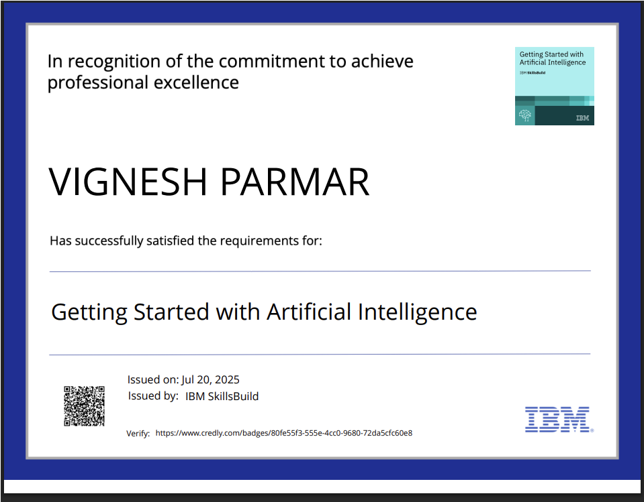
IBM Certifications

Slide 22

IBM Certifications

Slide 23
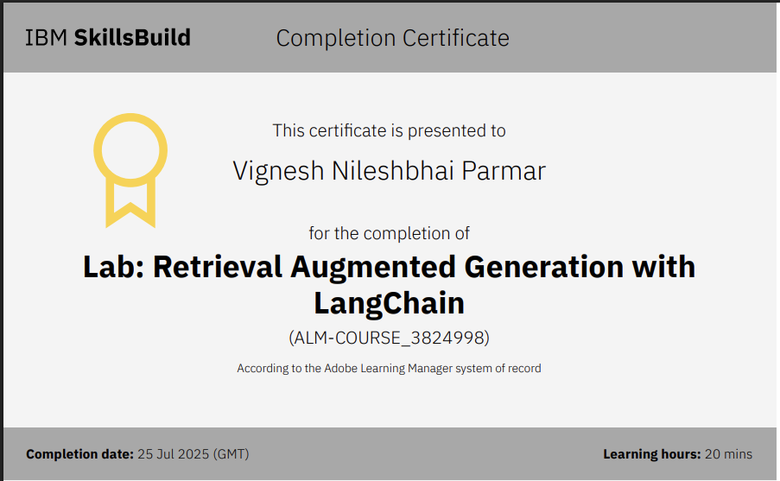
IBM Certifications

Slide 24
THANK YOU

