Slide 1


Product Demand Analysis
Predicting product demand is crucial to optimize inventory management and production planning for businesses. Our project uses machine learning models to forecast product demand based on historical sales data.

Slide 2
Problem Statement
Goal
Objective
Process
Create a machine learning model that forecasts product demand based on historical sales and external factors.
Help businesses optimize inventory management and production planning to meet customer needs efficiently
This involves data collection, data pre-processing, feature engineering, model selection, training, and evaluation.

Slide 3
Design
1
Data Collection
Historical sales data
Data Pre-processing
2
Clean and pre-process data, handle missing values, and convert categorical features into numerical representations
3
Feature Engineering
Create additional features that capture seasonal patterns, trends, and external influences on product demand
Model Selection
4
Choose suitable regression algorithms (e.g., Linear Regression, Random Forest, XGBoost) for demand forecasting
5
Model Training
Train the selected model using the pre-processed data
Evaluation
6
Evaluate the model’s performance using appropriate regression metrics (e.g., Mean Absolute Error, Root Mean Squared Error).
The project aims to train a predictive model for product demand forecasting using various machine learning algorithms. Once the model is trained, it can be used to predict the product's demand at different pricing points. This information can then be used to set the optimal price for the product during the holiday season.

Slide 4
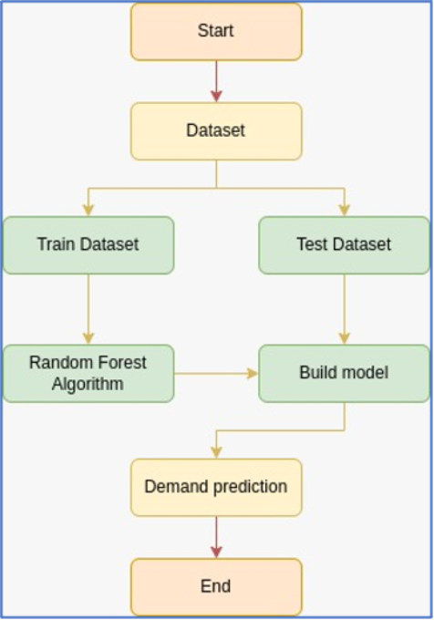
Flow chart for product demand prediction
Determine product demand based on historical sales data and offer optimal price at which the product can outperform its competitors in the market.
Train a predictive model that can forecast the product's demand under various pricing scenarios.
Analyze dataset containing historical sales data based on different price points and identify the price point at which the product is perceived to be a better deal compared to competitors.

Slide 5
Dataset Information
Product ID
Each product has a unique identifier to distinguish between different items.
Store ID
Identifies the specific store or location where the product was sold, helping in understanding regional variations in the demand
Total Price
The actual price at which the product was sold to customers during the sales transaction, including any discounts or promotions applied.
Base Price
The original or standard price at which the product is typically sold before any discounts or promotions are applied.
Units Sold (Quantity Demanded)
The quantity of the product sold at a given price point, reflecting the demand for the product at that particular price.
The primary goal is to create a predictive model that can estimate the demand for the product in the market under different pricing strategies. By analyzing historical sales data, we want to identify the price point at which the product is perceived to be a better deal compared to competitors, leading to increased sales.

Slide 6
Linear Regression
Algorithm
Process
Benefits
A simple but effective algorithm that models the relationship between the product price and units sold.
Through this algorithm, we can identify the price bracket that leads to an increase in demand, eventually leading to an increase in production planning, and inventory management.
This algorithm is straightforward and can analyze and predict demand based on one independent variable.

Slide 7
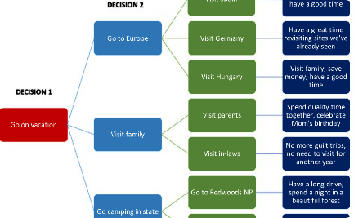
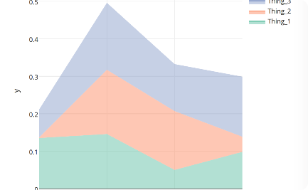

Decision Trees
Algorithm
Process
Benefits
The decision tree algorithm can learn complex relationships between the features in the dataset and the target variable(units sold).
This algorithm generates prediction models and can provide health check-ups on existing models, analyzing granular data across independent variables.
Some benefits of Decision Trees include the ease of interpretation and the ability to identify the factors that lead to product demand fluctuations in retrospect.

Slide 8
Gradient Boosting Machines
1
Algorithm
This algorithm combines the predictions of multiple decision trees to produce a more accurate forecast.
Process
2
The Gradient Boosting Machines use information from different points in time to build a more accurate model of forecasting product demand under different pricing scenarios.
3
Benefits
The algorithm is relatively quick and accurate, and its approach to improving random forest models can also make for a more comprehensive analysis.

Slide 9
Random Forests
1
Algorithm
2
Process
Similar to Gradient Boosting Machines, Random Forests use multiple trees to increase the accuracy of forecasts; however, it uses a different method for constructing decision trees.
The algorithm creates an ensemble of Decision Trees from training data samples to predict data values for unseen data. With each successive decision tree, the model averages across the decision trees and reduces variance and overfitting.
3
Benefits
The main benefit of Random Forests is that it can work on standard and categorical data with little data preparation and use an averaging method to reduce variance and improve accuracy.

Slide 10

Benefits of Using Machine Learning for Product Demand Prediction
Accuracy: Machine learning models can produce highly accurate demand predictions, especially when trained on large datasets of historical sales data.
Speed: Machine learning models can make predictions very quickly, leading to informed pricing decisions in real-time that can help businesses remain competitive in crowded markets.
Flexibility: Machine learning models can be adapted to account for changes in market conditions and consumer preferences.
Using machine learning to forecast product demand can give a business a competitive advantage in the market. By setting the optimal price for its products, the company can boost sales and improve in-store performance.

Slide 11
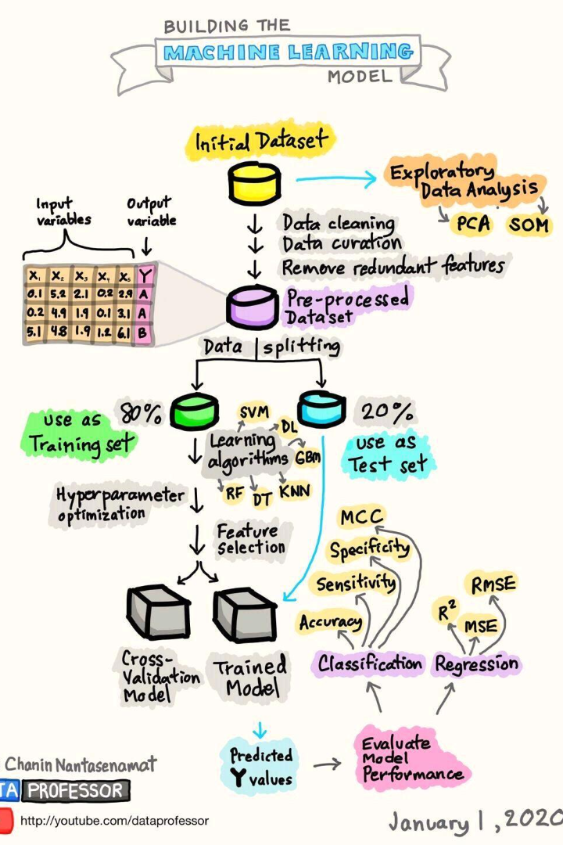
Conclusion
Product Demand Prediction brings a multitude of learning algorithms to the trend analysis stage on sales data. It is a diagnostic process that looks for patterns to help make pricing data-driven decisions with precision and speed, leading to customer satisfaction, reduced costs, and overall profitability.

