Slide 1
ENVIRONMENTAL MONITORING
PHASE:5 PROJECT DOCUMENTATION & SUBMISSION

Slide 2
DOCUMENTATION :
Describe the project's objectives, IoT device deployment, platform development, and code implementation.
Include diagrams, schematics, and screenshots of the IoT devices, environmental monitoring platform, and data display.
Explain how the real-time environmental monitoring system benefits park visitors and promotes outdoor activities.

Slide 3
Describe the project's objectives, IoT device deployment, platform development, and code implementation.

Slide 4
Project Objectives:The primary objectives of this environmental monitoring project are to:
Monitor Environmental Parameters: Continuously monitor key environmental parameters such as air quality, temperature, humidity, and weather conditions in a specific area (e.g., a park, urban area, or industrial site).
Real-Time Data Collection: Collect data in real-time from IoT devices deployed across the monitored area.
Data Storage: Store the collected data securely for historical analysis and reference.
Data Analysis: Implement data analysis algorithms to process the collected data and derive meaningful insights.
User Interface: Develop a user-friendly platform for data visualization, allowing stakeholders to access and interpret the data.
Alerting System: Set up alerts for critical events such as sudden air quality deterioration or extreme weather conditions.

Slide 5
IoT Device Deployment : Deploy IoT devices strategically across the area of interest. For environmental monitoring, this might include:
Weather Stations: These can measure temperature, humidity, air pressure, wind speed, and wind direction.
Air Quality Sensors: To measure pollutants like particulate matter (PM), volatile organic compounds (VOCs), and gases (e.g., CO2).Soil Sensors: For monitoring soil moisture and quality.
Remote Cameras: For visual assessment and recording of conditions .
Wireless Communication Infrastructure: Ensure reliable data transmission from devices to the central platform.

Slide 6
Platform Development : Create a central platform for data management and presentation. This platform should include:
Data Storage: A secure database for storing the collected data.
Data Analysis: Implement algorithms for data processing, trend analysis, and anomaly detection.
User Interface: Develop a web-based or mobile application for users to access the data in a user-friendly manner.
Alerting System: Set up automated alerts to notify users or administrators of critical events.
Data Visualization: Create interactive charts and maps for data visualization .
User Authentication: Implement user authentication and authorization to ensure data security.

Slide 7
Code Implementation: The code implementation involves various aspects, including:
Embedded Software: Writing firmware for the IoT devices to collect data and communicate it to the central platform.
Server-Side Development: Setting up the server and database infrastructure for data storage and analysis.
Web Development: Creating the user interface using HTML, CSS, and JavaScript.
Data Analysis Code: Developing algorithms for processing and analyzing the collected data.
Alerting System Code: Writing scripts for automated alerts based on predefined conditions.

Slide 8
Include diagrams, schematics, and screenshots of the IoT devices, environmental monitoring platform, and data display.

Slide 9
Microcontrollers:
Microcontrollers or IoT devices (e.g., Arduino, Raspberry Pi, ESP8266/ESP32) are used to interface with the sensors, collect data, and transmit it to the central system. They may also perform data preprocessing.

Slide 10
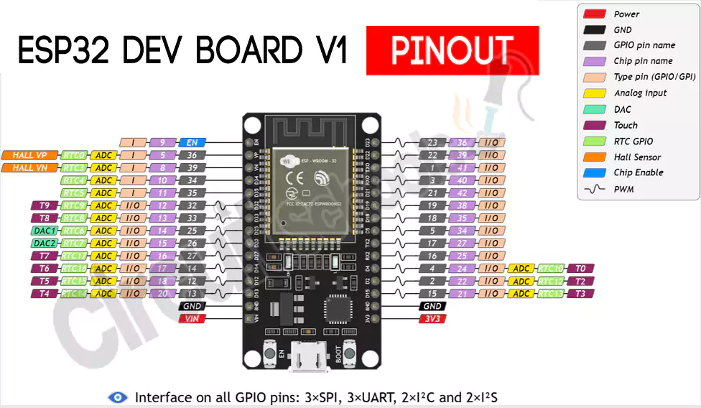

Slide 11
Communication: IoT devices communicate with the central system using various communication protocols, such as Wi-Fi, LoRa, Zigbee, or cellular networks, depending on the application's requirements.
Gateway: In some cases, a gateway device may be used to aggregate data from multiple IoT devices and forward it to the central system. This is common in larger-scale deployments .
Cloud Platform: The data collected is sent to a cloud-based platform (e.g., AWS, Azure, Google Cloud) for storage and processing. The cloud platform can provide scalability, security, and data analysis capabilities
Data Processing: Data from the sensors is processed on the cloud platform. This can involve real-time data analysis, data aggregation, and storage.

Slide 12
Explain how the real-time environmental monitoring system benefits park visitors and promotes outdoor activities.

Slide 13
Safety Assurance: Visitors can access real-time information about weather conditions, air quality, and other environmental factors. This helps them make informed decisions about their activities, ensuring their safety. For example, they can be alerted to adverse weather conditions or poor air quality, reducing the risk of health issues or accidents.
Activity Planning: Park visitors can check real-time data to plan their outdoor activities. They can choose the best times for hiking, biking, picnicking, or other activities based on weather conditions, temperature, and visibility, enhancing their overall experience.
Resource Management: Real-time monitoring allows park authorities to manage resources efficiently. They can adjust staff schedules, close or open certain areas of the park, or allocate resources based on visitor patterns and environmental conditions, ensuring a positive experience for visitors.
Educational Opportunities: Interactive displays or mobile apps can provide educational information about the environment, wildlife, and ecology in the park. Visitors can learn about the local ecosystem and engage more with the natural surroundings.
Enhanced Engagement: Real-time data and alerts can pique visitors' interest and encourage them to explore the park further. For example, they might decide to visit a scenic viewpoint when visibility is excellent, or join wildlife-watching tours when animals are active.
Environmental Awareness: The monitoring system can raise awareness about the importance of environmental conservation and sustainability. Real-time data on air quality, water quality, and energy consumption can educate visitors about the impact of their actions on the environment.
Accessibility: Real-time information can make the park more accessible to a wider range of visitors, including those with mobility issues or special needs. They can plan their visits more effectively and enjoy the park's offerings with greater ease.

Slide 14
Event Planning: Outdoor events, such as festivals or guided nature walks, can be scheduled based on real-time data. Visitors can participate in these events with confidence, knowing that the park authorities have considered environmental conditions .
Data for Research: Environmental data collected over time can also benefit researchers and scientists studying local ecosystems and climate. This can contribute to a better understanding of the park's biodiversity and environmental changes.
Community Building: Park visitors can share their experiences and insights about current conditions through social media or community forums. This can foster a sense of community among outdoor enthusiasts and help them connect with like-minded individuals.

