Slide 1
AGENTIC AI
A Practitioner’s Week
Build real agents in five days — visually and in code.
Five patterns · two tracks per day · canvas + code
Notes:
Welcome. This is a five-day, hands-on course. Each day you build the same pattern two ways: visually on a canvas, then in ~30 lines of Python. Goal: durable principles, not one vendor's API.

Slide 2
HOW THIS WORKS
Two tracks, reinforcing each other
You’ll learn the building blocks of real agents:
the agent loop, reflection, memory, tool use, planning, multi-agent orchestration, and the evaluation discipline that decides whether an agent ever ships.
V
Visual track — Langflow
Wire the pattern on a drag-and-drop canvas. See the whole agent at once; a working flow in minutes.
</>
Coding track — Python
Implement the same pattern in ~30 lines. Own the mechanism; take it to production. Exercises + solutions included.
Do either or both — the canvas builds intuition, the code makes it precise.
2
Notes:
The visual track is fast intuition; the coding track is depth and production-readiness. Langflow even exports flows to Python, bridging the two.

Slide 3
THE FIRST DECISION
Workflows vs. agents
WORKFLOW
AGENT
LLMs and tools orchestrated through predefined code paths.
Predictable and consistent. Best for well-defined tasks.
An LLM directing its own actions in a loop, based on feedback.
Flexible and model-driven. Best when steps can’t be predicted.
Rule of thumb: use the least autonomy that solves the task. For many jobs a simple workflow — or even one well-crafted LLM call with retrieval — beats a full agent.
3
Notes:
Don't reach for a full autonomous agent by default. Agents trade predictability for flexibility. Start simple and add autonomy only when the task truly needs model-driven decisions.

Slide 4
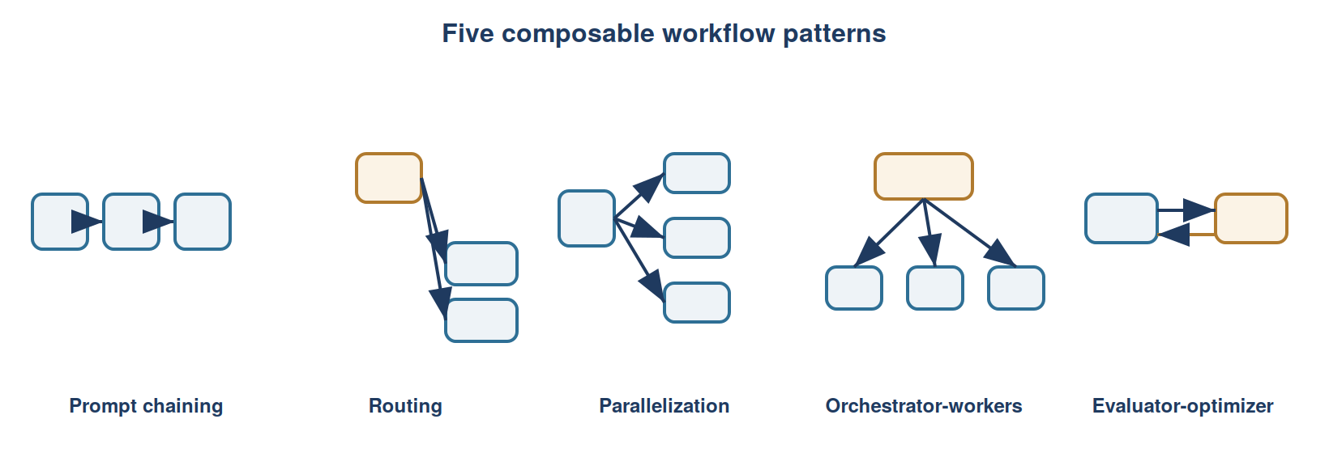
BUILDING BLOCKS
Most designs are combinations of five patterns
Chain steps · Route to handlers · Parallelize subtasks · Orchestrate workers · Evaluate–optimize in a loop
4
Notes:
These five are composable: routing feeds a chain; an orchestrator wraps evaluator-optimizer workers; parallelization sits inside any of them. You'll meet each this week.

Slide 5
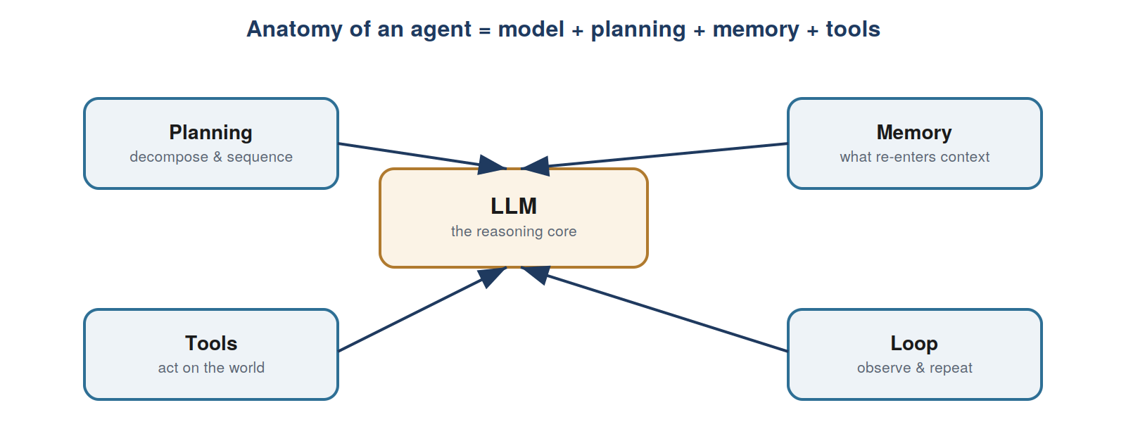
WHEN YOU DO NEED AN AGENT
It’s always the same four parts around a model
Each day of this course adds one part: planning, memory, tools, and the loop that ties them together.
5
Notes:
Planning: decompose and sequence. Memory: what you choose to re-enter the context window. Tools: acting on the world. Loop: observe results and repeat.

Slide 6
The lesson that matters most
The biggest predictor of a team’s success isn’t the model or the framework.
It’s whether they run a
disciplined evaluation and error-analysis process.
Teams that only tweak prompts hit a ceiling they can’t see. Teams that measure, trace, and fix the weakest component keep improving. Day 5 is devoted to it — and the mindset runs through every day.
Notes:
Emphasize this. Evals and error analysis are the differentiator. Treat evaluation as the main event, not an afterthought.

Slide 7
ROADMAP
The week at a glance
1
The agent loop
Workflows vs. agents; the ~15 lines that make one
First agent
2
Reflection & memory
Generate→critique→revise; context engineering
Self-improving copy
3
Tool use
Tools are structured outputs; function calling; MCP
Research assistant
4
Planning & multi-agent
Plan-as-JSON; orchestrator-workers; routing
Research team
5
Evaluation & capstone
Objective + judge evals; traces; guardrails
Deep-research agent
6
Notes:
Each day: a concept block, a visual lab with numbered steps, a coding exercise with a starter snippet, and an applied use case. About 2-3 hours per day.

Slide 8
VISUAL TRACK
Pick your canvas
OUR PICK
APPROVALS
REAL ACTIONS
ALL-IN-ONE
Langflow
Flowise
n8n
Dify
Largest community · native RAG & MCP · live testing · exports to Python
Fast RAG · the only native human-in-the-loop approval node
Looping + 400 integrations — great for the capstone
Builder + RAG + observability bundled together
Why Langflow leads for learning: RAG and tool use are native nodes, you test in a live chat pane, and every flow exports to Python — the bridge to the coding track.
7
Notes:
All four are free to self-host. Langflow is the best learning fit; n8n shines for the capstone's real-world actions; Flowise has native approval gates for regulated flows.

Slide 9
DAY 1 · FOUNDATIONS
The agent loop
Workflow vs. agent — predefined path vs. model-directed loop
The loop — call model → run requested tool → feed back → repeat
Own your control flow — it’s ordinary code you control, not magic
Autonomy spectrum — match autonomy to the stakes
for turn in range(max_turns):
resp = call_model(messages,
system=SYSTEM, tools=TOOLS)
if resp.stop_reason != "tool_use":
return text_of(resp) # done
# run each requested tool,
# append results, and loop
day1_agent_loop/exercise.py
8
Notes:
The whole of 'agentic' fits in about fifteen lines. Everything else in the course elaborates on this loop.

Slide 10
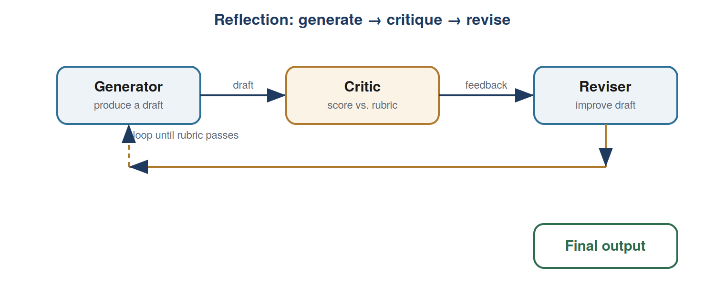
DAY 2 · REFLECTION & MEMORY
Improve your own work; remember what matters
Evaluator-optimizer — draft → critique → revise, looped
Rubrics beat vibes — specific yes/no criteria, not “rate 1–10”
Memory = context — buffer, summary, or retrieved facts
Own your context window — curate what enters attention
reflection_exercise.py
9
Notes:
Reflection is Anthropic's evaluator-optimizer pattern. The rubric is the real work. Memory is entirely context engineering — models are stateless.

Slide 11
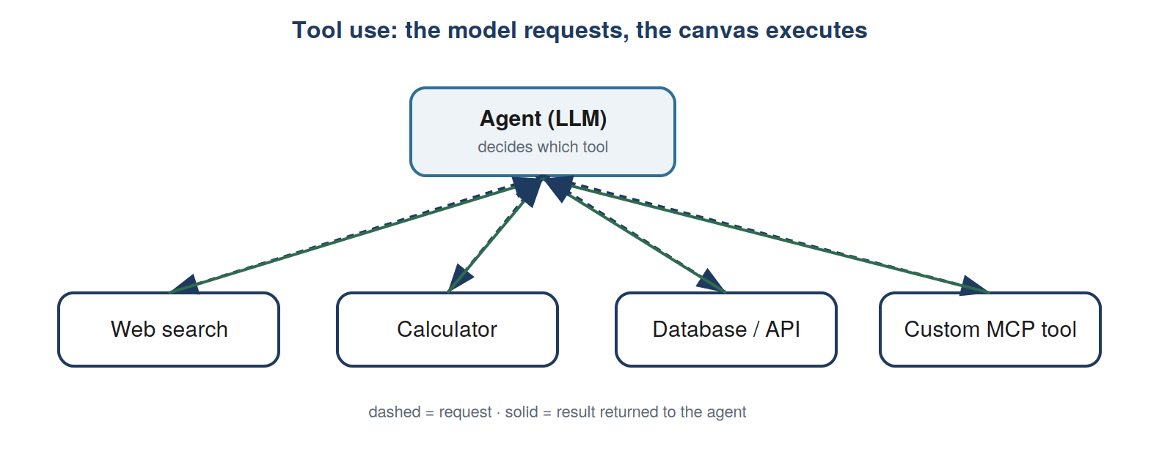
DAY 3 · TOOL USE
Connect the agent to the world
Tools are structured outputs — model emits JSON; your code runs it
Description quality — it’s the model’s whole manual for the tool
Structured extraction — force a tool call for clean, typed data
MCP — the standard for connecting tools & data
day3_tool_use/exercise.py
10
Notes:
The model decides, your code acts — that boundary is where safety and audit live. Precise tool descriptions are the top driver of correct tool selection.

Slide 12
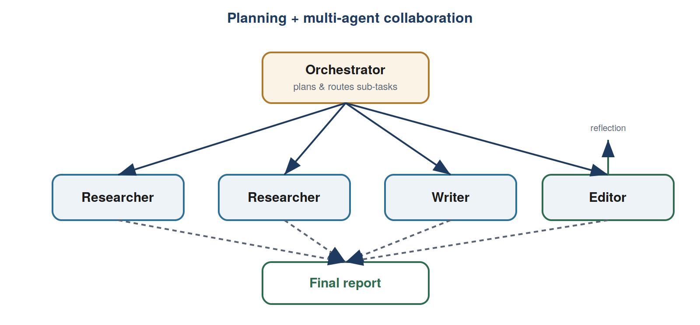
DAY 4 · PLANNING & MULTI-AGENT
From one agent to a coordinated team
Planning — emit a JSON plan, then execute & adapt
Orchestrator-workers — a lead delegates to specialists
Routing & parallelization — specialize handlers; run subtasks at once
Small, focused agents — narrow beats monolithic
orchestrator_exercise.py
11
Notes:
Composition works because a worker agent is exposed to the orchestrator as a tool. Routing is just tool selection one level up.

Slide 13
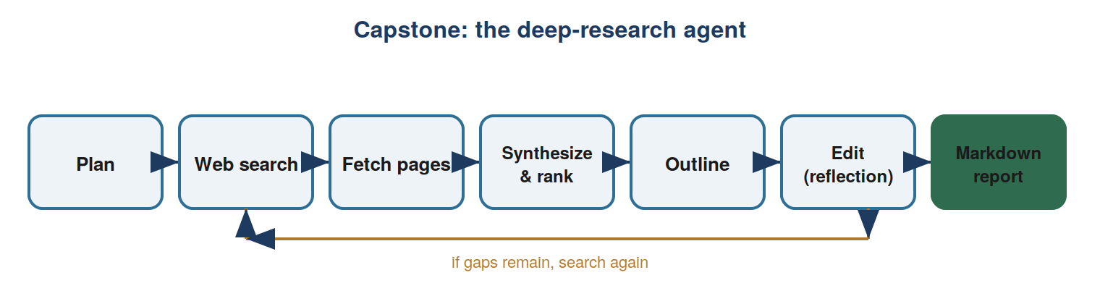
DAY 5 · EVALUATION & CAPSTONE
Measure, trace, fix — then build the capstone
Objective + judge evals — code checks where you can; a rubric-judge where you can’t
Error analysis via traces — find the weakest component and fix that one
Guardrails & humans-in-the-loop — deterministic checks; approval as a first-class step
eval_exercise.py · research_agent_solution.py
12
Notes:
The capstone composes every pattern: plan, search, fetch, synthesize, outline, edit (reflection), report — looping back to search when gaps remain.

Slide 14
TAKEAWAYS
Six ideas to leave with
1
Least autonomy wins
2
The loop is the game
3
Rubrics beat vibes
prefer a workflow until a loop is truly needed
call, run tools, feed back, repeat
specific criteria drive reflection and evals
4
Tools = structured outputs
5
Compose small agents
6
Evals are the real skill
model decides; your code validates & acts
planning routes; reflection polishes
measure, trace, fix the weakest part
13
Notes:
These six compress the week. If a learner remembers only these, they'll be ahead of most teams building agents today.

Slide 15
WHERE TO GO NEXT
From canvas to code to production
1
2
3
Canvas
Code
Production
→
→
Build the pattern visually to grasp its shape
Implement it in the Python labs to own the mechanism
Export to Python or a code-first framework; add evals & tracing
Langflow
agentic-ai-labs/
LangGraph · CrewAI
The node graph is the mental model; the code makes it testable and auditable.
14
Notes:
The two tracks converge on production. Grasp shape on the canvas, own the mechanism in code, then harden with evals, tracing, and a code-first framework.

Slide 16
Now go build an agent
Five days. Two tracks. Six ideas. Start with the loop.
Sources & further learning
Anthropic, “Building Effective Agents” · HumanLayer, “12-Factor Agents” · the shared agentic design patterns (reflection, tool use, planning, multi-agent) · Langflow / n8n / Flowise.
Notes:
Close by pointing to the two deliverables: the curriculum document and the hands-on labs. The best next step is to open day1 and implement the loop.

