Slide 1
MUSIC GENRE CLASSIFICATION
USING CNN
PRESENTED BY : VIGNESH D
YEAR & COLLEGE :3rd YEAR & KVCET
NM ID : au421221243044
EMAIL ID : velavignesh8@gmail.com

Slide 2

Proposed System
The advent of huge music collection has represented the test of how to recover,browse,and suggest their contained items.One approach to facilitate the access of huse music classification is to keep label explanations of all music resources.To solve this we compare gradient boosting , naïve bayes , random forest .
The first step for genre classification is to separate features and segments from the sound records. It includes pitch and mfcc features removed the sounds records.
.

Slide 3

Problem Statement
In the field of music genre classification, the primary challenge is the variability and complexity within musical styles. Existing systems often struggle to accurately categorize songs that blur the lines between genres, leading to misclassifications. This hinders the effectiveness of music recommendation systems and automated playlist generation.

Slide 4

Proposed Solution
1
Research & Analysis
Conduct in-depth analysis of music genre characteristics and patterns.
2
Model Development
Create machine learning models tailored to music genre recognition.
3
Testing & Refinement
Thoroughly test and refine the models to ensure accurate genre classification.

Slide 5
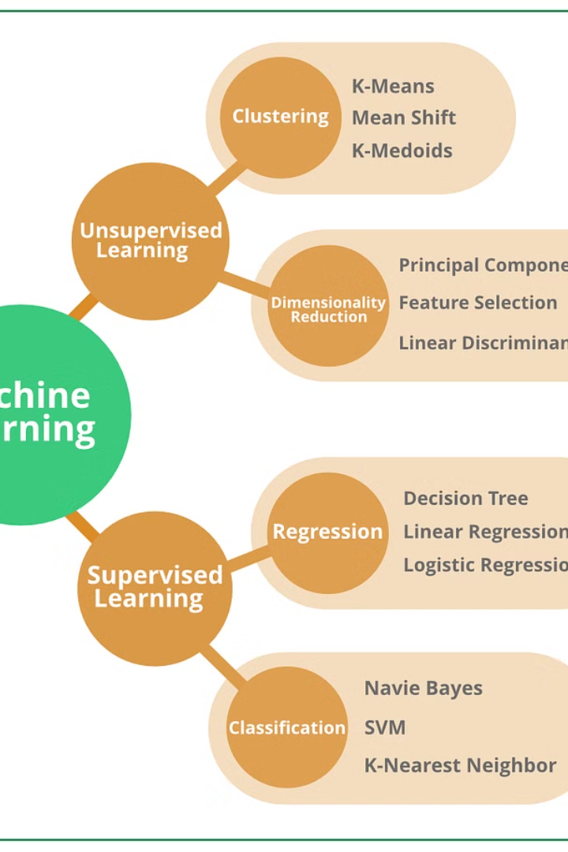
System Approach
When applying machine learning to music genres, the system approach involves developing models that can analyze and classify audio data based on key features and patterns. It requires a comprehensive understanding of music characteristics and genre distinctions to build an effective classification system.

Slide 6
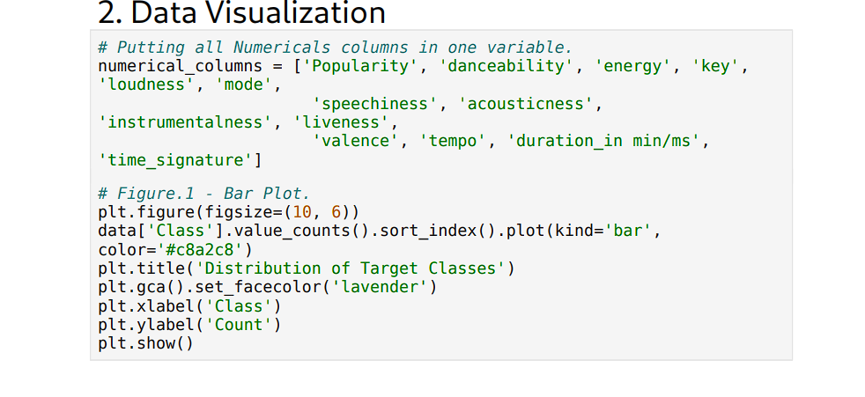
Algorithm and Deployment
Once the algorithm for music genre classification is developed, the next step is the deployment process. This involves integrating the algorithm into a user-friendly application or platform that can efficiently process and classify music based on genre. The various types of classification are used to develop the model .

Slide 7


Feature extraction from audio data
Spectrogram Analysis
Waveform Representation
Spectrograms visually represent audio data, showing frequency and time information in a detailed manner.
Waveforms illustrate the amplitude and intensity of audio signals, providing crucial insights for analysis.

Slide 8

Classification of Music Genres Using Machine Learning
Genre Feature Extraction: Utilizing machine learning algorithms to extract unique features from audio data.
Supervised Learning Models: Implementing various supervised learning techniques for accurate genre classification.
Model Evaluation: Assessing the performance of classification models for different music genres.

Slide 9




Challenges in Genre Classification
Labeling Ambiguity
1
Multiple genres per song
Feature Selection
2
Identifying relevant audio features
Data Imbalance
3
Varying genre representation
Model Overfitting
4
High accuracy, low generalization

Slide 10




Predicting Process
Data Collection
Collect audio samples from various music genres for analysis.
Feature Extraction
Extract relevant features such as tempo, pitch, and timbre from the audio data.
Model Training & Testing
Train machine learning models using the extracted features and test their accuracy.

Slide 11
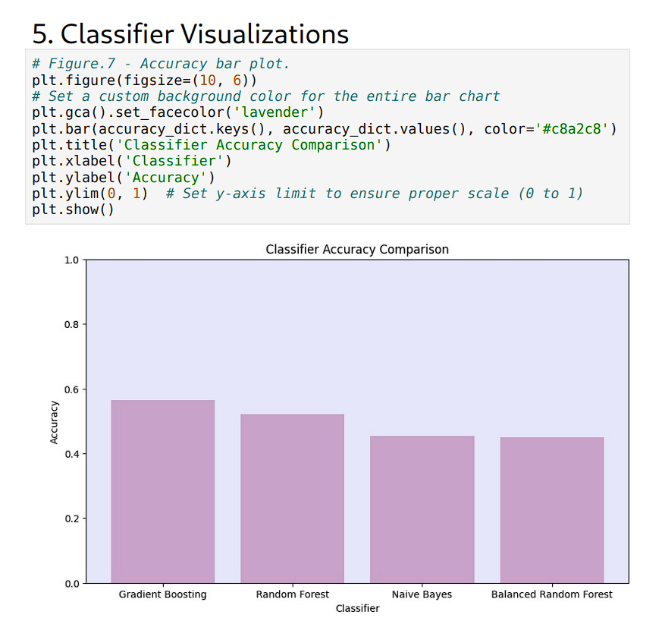
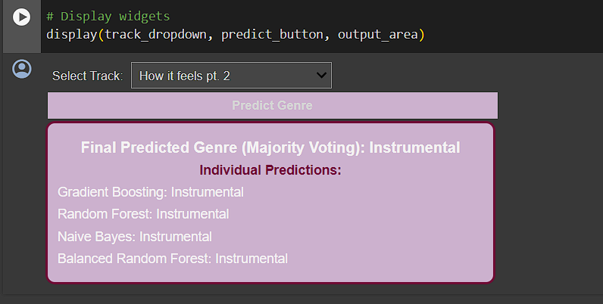
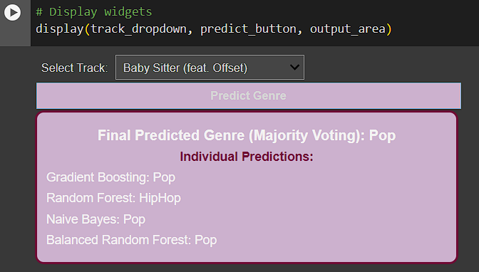
OUTPUT

Slide 12
CONCLUSION
We have presented a methodology for auto extracting musical features from audio files and them according to their genre in this paper. We feature extraction and selection, and finally classification process.naive bayes ,random forest , gradient boosting is a supervised learning classifier that is easy to implement.

Slide 13
FUTURE WORKS
Future work in music genre classification may explore advanced deep learning architectures tailored for audio, incorporating attention mechanisms and self-supervised learning. Fusion with multimodal data, such as lyrics or album art, could enrich representations. Additionally, employing generative models for data augmentation and unsupervised feature learning could further improve performance.

Slide 14
REFERENCES:
Data Set :https://www.Kaggle.com/datasets/music genre classification
Libraries(Pandas,numpy,etc…)
Gitup:https://www.gitup.com/music genre

