Slide 1
SECURE DATA HIDING IN IMAGES USING STEGANOGRAPHY
CAPSTONE PROJECT
Presented By: Vignesh D
Student Name : Vignesh D
College Name & Department : Adhiyamaan College of Engineering(Autonomous), Department of Information Technology

Slide 2
OUTLINE
Problem Statement
Technology used
Wow factor
End users
Result
Conclusion
Git-hub Link
Future scope

Slide 3
Problem Statement
Risk of Interception: Conventional encryption methods are increasingly prone to being intercepted and decrypted by unauthorized entities, despite the rising demand for secure communication.
Suspicion & Vulnerability: Traditional security measures often draw attention, making them susceptible to targeted attacks and breaches.
Need for Stealthy Data Embedding: A subtle yet robust approach is essential to integrate confidential data into digital media while maintaining its original appearance.
Steganographic Solution: By concealing sensitive information within images, data can be securely transmitted without arousing suspicion or compromising its integrity.
Focus on Efficiency & Security: The system will prioritize optimizing embedding efficiency, strengthening its resistance against attacks, and ensuring long-term data protection.
Preserving Image Quality: The method must guarantee that the hidden data does not visibly alter the image, ensuring seamless and undetectable communication.

Slide 4
Technology used
Libraries Used in the Program:
OpenCV (cv2) – Used for reading, modifying, and saving images.
OS (Used to execute system commands (e.g., opening the encrypted image).
String (Provides character manipulation utilities (though not used explicitly).
Platform Compatibility:
The program is designed for Windows (due to os.system("start encryptedImage.jpg") for opening the image).
It can run on Linux/macOS with minor.
Requires Python 3.x with OpenCV (cv2) installed (pip install opencv-python).

Slide 5
Wow factors
UNIQUE FACTORS:
Custom Encryption Logic.
Passkey-Protected Decryption.
Real-Time Image Encryption & Decryption .

Slide 6
End users
End Users of the Project :
Cybersecurity Professionals
Corporate & Business Organizations
Privacy-Conscious Individuals

Slide 7
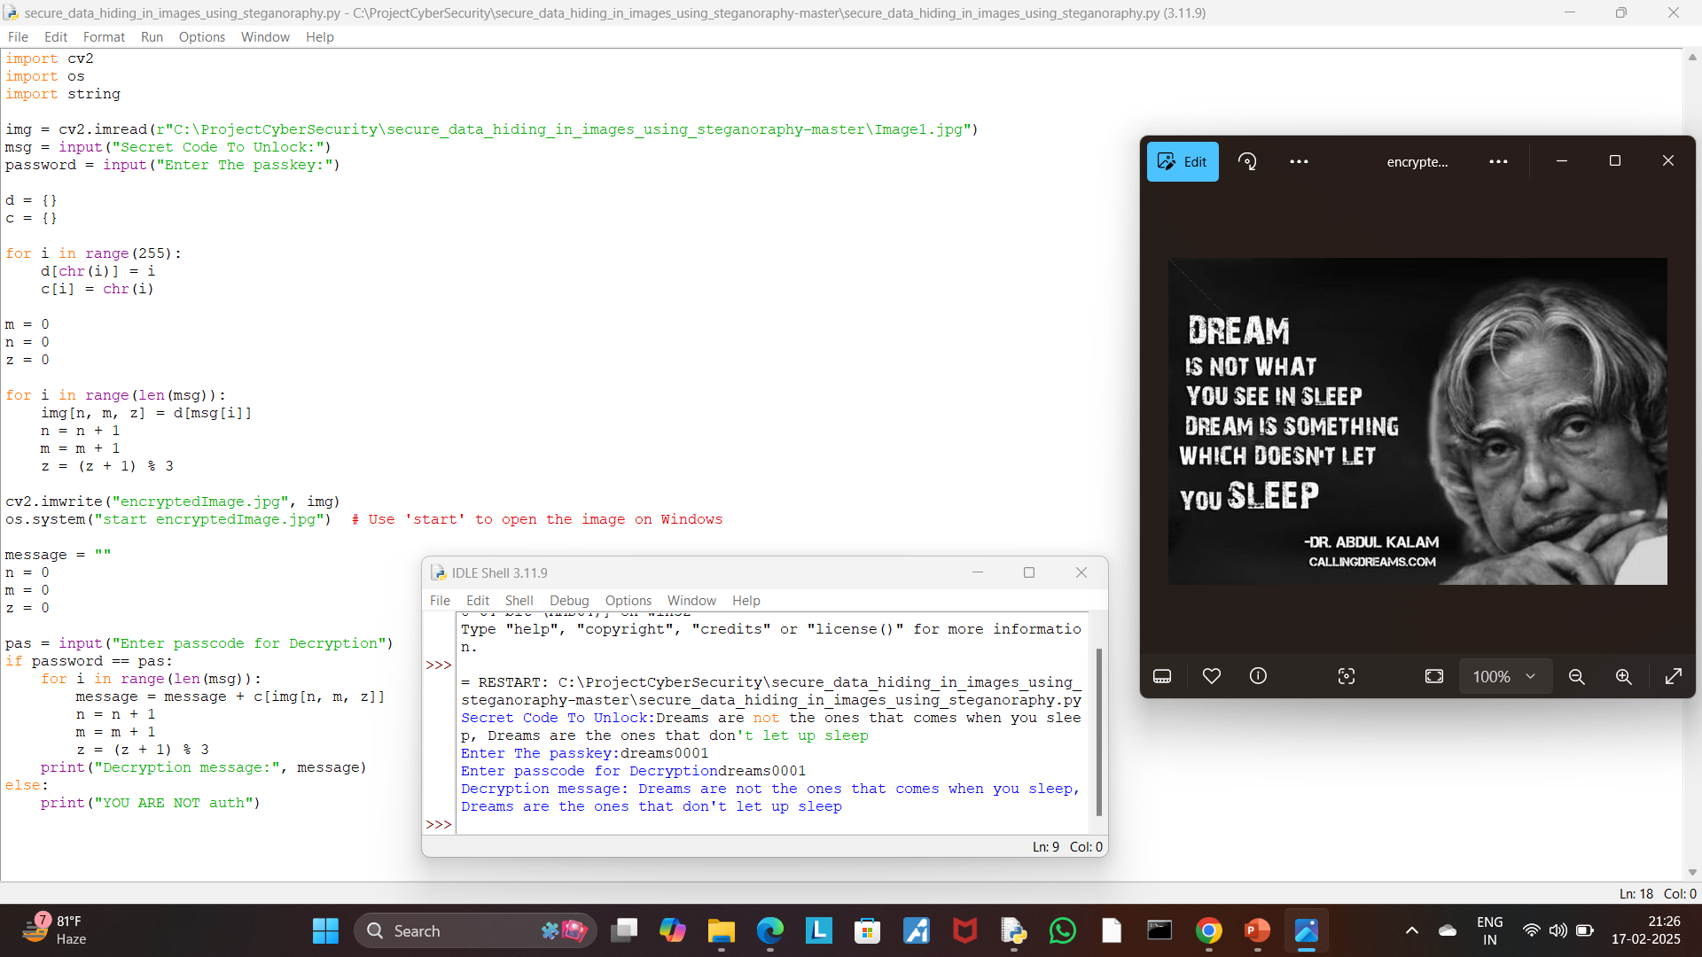
Results

Slide 8
Conclusion
The challenge of covert data transmission is effectively tackled by the Steganography Project, which seamlessly embeds confidential information within digital images while maintaining their visual quality. Unlike conventional encryption methods that may attract attention and risk interception, this technology ensures that sensitive communications remain completely undetectable to unauthorized individuals.
By leveraging passkey-protected decryption and precise pixel modification, the solution strengthens security and prevents unauthorized access. A lightweight yet highly efficient steganographic technique is used to minimize image distortion, making it a perfect choice for secure communication across various domains, including cybersecurity, law enforcement, and corporate data security.

Slide 9
GitHub Link
The GitHub link:
https://github.com/VigneshDina24/-secure_data_hiding_in_images_using_steganoraphy

Slide 10
Future scope(optional)
My Future Scope in Cyber Security is to learn about to protect myself and people in my society from cyber threats and protect my identity.

Slide 11
THANK YOU

