Slide 1
CAPSTONE PROJECT TEAM –93 Electronics & Communication Engineering

Slide 2

TITLE: Calorie Estimation Using Deep Learning for Dietary Images.
TEAM MEMBERS :
Mohammed Aman Sami Ur Rahman
2103A51342
Gattepally Vignesh
2103A51353
Punnam Raja Rohith
2103A51376
Syed Tameemuddin
GUIDE :
Syed Nawaz Pasha
2103A51212

Slide 3
PRESENTATION FLOW
Introduction
Drawbacks from Literature Review
Objectives
System Architecture
Methodology
Flow Chart
Results
Conclusion & Future Scope
Paper Published

Slide 4
INTRODUCTION
Obesity becoming a major health concern in many parts of the world, high calorie food intake can be harmful and result in obesity.
It causes the health problems such as heart diseases, diabetes, blood pressure and cancer.
To avoid these problems ,food journaling has become popular to help people keep track of how much calorie they should consume in a particular time.
Food detection and calorie estimation can be done in a digital way by taking a snap of photo.
The food is recognized by going through the fundamental steps in image processing
Here we train the model which can look at the food image and estimate the calorie and fat content of food item.

Slide 5
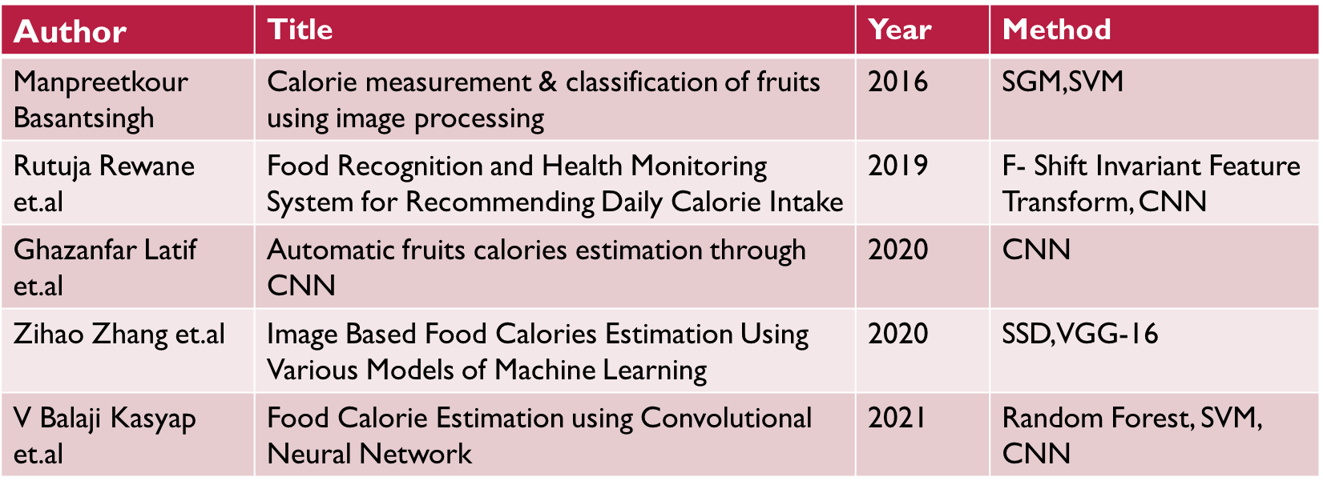
Literature Review

Slide 6
PROBLEM STATEMENT
To develop a model that could help in detecting the various types of food images and calorie content present in the food item using image processing and deep learning algorithm.
OBJECTIVES
To propose a framework to estimate Calorie and fat content for different kinds of fruits and vegetables by applying deep learning.
To identify the variety and healthy food for a diety.
To quantify the intake of food for a diety based on diet plans.
To make one’ fit with good health and longevity.
To develop a functional prototype (web application) for the proposed framework.

Slide 7
REQUIREMENTS
SOFTWARE
HARDWARE
Windows Edition: Windows 10 Pro
Processor: Intel® CoreTM [i5 processor] CPU
RAM: minimum 4.00 GB
System Type: 64-bit Operating System
HDD 10 GB Hard Disk Space and Above (Having SSD would be better)
Programming Language: Python (Object Oriented Programming Language) 3.9.5 version
Scripting Language: JavaScript (for dynamic web app)
Other Languages: HTML (Hypertext Markup Language), CSS (Cascading Style Sheets)
Tools- Jupyter Notebook, PyCharm

Slide 8
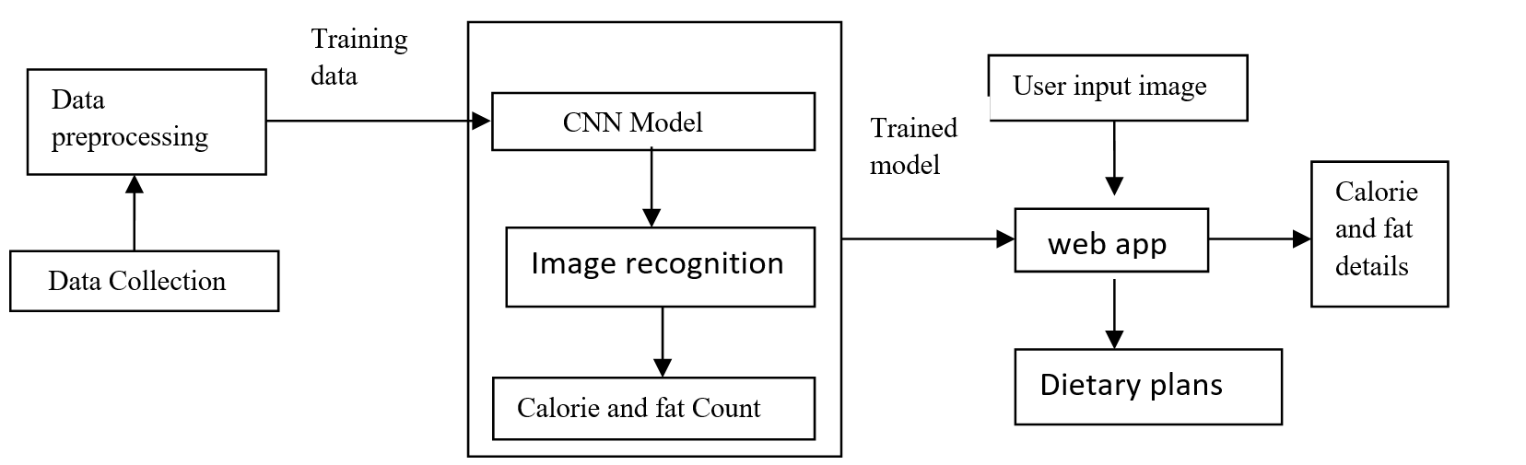
System Architecture:

Slide 9
METHODLOGY
In implementing this project following methodology is incorporated
Step 1 – Data Collection
Step 2 - Data Pre-processing
Step 3 – Feature extraction & Classification
Step 4 – Calorie Extraction
Step 5 – Recommending weekly diet plans
Step 6 – Model Deployment

Slide 10
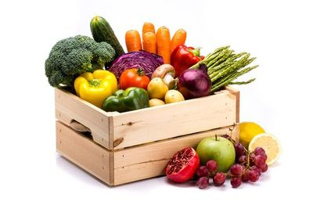
DATA Collection
The dataset for the project was gathered from Kaggle.
This dataset contains 3600 food images grouped in 36 major fruits and vegetables categories.
There are 3 splits in this dataset:
Test, train & validation
Each split contains 36 categories of fruits and vegetables:
Apple, banana, cabbage, cauliflower, cucumber, lemon, orange, pomegranate, potato etc..

Slide 11
-Data Pre-Processing
In order for the recognition to take place, the image has to be loaded into the system. This is done by choosing an RGB file from a directory. The image is then passed onto the preprocessing. The pre-processing used in this system is resizing the images to 224 × 224 dimensions in order to speed up the performance of the other processes and makes it easier for the system to process the features to be extracted from the image.
As mentioned images were resized to 224,224 and the add the input tensor of shape (224, 224 , 3) to the pretrained MobileNetV2 model, here 3 is number of channels.

Slide 12
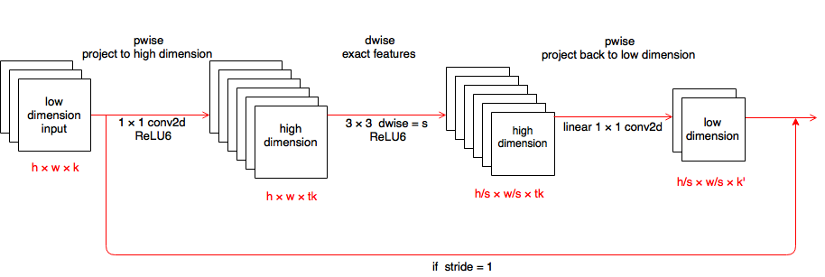
Feature extraction & classification
We are using the MobilenetV2 architecture. MobileNetV2 is a convolutional neural network architecture that seeks to perform well on mobile devices. It is based on an inverted residual structure where the residual connections are between the bottleneck layers. MobilenetV2 support any input size greater than 32 x 32

Slide 13
MobileNetV2
In MobileNetV2, there are two types of blocks. One is residual block with stride of another one is block with stride of 2 for downsizing.
There are 3 layers for both types of blocks.
This time, the first layer is 1×1 convolution with ReLU6.
The second layer is the depth wise convolution.
The third layer is another 1×1 convolution but without any non-linearity. It is claimed that if RELU is used again, the deep networks only have the power of a linear classifier on the non-zero volume part of the output domain.

Slide 14
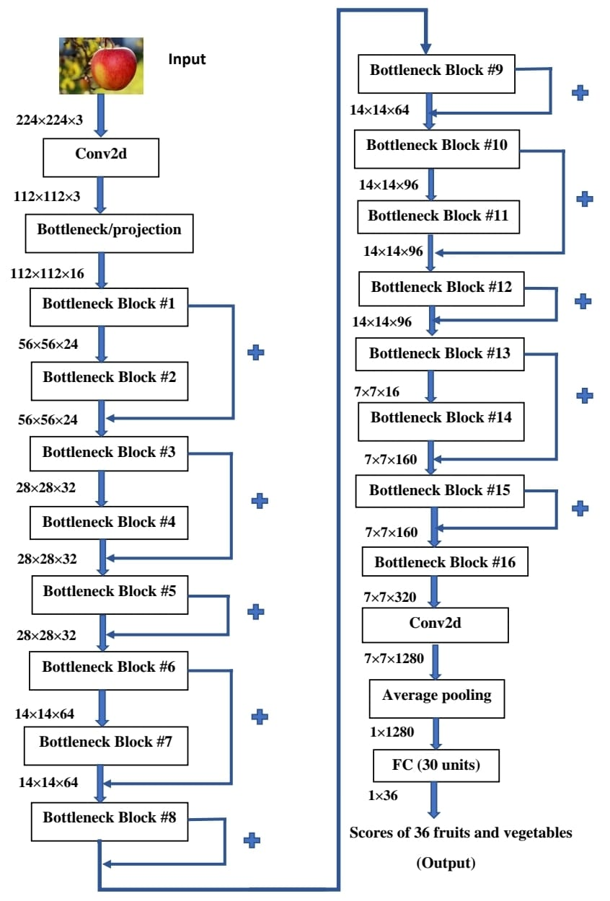
Flow of model

Slide 15
Calorie & Fat Content Extraction
Once the image is categorized and classified into fruit/vegetable the labels are mapped accordingly, and the class of input is predicted. The predicted class is sent as an input to extract or retrieve calories from websites using web scraping. Here Beautifulsoup and requests are used for scrapping the calories and fat content from the internet for the predicted object.
Recommending Weekly Diet Plans
The weekly dietary plans are suggested for the people who are suffering with diseases like high blood pressure, rheumatoid arthritis, high cholesterol etc. For this the user need to click on go to diet plan, at the bottom the user can see two options like “read more” and “view diet plan”. In the view diet plan the user can able to see weekly diet plan for respective disease and in the read more the user can able to view the information regarding disease like causes symptoms etc

Slide 16
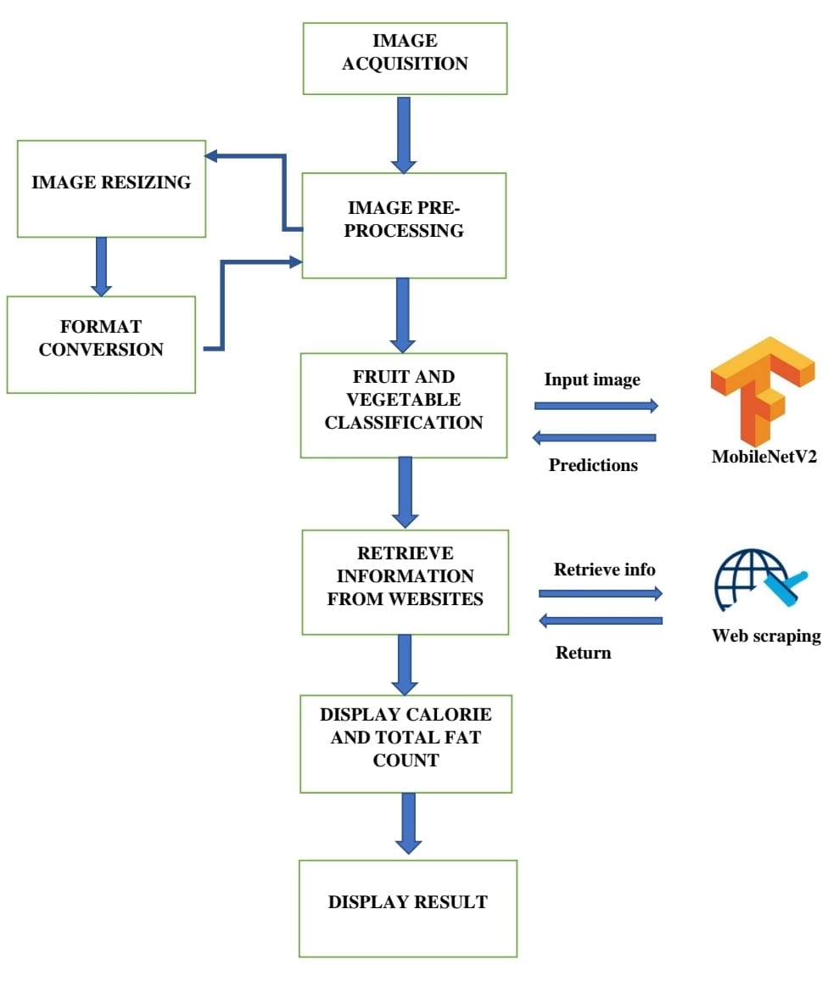
Flow Chart Case 1:

Slide 17
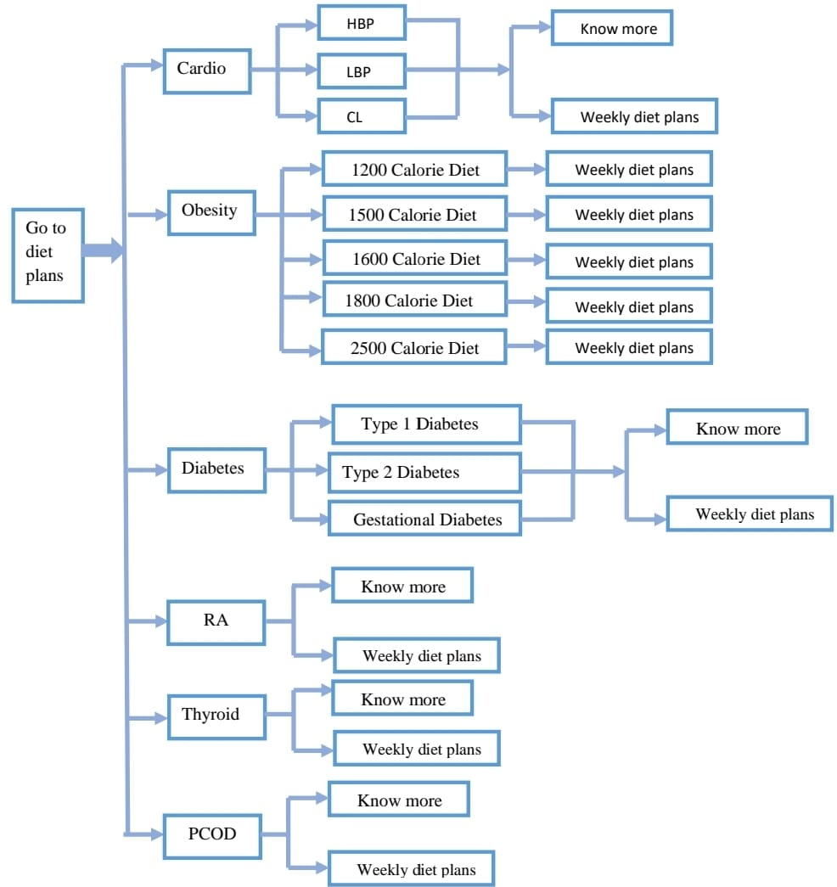
Flow Chart Case 2:

Slide 18
Model Deployment
After acquiring a satisfied model accuracy, the model architecture together with its weights were all frozen, saved as hd5 file and converted into constants using TensorFlow library. Firstly, the load model library from the tensorflow.keras.models package is used to load the best model to access anytime. After saving the model, web app is developed using streamlit in local machine by installing required libraries as mentioned in software tools. The application code ofstreamlit consists of GUI for app, model processing code, image saving and prediction code and code for fetching the calories and total fat count for a particular class using Web scraping.

Slide 19
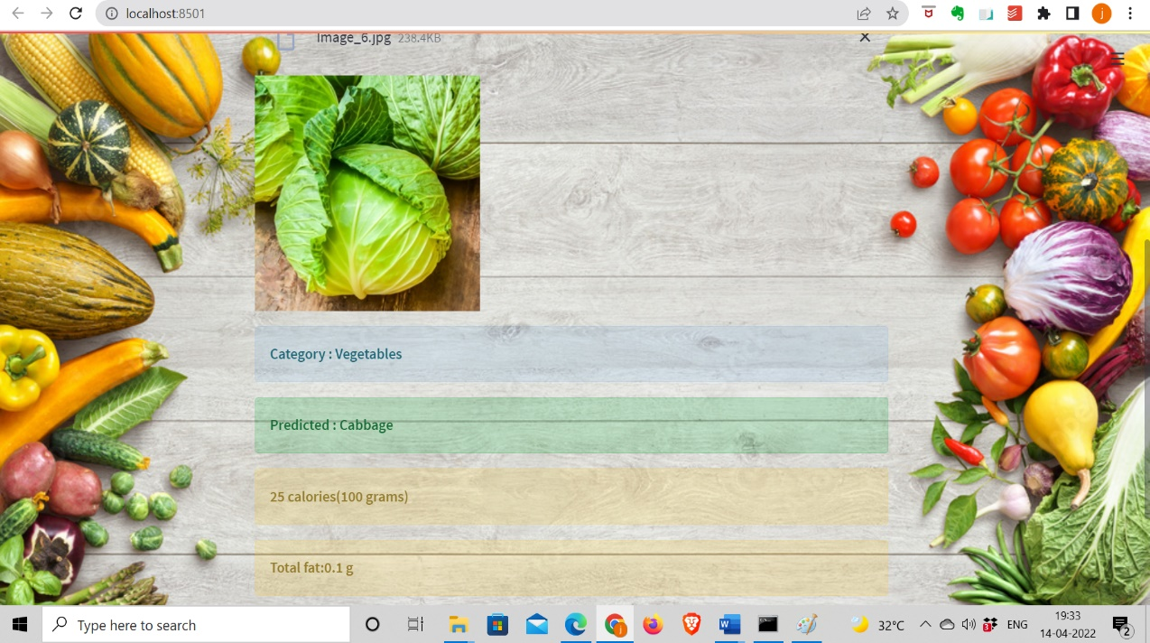
RESULTS:

Slide 20
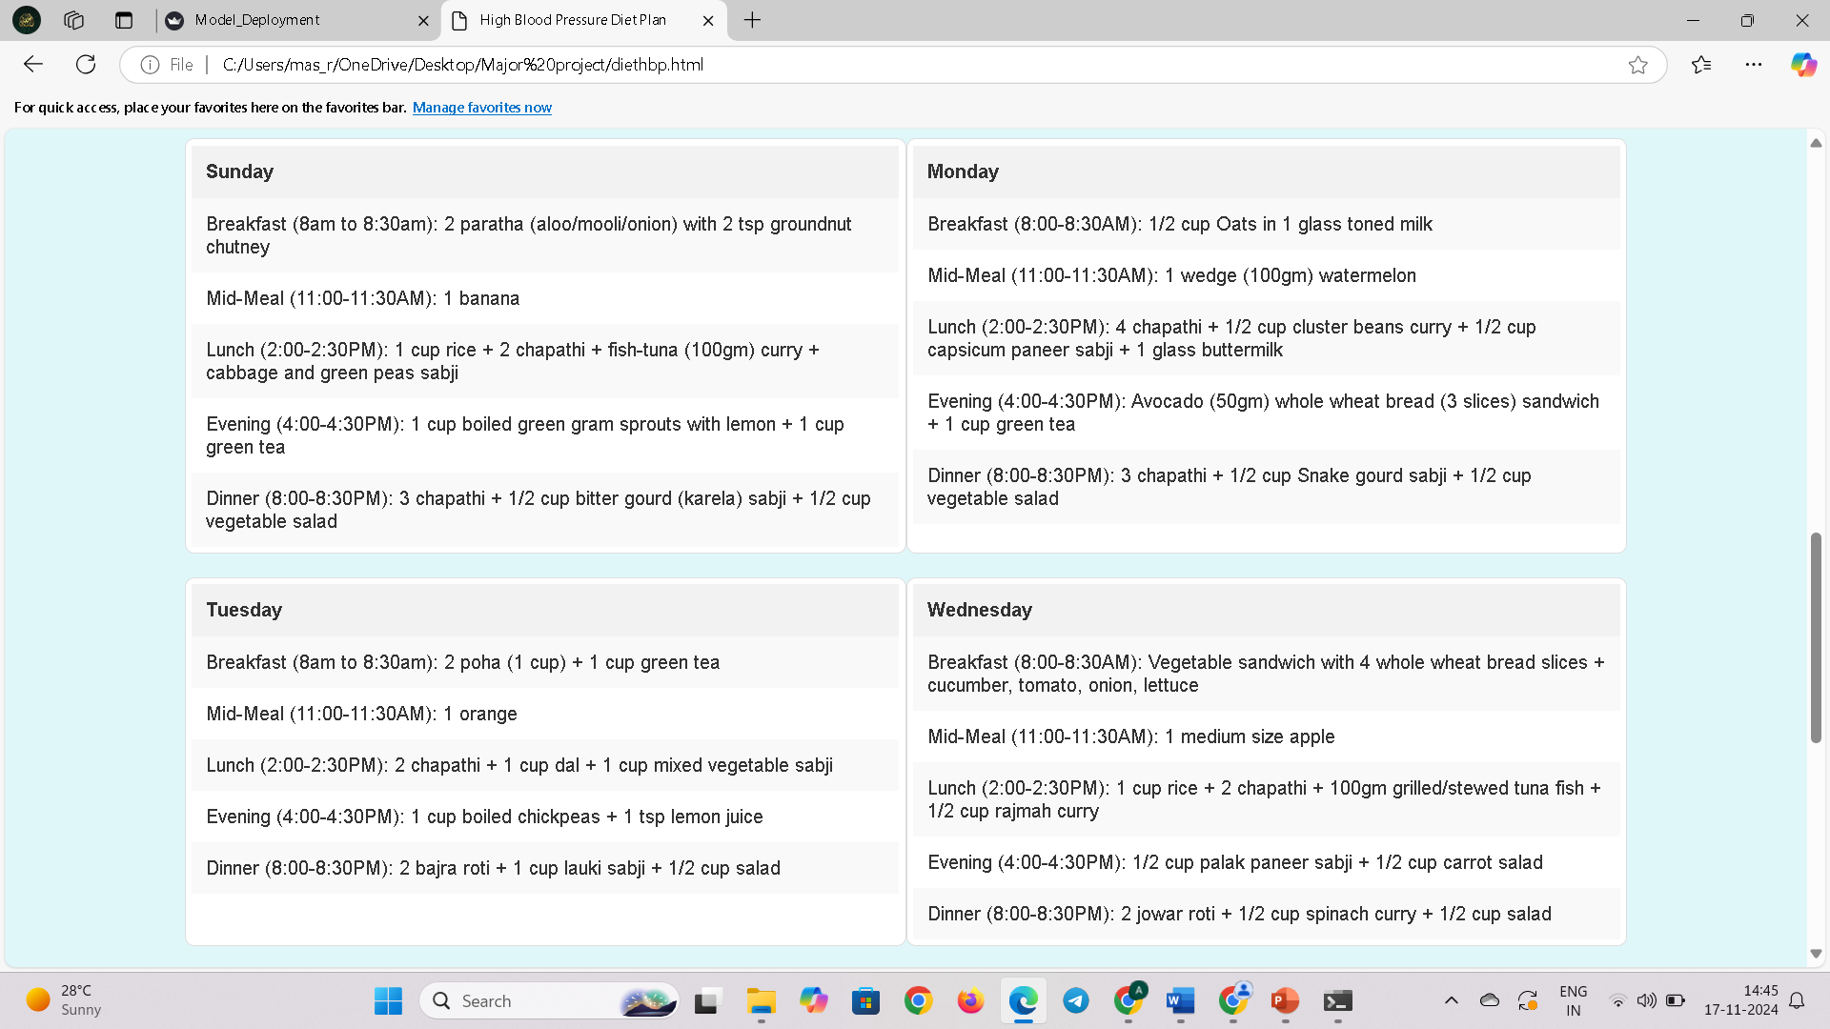

Slide 21
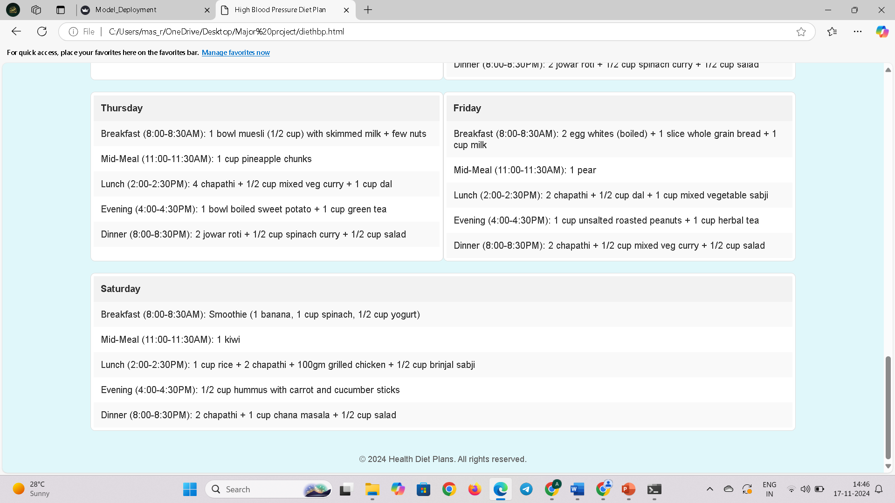

Slide 22
CONCLUSION & FUTURE SCOPE
In the present work, a model to assist one to lead a healthy and longevity by resolving dietary issues is presented. Here a model is developed by identifying clinical problem and provide a suitable diet plan. The website developed provides necessary food information to diseased by providing data of the amount of calorie and the fat content present in the food item based on images. The identification of food item is carried out using CNN algorithm as it provides highest accuracy. The developed model is unique with a novel idea to prevent people from major health diseases such as diabetics, blood pressure and many more chronic diseases. In the present work calorie and fat estimation is carried out by taking few samples of fruits and vegetables. However, the work can be further extended by adding all varieties of fruits and vegetables and estimating their calorie and fat contents. Further, non-vegetarian foods may also be categorized and provided with necessary protein contents as this is also one of necessary nutrient needed for a diet plan.

Slide 23
THANK YOU
Any queries?

