Slide 1
Modeling and Validating the kinematic and dynamic properties of Shape memory alloy based Continuum robots (Temp Title)
Thesis Statement
Name: Vignesh Venkatachalam
Matriculation No.: 21864036
Course: Mechatronics
University: Hamburg University of Technology
Email: vignesh.venkatachalam@tuhh.de

Slide 2
Topics Covered
Motivation
Shape memory alloy actuators
Modeling approaches
Scope of the thesis
Proposed timeline for the thesis

Slide 3
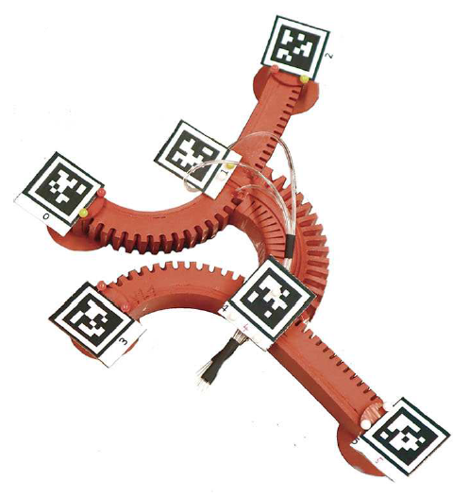
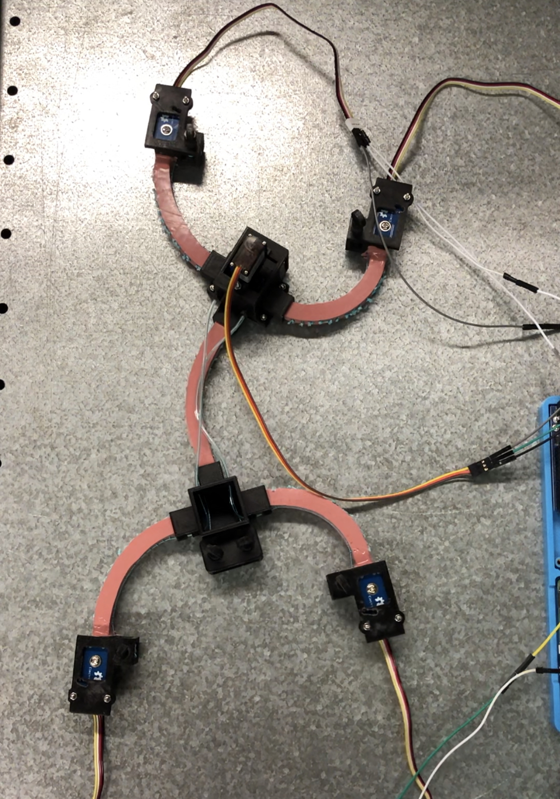
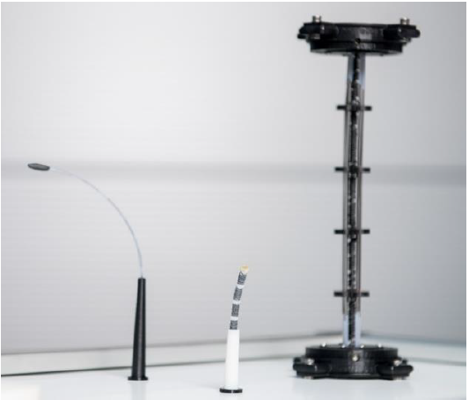
Motivation
Research into Smart materials has brought about innovative actuation methods in Soft robotics
Pneumatic actuators → relatively large pressure valves
Cable-driven actuators → relatively large motors
Smart materials like SMAs integrate well into the robot → only electrical circuit to power them
Modeling necessary to predict their behavior for future control algorithms
Fig. 1: Pneumatically actuated Gecko-inspired robot [1]
Fig. 2: Cable-driven Gecko-inspired robot
Fig. 3: Prototypes of SMA driven continuum robots [2]
Notes:
Common methods currently in use – Pneumatic and Cable-driven

Slide 4
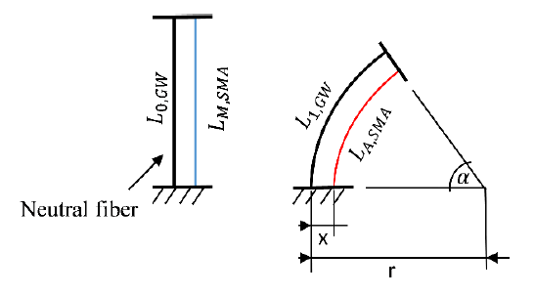
Shape memory alloy actuators
SMAs → integrated directly into robot
Actuated by electric current → Joule heating
Heating above austentite transformation temperature leads to a contraction due to phase transformation in lattice crystal material
Initial shape → applying external force (e.g., with another SMA wire)
Non-linear response of strain to input current, hysteresis characteristic
Need accurate mathematical model → more accurate control
Fig. 3: Schematic diagram of a continuum robot with integrated SMA wire for the theoretical design of the actuators. [2]
Notes:
Drawback – non-linear response
Hysteresis leads to imprecise and difficult control
Efficiency of SMA actuator depends on the accuracy of control which in turn depends on the mathematical model

Slide 5
Modeling approaches
Modeling generally involves 2 steps
  Kinematic framework → geometry of the manipulator
  Dynamics framework → mechanics
Kinematic frameworks:
  Discrete approaches → homogeneous transforms from D-H parameter tables
  Constant-curvature kinematic frameworks → homogeneous transforms from D-H tables or Frenet-Serret frames
  Variable-curvature framework
Dynamics frameworks:
  Lumped parameter models
  Euler-Bernoulli beam theory
  Cosserat rod theory
  Above models generally obtained from Energy methods or classical Newton-Euler equations
Notes:
Dynamics – constitutive relationships and first principles of mechanics to relate actuation and external loads to manipulator shape and motion
Constant-curvature – finite number of mutually tangent curved segments each having constant curvature along its length
Single const-curvature element per actuating section
Lumped parameter – point masses, springs and dampers to approximate mechanical behavior
Cosserat rod theory neglects shear and axial strain

Slide 6
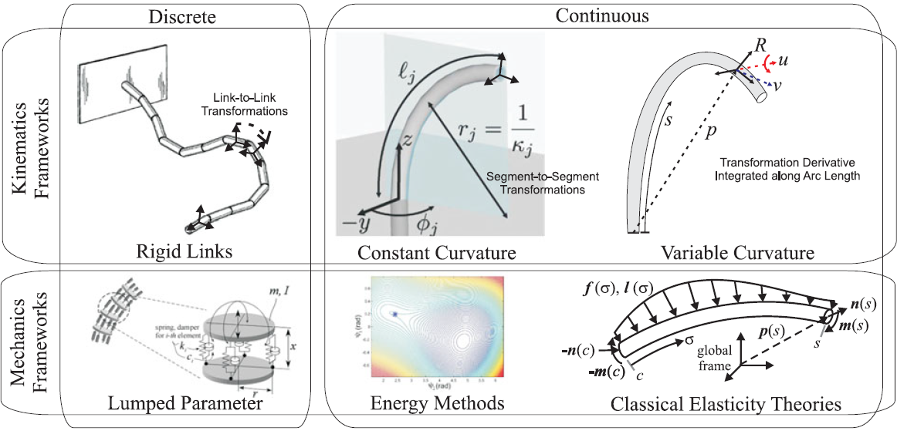
Modeling approaches (Contd.)
Fig. 4: Overview of the different frameworks in modeling continuum robots. [3]

Slide 7
Scope of the thesis
Develop mechanical models for SMA continuum robots.
Validate in real case studies with prototypes.
Understand how to optimize design for max stroke/force performance
Comparison between different models could also be undertaken.
Of interest → relationship b/w electrical resistance in SMA wire and actuator displacement
Notes:
Optimize design – vary wire length, wire placement, geometry
Electrical resistance – sensorless position control

Slide 8
Proposed timeline for the thesis
Literature review and model selection
Aug-Sept 21
Fabrication of prototypes and experiments
Nov-Dec 21
Further experiments and calibration of models
Jan-Feb 22
Documenting and conclusion
March 2022
Mathematical modeling and simulation
Oct 21

Slide 9
References
L. Schiller, A. Seibel, and J. Schlattmann, “A lightweight simulation model for soft robot’s locomotion and its application to trajectory optimization,” IEEE Robotics and Automation Letters, 2020. [1]
Y. Goergen, R. Chadda, R. Britz, D. Scholtes, N. Koev, P. Motzki, R. Werthschützky, M. Kupnik, and S. Seelecke, “Shape memory alloys in continuum and soft robotic applications,” in Smart Materials, Adaptive Structures and Intelligent Systems, vol. 59131, p. V001T04A014, American Society of Mechanical Engineers, 2019. [2]
J. Burgner-Kahrs, D. C. Rucker, and H. Choset, “Continuum robots for medical applications: A survey,” IEEE Transactions on Robotics, vol. 31, no. 6, pp. 1261–1280, 2015. [3]

Slide 10
Thank you for your attention!
Any questions?

