Slide 1
Modeling and Validating the kinematic and dynamic properties of Shape memory alloy based Continuum robots (Temp Title)
Name: Vignesh Venkatachalam
Matriculation No.: 21864036
Course: Mechatronics
University: Hamburg University of Technology
Email: vignesh.venkatachalam@tuhh.de

Slide 2
Topics Covered
Recap - Modeling approaches
Recap - Scope of the thesis
Recap - Proposed timeline for the thesis
Current work
Short-term goals for the next weeks

Slide 3
Recap - Modeling approaches
Modeling generally involves 2 steps
Kinematic framework → geometry of the manipulator
Dynamics framework → mechanics
Kinematic frameworks:
Discrete approaches → homogeneous transforms from D-H parameter tables
Constant-curvature kinematic frameworks → homogeneous transforms from D-H tables or Frenet-Serret frames
Variable-curvature framework
Dynamics frameworks:
Lumped parameter models
Euler-Bernoulli beam theory
Cosserat rod theory
Above models generally obtained from Energy methods or classical Newton-Euler equations
Notes:
Dynamics – constitutive relationships and first principles of mechanics to relate actuation and external loads to manipulator shape and motion
Constant-curvature – finite number of mutually tangent curved segments each having constant curvature along its length
Single const-curvature element per actuating section
Lumped parameter – point masses, springs and dampers to approximate mechanical behavior
Cosserat rod theory neglects shear and axial strain

Slide 4
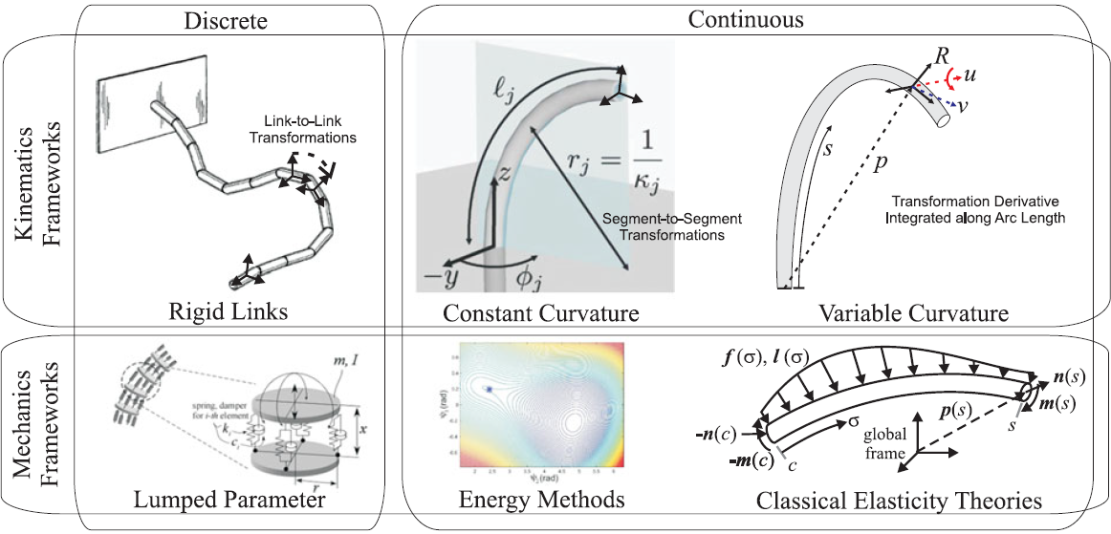
Recap - Modeling approaches (Contd.)
Fig. 1: Overview of the different frameworks in modeling continuum robots. [2]

Slide 5
Recap - Scope of the thesis
Develop mechanical models for SMA continuum robots.
Validate in real case studies with prototypes.
Understand how to optimize design for max stroke/force performance
Comparison between different models could also be undertaken.
Of interest → relationship b/w electrical resistance in SMA wire and actuator displacement
Notes:
Optimize design – vary wire length, wire placement, geometry
Electrical resistance – sensorless position control

Slide 6
Recap - Proposed timeline for the thesis
Literature review and model selection
Aug-Sept 21
Fabrication of prototypes and experiments
Nov-Dec 21
Further experiments and calibration of models
Jan-Feb 22
Documenting and conclusion
March 2022
Mathematical modeling and simulation
Oct 21

Slide 7

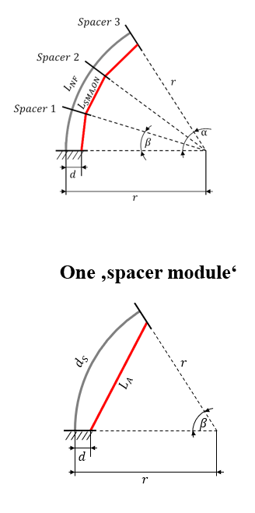
Current work
Videos on SMA material model and SMA actuator model vis-à-vis Gibbs free energy.
Started reading through few papers for the modeling approaches
Studying constant curvature model previously worked on by Yannik
Fig 2: Constant curvature model for SMA continuum robots.

Slide 8
Short-term goals for the next weeks
Understand the Constant curvature model using spacers.
Read through more papers on other models as well, parallelly.
Work on simple matlab codes to test out the constant curvature model for 2D kinematics
Complete videos on SMA system models by Prof. Gianluca

Slide 9
References
Y. Goergen, R. Chadda, R. Britz, D. Scholtes, N. Koev, P. Motzki, R. Werthschützky, M. Kupnik, and S. Seelecke, “Shape memory alloys in continuum and soft robotic applications,” in Smart Materials, Adaptive Structures and Intelligent Systems, vol. 59131, p. V001T04A014, American Society of Mechanical Engineers, 2019. [1]
J. Burgner-Kahrs, D. C. Rucker, and H. Choset, “Continuum robots for medical applications: A survey,” IEEE Transactions on Robotics, vol. 31, no. 6, pp. 1261–1280, 2015. [2]

Slide 10
Thank you for your attention! Any questions?

Slide 11
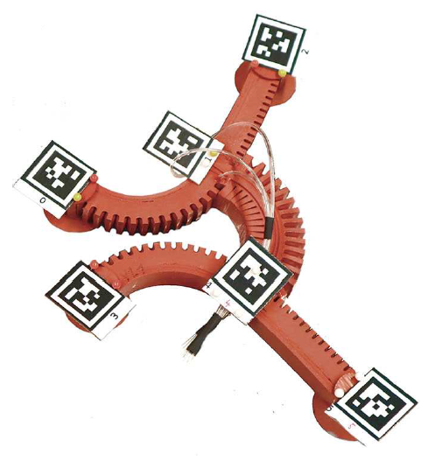
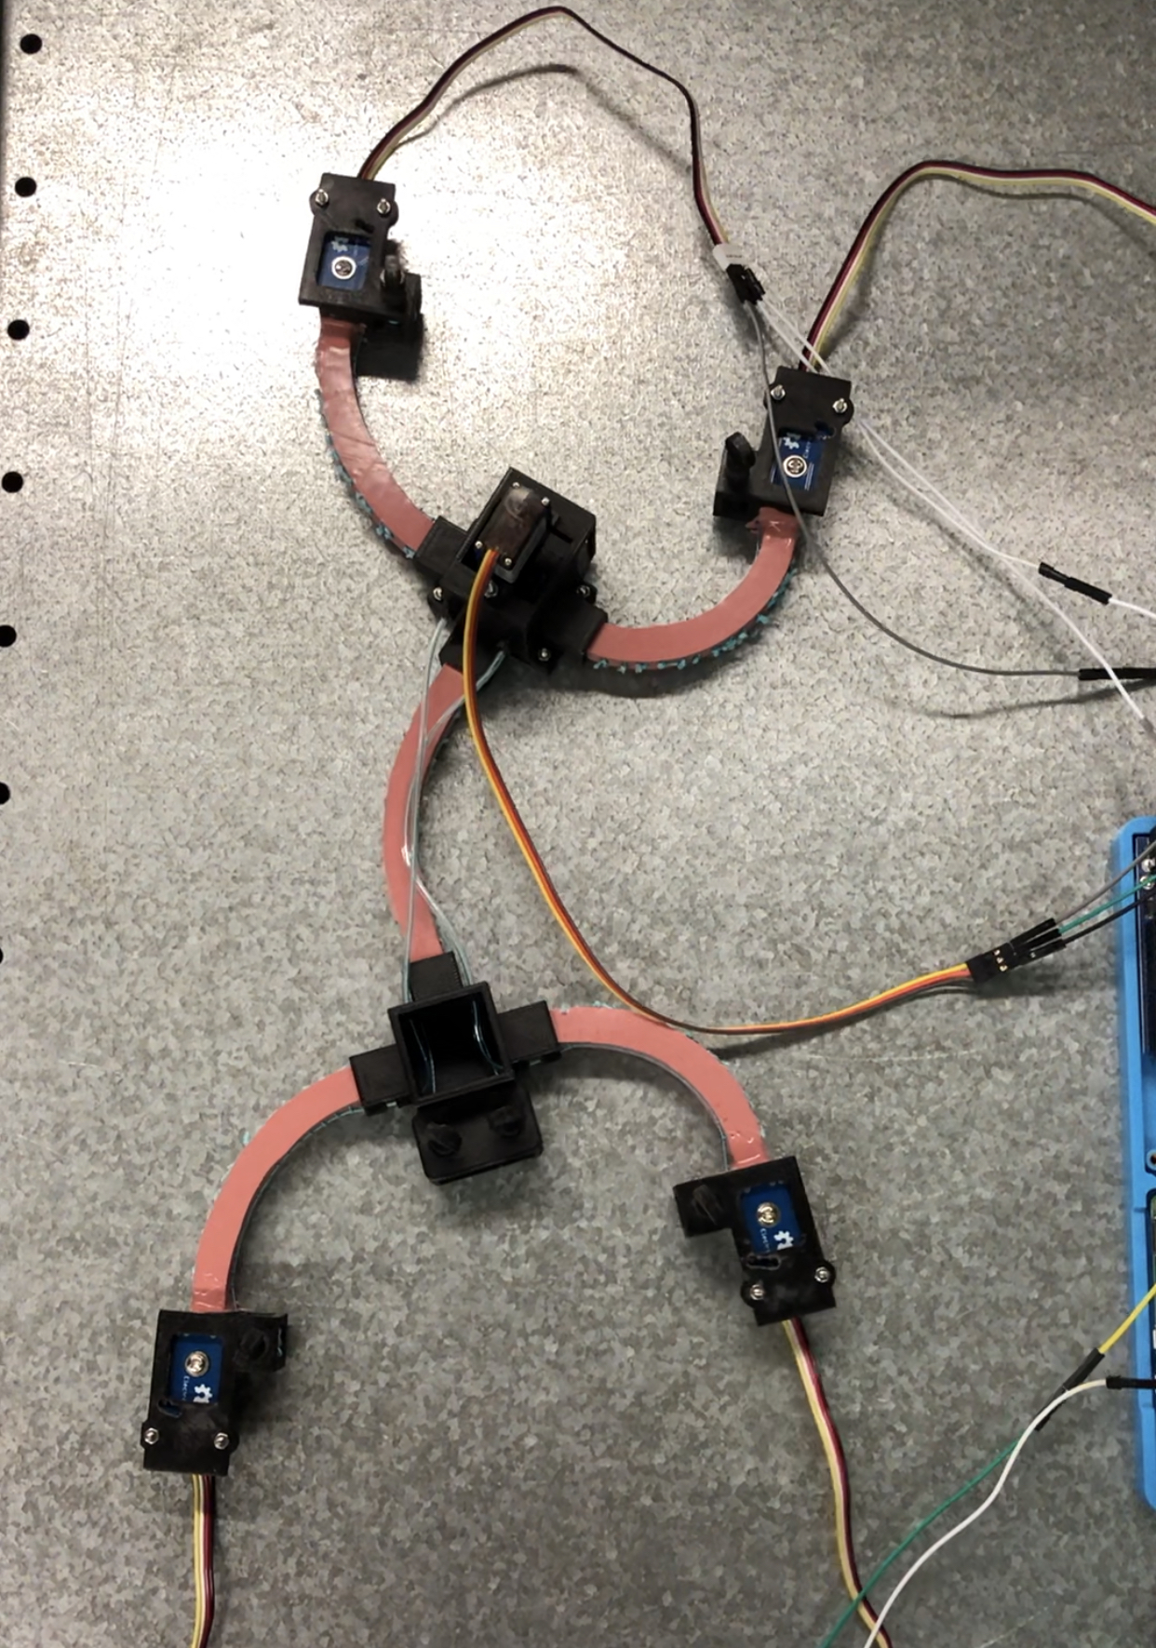
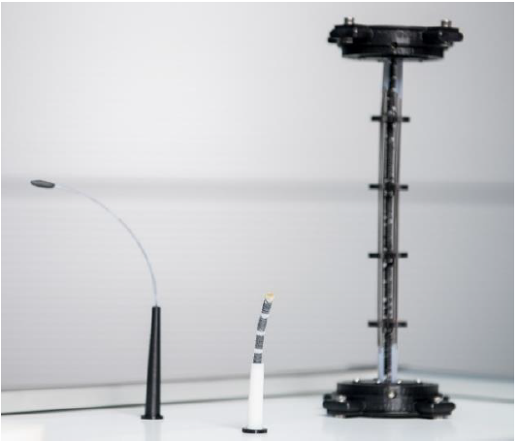
Motivation
Research into Smart materials has brought about innovative actuation methods in Soft robotics
Pneumatic actuators → relatively large pressure valves
Cable-driven actuators → relatively large motors
Smart materials like SMAs integrate well into the robot → only electrical circuit to power them
Modeling necessary to predict their behavior for future control algorithms
Fig. 1: Pneumatically actuated Gecko-inspired robot [1]
Fig. 2: Cable-driven Gecko-inspired robot
Fig. 3: Prototypes of SMA driven continuum robots [2]
Notes:
Common methods currently in use – Pneumatic and Cable-driven

Slide 12
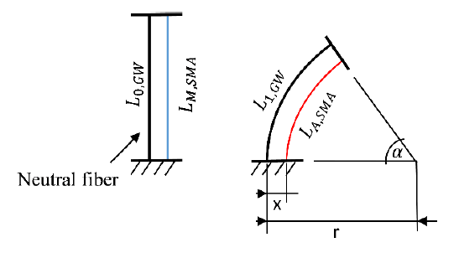
Shape memory alloy actuators
SMAs → integrated directly into robot
Actuated by electric current → Joule heating
Heating above austentite transformation temperature leads to a contraction due to phase transformation in lattice crystal material
Initial shape → applying external force (e.g., with another SMA wire)
Non-linear response of strain to input current, hysteresis characteristic
Need accurate mathematical model → more accurate control
Fig. 3: Schematic diagram of a continuum robot with integrated SMA wire for the theoretical design of the actuators. [2]
Notes:
Drawback – non-linear response
Hysteresis leads to imprecise and difficult control
Efficiency of SMA actuator depends on the accuracy of control which in turn depends on the mathematical model

