Slide 1
Modeling and Validating the kinematic and dynamic properties of Shape memory alloy based Continuum robots
Name: Vignesh Venkatachalam
Matriculation No.: 21864036
Course: Mechatronics
University: Hamburg University of Technology
Email: vignesh.venkatachalam@tuhh.de

Slide 2
Topics Covered
Constant Curvature model
Forward Kinematics
Inverse kinematics – one CC segment
Plan for next steps

Slide 3
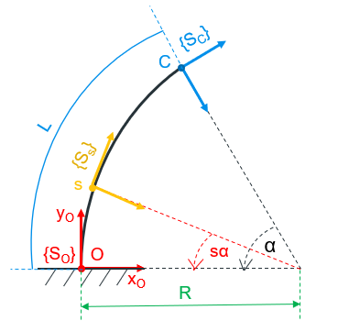
Constant Curvature model
Initially considering only the backbone.
z-axis out of the frame. Only in-plane bending considered for 2D case (x-y).
X and Y coordinates derived through arc geometry.
Rotation is given by R_{z}(-α) for this simple 2D case. –ve sign due to convention.
Fig. 1: Single Constant Curvature segment
Notes:
Dynamics – constitutive relationships and first principles of mechanics to relate actuation and external loads to manipulator shape and motion
Constant-curvature – finite number of mutually tangent curved segments each having constant curvature along its length
Single const-curvature element per actuating section
Lumped parameter – point masses, springs and dampers to approximate mechanical behavior
Cosserat rod theory neglects shear and axial strain

Slide 4

Constant Curvature model (Contd.)
Transform matrix for each point on the continuum backbone
$T\left(s, α\right)= \left(\begin{matrix}cos⁡(sα) & sin⁡(sα) & 0 & L \frac{(1 −\cos\left(sα\right))}{α} \\ −sin⁡(sα) & cos⁡(sα) & 0 & L \frac{sin⁡(sα)}{α} \\ 0 & 0 & 1 & 0 \\ 0 & 0 & 0 & 1\end{matrix}\right)$ , where $s∈[0, L]$ … $\left(1\right)$
Limiting case when $α→0$ , $P= \left(\begin{matrix}0 \\ s \\ 0\end{matrix}\right)$

Slide 5
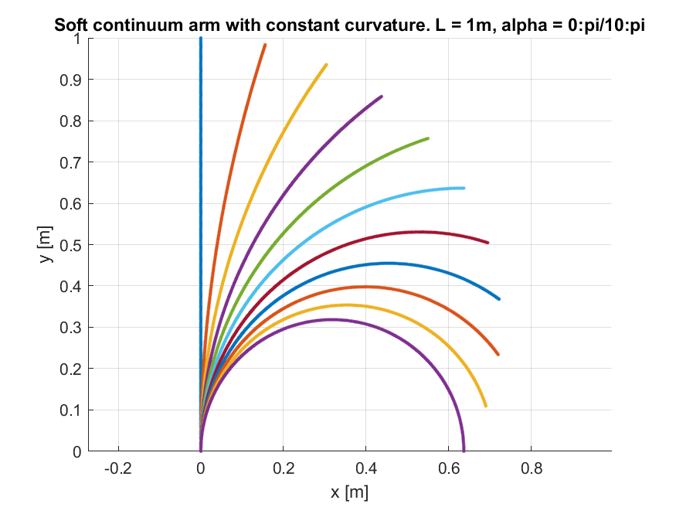
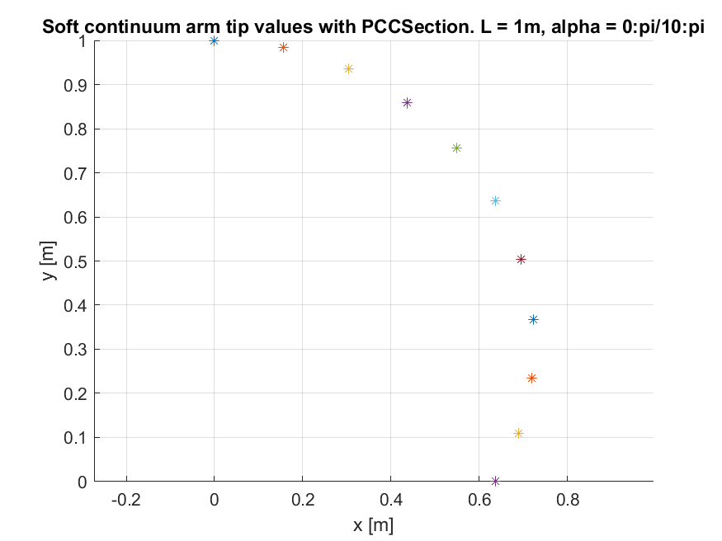
Constant Curvature model (Contd.)
Fig. 2: Continuum backbone bending for different angles.
Fig. 3: Tip positions when considering multiple CC segments for different angles.
Notes:
Optimize design – vary wire length, wire placement, geometry
Electrical resistance – sensorless position control

Slide 6
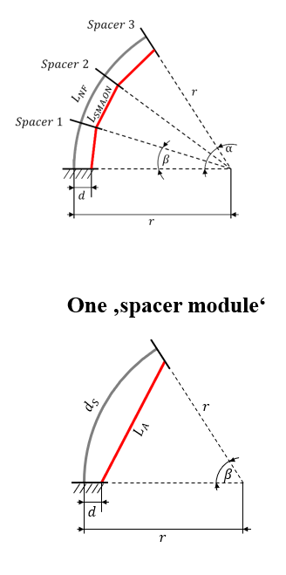
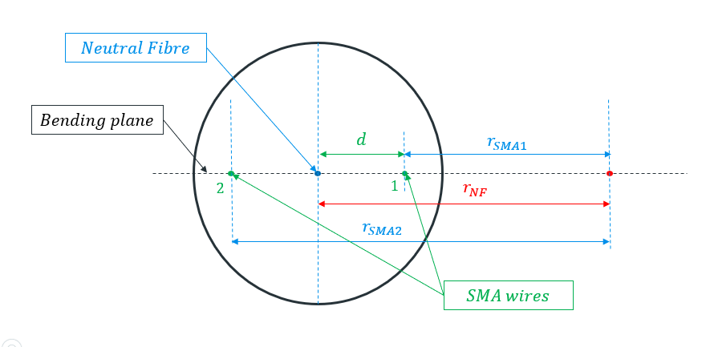
Forward Kinematics
Goal: Given SMA lengths, calculate tip position
Fig. 4: Top view of spacer
Fig. 5: Constant curvature model with spacers

Slide 7

Forward Kinematics (Contd.)
From Figure 4,
$l_{NF}= \frac{l_{SMA1} + l_{SMA2}}{2}$ … $\left(2\right)$
$β= \frac{l_{SMA2} − l_{SMA1}}{2d}$ … $\left(3\right)$
Given SMA lengths, angle $β$ can be calculated from eqn. 3
MATLAB function,
$T=FKineSMA(lengths_{sma}, d, lengths_{segments})$

Slide 8
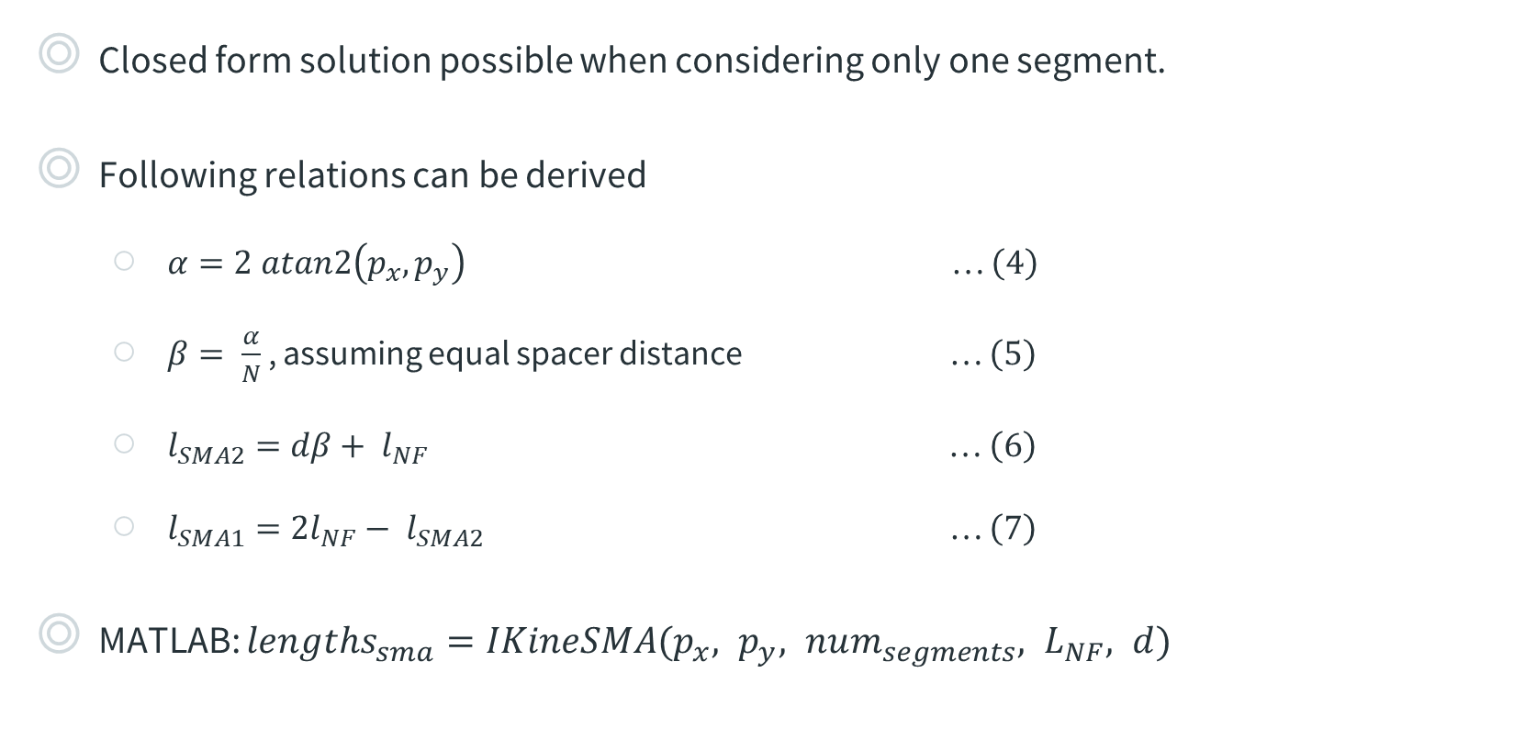
Inverse Kinematics – one segment
Closed form solution possible when considering only one segment.
Following relations can be derived
$α=2 atan2\left(p_{x}, p_{y}\right)$ … $\left(4\right)$
$β= \frac{α}{N}$ , assuming equal spacer distance … $\left(5\right)$
$l_{SMA2}=dβ+ l_{NF}$ … $\left(6\right)$
$l_{SMA1}=2l_{NF}− l_{SMA2}$ … $\left(7\right)$
MATLAB: $lengths_{sma}=IKineSMA(p_{x}, p_{y}, num_{segments}, L_{NF}, d)$

Slide 9
Plan for next steps
Jacobian methods for inverse kinematics
Study into implementing dynamics, specifically looking at SMA based papers
Start working on experimental setup

Slide 10
Thank you for your attention! Any questions?

Slide 11









$$Neutral Fibre$$
$$Bending plane$$
$$d$$
$$r_{SMA1}$$
$$2$$
$$1$$
$$r_{NF}$$
$$r_{SMA2}$$
$$SMA wires$$

Slide 12
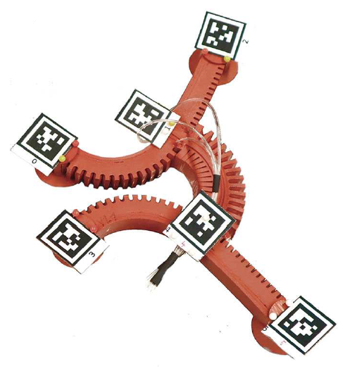
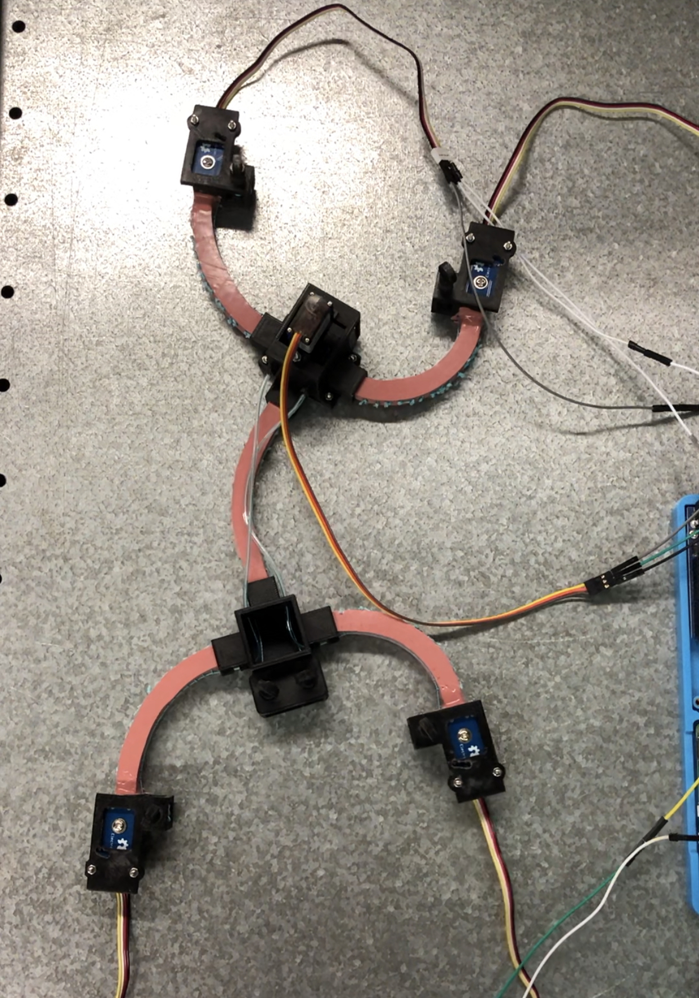
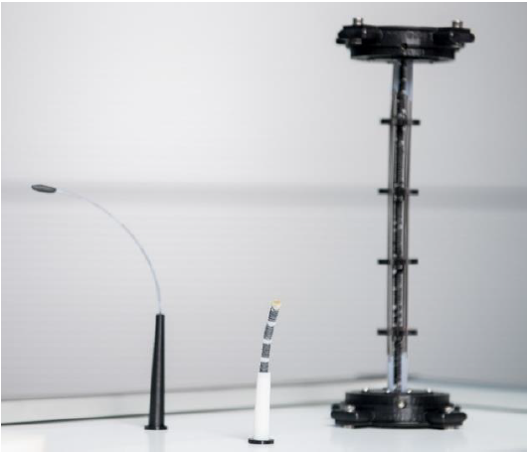
Motivation
Research into Smart materials has brought about innovative actuation methods in Soft robotics
Pneumatic actuators → relatively large pressure valves
Cable-driven actuators → relatively large motors
Smart materials like SMAs integrate well into the robot → only electrical circuit to power them
Modeling necessary to predict their behavior for future control algorithms
Fig. 1: Pneumatically actuated Gecko-inspired robot [1]
Fig. 2: Cable-driven Gecko-inspired robot
Fig. 3: Prototypes of SMA driven continuum robots [2]
Notes:
Common methods currently in use – Pneumatic and Cable-driven

Slide 13
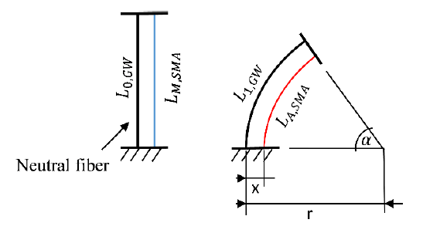
Shape memory alloy actuators
SMAs → integrated directly into robot
Actuated by electric current → Joule heating
Heating above austentite transformation temperature leads to a contraction due to phase transformation in lattice crystal material
Initial shape → applying external force (e.g., with another SMA wire)
Non-linear response of strain to input current, hysteresis characteristic
Need accurate mathematical model → more accurate control
Fig. 3: Schematic diagram of a continuum robot with integrated SMA wire for the theoretical design of the actuators. [2]
Notes:
Drawback – non-linear response
Hysteresis leads to imprecise and difficult control
Efficiency of SMA actuator depends on the accuracy of control which in turn depends on the mathematical model

