Slide 1
Modeling and Validating the kinematic and dynamic properties of Shape memory alloy based Continuum robots
Name: Vignesh Venkatachalam
Matriculation No.: 21864036
Course: Mechatronics
University: Hamburg University of Technology
Email: vignesh.venkatachalam@tuhh.de

Slide 2
Topics Covered
Constant Curvature model (Recap)
Forward Kinematics (Recap)
Workspace of the CC section
Relation between linear and circular arc segment
Differential Kinematics
Next course of action

Slide 3
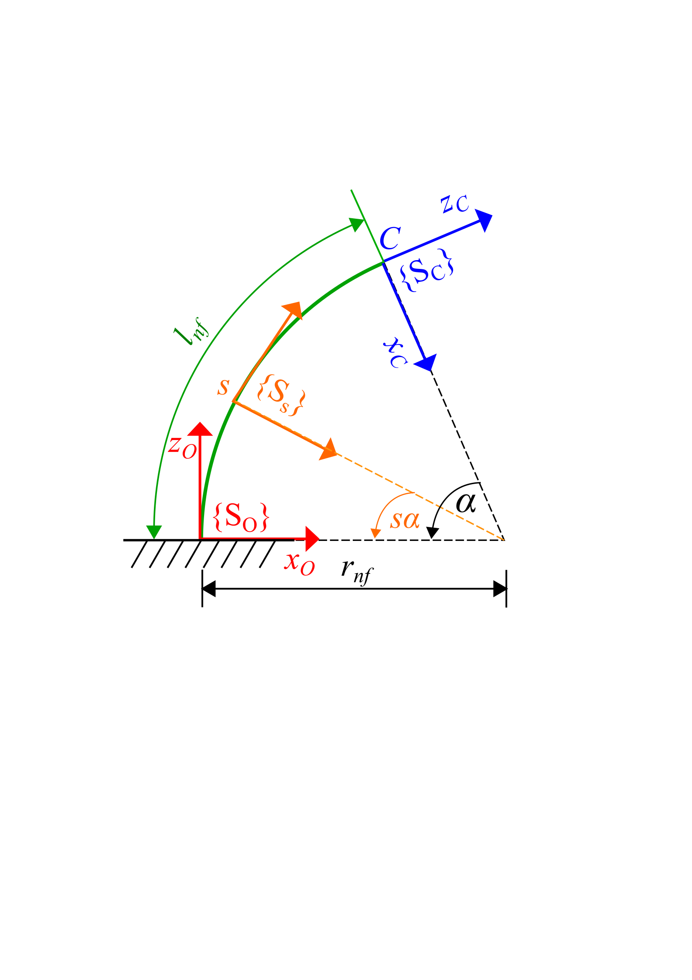
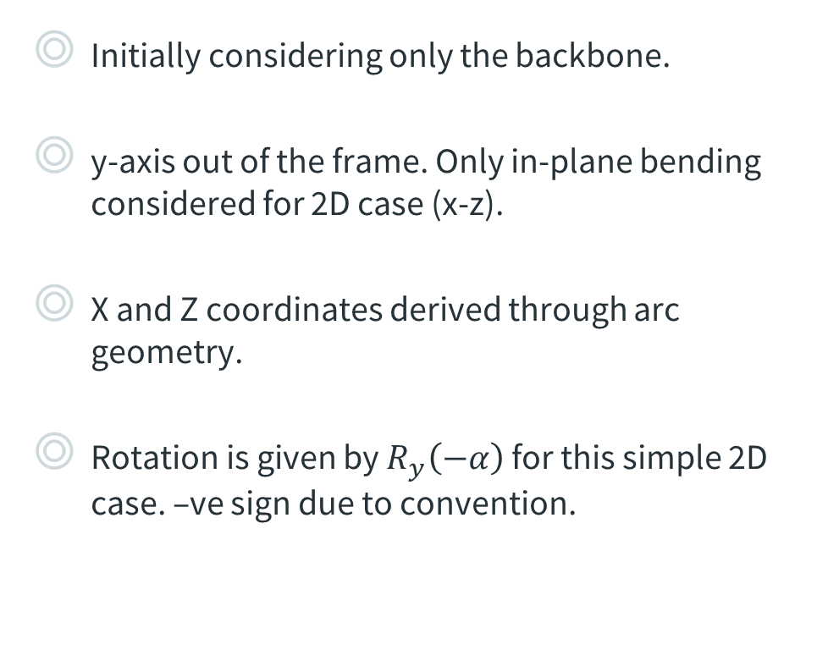
Constant Curvature model (Recap)
Initially considering only the backbone.
y-axis out of the frame. Only in-plane bending considered for 2D case (x-z).
X and Z coordinates derived through arc geometry.
Rotation is given by $R_{y}\left(−α\right)$ for this simple 2D case. –ve sign due to convention.
Fig. 1: Single Constant Curvature segment
Notes:
Dynamics – constitutive relationships and first principles of mechanics to relate actuation and external loads to manipulator shape and motion
Constant-curvature – finite number of mutually tangent curved segments each having constant curvature along its length
Single const-curvature element per actuating section
Lumped parameter – point masses, springs and dampers to approximate mechanical behavior
Cosserat rod theory neglects shear and axial strain

Slide 4

Constant Curvature model (Recap)
Transform matrix for each point on the continuum backbone
$T\left(s, α\right)= \left(\begin{matrix}cos⁡(sα) & 0 & −sin⁡(sα) & l_{nf}\frac{(1 −\cos\left(sα\right))}{α} \\ 0 & 1 & 0 & 0 \\ sin⁡(sα) & 0 & cos⁡(sα) & l_{nf}\frac{sin⁡(sα)}{α} \\ 0 & 0 & 0 & 1\end{matrix}\right)$ , where $s∈[0, 1]$ … $\left(1\right)$
Limiting case when $α→0$ , $P= \left(\begin{matrix}0 \\ 0 \\ sL\end{matrix}\right)$

Slide 5
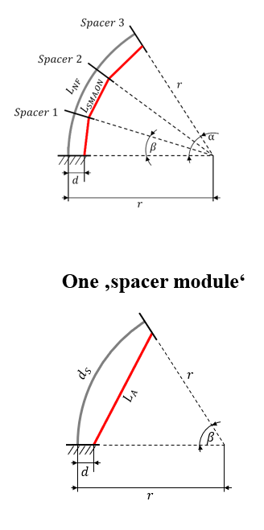
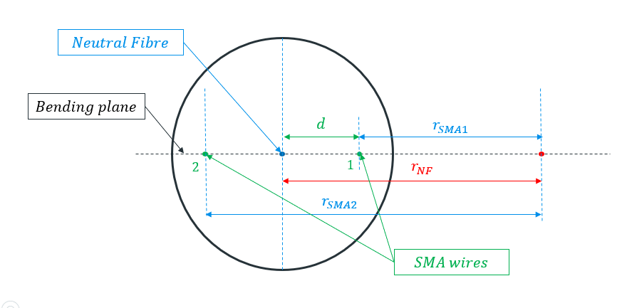
Forward Kinematics (Recap)
Goal: Given SMA lengths, calculate tip position
Fig. 4: Top view of spacer
Fig. 5: Constant curvature model with spacers

Slide 6

Forward Kinematics (Recap)
From Figure 4,
$l_{NF}= \frac{l_{SMA1} + l_{SMA2}}{2}$ … $\left(2\right)$
$α= \frac{l_{nf} − l_{SMA1}}{d}$ … $\left(3\right)$
Given SMA length l_{SMA1}, angle $α$ can be calculated from eqn. 3
MATLAB function,
$T=FKineSMA(lengths_{sma}, d, lengths_{segments})$

Slide 7
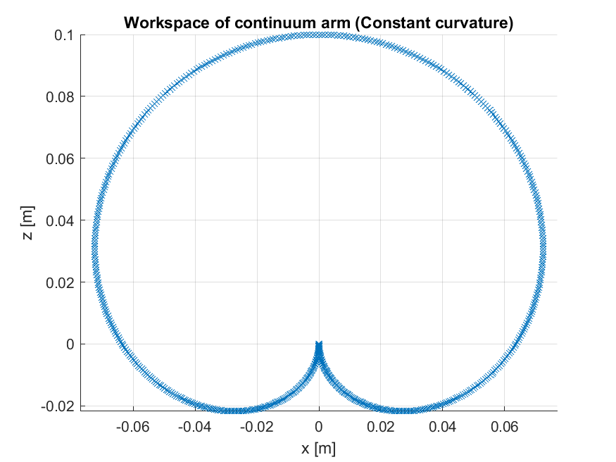
Workspace of the CC section
Fig. 6: Workspace of the constant curvature section

Slide 8
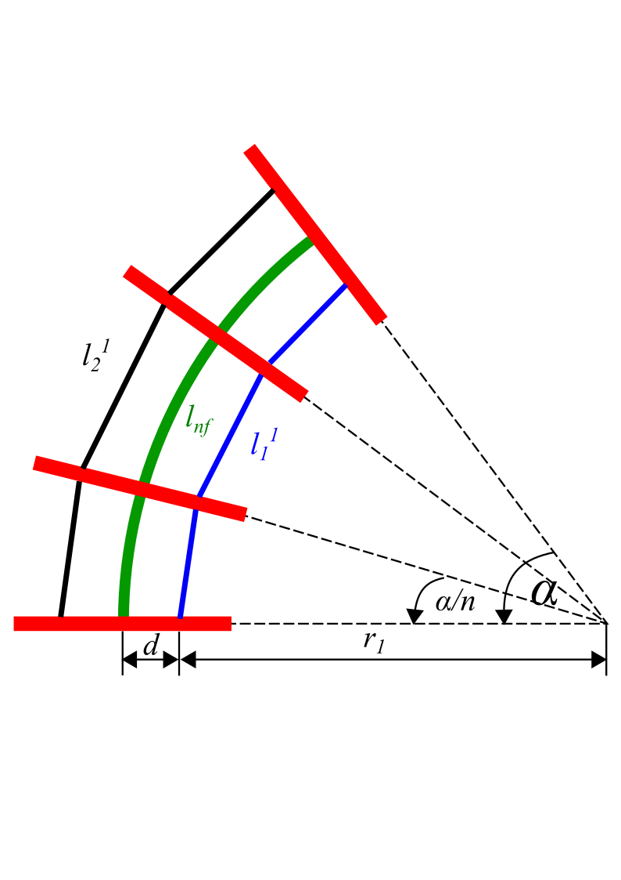
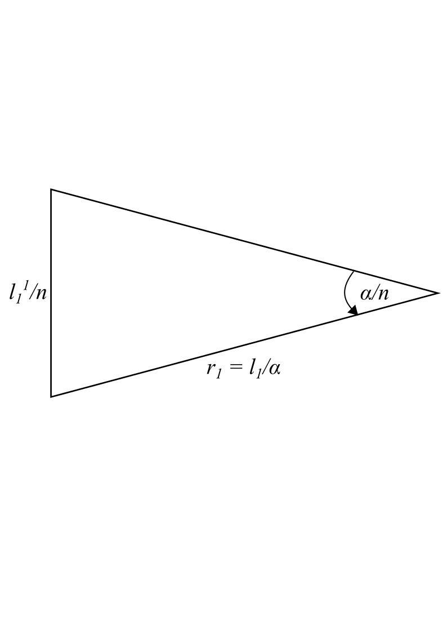
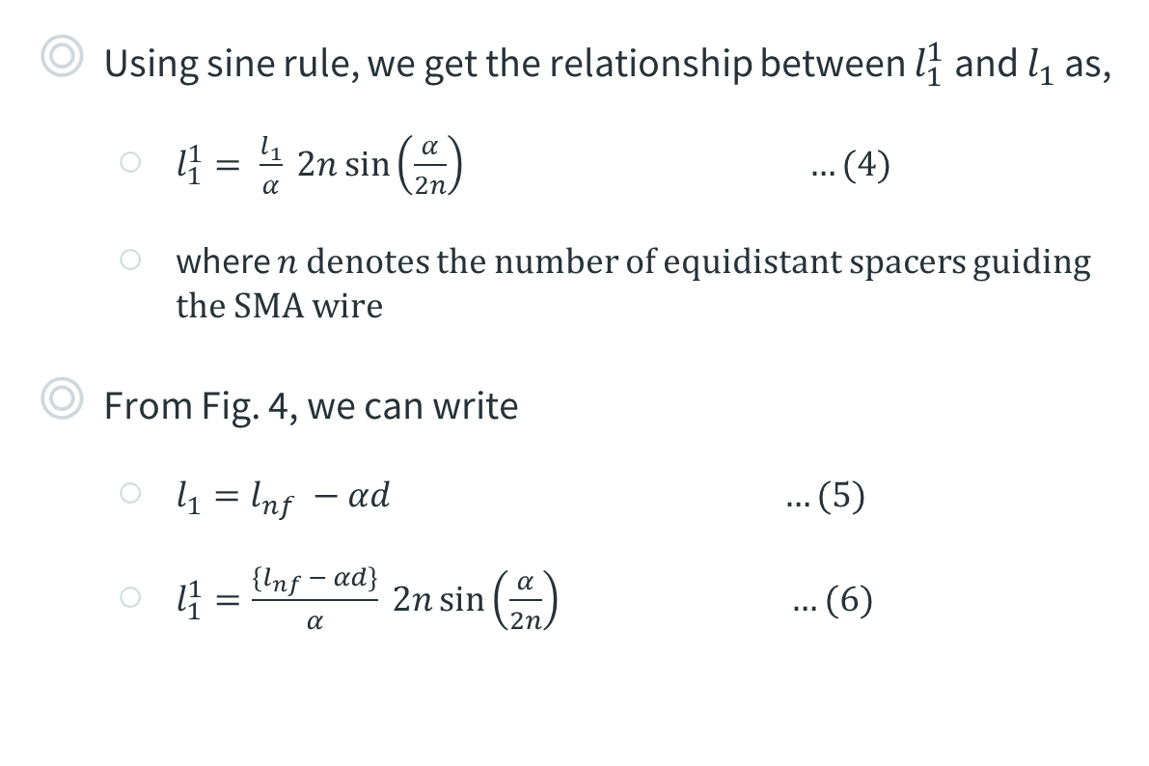
Relation between linear and circular arc segment
Using sine rule, we get the relationship between $l_{1}^{1}$ and $l_{1 }$as,
$l_{1}^{1}= \frac{l_{1}}{α} 2n\sin\left(\frac{α}{2n}\right) …(4)$
where $n$ denotes the number of equidistant spacers guiding the SMA wire
From Fig. 4, we can write
$l_{1}=l_{nf} −αd …(5)$
$l_{1}^{1}=\frac{\{l_{nf} − αd\}}{α} 2n\sin\left(\frac{α}{2n}\right) …(6)$
Fig. 7: Relation between linear section and circular SMA arc (n = 3 in figure)

Slide 9
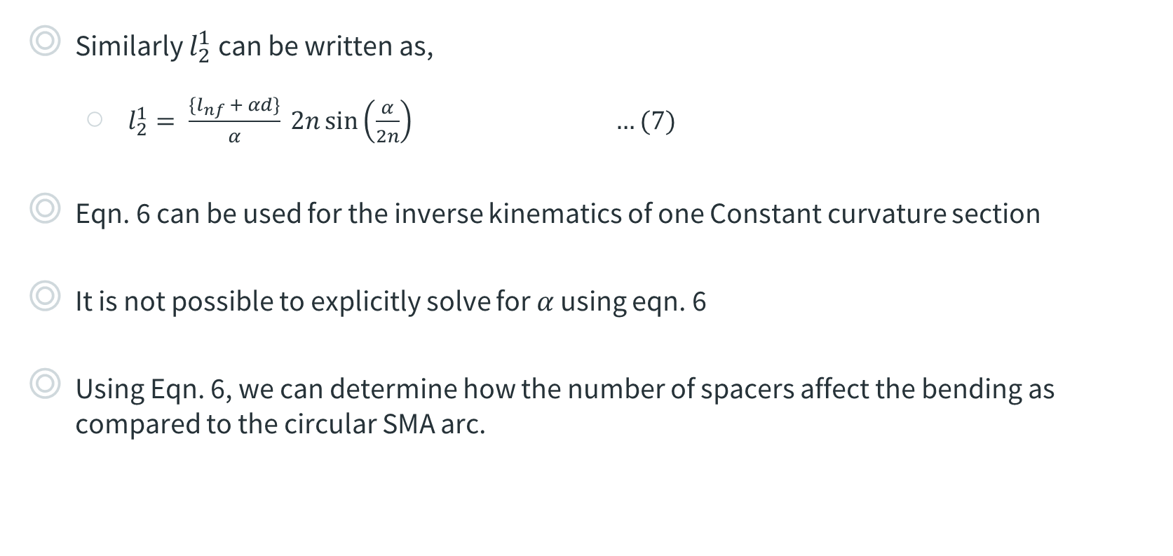
Relation between linear and circular arc segment
Similarly $l_{2}^{1}$can be written as,
$l_{2}^{1}= \frac{\{l_{nf} + αd\}}{α} 2n\sin\left(\frac{α}{2n}\right) …(7)$
Eqn. 6 can be used for the inverse kinematics of one Constant curvature section
It is not possible to explicitly solve for $α$ using eqn. 6
Using Eqn. 6, we can determine how the number of spacers affect the bending as compared to the circular SMA arc.

Slide 10
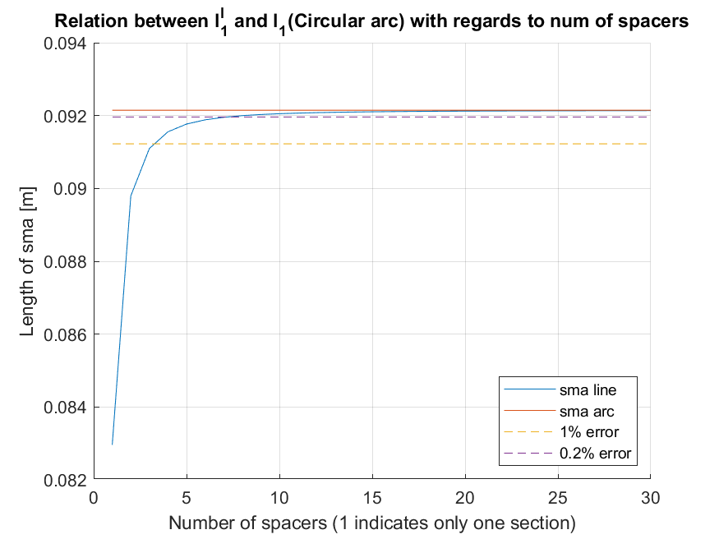

Relation between linear and circular arc segment
Fig. 8: Relation between $l_{1}^{1}$ and $l_{1}$ w.r.t number of spacers

Slide 11
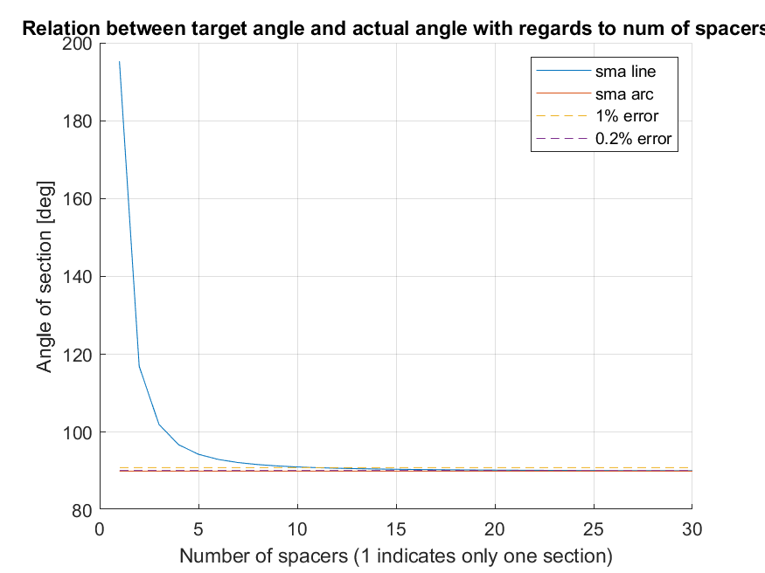
Relation between linear and circular arc segment
Fig. 9: Comparison of target angle and actual angle achieved w.r.t number of spacers

Slide 12
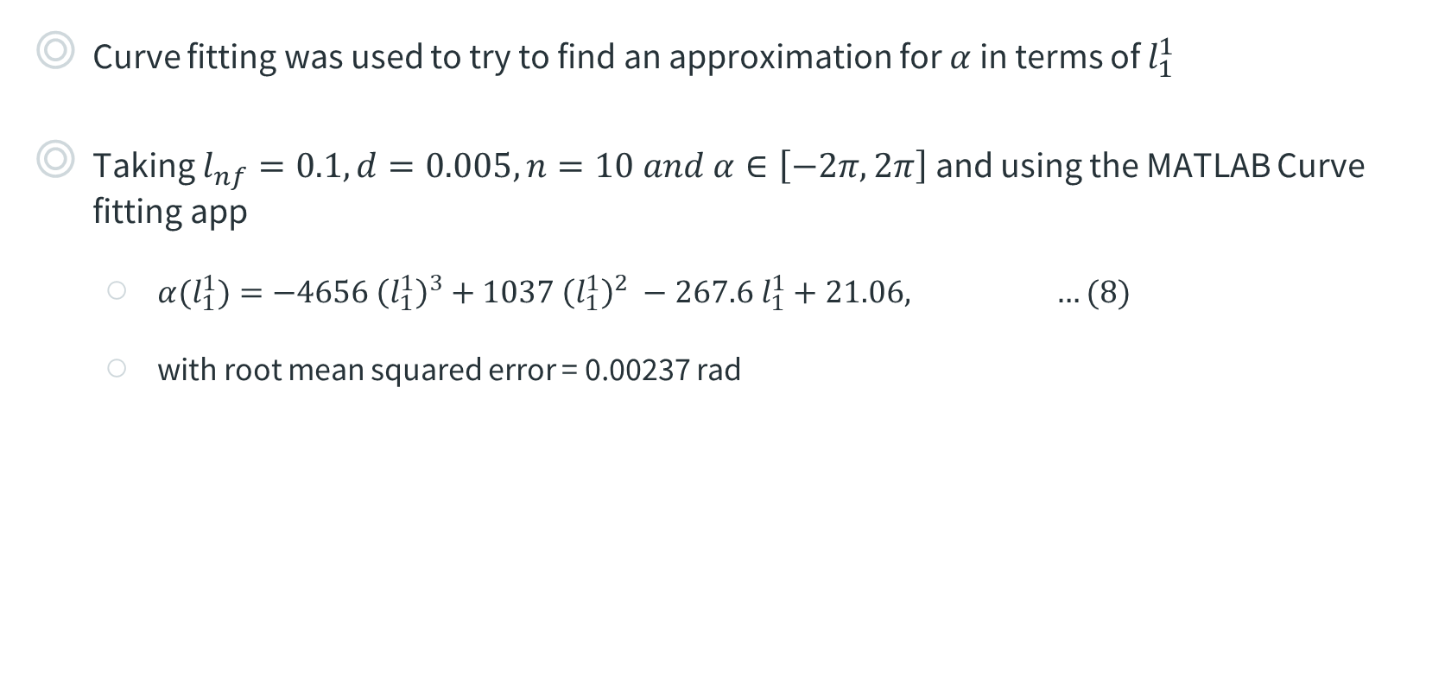
Relation between linear and circular arc segment
Curve fitting was used to try to find an approximation for $α$ in terms of $l_{1}^{1}$
Taking $l_{nf}=0.1, d=0.005, n=10 and α∈\left[−2π, 2π\right]$ and using the MATLAB Curve fitting app
$α(l_{1}^{1})=−4656 {\left(l_{1}^{1}\right)}^{3}+1037{ \left(l_{1}^{1}\right)}^{2} −267.6 l_{1}^{1}+21.06, …(8)$
with root mean squared error = 0.00237 rad

Slide 13
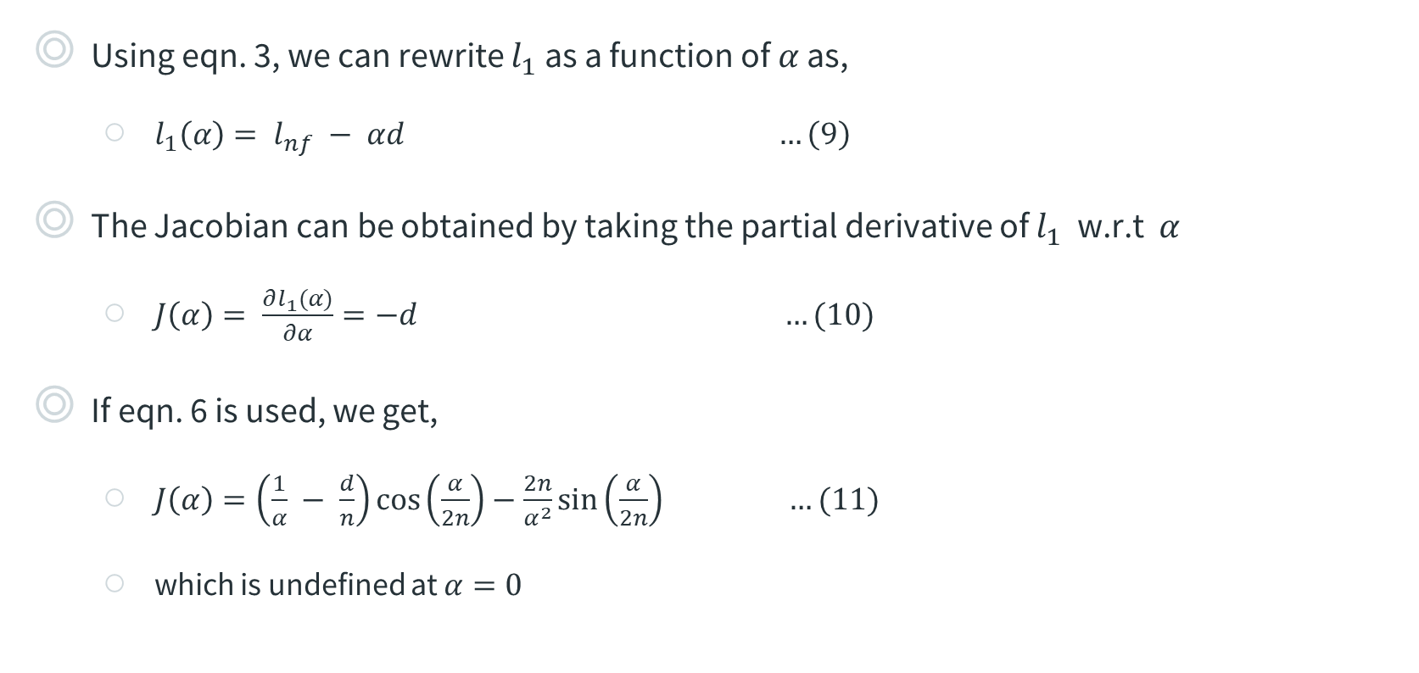
Differential Kinematics
Using eqn. 3, we can rewrite $l_{1}$ as a function of $α$ as,
$l_{1}\left(α\right)= l_{nf} − αd …\left(9\right)$
The Jacobian can be obtained by taking the partial derivative of $l_{1}$ w.r.t $α$
$J\left(α\right)= \frac{∂l_{1}(α)}{∂α}=−d …(10)$
If eqn. 6 is used, we get,
$J\left(α\right)=\left(\frac{1}{α} − \frac{d}{n}\right)\cos\left(\frac{α}{2n}\right)−\frac{2n}{α^{2}}\sin\left(\frac{α}{2n}\right) …(11)$
which is undefined at $α=0$

Slide 14
Next course of action
Sort out discrepancy in Differential kinematics
Work on building the first prototype for testing
Start reading up on Dynamics modeling, specifically on SMA modelling

Slide 15
Thank you for your attention! Any questions?

Slide 16









$$Neutral Fibre$$
$$Bending plane$$
$$d$$
$$r_{SMA1}$$
$$2$$
$$1$$
$$r_{NF}$$
$$r_{SMA2}$$
$$SMA wires$$

Slide 17
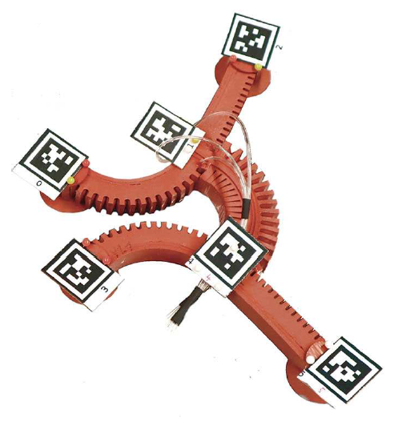
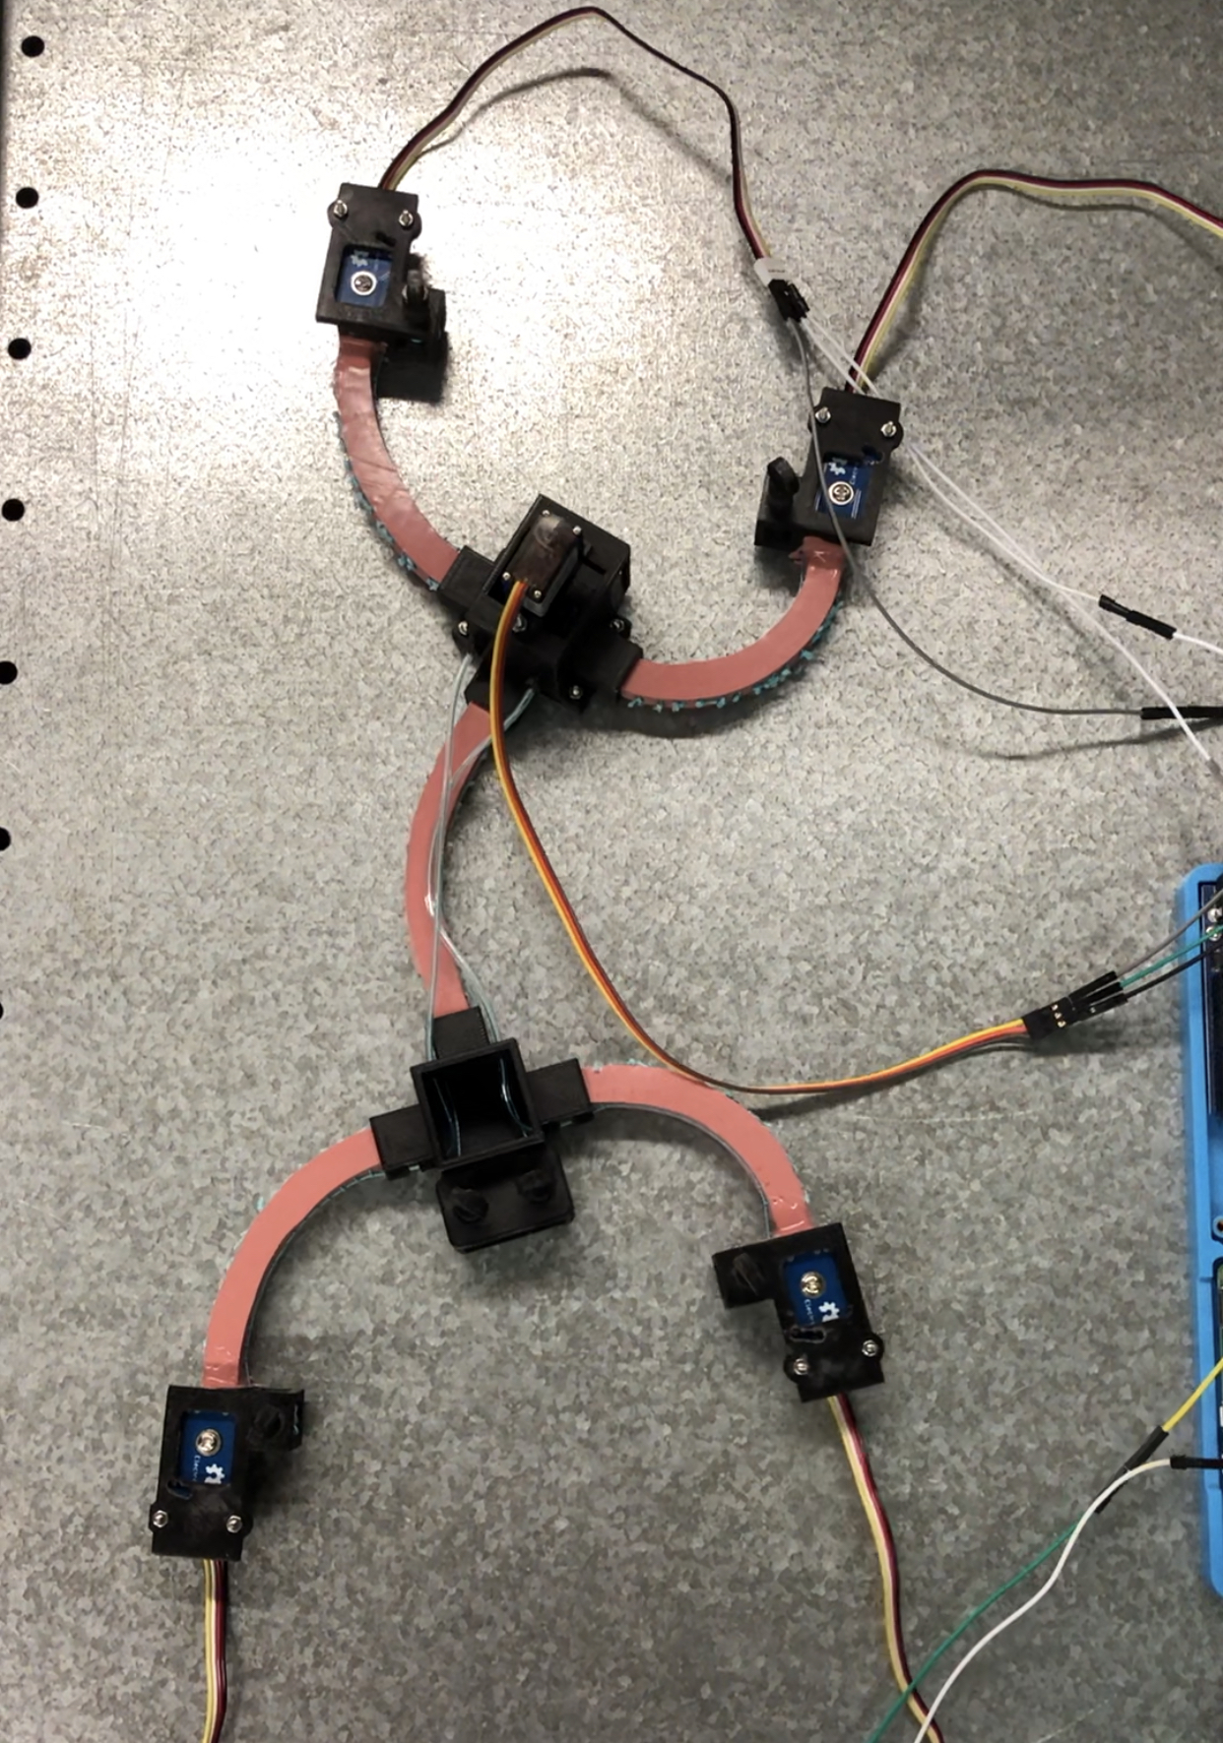
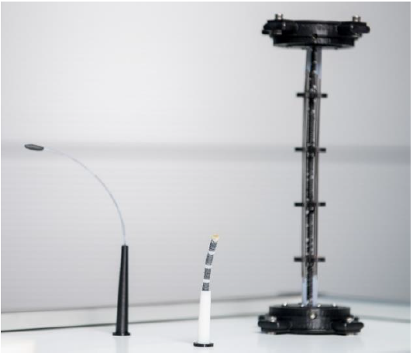
Motivation
Research into Smart materials has brought about innovative actuation methods in Soft robotics
Pneumatic actuators → relatively large pressure valves
Cable-driven actuators → relatively large motors
Smart materials like SMAs integrate well into the robot → only electrical circuit to power them
Modeling necessary to predict their behavior for future control algorithms
Fig. 1: Pneumatically actuated Gecko-inspired robot [1]
Fig. 2: Cable-driven Gecko-inspired robot
Fig. 3: Prototypes of SMA driven continuum robots [2]
Notes:
Common methods currently in use – Pneumatic and Cable-driven

Slide 18
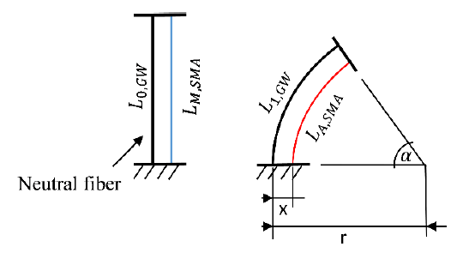
Shape memory alloy actuators
SMAs → integrated directly into robot
Actuated by electric current → Joule heating
Heating above austentite transformation temperature leads to a contraction due to phase transformation in lattice crystal material
Initial shape → applying external force (e.g., with another SMA wire)
Non-linear response of strain to input current, hysteresis characteristic
Need accurate mathematical model → more accurate control
Fig. 3: Schematic diagram of a continuum robot with integrated SMA wire for the theoretical design of the actuators. [2]
Notes:
Drawback – non-linear response
Hysteresis leads to imprecise and difficult control
Efficiency of SMA actuator depends on the accuracy of control which in turn depends on the mathematical model

