Slide 1

Traffic Crash Analytics & Safety Intelligence Platform
Submitted By : Vignesh Yebushi
Technologies : Python | SQLite | Streamlit

Slide 2
ABSTRACT
The Traffic Crash Analytics & Safety Intelligence Platform is a
project built with the aid of Python, SQLite and Streamlit to
analyze traffic accident data and provide useful
information on road safety, trends in accidents, accident patterns,
and accident causality risks. In this project, different advanced
SQL methods have been used to find out risk hotspots, risky
periods, and accident causality factors from the traffic data set.
The findings and business intelligence obtained through the
analysis are displayed through a Streamlit interface.

Slide 3
PROBLEM STATEMENT
Traffic crash data contains valuable insights that can help improve road safety, optimize emergency response, and support policy decisions. However, extracting meaningful insights from large-scale structured data requires strong SQL and analytical skills.

Slide 4
TECHNOLOGY STACK
Python (version 3.12.4 ): Used to load the CSV data into SQLite, execute SQL queries. It was also used to connect the SQLite database with the Streamlit dashboard.
SQLite (version3): Used to store and manage the traffic crash data in a structured relational database. It is lightweight, serverless, and easily integrates with Python, making it suitable for this analytics project
Streamlit (version 1.58.0) : Used to create an interactive dashboard for displaying query results and business insights.

Slide 5
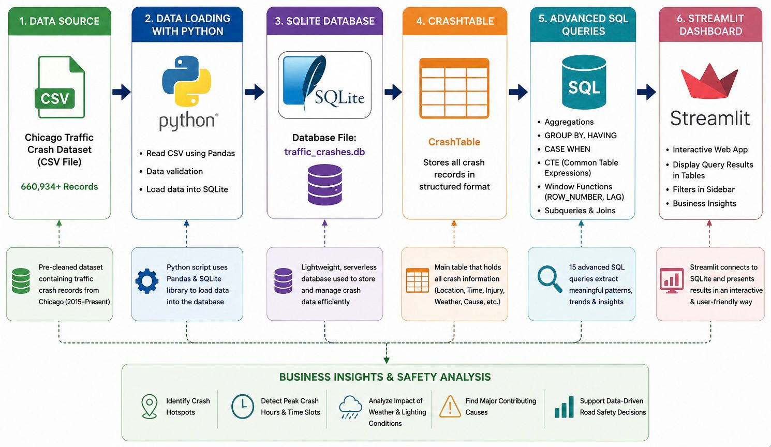
ARCHITECTURE

Slide 6
SQL ANALYSIS
15 analytical SQL queries implemented
Advanced SQL Concepts Used
GROUP BY()
CASE()
HAVING()
CTE()
ROW_NUMBER()
LAG()
Key Queries
Hotspot Analysis
Year-over-Year Growth
Top Contributing Causes
Injury Rate Analysis

Slide 7
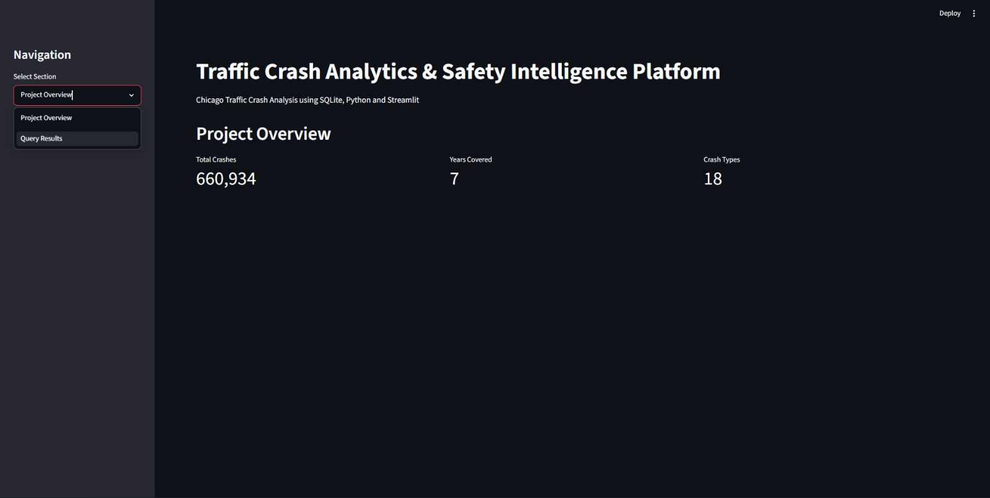
STREAMLIT DASHBOARD

Slide 8
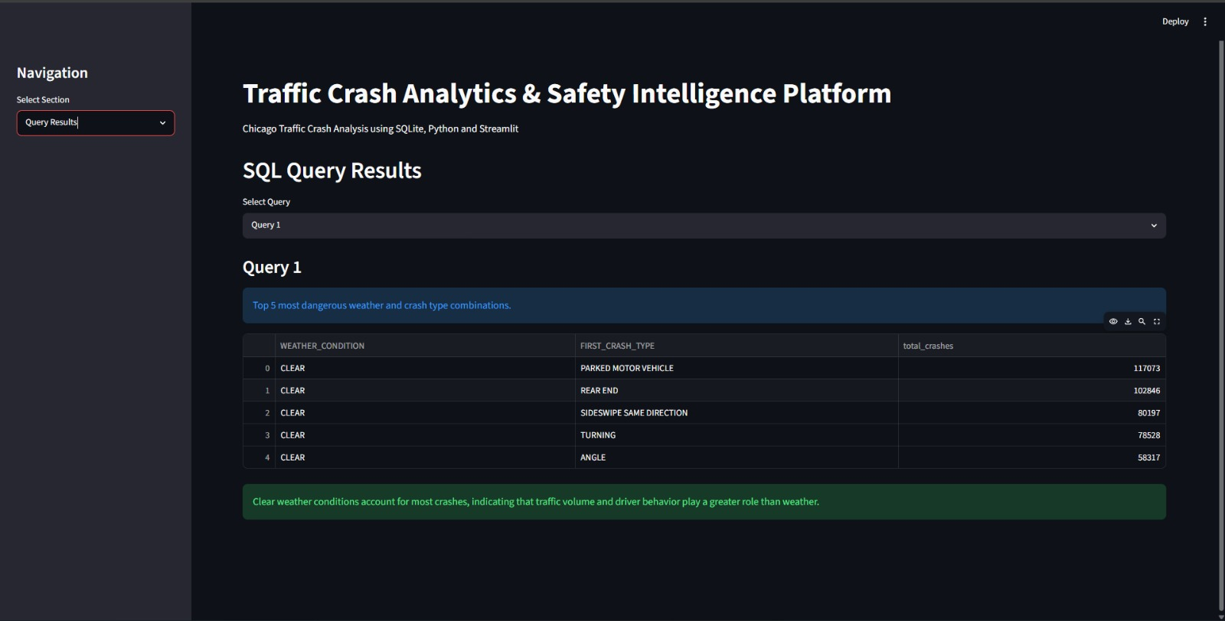
SAMPLE QUERY RESULTS

Slide 9
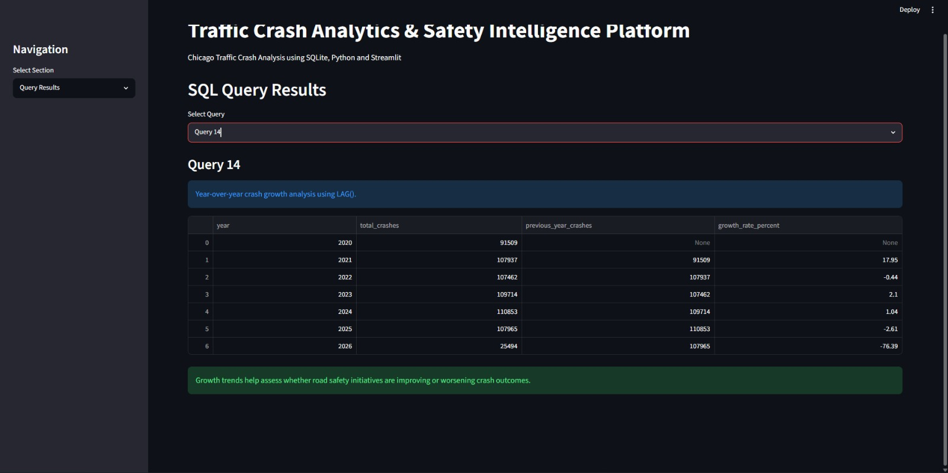

Slide 10
CONCLUSION
Successfully analyzed 660,934 traffic crash records using Python, SQLite, and Streamlit.
Identified crash hotspots, injury patterns, peak crash periods, and major contributing causes through advanced SQL analysis.
Developed an interactive dashboard that converts raw crash data into meaningful insights for road safety planning.
The project demonstrates how data analytics can support data-driven decisions to improve traffic safety and reduce accident risks.

Slide 11
THANK YOU

