Slide 1
Product Demand Prediction with Machine Learning
Phase-2

Slide 2
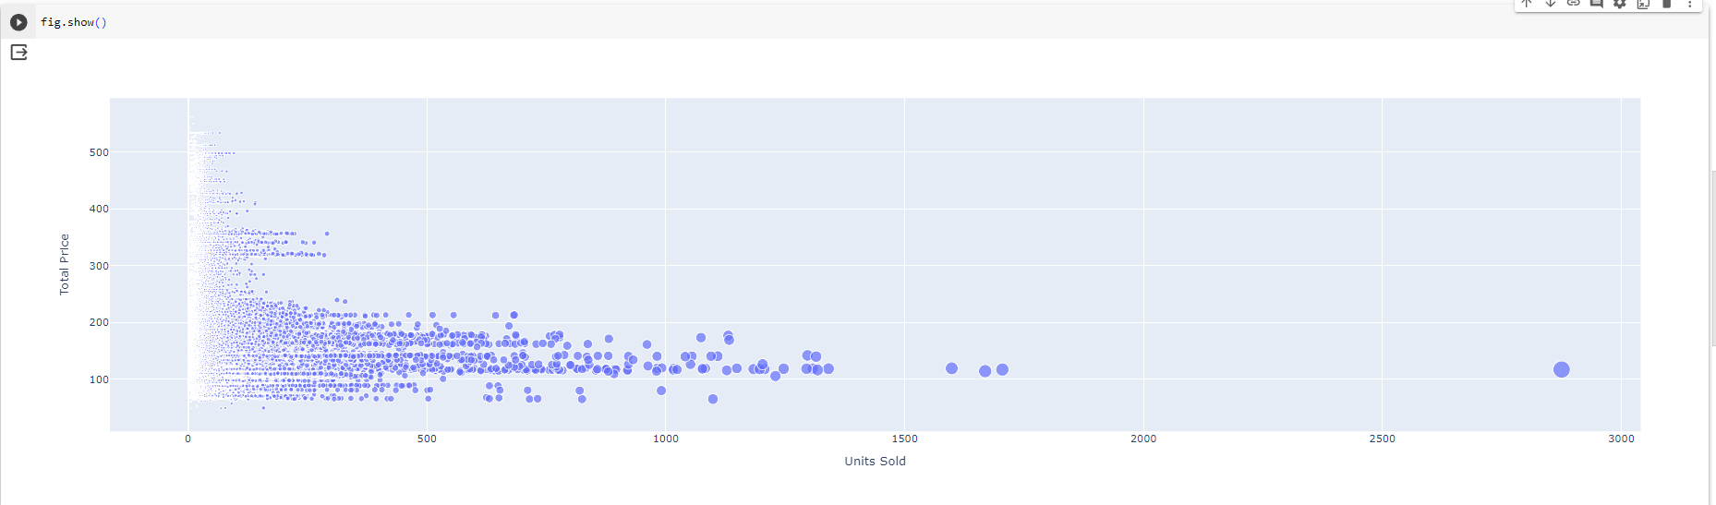
The relationship between the price and the demand for the product

Slide 3
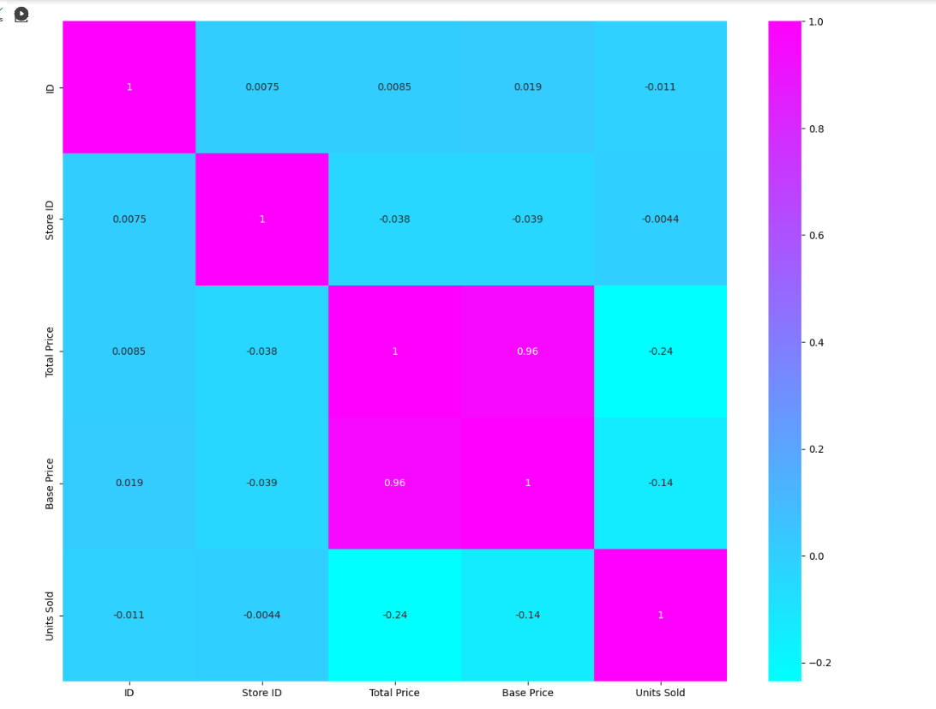
Look at the correlation between the features of the dataset

