Slide 1
VIGNESHWARAN M

Slide 2

ChatBot for Customer Care (NLP Algorithm)

Slide 3
Agenda
Problem statement
Project overview
Who are the end users?
You solution and its value propositions
The wow in your solution
Modelling
Results

Slide 4
Problem statement
In this article, we will create an AI chatbot using Natural Language Processing (NLP) in Python. Our goal is to help you build a smart chatbot. First, we’ll explain NLP, which helps computers understand human language. Then, we’ll show you how to use AI to make a chatbot to have real conversations with people. Finally, we’ll talk about the tools you need to create a chatbot like ALEXA or Siri.
This guide is hands-on. We’ll give you step-by-step instructions, and you can follow our examples or change them to fit your needs.

Slide 5
Project Overview
Were you ever curious as to how to build a talking ChatBot with Python and also have a conversation with your own personal AI?
As the topic suggests we are here to help you have a conversation with your AI today. To have a conversation with your AI, you need a few pre-trained tools which can help you build an AI chatbot system. In this article, we will guide you to combine speech recognition processes with an artificial intelligence algorithm.
Natural Language Processing or NLP is a prerequisite for our project. NLP allows computers and algorithms to understand human interactions via various languages. In order to process a large amount of natural language data, an AI will definitely need NLP or Natural Language Processing. Currently, we have a number of NLP research ongoing in order to improve the AI chatbots and help them understand the complicated nuances and undertones of human conversations.

Slide 6
Who are the end users
Consider enrolling in our AI and ML Blackbelt Plus Program to take your skills further. It’s a great way to enhance your data science expertise and broaden your capabilities. With the help of speech recognition tools and NLP technology, we’ve covered the processes of converting text to speech and vice versa. We’ve also demonstrated using pre-trained Transformers language models to make your chatbot intelligent rather than scripted.

Slide 7
Your solution and its value propositions
chat = nlp(transformers.Conversation(ai.text), pad_token_id=50256) res = str(chat) res = res[res.find("bot >> ")+6:].strip()Finally, we’re ready to run the Chatbot and have a fun conversation with our AI.

Slide 8
The wow in your solution
NLP technologies have made it possible for machines to intelligently decipher human text and actually respond to it as well. However, communication amongst humans is not a simple affair. There are a lot of undertones dialects and complicated wording that makes it difficult to create a perfect chatbot or virtual assistant that can understand and respond to every human.
To overcome the problem of chaotic speech, developers have had to face a few key hurdles which need to be explored in order to keep improving these chatbots.
Notes:
(These don’t have designer IDs since they were based off the default master slides already in the deck.

Slide 9
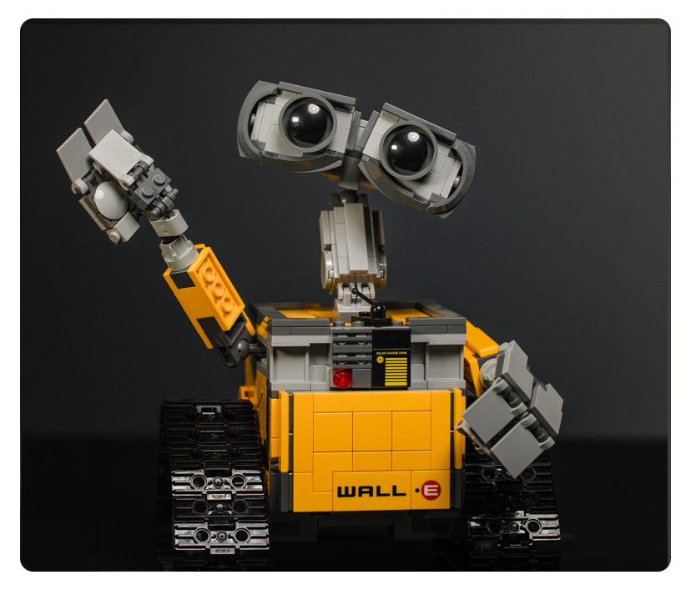
Modelling
Notes:
(These don’t have designer IDs since they were based off the default master slides already in the deck.

Slide 10
Results
In this guide, we’ve provided a step-by-step tutorial for creating a conversational AI chatbot. You can use this chatbot as a foundation for developing one that communicates like a human. The code samples we’ve shared are versatile and can serve as building blocks for similar AI chatbot projects.

