Slide 1

Business oriented web service application
Business oriented web service application

Slide 2
About company
BizShot is a social news website primarily focusing on establishing a communication link between the investors and the startups with innovative ideas. It also provides service to the local business people to disseminate their business across the city, state, country or even globaly. It serves as a platform specifically for the business people to gather, communicate and to grow together.

Slide 3
Website goals
For Investors - To find a perfect business idea and to invest money in the right business trend based on the current business trends in the news.
For ideas/talent persons - A platform to broadcast their ideas or talent to be recognised by the investors to bring their ideas to implementation.
For Business Expandors - They can post about their current business details and request for interested investors for further establishment of their business globally.

Slide 4
Website goals
The visitors of the site should be able to see the articles in the Articles section about the current trends in the industry and also to ask the Questions on any doubts about their business in the dedicated Q&A section
The visitor can able to register and become a member of the site and this is achieved by providing a Signup option
Exisiting members can Login directly into the site with the Login option
Once the user has logged in they are directed to a dashboard view where they can search about a particular business ideas post or about any investors proposal on investing on a particular idea.

Slide 5
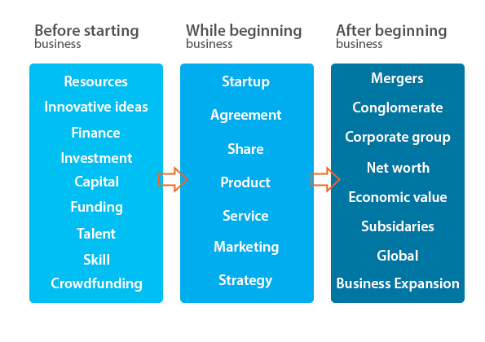
Brainstorming

Slide 6
Competitor analysis
Indirect competitors -
www.reddit.com - This site is user generated questions and replies.
www.digg.com - This system allows users to "digg" or "bury" articles. "Digging" is the equivalent of voting positively, so that popular articles are displayed first. "Burying" does not lower an article's score. However, if an article is buried enough times, it will be automatically deleted from the site
www.voat.co - is similar to reddit where user generated articles.
www.lumn.io - is a social news website where users can submit stories

Slide 7
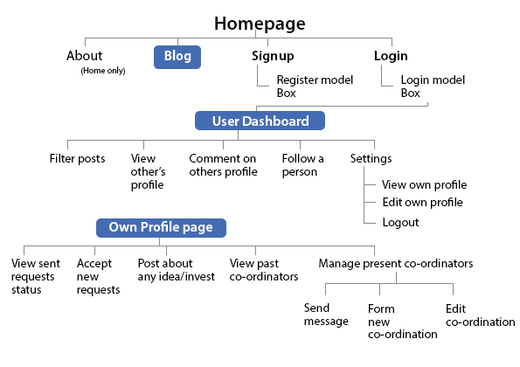
IA - Sitemap

Slide 8


Landing Page

Slide 9
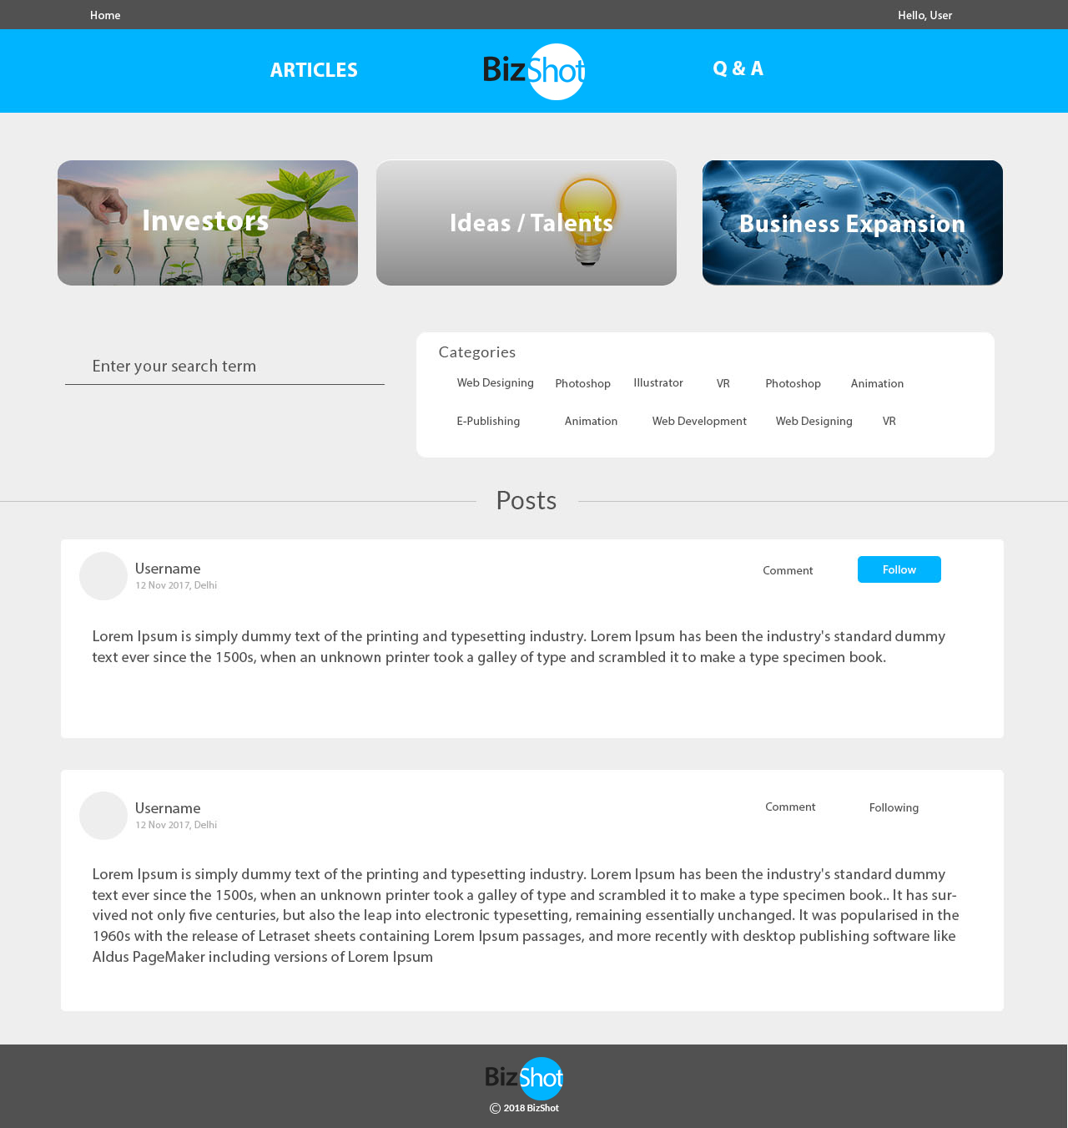
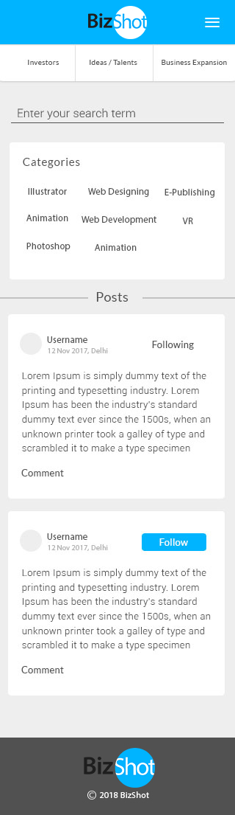
User DashBoard

Slide 10
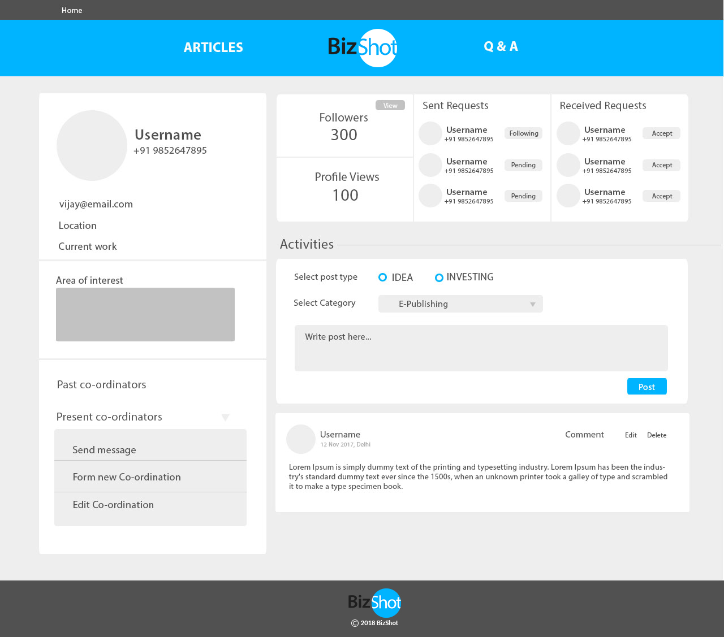
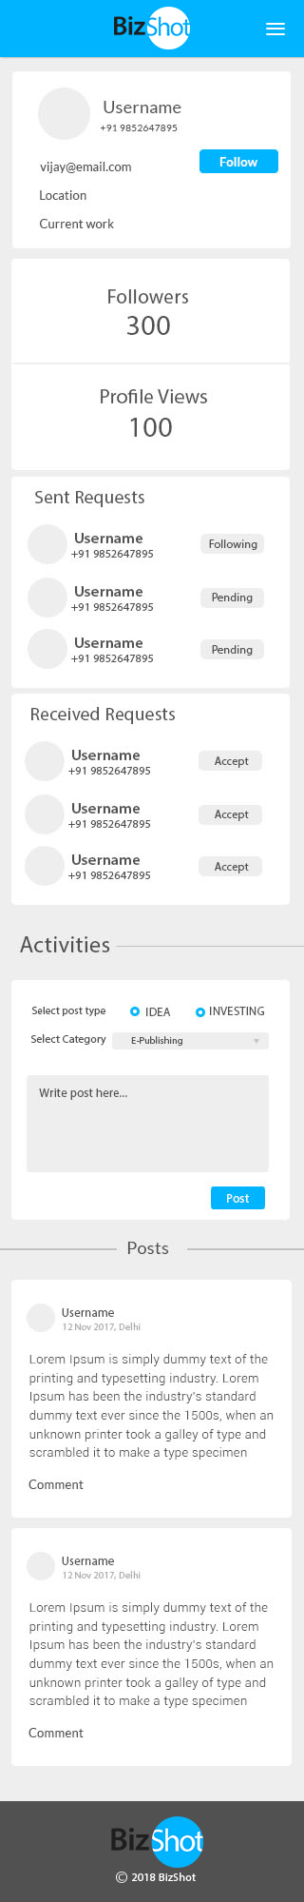
User Own profile

Slide 11
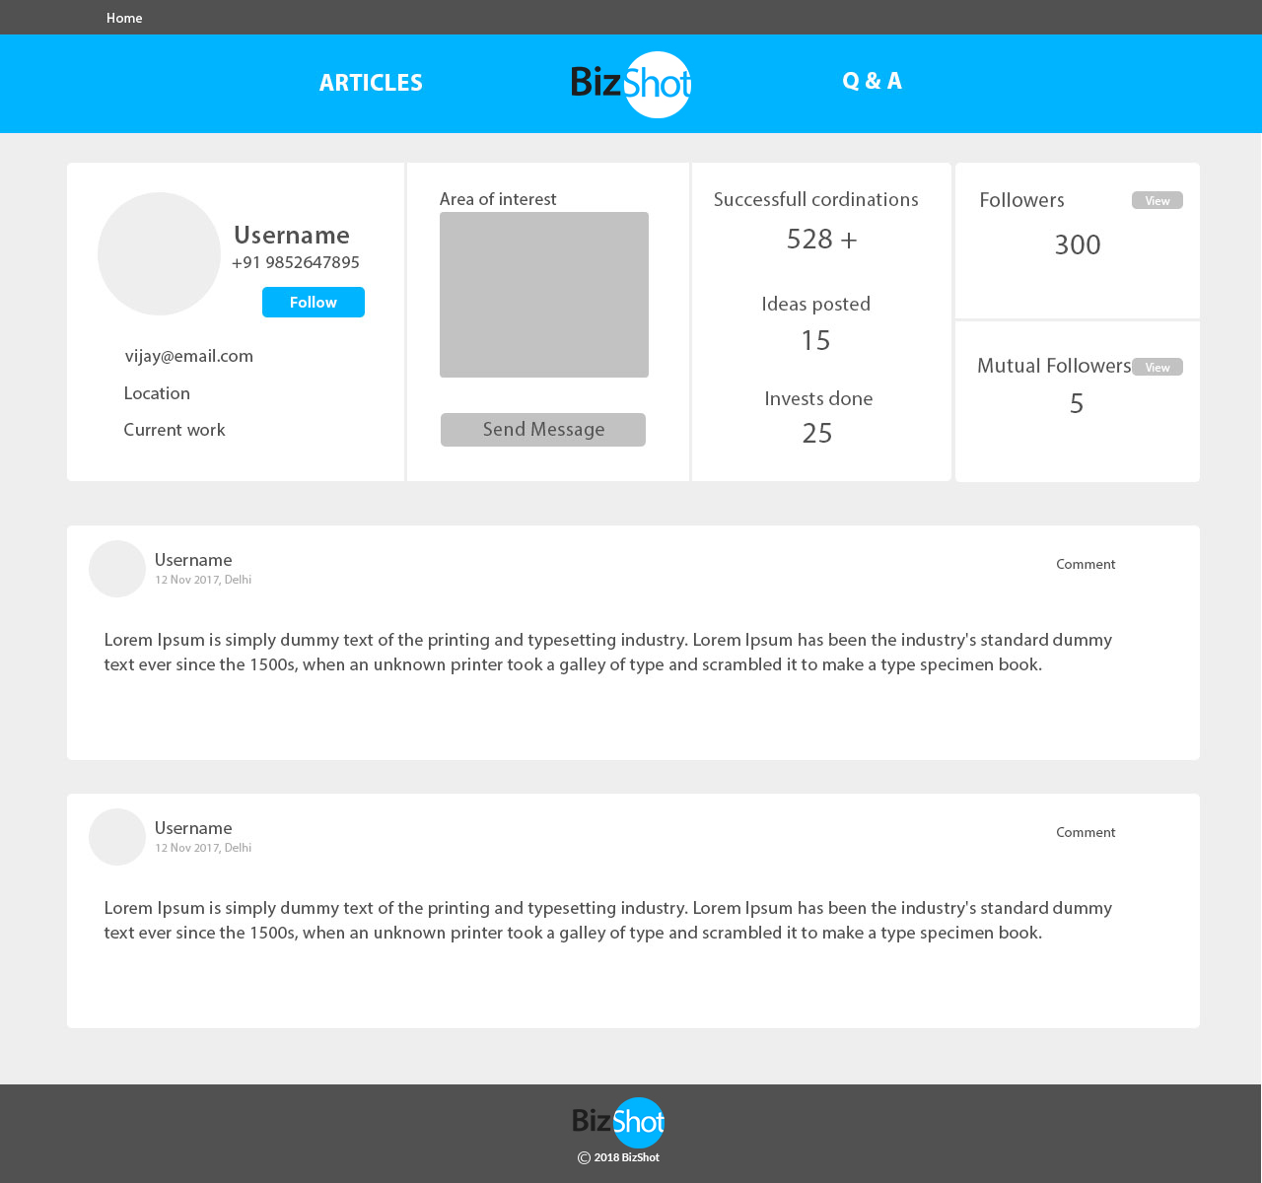
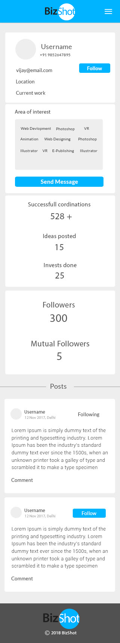
Other user profile

Slide 12

Theme
Blue
Neutrals
Hex codes - #515151
#FFFFFF, #446CB3
#EEEEEE

Slide 13
Typography
Heading - Lato
Sub heading -Lato
Body content - Roboto

Slide 14
Implementation of dynamic website
Landing_Page | Signup, Login
User_Dashboard | Username displayed from session
 | Posts will dynamically change on selection of any one option(card view) specifically on the selected option
 | The categories listed out as the user enters the search input using AJAX
 | Posts will change concentrated on the selected category item.
 | On clicking username the page directs to the userprofile of that selected person
 | On clicking Follow button the request will be sent to the person.
 | User can post comments and other users can reply to our comments

Slide 15
Implementation of dynamic website
Our_Profile | User details given in registration form.
 | Location,current work and area of interest need to be added
 | Sent Request and received request is shown
 | Followers and profile view will be shown from database
 | User can select any one of the post type, category and write the post
 | Edit and Delete post options available

Slide 16
Implementation of dynamic website
Other_User_Profile | The user details will be displayed
 | Posts of the user will be displayed
 | We can comment on any of the posts
 | We can follow the user by clicking on follow button
 | We can send a message to the person if that person is in our coordination list of members

Slide 17
Database Schema
User_Registration | User_Detail | User_post
user_id | id | id
name | name | user_id
password | user_id | name (session)
email_id | location | post_type
mobile_number | current_work | post_category
log | area_of_interest (multi-value) | post_text
 | total_followers | comment_count
 | total_profile_views | comment_text
 | total_ideas_posted | comment_date_time
 |  | comment_name

Slide 18
Database Schema
Sending_Request | Receiving_request
id | id
name | person_id
user_id | person_name
person_id | permit
person_name | user_id
status

