Slide 1

EXPLORATORY DATA ANALYSIS
E-Commerce Data Analysis
DATASET UNDERSTANDING, DATA CLEANING AND BUSINESS INSIGHTS
Presented By
G.VIGNESH BABU

Slide 2
About Dataset
  ANALYSIS BASED ON ECOMMERCE_CUSTOMER.CSV
  DATASET SIZE: 3,055 ROWS × 32 COLUMNS
FOCUS: DATA QUALITY, INVALID RECORDS, PRODUCTS, CHANNELS, PAYMENTS, MARKETING AND CATEGORIES

Slide 3
COLUMNS
  Gross_Amount
  Discount_Pct
  Discount_Amount
  Net_Sales
  Estimated_Cost
  Profit
  Profit_Margin_Pct
  Shipping_Days
  Sales_Channel
  Payment_Method
  Device
  Return_Status
  Delivery_Rating
  Customer_Rating
  Customer_Loyalty_Points
  Customer_Satisfaction
  Items_Viewed
  Order_ID
  Order_Date
  Order_Status
  Customer_ID
  Customer_Age
  Customer_Segment
  City
  Region
  Product_Name
  Category
  Quantity
  Unit_Price
  Previous_Orders
  Website_Session_Minutes
  Marketing_Source

Slide 4
Problem Statements & Analysis Objectives
Problem Statement 1 – Dataset Understanding and Data Cleaning & Duplicate and Invalid Data Handling
The e-commerce business is facing data-quality issues that may affect the reliability of its sales analysis.
The available transaction data must be examined for missing values, incorrect data types, and incomplete records.
Problem Statement 2 – Most-Selling and Most-Profitable Products
The business needs to know which products are driving customer demand and which products are generating the most profit.
Differences between high sales volume and high profitability may affect inventory and product strategies.
Problem Statement 3 – Sales Channel Preference
The business operates through Online, Store, Mobile App, and Marketplace channels but does not know which channel customers prefer most.
Understanding purchasing behavior across these channels is important for improving sales and customer engagement.
The analysis should help the business prioritize the channels with the strongest customer activity

Slide 5
Problem Statements & Analysis Objectives
Problem Statement 4 – Customer Payment Method Preference
Customers use multiple payment options, but the business needs to understand which methods are most commonly used.
Low usage or changing preferences may indicate opportunities to improve the payment experience.
The analysis should help the business optimize its payment options based on actual customer behavior.
Problem Statement 5 – Impact of Marketing Sources on Sales
The business is investing in multiple marketing sources but needs to understand which ones are actually generating sales.
Sales performance from Email, Google Ads, Organic, Referral, and Social Media needs to be compared.
The results can help management allocate future marketing budgets toward more effective customer acquisition channels.
Problem Statement 6 – Category Attracting Customers
The business offers products across several categories but needs to understand where customer demand is strongest.
Differences in sales between Electronics, Fashion, Sports, Grocery, and Home Appliances can influence inventory and promotional decisions.

Slide 6
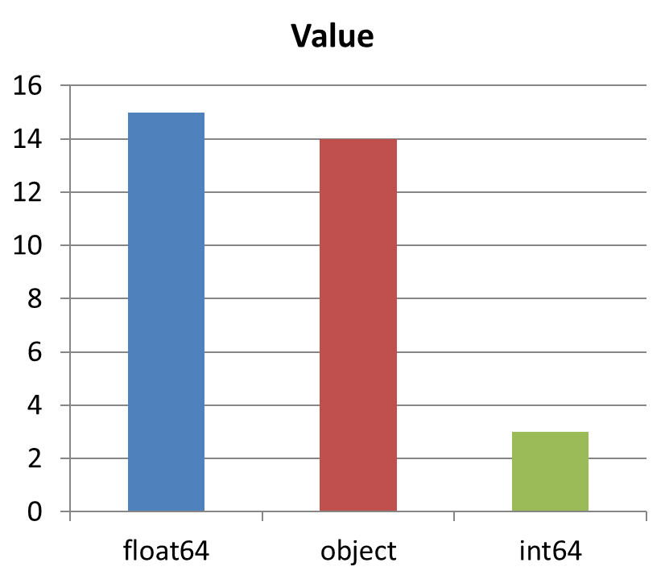
Problem Statement 1
  Total rows: 3,055
  Total columns: 32
  Data contains categorical/object fields, integer fields and floating-point numerical fields.
  Order_Date was initially stored as an object and was converted to a date format during cleaning.

Slide 7
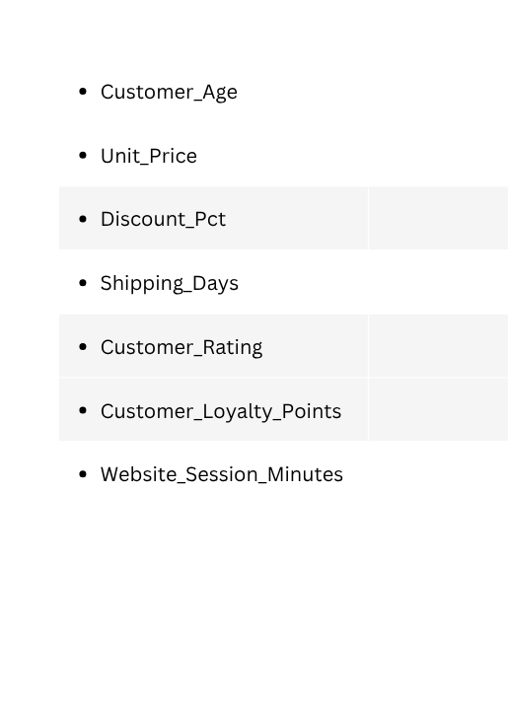
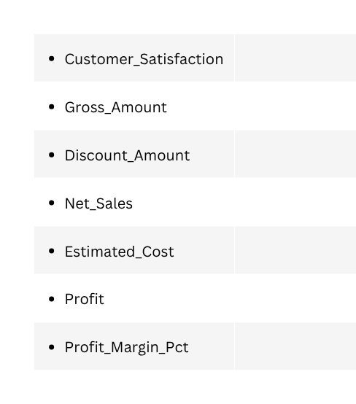
  Total Columns affected by missing values/null values: 16
  Total Null values are :2518
  Then we spliit into to parts as numarical cloumns and categorical cloumns which
have the null values.
  Mostly we prefer mode to fill the categorical cloumns
  City 76
  Payment_Method 77
For the numarical cloumns we have to try with mean and median comapre those values.

Slide 8
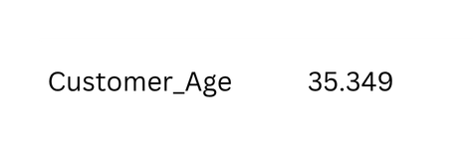
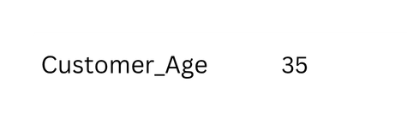
  After comparing the Mean and Median. I chose Median to fill the values.
  It helps to reduce the ouliers.
For example:
MEAN
MEDIAN
Check again if we have any null values left.
  df.isnull().any().sum()

Slide 9
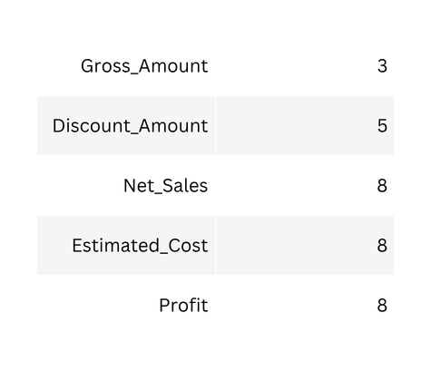
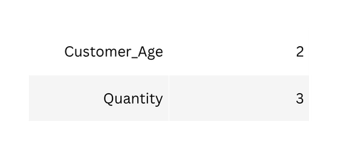
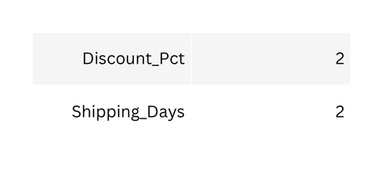
Duplicate and Invalid Data Handling
  Removing Duplicated values which are repeated. 50 rows have Duplicated values
  Drop them df.drop_duplicates(inplace=True)then we have 3,000 rows
  Finding Invalid data like Negative values,Exceeded values then given limit(rating).
  These are the columns we have negative values
we have to replace those values.Except profit ,
  profit can be in negative in the Business Insights
  With median I replaced all the negative values.

Slide 10
Removing the invalid data
  Shipping_Days - Identify negative shipping days as invalid values.
  Customer_Rating - Identify ratings above 5 as invalid.
  Quantity - Identify values ≤ 0 as invalid quantities.
  Estimated_Cost - Identify negative costs as invalid.
  Net_Sales - Identify negative sales values as invalid.
  Discount_Amount - Identify negative discount amounts as invalid.
  Gross_Amount - Identify negative gross amounts as invalid.
  Discount_Pct - Identify discount percentages below 0% or above 100% as invalid.

Slide 11
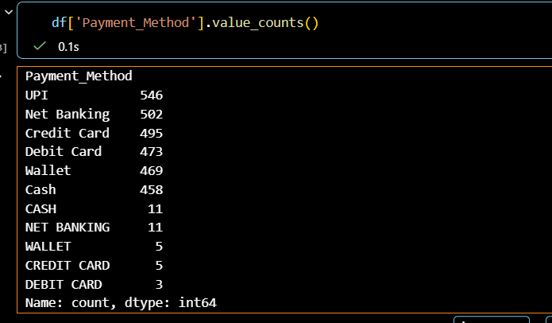
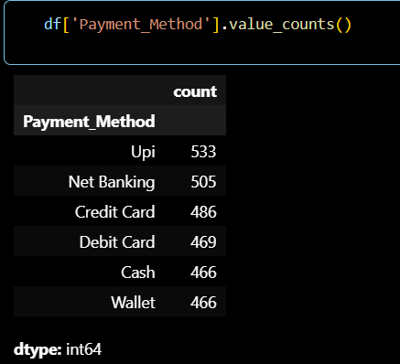
  During the analysis we got invalid data called inconsistent capitalization
in the 3 columns , “City”, “Payment_method”,”Category”
  By Uing the str.title
df['Payment_Method'] = df['Payment_Method'].str.title()
Example:
value_counts()

Slide 12
NOW THE DATA IS CLEANED
WITH NO NULL VALUES, NO DUPLICATES, NO INVALID DATA.

Slide 13
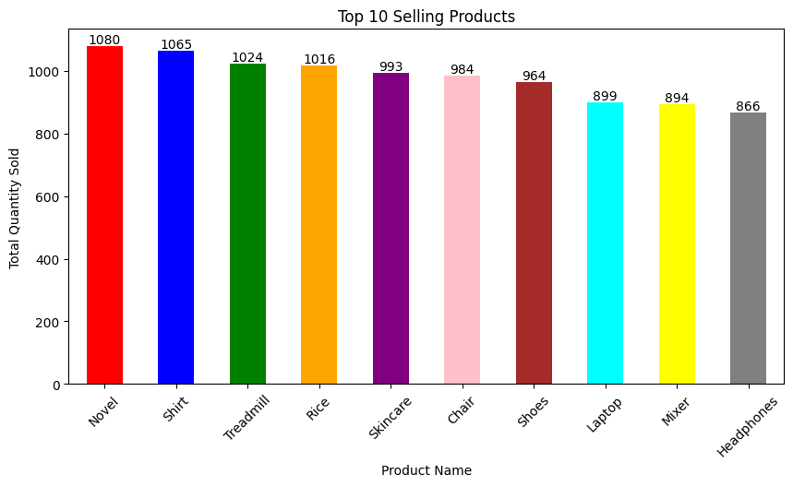
Problem Statement 2
MOST-SELLING AND MOST-PROFITABLE PRODUCTS
  Novels are the most selling prodcut
with the Quantity of 1080 sold

Slide 14
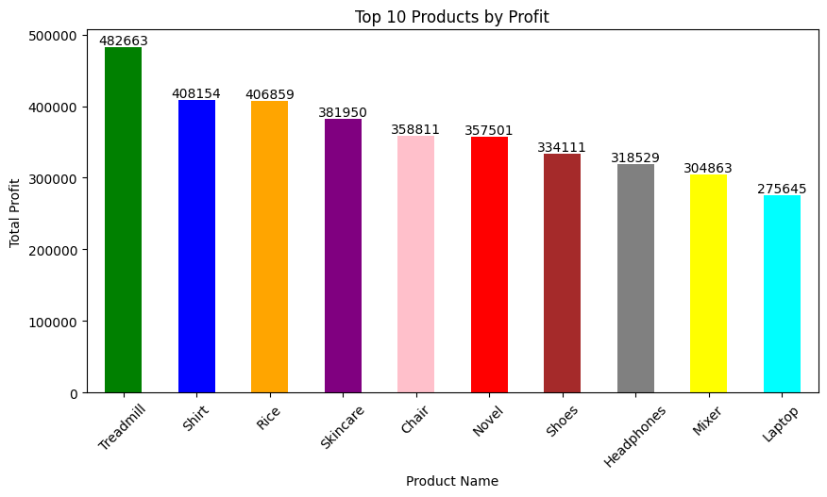
MOST-PROFITABLE PRODUCTS
  Threadmill is the most profitable product, with profit of 482663

Slide 15
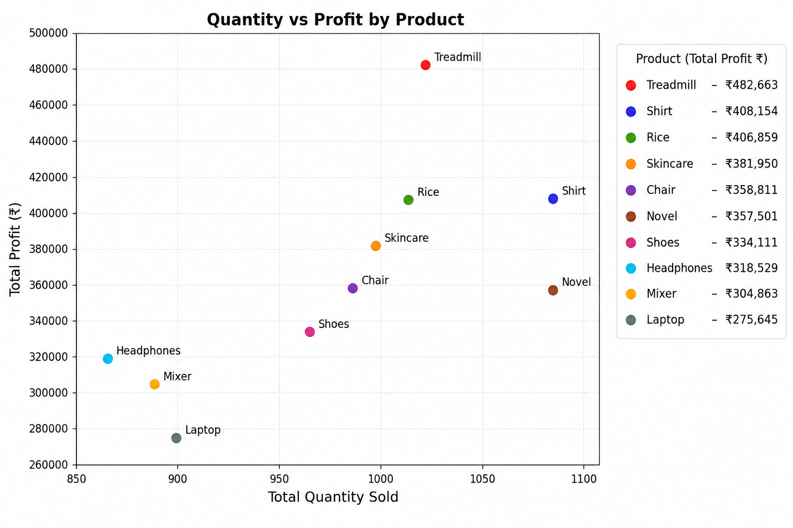
QUANTITY VS PROFIT BY PRODUCT

Slide 16
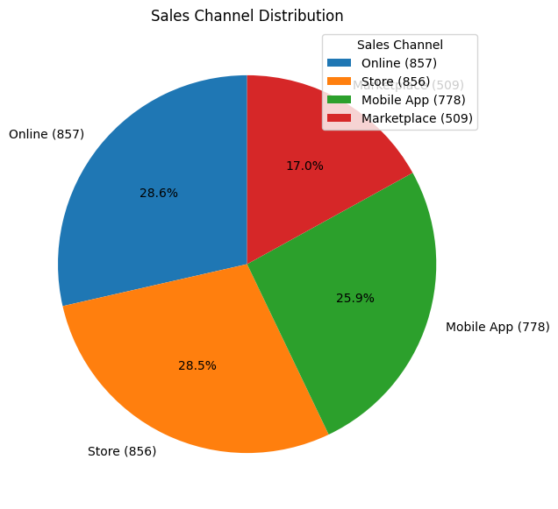
Problem Statement 3
Sales Channel Preference
  Highest purchase: Online and Store (857 purchases each)
  Mobile App: 778 purchases
  Marketplace: 509 purchases

Slide 17
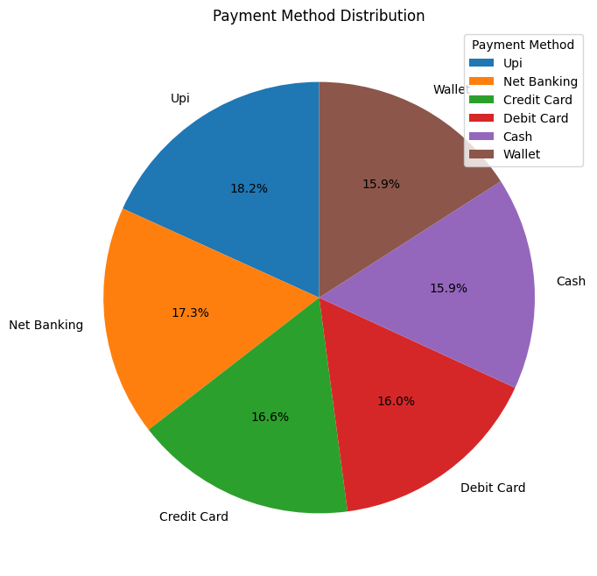
Problem Statement 4
Customer Payment Method Preference
  Most preferred payment method: Upi (610 purchases)
  Second preference: Net Banking (505)

Slide 18
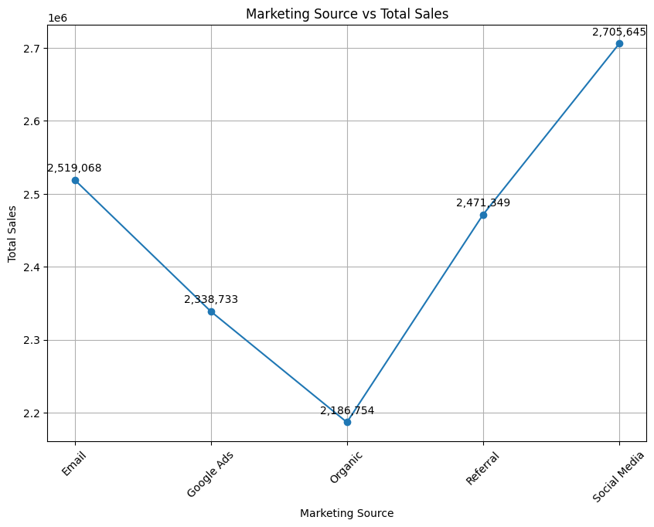
Problem Statement 5
Impact of Marketing Sources on Sales
  Top marketing source: Social Media
  Net Sales generated: 2,705,645
  Lowest among analyzed sources: Organic (2,486,754)

Slide 19
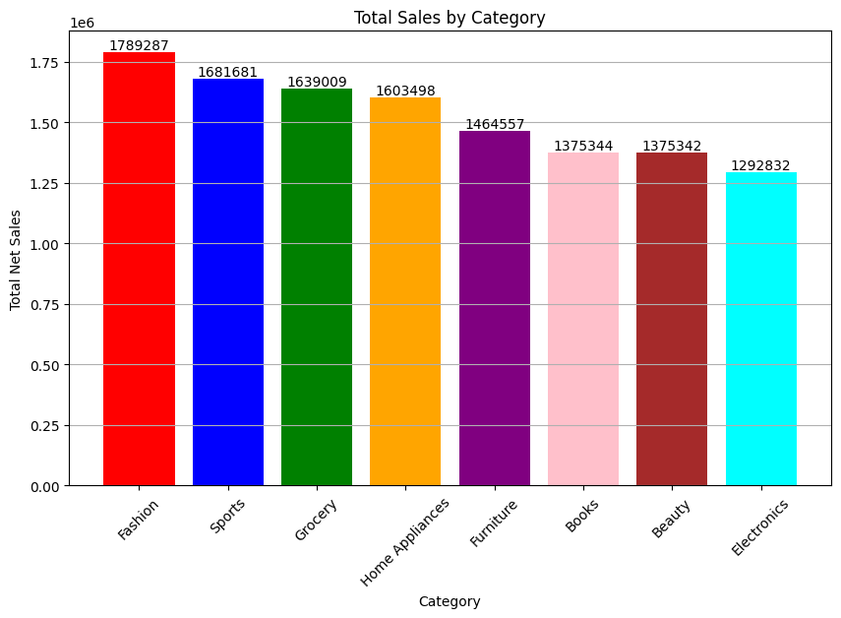
Problem Statement 6
  Highest Net Sales category:
Fashion (1789287)

Slide 20
Conclusion:
  Future predictions from the cleaned and transformed e-commerce dataset indicate several key trends.
  Customer behavior is expected to shift towards more personalized shopping experiences, driven by data-driven recommendations across products and channels.
  Sales performance will likely improve with the optimization of payment methods, offering more flexibility and security to consumers.
  Marketing strategies will become increasingly targeted, focusing on high-performing sources and categories, enhancing customer engagement and retention.
  Overall, these insights suggest a promising increase in revenue and profitability for businesses that leverage this comprehensive analysis.

Slide 21

ANY QUESTION

Slide 22
THNAK YOU

