Slide 1
RETAIL SALES PULSE
From Analysis to Pipeline
Retail / E-commerce | Jan–Jun 2026 + weekly API pulse
EDA + DATA PIPELINE
Presented by
G.Vignesh babu

Slide 2
One business story: analysis → automation
Part 1 — Retail Sales Pulse
Part 2 — Automating the Pulse
5.1 Load & inspect
5.2 Revenue by store
5.3 Category trends
5.4 Day-of-week & monthly patterns
5.5 Anomaly identification
5.6 Business recommendation
5.7 Understand JSON structure
5.8 Ingest & parse API response
5.9 Validate corrupt data
5.10 Transform & aggregate
5.11 Generate weekly summary
2

Slide 3
Part 1 — Retail Sales Pulse
2

Slide 4
5.1 — Load and inspect the data
107,836
10
0
Jan–Jun
transactions
columns
null values
2026 coverage
0
0
₹45+Cr
Total revenue
Duplicates
Invalid Data
Observation 1
Observation 2
Average transaction revenue is about ₹4,263.92, while the maximum is ₹355,090.88. The very large maximum suggests that unusually high-value transactions should be monitored.
Average units sold is 2.58 per transaction. This suggests most transactions involve only a small number of items, so revenue performance is strongly influenced by transaction value and product mix.
3

Slide 5
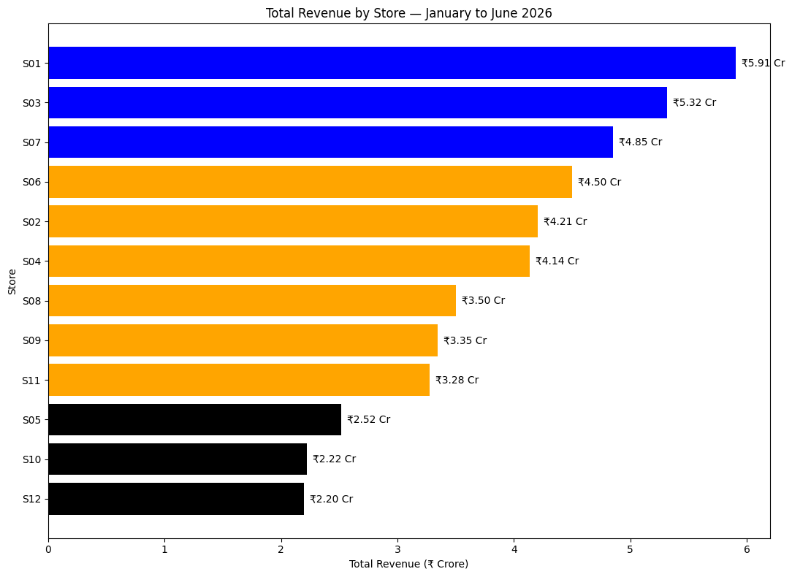
5.2 — Revenue by store
Six-month revenue, ranked highest to lowest
0
Top 3
S01 — Vijayawada: ₹5.91 Cr
S03 — Guntur: ₹5.32 Cr
S07 — Tirupati: ₹4.85 Cr
Bottom 3
S05 — Rajahmundry: ₹2.52 Cr
S10 — Nellore : ₹2.22 Cr
S12 — Kakinada : ₹2.20 Cr
4

Slide 6
5.2 — Revenue by store
Follow the chart with 2–3 sentences on what stands out and what it might signal to the operations team.
what stands out and what it might signal to the operations team.
The chart shows that S01 – Vijayawada has the highest six-month revenue at approximately ₹5.91 crore, while S12 – Kakinada has the lowest at approximately ₹2.20 crore. This large difference in store performance may signal differences in customer demand, inventory availability, promotions, or local market conditions. The operations team should investigate the reasons for S12’s lower performance and identify successful practices from high-performing stores like S01.
4

Slide 7
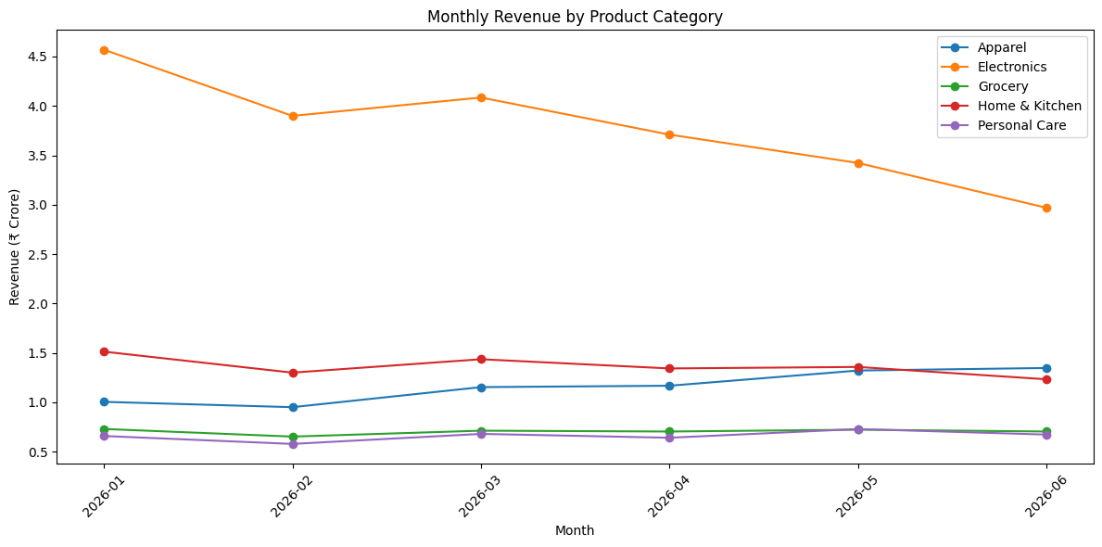
5.3 — Category performance over time
Steepest decline
Electronics showed the steepest decline, falling from about ₹4.57 Cr in January to ₹2.97 Cr in June.
Electronics declining ~25% Jan–Jun
5

Slide 8
5.3 — Category performance over time
Electronics declining ~25% Jan–Jun.
In India or especially AP , electronics such as ACs, refrigerators, and washing machines often have strong promotional offers during certain periods, so the decline may also be related to changes in seasonal demand or fewer offers after the early-year sales period.
The key business question is: Why is Electronics revenue falling while other categories, such as Apparel, are improving?
Write 2 sentences of business interpretation: not just "Electronics declined" but what that might mean and what question it raises.
5

Slide 9
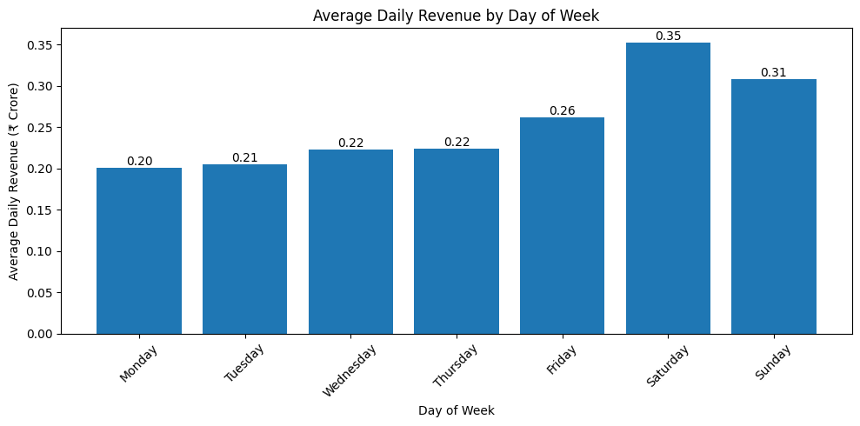
5.4 — Day-of-week and monthly patterns
Finding
Best day: Saturday 0.35Cr | Worst day: Monday 0.20Cr
6

Slide 10
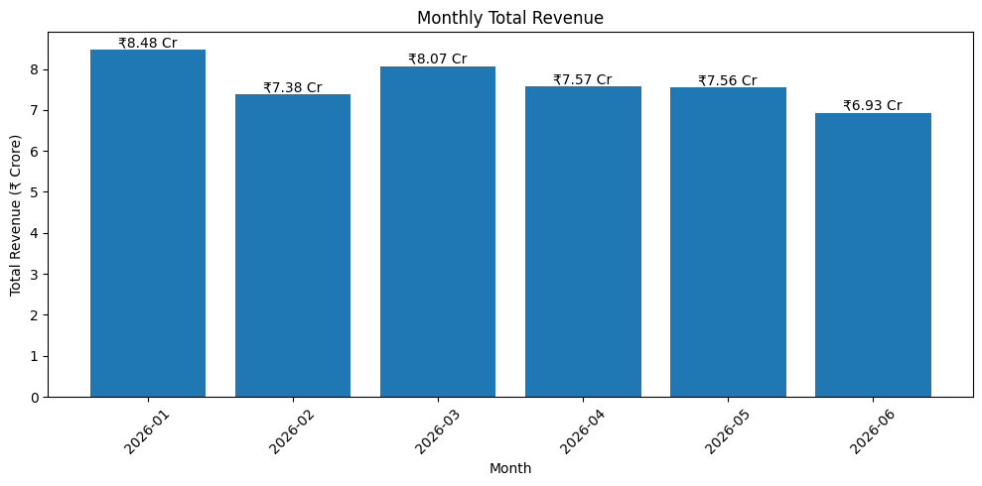
5.4 — Day-of-week and monthly patterns
Finding
Best month: 2026-01 | Worst month: 2026-06
6

Slide 11
5.4 — Operations advice
if you were advising the operations head on when to run a flash promotion, what would you say based on this data?
Run a flash promotion on Saturday, because it has the highest average daily revenue (₹35.24 lakh).
Saturday appears to be the strongest customer-demand day, so promotions may reach more customers and generate higher sales.
Friday and Sunday are also strong days, so the promotion could be extended around the weekend if needed.
Monday has the lowest average revenue, so a separate promotion could be tested on Monday to increase demand on the weakest day.
Saturday
Monday
January
strongest day
weakest day
strongest month
7

Slide 12
5.5 — Anomaly identification
Store-week revenue > 2 standard deviations below that store's own average
Flagged combinations
S05 — Rajahmundry | 09 Feb 2026 | ₹655,732
S10 — Nellore | 06 Apr 2026 | ₹505,537
S02 — Vijayawada | 18 May 2026 | ₹1,173,289
S04 — Guntur | 08 Jun 2026 | ₹1,137,480
Calculate weekly revenue for each store(Sum).
Calculate each store’s average weekly revenue(Mean).
Calculate the standard deviation (SD) of weekly revenue for each store.
Set the anomaly threshold: Threshold = Average Weekly Revenue − (2 × SD)
Flag a store-week as an anomaly if:Weekly Revenue < Average Weekly Revenue − 2 × SD
Anomaly Identification — Logic
8

Slide 13
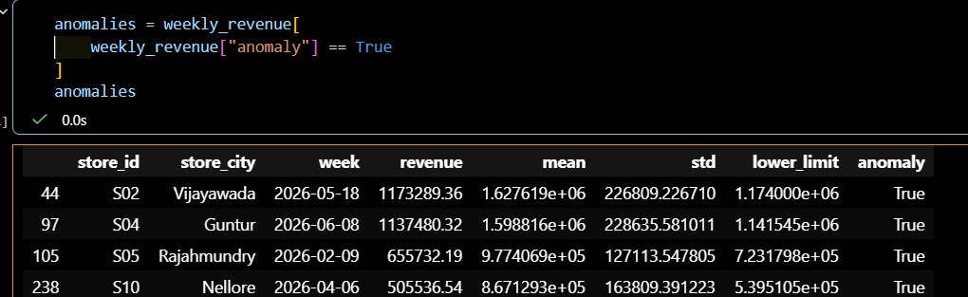
5.5 — Anomaly identification
Possible business reasons
Supply disruption — Some products may have been unavailable, reducing sales.
Local event — A local event may have reduced customer footfall.
Pricing issue — Prices may have been less competitive during the week.
Competitor activity — A competitor may have offered promotions that attracted customers.
8

Slide 14
5.6 — Business Recommendation
S01 – Vijayawada generated the highest six-month revenue: ₹5.91 crore.
S12 – Kakinada generated the lowest six-month revenue: ₹2.20 crore(Investigate Needed).
January recorded the highest monthly revenue: ₹8.48 crore.
Saturday had the highest average daily revenue: ₹35.24 lakh.
Electronics revenue declined by ~25% from January to June, which needs attention.
Anomalies were identified in S05, S10, S02, and S04, indicating unusually low weekly revenue compared with their normal performance.
Recommended action: Investigate the anomalous store-weeks, especially S10 – Nellore, and check for inventory, demand, pricing, or operational issues.
what additional data you would want before being fully confident
Store footfall
Pricing & discounts
Inventory availability
₹5.91 Cr
₹2.20 Cr
Electronics
S01 — Vijayawada
S12 — Kakinada
category to review
9

Slide 15
Part 2 — Automating the Pulse
10

Slide 16
5.7 — Understand the JSON structure
Top-level structure
Where is the transaction data?
The JSON contains six top-level keys:
status
request_id
generated_at
period
record_count
data
The actual transaction data sits inside the data key. It contains a list of 4,291 transaction records.
A real retail API can use this structure to send weekly sales data together with the period, record count and response information so a downstream system can verify and process the data.
10

Slide 17
5.7 — Understand the JSON structure
How would a real retail API use this structure to deliver weekly sales data to a downstream system?
Real Retail API Uses This Structure
A real retail API would send weekly sales data in a structured JSON format. The status, request_id, period, and record_count help the downstream system verify that the response is valid and complete. The data section contains the actual sales transactions, which the downstream system can use for analysis, reporting, dashboards, and business decisions.
10

Slide 18
5.8 — Ingest and parse the API response
4,291
4,291
TRUE
Jun 24–30
records received
records in DataFrame
record count matches
period
Why check the record count?
A production pipeline checks the record count to make sure that all expected records were received successfully. If the JSON says there should be 4,291 records but the DataFrame contains fewer records, some data may have been lost or failed during transmission. This helps detect incomplete API responses and prevents incorrect sales reports or analysis.
11

Slide 19
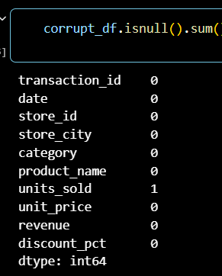
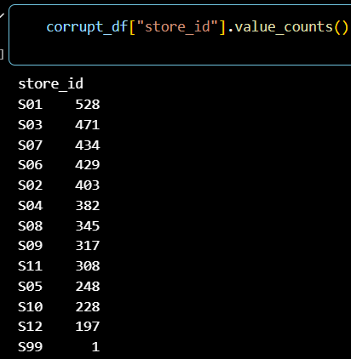
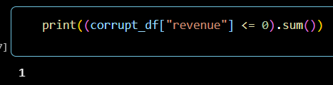
5.9 — Validate the data before processing
Null values
Negative revenue
Invalid store ID
1 issue
Row 12
Column: units_sold
1 issue
Row 5
Revenue: -150.0
1 issue
Row 20
Store ID: S99
STATUS: FAILED — 3 issues detected. Pipeline halted.
12

Slide 20
5.9 — Pipeline decision
what should a well-designed pipeline do when it encounters corrupt data
A well-designed pipeline should stop completely when critical corrupt data is found, because processing invalid data can lead to incorrect results and unreliable business decisions.
Validation lesson
All three deliberate data-quality issues must be caught before processing the weekly data.
13

Slide 21
5.10 — Transform and aggregate
weekly_revenue_by_store
weekly_revenue_by_category
top_store_this_week
7-day revenue by store and city.
7-day revenue by category.
S03 — Guntur
₹2,037,560.19
category_alert
Part 1 → Part 2 connection
Electronics is the alert category.
Weekly revenue: ₹5,764,693.85
6-month weekly baseline: ₹8,760,740.74
Down by approximately 34.2% versus baseline.
The historical CSV provides the six-month baseline. The clean JSON provides the current 7-day signal. Comparing them makes the weekly alert meaningful.
14

Slide 22
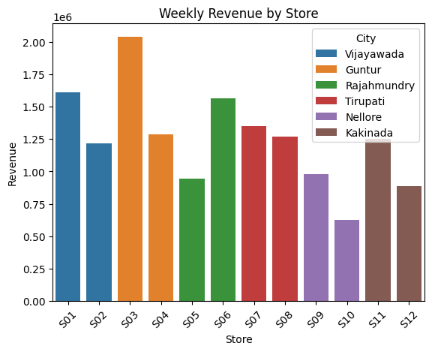
5.10 — Transform and aggregate
weekly_revenue_by_store
7-day revenue by store and city.
S03 – Guntur generated the highest weekly revenue of ₹20.38 lakh
14

Slide 23
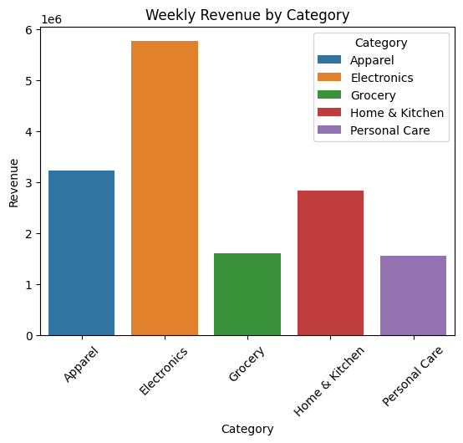
5.10 — Transform and aggregate
weekly_revenue_by_category
7-day revenue by category.
Electronics generated the highest weekly revenue of ₹57.65 lakh
14

Slide 24
5.10 — Transform and aggregate
top_store_this_week
S03 — Guntur
₹2,037,560.19
category_alert
Electronics is the alert category.
Weekly revenue: ₹5,764,693.85
6-month weekly baseline: ₹8,760,740.74
Down by approximately 34.2% versus baseline.
Logic of Category Alert
CSV dataset: Used to calculate the normal 6-month daily average.
Weekly JSON dataset: Used to get this week's category revenue.
How the Alert is Decided
Calculate 6-month daily average from CSV Electronics daily average = ₹12,51,534
Convert daily average to weekly average ₹12,51,534 × 7 = ₹87,60,741
Calculate the 20% lower limit ₹87,60,741 × 80% = ₹70,08,593
Compare this week's revenue This week's Electronics revenue = ₹57,64,693.85
₹57,64,693.85 < ₹70,08,593
Part 1 → Part 2 connection
The historical CSV provides the six-month baseline. The clean JSON provides the current 7-day signal. Comparing them makes the weekly alert meaningful.
14

Slide 25
5.11 — Pipeline summary output
=== RETAIL SALES PULSE — WEEKLY SUMMARY ===
Period: 2026-06-24 to 2026-06-30
Records processed: 4,291
Top store this week: S03 — Guntur (₹2,037,560.19)
Bottom store this week: S10 — Nellore (₹627,119.87)
Category alert: Electronics revenue down approximately 34.2% vs 6-month baseline
No alert: Apparel, Grocery, Home & Kitchen, Personal Care
Pipeline status: COMPLETED SUCCESSFULLY

Slide 26
5.11 — What to add for a Monday-morning email
what would you add to this summary if it were being emailed to the operations head every Monday morning?
If this summary were emailed to the Operations Head every Monday morning, I would add key alerts, major changes in store and category performance, and recommended actions so that the Operations Head can quickly identify problems and decide what action needs to be taken.
Part 1
Part 2
Business value
Find the insight
Keep it current
Support decisions

Slide 27


Slide 28
THANKYOU

