Slide 1
SUPERVISED LEARNING PROJECT
Customer Churn Prediction
A Messy Real-World Dataset — End-to-End Business Use Case
Business goal: Predict whether a subscription customer will churn (Yes/No) and provide evidence the model is reliable on unseen data.
Presented by
G.VIGNESHBABU
SUPERVISED LEARNING PROJECT
Role: Junior Data Scientist | Target: Churn | Records: 184 raw customers

Slide 2
BUSINESS UNDERSTANDING
Business Context & Objective
Business Context
Business Objective
A subscription-based company is experiencing customer churn.
Management wants to identify customers who are likely to leave so the retention team can intervene before they churn.
A raw customer dataset was provided with demographic, usage, billing, service, and satisfaction information.
The dataset intentionally contains common real-world data-quality issues (missing values, duplicates, inconsistent labels, invalid values).
Build a supervised machine learning solution that predicts whether a customer is likely to churn, and provide evidence that the model is reliable on unseen data.
Classification problem — target Churn is categorical (Yes/No).
Compare multiple models rather than choosing on training score alone.
Do not rely on accuracy alone; interpret precision, recall and F1 for the business need.
2

Slide 3
DATA UNDERSTANDING
Dataset Overview
184
13
180
1
97 / 87
Supervised Classification
Raw customer
records
Columns
(features + target)
Rows after
duplicate removal
Target column:
Churn (Yes/No)
Raw class split
Yes / No
Problem type
Column groups identified
Type | Columns
Identifier | Customer_ID
Numerical (7) | Age, Annual_Income, Tenure_Months, Monthly_Charges, Support_Calls_Last_3M, Data_Usage_GB, Satisfaction_Score
Categorical (4) | Contract_Type, Payment_Method, Region, Plan_Type
Target | Churn (Yes / No)
Initial inspection: df.info() showed missing values in every numeric column and Annual_Income stored as text (object dtype) rather than numeric — the first sign of data-quality issues.
3

Slide 4
DATA UNDERSTANDING
Data-Quality Issues Identified
Missing values by column
Other issues found in raw data
Column | Missing
Age | 8
Annual_Income | 12
Tenure_Months | 7
Monthly_Charges | 6
Support_Calls_Last_3M | 5
Data_Usage_GB | 6
Satisfaction_Score | 6
Exact duplicate rows: 4 (Customer_ID repeated, e.g. CUST-1008, CUST-1043, CUST-1110, CUST-1152).
Annual_Income loaded as text (object) instead of numeric — required conversion.
Placeholder values ("?") in Contract_Type, Payment_Method and Region.
Inconsistent categorical text: e.g. "MONTHLY" / "monthly" / "Monthly", "bank transfer" / "Bank Transfer", "NORTH" / "north".
Impossible values: negative Age (-5), Age of 145, negative Annual_Income (-11,500 / -12,000), negative Data_Usage_GB (7 rows), Monthly_Charges up to 999.
IQR outlier scan: ~16 outlier values across numeric columns (1.24% of all numeric values).
Total missing values: 49
4

Slide 5
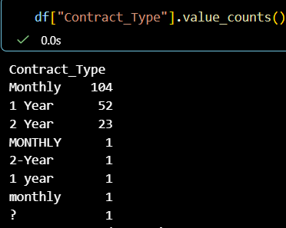
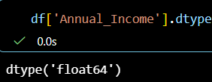
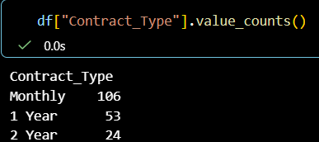
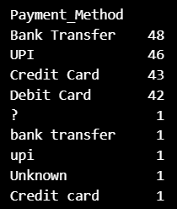
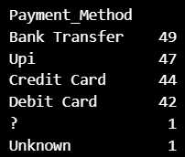
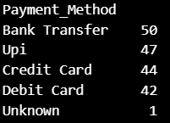
DATA PREPARATION
Data Cleaning — Decisions Made
1
Fix data types
Converted Annual_Income from text to numeric using pd.to_numeric(errors='coerce').
2
Standardize categories
Stripped whitespace and normalized case for Contract_Type, Payment_Method and Region
3
Handle placeholders
Replaced "?" entries with NaN, then imputed with each column's mode.
6
7
5

Slide 6
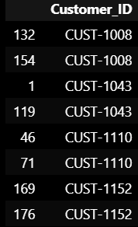
DATA PREPARATION
Data Cleaning — Decisions Made
4
Fix impossible values
Masked negative Age, negative Data_Usage_GB, negative Annual_Income, and unrealistic Age values (10, 16, 17, 145) to NaN.
5
Impute missing values
Numeric columns filled with column median; categorical columns filled with mode — no rows deleted for missingness.
1
2
7
Review outliers
IQR-based scan retained after review (not deleted), per the rule not to delete unusual records without investigation.
6
Remove duplicates
Dropped 4 exact duplicate rows: 184 → 180 rows, 0 duplicates remaining.
Annual Income 9,999,999 → 1 record (CUST-1026)This is a major outlier compared with the rest of the dataset.
Tenure150 months → 1 record (CUST-1013)If your dataset is intended to cover a maximum of 72 months, this is invalid.
Monthly Charges 0.00 → 1 record (CUST-1045)999.00 → 1 record (CUST-1089)These need validation against the intended pricing range.
Total outliers
16
Total Outlier percentage 1.24%
Result: cleaned_customer.csv — 180 rows × 13 columns, 0 missing values, 0 duplicates.
5

Slide 7
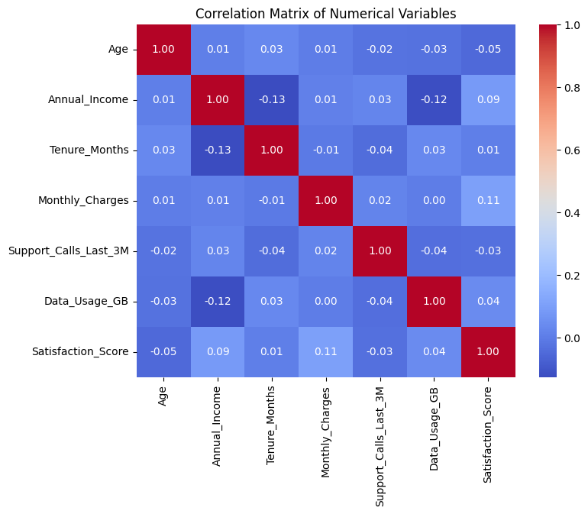
EXPLORATORY DATA ANALYSIS
Correlation Among Numeric Features
What the heatmap shows
All pairwise correlations among the 7 numeric features are weak (|r| ≤ 0.13).
Strongest pair: Annual_Income vs Tenure_Months at r = -0.13 — still negligible.
No sign of multicollinearity, so no numeric features needed to be dropped before modeling.
This also signals that churn is unlikely to be explained by any single numeric variable in isolation.
6

Slide 8
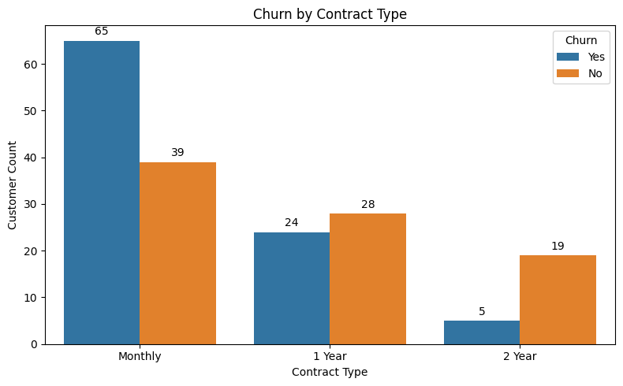
EXPLORATORY DATA ANALYSIS
Does Churn Differ by Contract Type?
Churn rate within each contract (%)
Contract | No Churn % | Churn %
Monthly | 37.5 | 62.5
1 Year | 53.8 | 46.2
2 Year | 79.2 | 20.8
Business meaning: Monthly-contract customers churn far more often (62.5%) than 2-year customers (20.8%). Contract length is one of the clearest churn signals in the data.
7

Slide 9
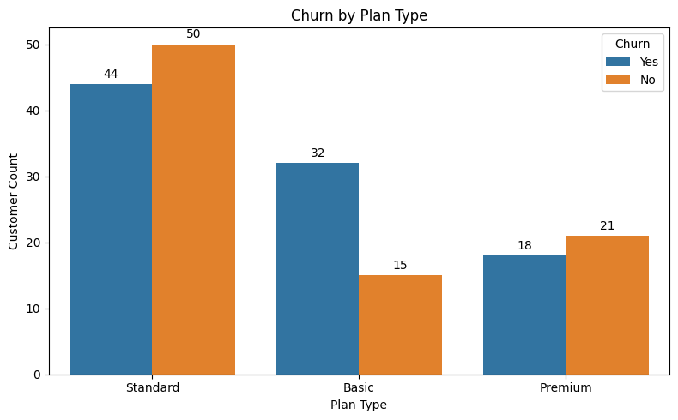
EXPLORATORY DATA ANALYSIS
Churn by Plan Type
Standard Plan: 44 customers churned, while 50 did not churn.
Basic Plan: 32 customers churned compared with only 15 non-churned customers.
Premium Plan: 18 customers churned and 21 did not churn.
The Basic Plan shows the highest churn proportion among the three plan types.
Standard Plan has the largest number of customers overall in the dataset.
7

Slide 10
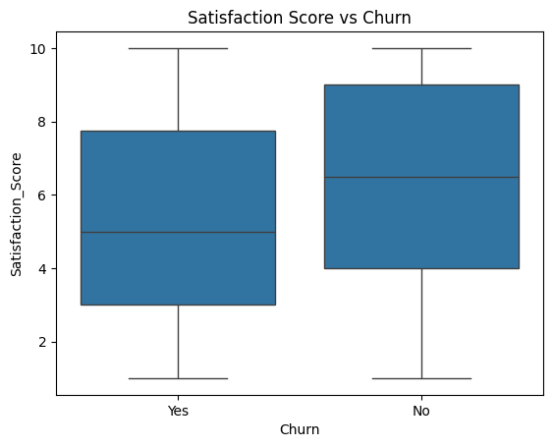
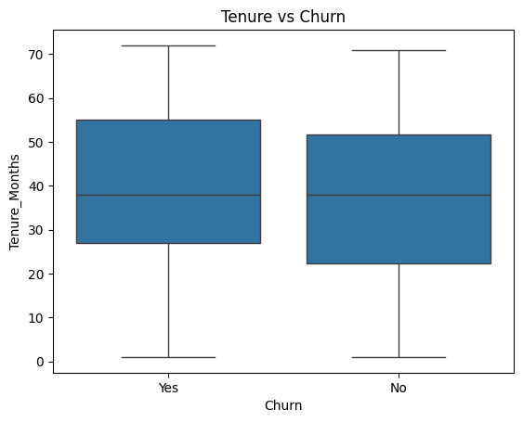
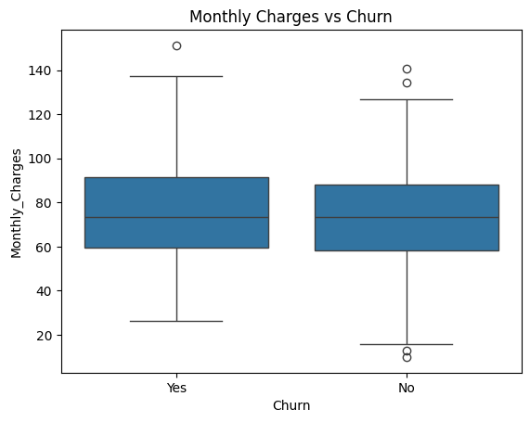
EXPLORATORY DATA ANALYSIS
Satisfaction, Tenure & Charges vs Churn
Satisfaction Score: churned customers show a visibly lower median satisfaction score than retained customers — the clearest of the three relationships.
Tenure: median tenure is similar for churned and retained customers in this data — limited separation.
Monthly Charges: distributions largely overlap between churned and retained customers, with a few high-charge outliers on both sides.
8

Slide 11
THE DATA WAS CLEANED

Slide 12
DATA PREPARATION
Feature Engineering & Preprocessing
Train / Test Split
Preprocessing pipeline
144
36
Customer_ID dropped — it is an identifier, not a predictive feature.
Target Churn encoded: Yes → 1, No → 0 (94 vs 86 after cleaning).
Numeric features (7): median imputation + scaling. Standard, MinMax and Robust scalers were all tested.
Categorical features (4): most-frequent imputation + one-hot encoding (unknown categories ignored at inference).
Combined via a scikit-learn ColumnTransformer + Pipeline to prevent test-set leakage.
Training rows
(80%)
Test rows
(20%)
80 / 20 split, stratified on Churn to preserve class balance.
random_state = 42 for reproducibility.
X shape (180, 11) → X_train (144, 11), X_test (36, 11).
Preprocessing fitted on training data only, then applied to test data — avoids data leakage.
9

Slide 13
MODELING
Supervised Learning Models Built
1
Logistic Regression
2
K-Nearest Neighbors
3
Decision Tree
Linear baseline classifier (max_iter = 1000)
Distance-based classifier, k = 5
Single tree classifier (random_state = 42)
4
Random Forest
5
AdaBoost
6
Gradient Boosting
Bagged ensemble of 100 trees
Boosted ensemble, 100 estimators
Boosted ensemble, 100 estimators
7
CatBoost
Gradient boosting on decision trees, 100 iterations
10

Slide 14
MODEL EVALUATION
Evaluation Metrics — Initial Comparison
Model | Accuracy | Precision | Recall | F1-Score
Logistic Regression | 0.583 | 0.625 | 0.526 | 0.571
KNN | 0.500 | 0.526 | 0.526 | 0.526
Decision Tree | 0.472 | 0.500 | 0.368 | 0.424
Random Forest | 0.611 | 0.667 | 0.526 | 0.588
AdaBoost | 0.556 | 0.600 | 0.474 | 0.529
Gradient Boosting | 0.528 | 0.563 | 0.474 | 0.514
CatBoost | 0.500 | 0.529 | 0.474 | 0.500
Why not rely on accuracy alone? For a retention use case, missing an actual churner (false negative) is usually costlier than a false alarm (false positive). Recall and F1-score — not accuracy — best reflect the model's ability to catch customers who are about to churn.
11

Slide 15
MODEL EVALUATION
Cross-Validation & Overfitting Check
5-fold stratified CV accuracy
Train vs Test accuracy (overfitting check)
Model | CV Score
AdaBoost | 0.611
Logistic Regression | 0.590
Random Forest | 0.576
CatBoost | 0.555
Decision Tree | 0.535
KNN | 0.534
Gradient Boosting | 0.465
Model | Train | Test
Logistic Regression | 0.715 | 0.583
KNN | 0.694 | 0.500
Decision Tree | 1.000 | 0.472
Random Forest | 1.000 | 0.611
AdaBoost | 0.868 | 0.556
Gradient Boosting | 1.000 | 0.528
CatBoost | 1.000 | 0.500
Signs of overfitting: Decision Tree, Random Forest, Gradient Boosting and CatBoost all reach perfect training accuracy (1.000) but drop sharply on the test set — a clear overfitting pattern on this small dataset. Logistic Regression and AdaBoost show a smaller train–test gap.
12

Slide 16
MODEL EVALUATION
Feature Scaling — Does Changes the Accuracy
Because KNN is distance-based, three scalers were tested on it:
Scaler | Accuracy | Precision | Recall | F1 | CV Mean
StandardScaler | 0.500 | 0.526 | 0.526 | 0.526 | 0.534
MinMaxScaler | 0.639 | 0.714 | 0.526 | 0.606 | 0.577
RobustScaler | — | — | — | — | 0.541
Logistic Regression ( StandardScaler vs MinMaxScaler):
Scaler | Accuracy | Precision | Recall | F1 | CV Mean
StandardScaler | 0.583 | 0.625 | 0.526 | 0.571 | 0.589
MinMaxScaler | 0.611 | 0.666 | 0.526 | 0.606 | 0.588
MinMaxScaler gave KNN the best accuracy (0.639), precision (0.714) and F1-score (0.606) of the three scalers tested.
RobustScaler gave the most stable cross-validation scores (lowest std = 0.061), useful when outliers are a concern.
StandardScaler performed the weakest for this distance-based model on this dataset.
Based on this comparison, KNN with MinMaxScaler was carried forward into the final model comparison.
13

Slide 17
MODEL COMPARISON
Final Model Comparison Table
Model | Accuracy | Precision | Recall | F1 | CV Score
KNN (MinMaxScaler) | 0.639 | 0.714 | 0.526 | 0.606 | 0.577
Logistic Regression(MinMaxScaler) | 0.611 | 0.666 | 0.526 | 0. 588 | 0.590
Random Forest | 0.611 | 0.667 | 0.526 | 0.588 | 0.576
AdaBoost | 0.556 | 0.600 | 0.474 | 0.529 | 0.611
Gradient Boosting | 0.528 | 0.563 | 0.474 | 0.514 | 0.465
CatBoost | 0.500 | 0.529 | 0.474 | 0.500 | 0.555
Decision Tree | 0.472 | 0.500 | 0.368 | 0.424 | 0.535
KNN with MinMaxScaler achieved the highest test Accuracy, Precision and F1-score of all models compared.
AdaBoost and Logistic Regression had marginally higher cross-validation scores, suggesting more consistent performance across folds — a trade-off worth noting alongside raw test-set accuracy.
14

Slide 18
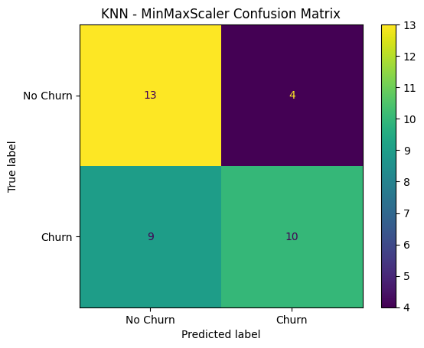
MODEL COMPARISON
Confusion Matrix — Selected Model (KNN, MinMaxScaler)
Test-set outcome (36 customers)
13
4
True Negative
(correctly kept)
False Positive
(wrongly flagged)
9
10
False Negative
(missed churner)
True Positive
(caught churner)
Reading the errors: 9 actual churners were missed (false negatives) — the costlier error for a retention program — while 4 loyal customers were incorrectly flagged (false positives).
15

Slide 19
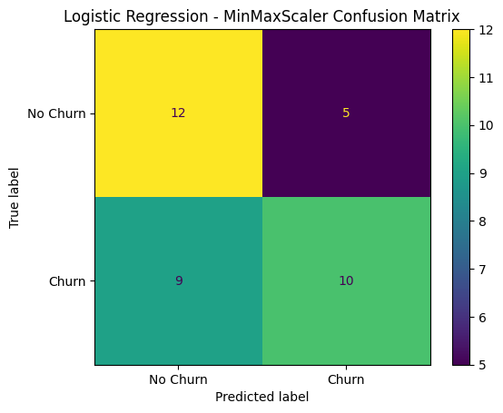
MODEL COMPARISON
Confusion Matrix — Selected Model (Logistic Regression, MinMaxScaler)
Test-set outcome
12
5
True Negative
(correctly kept)
False Positive
(wrongly flagged)
9
10
False Negative
(missed churner)
True Positive
(caught churner)
Reading the errors: 9 actual churners were missed (false negatives) — the costlier error for a retention program — while 5 loyal customers were incorrectly flagged (false positives).
15

Slide 20
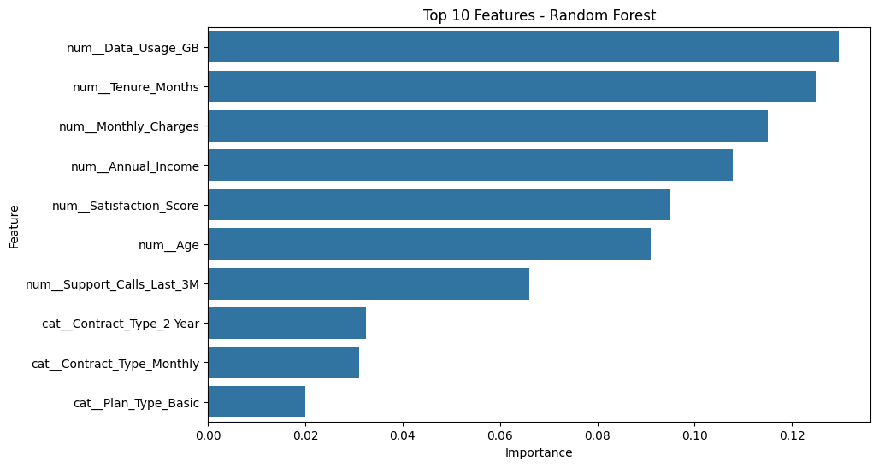
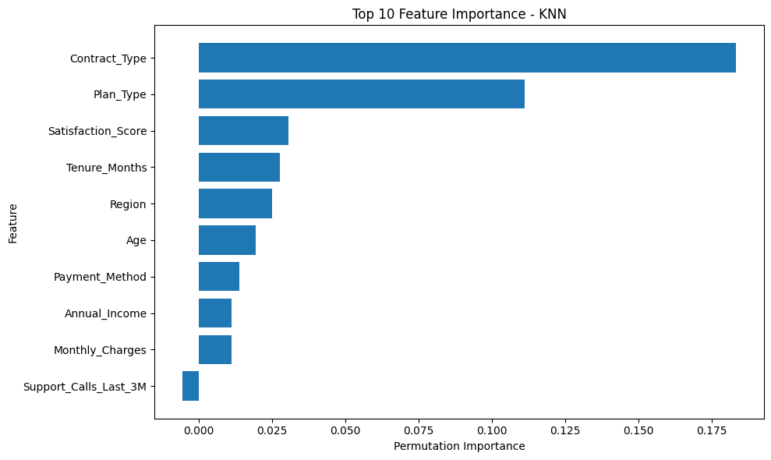
MODEL COMPARISON
Which Features Matter Most?
Random Forest (built-in importance) ranks numeric usage/billing features highest: Data_Usage_GB, Tenure_Months, Monthly_Charges, Annual_Income.
The selected model, KNN (MinMaxScaler), ranks Contract_Type and Plan_Type as by far the most influential features (permutation importance) — consistent with the contract-type churn pattern seen in the EDA.
16

Slide 21
BUSINESS RECOMMENDATIONS
Findings & Recommendations for the Retention Team
1
Target Monthly-contract customers first — They churn at 62.5% vs 20.8% for 2-year contracts — the single clearest segment associated with higher churn.
2
Watch satisfaction scores closely — Churned customers show a visibly lower median satisfaction score — treat low scores as an early warning sign for outreach.
3
Prioritize by Contract_Type and Plan_Type — These were the two most influential features for the selected model — retention offers should be aimed at Monthly-contract, Basic-plan customers.
4
Don't over-rely on tenure or monthly charges alone — Both show heavy overlap between churned and retained customers in this dataset, so they are weak standalone signals.
5
Weigh false negatives vs false positives — The selected model missed 9 of 19 churners (false negatives) and misflagged 4 loyal customers (false positives) — balance outreach cost against the cost of losing a customer.
17

Slide 22
CONCLUSION
Final Model & Limitations
Final model: KNN with MinMaxScaler — best test Accuracy (0.639), Precision (0.714) and F1-score (0.606) among all 7 models compared.
Cross-validation was lower (0.577) than Logistic Regression (0.590) and AdaBoost (0.611), showing model choice involves a trade-off between single-split test performance and fold-to-fold stability.
Even logistic regression(minmax) -- Good accuracy (0.611), Precision (0.666) and F1-score (0.606)
Decision Tree, Random Forest, Gradient Boosting and CatBoost all overfit — perfect training accuracy but a large drop on test data — on this small dataset.
Numeric features showed only weak correlations with each other (|r| ≤ 0.13); Contract_Type and Plan_Type were the strongest predictors for the selected model.
Limitation: only 180 customer records after cleaning — a small sample that limits how confidently these results generalize. More data, and richer behavioral features, would likely improve reliability.

Slide 23

THANKYOU
-G.VIGNESHBABU

